Slide 1
Coreform Cubit Customization Training
Command Panels - Python

Slide 2
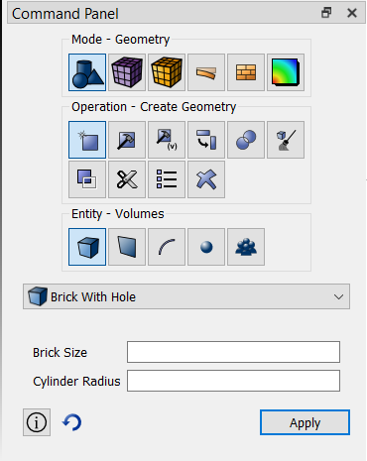
Custom Panels
At the end of this lesson, you will be able to:
Create a custom panel UI with Qt Designer.
Write python scripts to run when “Apply” or “Preview” are clicked.
Organize the panels using Navigation XML.

Slide 3
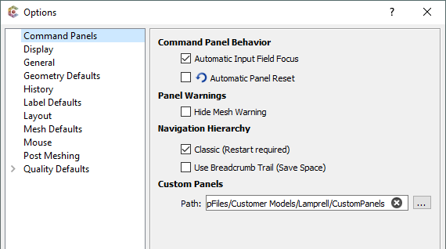
Custom Panel Directory
Create a directory to store command panels.
Each panel requires a subdirectory in this main directory.
Navigate to Tools -> Options -> Command Panels and point Cubit to this new directory.
Specify the custom panel directory here

Slide 4
Custom Panel Directory
Within the CustomPanel directory, create a subdirectory for a new panel. The name is not important.
Eventually, it will contain the following files:
marker.txt = contains the navigation xml marker name
panel.ui = the Qt UI description file
apply.py = python script to run on Apply
preview.py = (optional) python script to run on Preview
If this file is missing, the Preview button will automatically be removed.

Slide 5
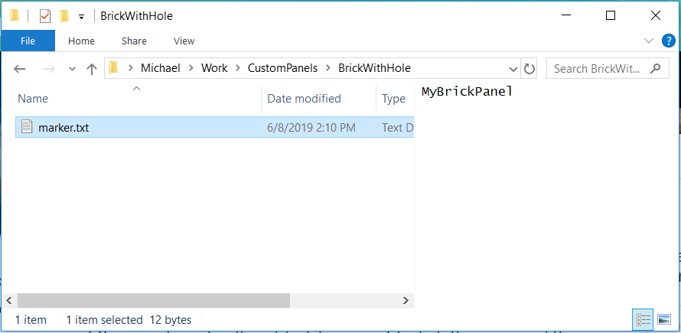
Navigation Marker
Create a subdirectory named “BrickWithHole”
Create the file marker.txt and in it, insert the text “MyBrickPanel”. Save the file.
The marker can be anything. It just needs to match what we will put in the navigation XML.
File contents

Slide 6
Navigation Marker
Open one of the navigation xml files
In the Cubit installation directory, find and open bin/xml/action-based-xml/GeometryCreateNavigation.xml
Insert your panel marker
Copy/paste the Brick NavigationNode and modify with your panel details:
Make sure the marker text matches what we put into marker.txt.
Save the xml file.
Restart Cubit for the changes to take effect.

Slide 7
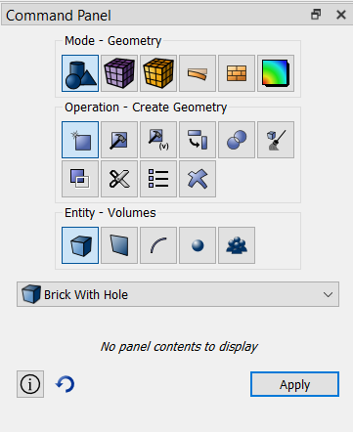
Navigation Marker
The “Brick With Hole” panel will now appear under
Geometry -> Create -> Volumes
in the command panel hierarchy.
Note that there are no panel contents because we have not created a panel.ui file yet.

Slide 8
Panel UI
Cubit is built using Qt 5 (see qt.io for more info)
Qt Designer is required to make a .ui file.
Available as part of the standard Qt download OR
Available from Coreform upon request
Designer uses a drag-and-drop interface to create a user interface.
Use Designer to create a new widget with two line edits (see example on next slide).
Tip: Don’t forget to add a layout to your widget.
Save the file as panel.ui in the BrickWithHole directory we created earlier.

Slide 9
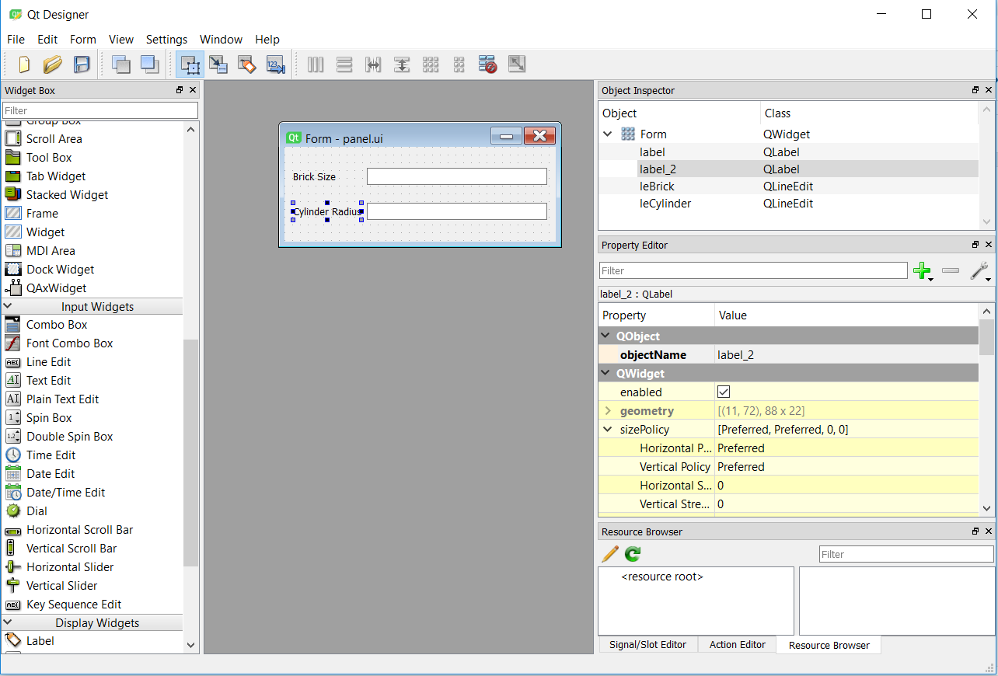
Panel UI
Pay attention to the names of the line edits.
Grab widgets from here.
Edit widget properties here.

Slide 10
Panel UI
In Cubit, right click on the panel (where it says “No panel contents to display”) and choose “Reset Data”.
The custom panel should now appear.
Tip: The panel.ui file is reloaded when “Reset Data” is executed. This allows you to modify the ui layout without restarting Cubit, or set default values in the UI file.

Slide 11
Panel UI Widgets
Values for the panel widgets can be retrieved in Python for the following types of widgets:
Pick widget (a.k.a. selection widget)
Line edit
Combo box
Radio button
Check box
Spin box (integers)
Double spin box (decimals)
Sliders
Values are retrieved using the widget’s name, as specified in the panel.ui file.

Slide 12
Pick Widget
Pick Widgets are not part of the default Qt toolkit as they are tailored to interact specifically with the graphics engine of Cubit.
To create a pick widget, use a line edit and give it a name following the pattern pw<Type>_...
For example, to create a volume pick widget, name the line edit something like “pwVolume_something”.
Cubit will automatically convert the line edit to a pick widget when the UI is loaded.
Note that the name is case-sensitive.

Slide 13
Pick Types
Geometry
Body
Volume
Surface
Curve
Vertex
Group
Exodus containers
Nodeset
Sideset
Block
CFD Boundary Conditions
Axis
ExhaustFan
Fan
InletVent
InletMassflow
InletPressure
InletVelocity
IntakeFan
Interface
Interior
Outflow
OutletVent
OutletPressure
FarfieldPressure
Periodic
PeriodicShadow
PorousJump
Radiator
Symmetry
Wall
FEA Boundary Conditions
Acceleration
Velocity
Force
Pressure
HeatFlux
Displacement
Temperature
Convection
ContactRegion
ContactPair
Mesh
Hex
Tet
Pyramid
Wedge
Quad
Tri
Edge
Node
BoundaryLayer

Slide 14
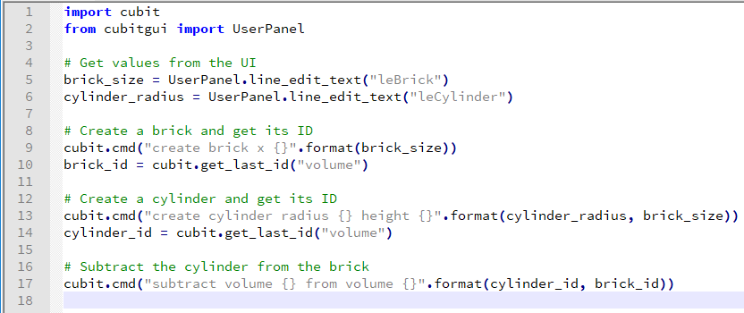
Apply Script
With the panel UI complete, we are now ready to implement the panel’s apply script.
In the BrickWithHole directory, create a new file called “apply.py” and add the following contents:
Note how the names here match the widget names in panel.ui.

Slide 15
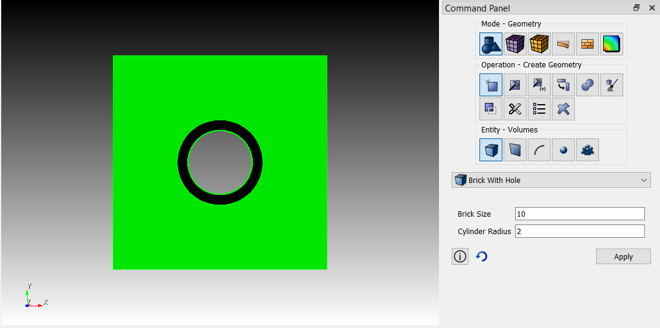
Apply Script
Save apply.py, then in Cubit, set values for the brick size and cylinder radius in the panel and click Apply to create a brick with a hole:

Slide 16
UserPanel Functions
The following functions are available in the cubitgui.UserPanel class to get UI values in Python:
pick_widget_text(name) -> string
pick_widget_type(name) -> string
line_edit_text(name) -> string
combo_box_text(name) -> string
radio_button_is_checked(name) -> bool
check_box_is_checked(name) -> bool
spin_box_value(name) -> int
double_spin_box_value(name) -> float
slider_value(name) -> int

Slide 17
Preview Script
To enable the Preview button in a custom panel, simply create the file preview.py in the panel’s directory and add the code to execute.
Reset the panel and the preview button should appear.
Note that not all commands in Cubit will have a preview option, so this button may have limited use.

