Slide 1
CUBIT™ Fast-Start Tutorial
26. Tet Meshing Best Practices
Notes:
Type: FORMAL - Training
Title: Cubit 200 Training
SAND Number: SAND2020-0682 TR
Contact: Hensley,Trevor Michael

Slide 2
Tet Meshing Best Practices
Automatic Tet Meshing
No decomposition required
But geometry issues must be addressed
Small features
Gaps, overlaps, misalignments
Ensure elements are good quality
Scaled Jacobian
In-radius (size) to ensure reasonable time step
Best Practices
Depends on application
Check with colleaugues
wiki pages
journal files
Recommended operations, practices
presented here

Slide 3
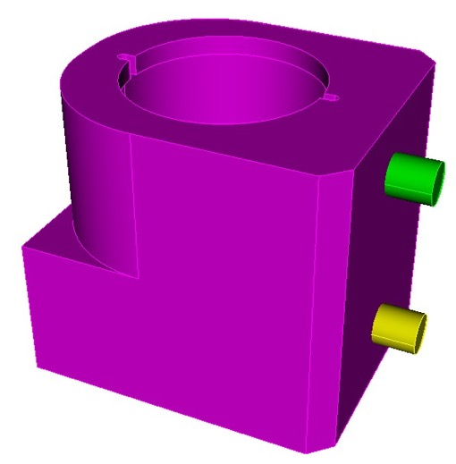
Selected Best Practices
Block Assignment
Time Step Metric
Defeaturing
Heal and Regularize Operations
Remove Cone Surfaces
Geometry Power Tool
Surface Removal/Composting
Blunt Tangency
Imprint/Merge
Tet Meshing
Deviation and Gradation
Geometric Sizing
Overlap Detection/Correction
Geometry Overlap
Mesh Overlap
Massive Composite Operation
Tiny Edge Length
Grouping with Extended Parsing
a901-2.sat
For this tutorial we will be using the following model to illustrate some of the best practices
import acis "a901-2.sat"

Slide 4
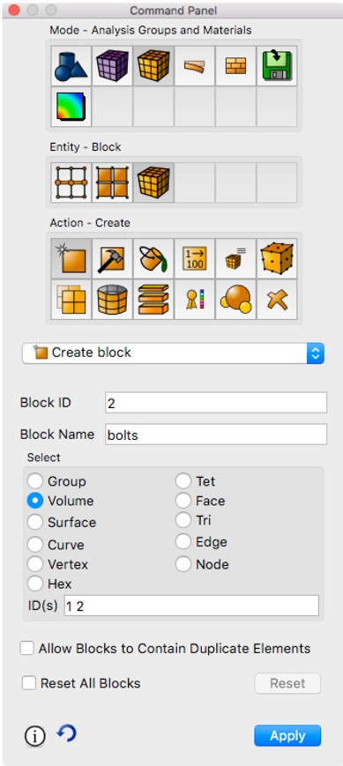
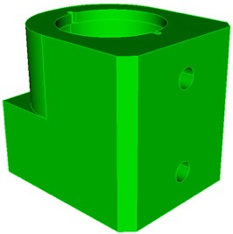
Block Assignment
Create Blocks
Blocks are used to group elements together according to a common material
Creating blocks and assigning volumes to blocks is good practice
Tets that we create later will be automatically assigned to the blocks
Name the blocks for easier reference
block 1 volume 3
block 1 name "casting"
block 2 volume 1 2
block 2 name "bolts"
draw casting
draw bolts
casting
bolts

Slide 5
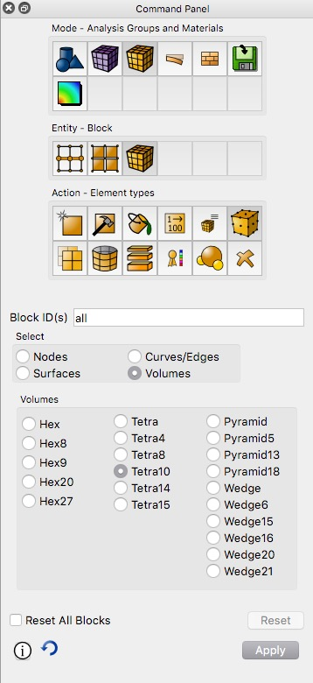
Block Assignment
Element Type
Tet10 elements are preferred over Tet4s
Tet4
Tet10
Element types are defined on the block (one element type per block)
bolts element type tetra10
casting element type tetra10
Ensure mid-side nodes will be projected to geometry when needed
set node constraint smart
(should be default)

Slide 6
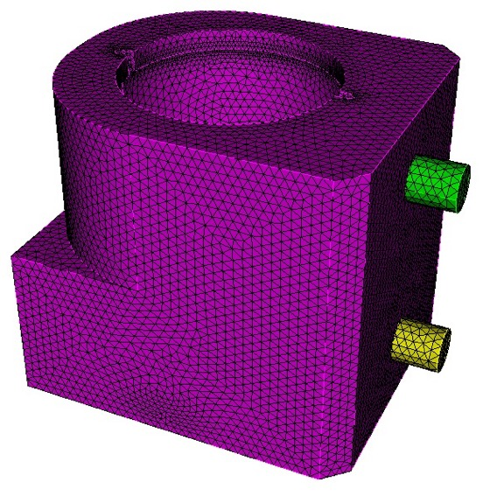
Time Step Metric
Small elements can result in very small time steps in your analysis.
Smallest element size can control how long your analysis will take to run when using explicit transient dynamics codes.
CUBIT™ can display metric based on time step
vol all scheme tetmesh
vol all size 0.2
mesh vol all
list totals

Slide 7
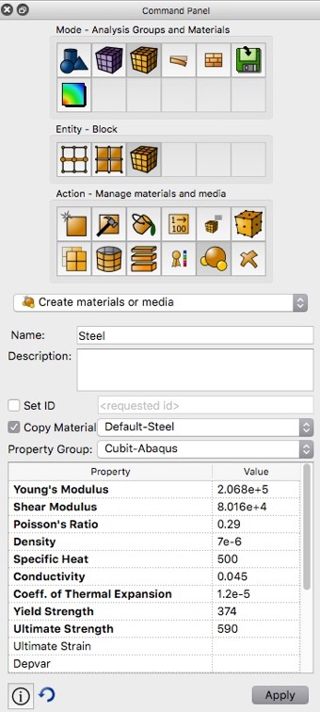
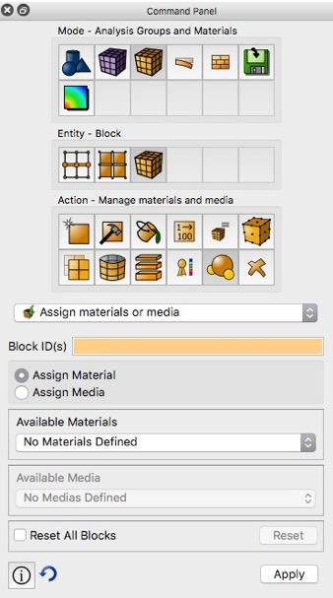
Time Step Metric
From the Command Panels, create a material by copying Default-Steel and then assign the new material to the blocks
2. Assign Material to Block
1. Create Material
Or from the command line:
create material name 'steel' elastic_modulus 2.068e5 poisson_ratio 0.29 density 7e-6
casting material 'steel'
bolts material 'steel'

Slide 8
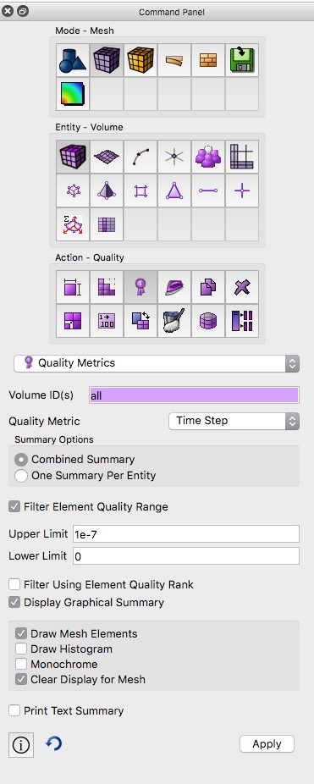
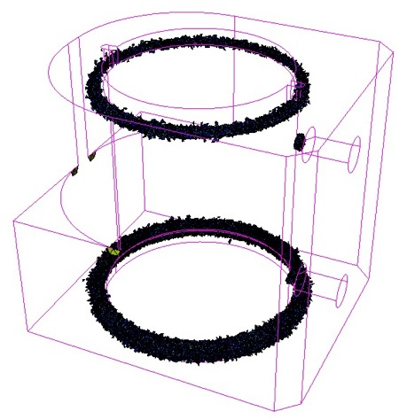
Time Step Metric
Note that materials can be created from command line. Consider creating a set of commonly used materials in a journal file
Display the time step metric on the current tet mesh
Filter the element quality to display only elements with time step less than 1.0e-7
Note where "poor" elements are located. What is causing elements to be "small"?

Slide 9
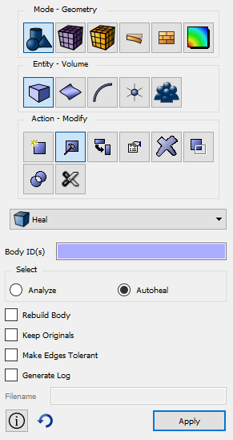
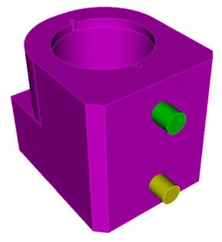
Healing
Healing can fix geometry problems introduced by the CAD tool that was used to build the model
Analyze
Lists problems with the selected volumes
healer analyze volume all
validate volume all
AutoHeal
Attempts to fix the problems
healer autoheal volume all
HEALER ANALYSIS SUMMARY:
------------------------
Analyzed 3 Volumes: 1 to 3
Found 0 bad Vertices.
Found 0 bad Curves.
Found 0 bad CoEdges.
Found 0 Bodies with problems.

Slide 10
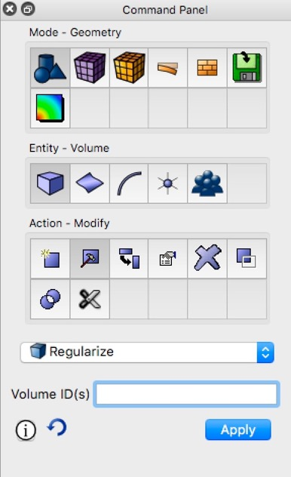
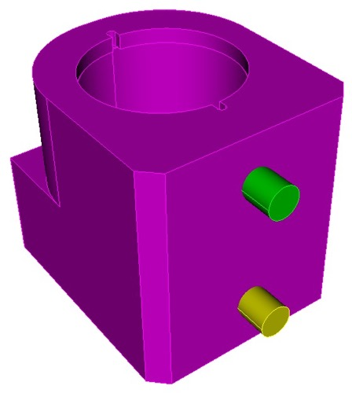
Regularize Operation
Adjacent surfaces that share the same analytic definition can be combined
Removes unnecessary curves
regularize vol all
curves removed

Slide 11
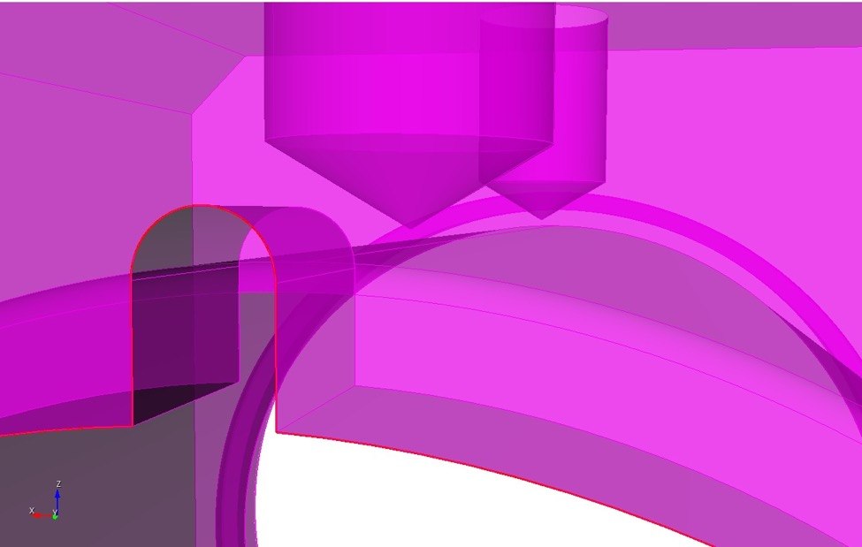
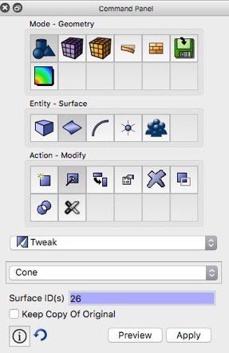
Remove Cone Surfaces
cone surfaces
Cone Surfaces often occur at the bottom of cylindrical holes.
The vertex at the apex of the cone can result in very small tets.
Its usually safe to remove cone surfaces
To remove cone:
Tweak Remove Cone Command Panel
tweak surface 50 cone
tweak surface 26 cone

Slide 12
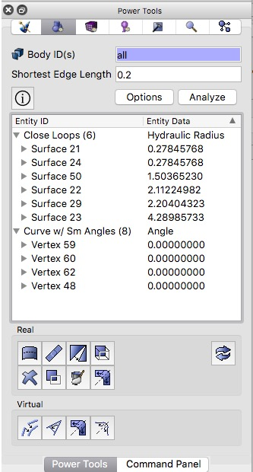
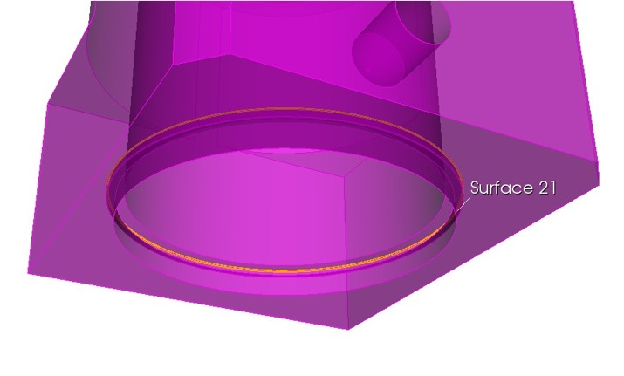
Geometry Power Tool
Use the Geometry Power Tool to detect small curves and surfaces that may be constraining the element sizes
Enter a small edge length and click Analyze
Right Click and Select Fly-in or Zoom to examine each

Slide 13
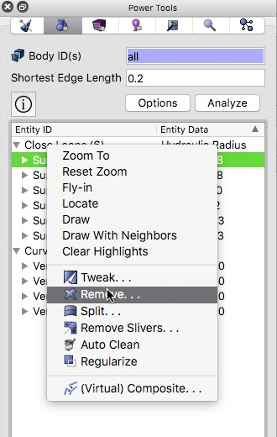
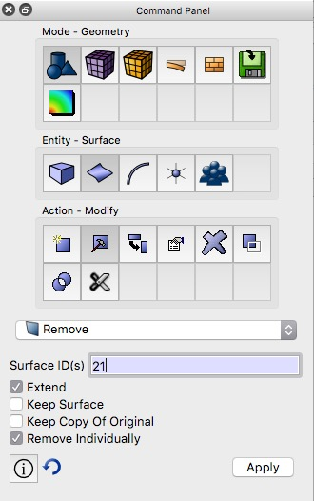
Geometry Power Tool
Remove Close Loops
Try removing other surfaces identified as Close Loops
Check for Errors.
Note that all Close Loops may not be able to be removed in this manner.
Try other operations if "Remove" does not work
Hint: tweak replace with surface, webcut with surface extended, unite volumes, etc..
Right Click on Surface ID and Select Remove...
Remove Surface panel should appear. Select Apply

Slide 14
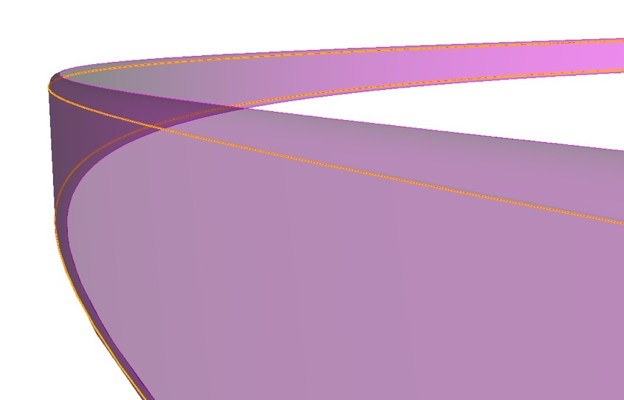
Geometry Power Tool
Remove skinny (close loop) surfaces
tweak surface 21 remove extend
tweak surface 24 remove extend
Surface 21
Surface 22
Surface 24

Slide 15
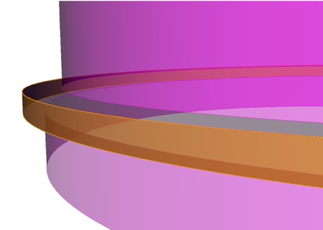
Geometry Power Tool
Remove indentation by tweaking surface 22 to surface 28
draw curve in surface in curve in surface 22
Surface 22
Surface 28
tweak replace
regularize
tweak surface 22 replace with surface 28
regularize vol all

Slide 16
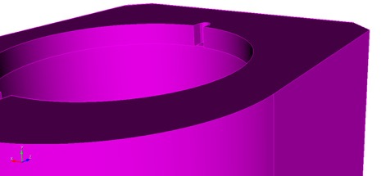
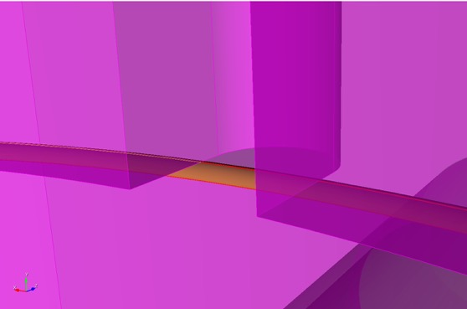
Geometry Power Tool
Surface 40
Surface 40
Remove fillet at surface 48 by webcutting
tweak remove can not be used for surface 48 because adjacent surfaces can't be extended to fill
Surface 48
Surface 49
zoom surface 40
Volume 3
Volume 3
Volume 3
Volume 3
Volume 3
Volume 3
Volume 3
Surface 49
Volume 6
Volume 7
Volume 6
Surface 48
Surface 48
Surface 37
1. webcut with surf 49
2. webcut with surf 37
3. delete vol 7
4. unite vol 3 6

Slide 17
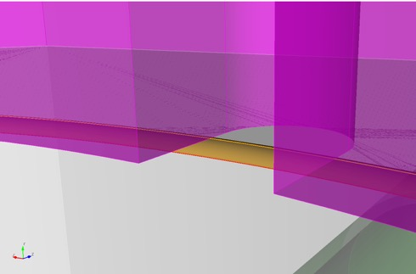
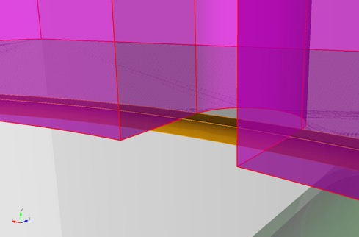
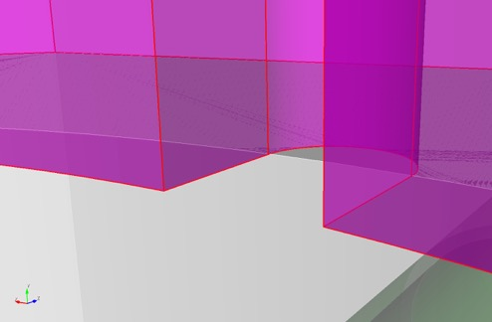
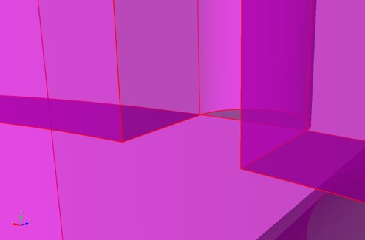
Geometry Power Tool
Surface 37
Volume 7
Volume 6
webcut volume 3 with sheet extended from surface 49
webcut volume 6 with sheet extended from surface 37
delete volume 7
unite volume 3 6

Slide 18
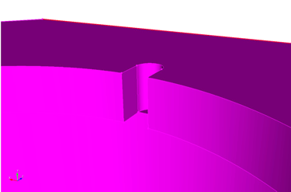
Geometry Power Tool
Surface 38
Curve 167
Curve 167
Surface 44
Remove small curves by compositing adjacent surfaces
zoom curve 167
Surface 80
composite create surface 44 38 43
composite create surface 42 45 39

Slide 19
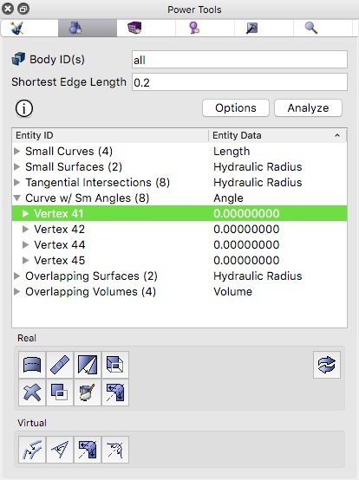
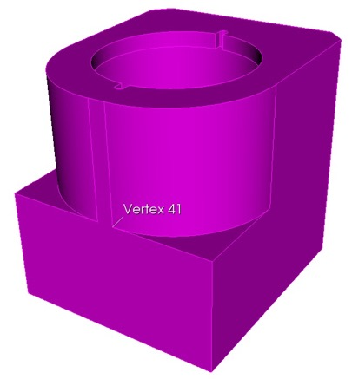
Geometry Power Tool
Curves with small angles (tangencies) can constrain mesher resulting small angles
Enter a small edge length and click Analyze
Right Click and Select Fly-in or Zoom to examine each
Blunt Tangency Operation
small angle
larger angle
Vertex 41
Vertex 41
poor tet element
improved
tet element

Slide 20
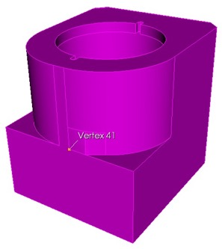
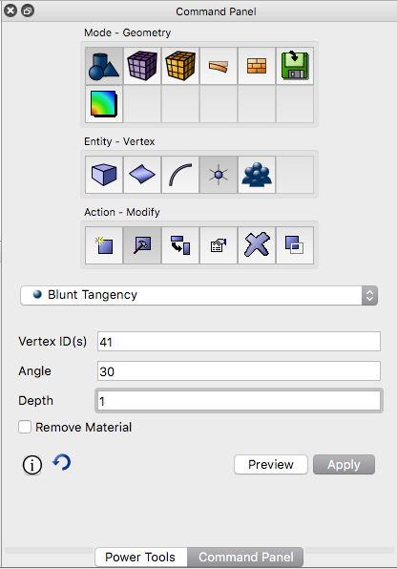
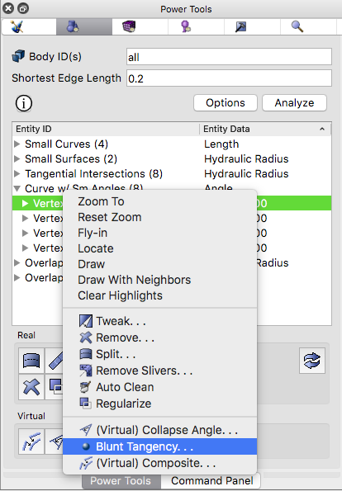
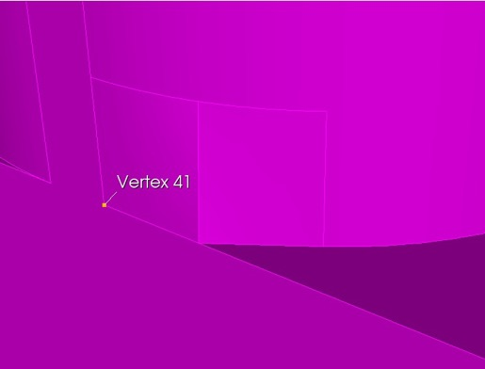
Geometry Power Tool
Remove Small Angles at Vertices
depth
angle
Blunt Tangency will "blunt" the angle at a vertex to avoid small angles in tets
Right Click on Vertex ID and select Blunt Tangency...
Set an Angle and Depth (or use Default). Click Preview and Apply
Try removing all tangencies

Slide 21
Geometry Power Tool
Blunt Tangency
blunt tangency vertex 41 angle 30 depth 1
blunt tangency vertex 42 angle 30 depth 1
blunt tangency vertex 44 angle 30 depth 1
blunt tangency vertex 45 angle 30 depth 1
depth
angle

Slide 22
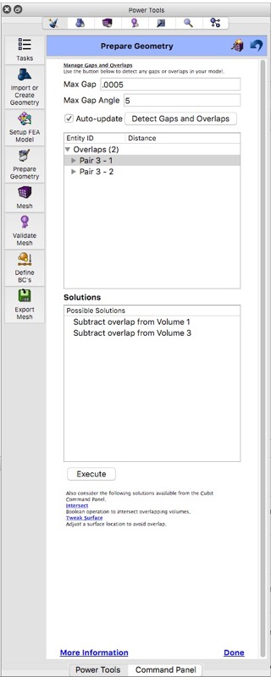
Overlap Detection/Correction
Check to see if any volumes overlap
measure volume all overlap
Pairs of intersected volumes are as follows:
Volume 1 (Volume 1) and Volume 3 (Volume 3) Overlap.
Volume 2 (Volume 2) and Volume 3 (Volume 3) Overlap.
The Manage Gaps and Overlaps Tool in the ITEM Wizard can also be used to interactively explore overlaps
Click on Power Tools
Wizard Icon
Prepare Geometry
Connect Volumes
Manage Gaps and Overlaps

Slide 23
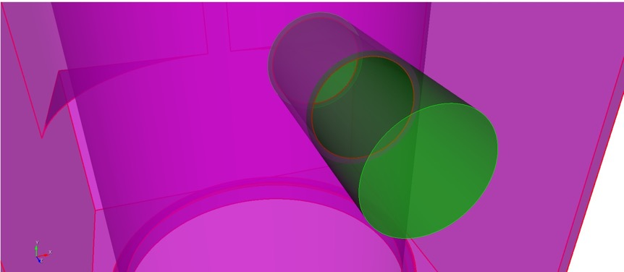
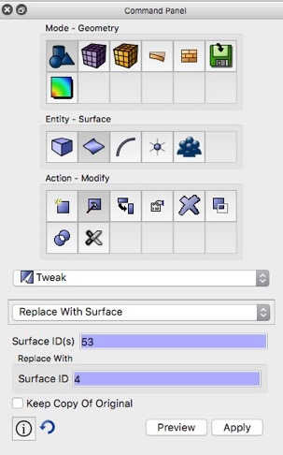
Overlap Detection/Correction
Note the overlap between cylinder and hole. This can be a common occurence
draw volume 1 3
volume 3
volume 1 has a larger radius than the hole in volume 3
volume 1
Tweak Replace operation can be used to increase the radius of the hole or decrease the radius of the cylinder
Tweak Replace command panel
tweak surface 51 replace with surface 4
tweak surface 27 replace with surface 8

Slide 24
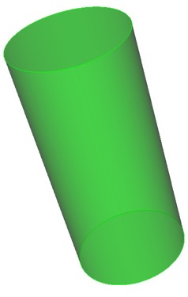
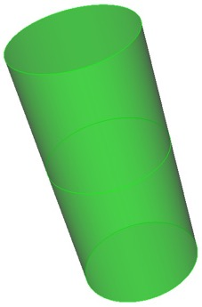
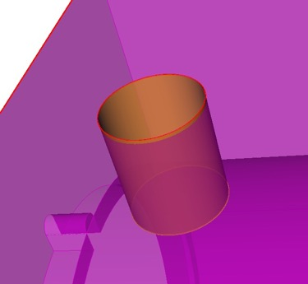
Imprint and Merge
Imprint operation adds curves and surfaces
Surface 106
Surface 4
imprint all
Curve 256
Volume 1
Surface 107
Merge operation combines curves and surfaces
Surface 51
Surface 106
merge all
Curve 14
After meshing, faces and nodes will be shared across merged surfaces
Curve 14
Surface 51
Volume 3

Slide 25
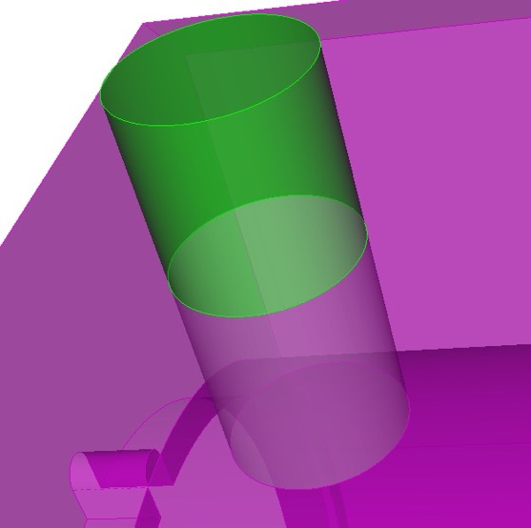
Imprint and Merge
Following merge operation, check Cubit output
Should be 0 curves and 0 vertices merged
Cubit>merge all
...Merging all features in the model
...Merging all Surfaces in the model
Consolidated 4 pairs of surfaces
...Merging all Curves in the model
Consolidated 0 pair of curves
...Merging all Vertices in the model
Consolidated 0 pairs of vertices
All detected matches successfully merged
Journaled Command: merge all
CUBIT™ output from merge all command

Slide 26
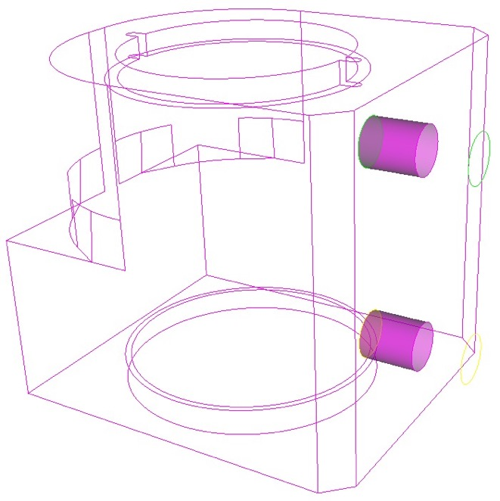
Imprint and Merge
Check merged surfaces
Use is_merged keyword to verify all surfaces are correctly merged
draw surface with is_merged
draw curve all add
If surfaces are not correctly merged, additional geometry operations may be necessary to correct gaps, overlaps and misalignments

Slide 27
Identify Contact Surfaces
Identify surfaces that will be in contact
Contact
For our example: Assume volume 1 bolt in contact with casting, Volume 2 bolt is fixed to casting
Volume 1
Unmerge operation will replace surfaces that were combined during merge
Fixed
Volume 2
unmerge volume 1
Use is_merged again to verify surfaces that are not in contact
draw surface with not is_merged
draw curve all add

Slide 28
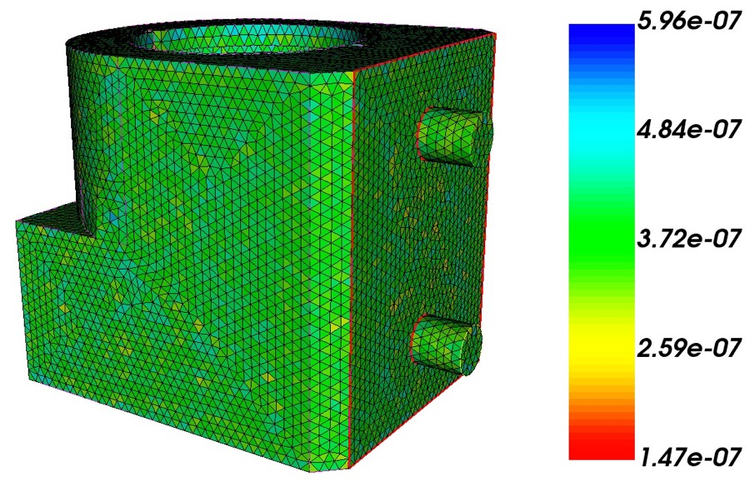
Remesh
Mesh the volumes
vol all scheme tetmesh
vol all size 0.2
mesh vol all
list tot
Check the numer of tets and time step metric
How does it compare to the original mesh?
quality volume all time step draw mesh

Slide 29
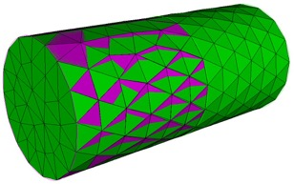
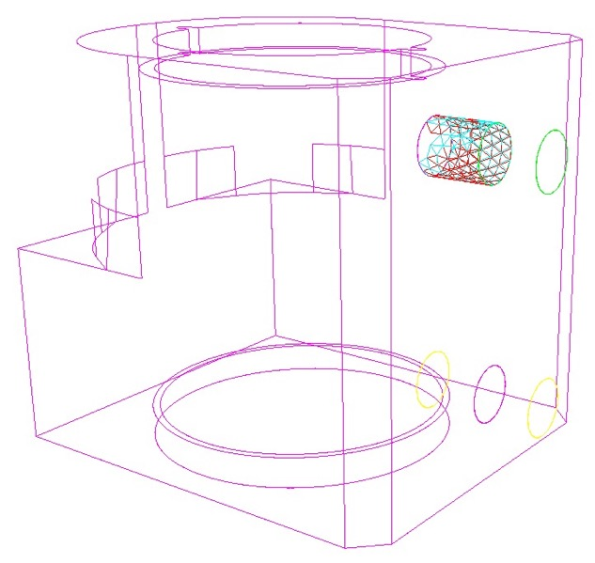
Mesh Overlap Detection
Mesh may overlap at contact surfaces. This can cause problems in the analysis. Best practice to remove mesh overlap before analysis
find mesh intersection surface all draw
draw curve all add
Displays triangles that are overlapping
surf 51
surf 107
Note that triangles don't overlap at merged surface

Slide 30
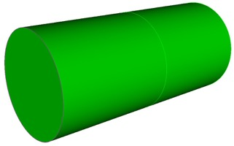
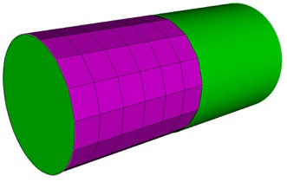
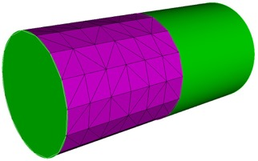
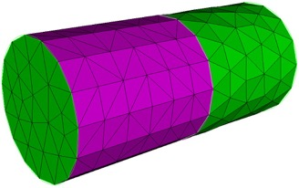
Mesh Overlap Correction
QTri Method
1.
2.
One way to address mesh overlap on contact pairs
1. First merge the unmeshed surfaces.
2. Mesh the merged surface with a mapped mesh
3. Perform qtri operation
4. Unmerge
This guarantes the same (non-overlaping) mesh but maintains the contact/slip condition
surface 51
delete mesh
imprint vol 1 3
merge vol 1 3
surf 51 scheme map
mesh surf 51
3.
4.
qtri surf 51
vol all scheme tetmesh
mesh vol all
unmerge vol 1
creating a qtri mesh may be benefial in avoiding future mesh intersections if cylinder moves along its axis
check for mesh overlap again.
contact pairs contain overlapping surfaces

Slide 31
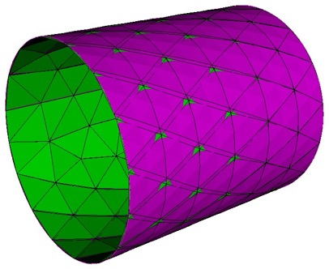
Mesh Overlap Correction
Move Node Method
before moving nodes
after moving nodes
Move the nodes on one of the surfaces a small distance to avoid overlap
This creates a small gap between the elements at the contact surfaces
Determine offset distance, d, from trial and error
First delete the elements created with the QTri Method
draw surf 51 107
zoom surf 51 107
Move the nodes in surface 51 a distance of d=0.02 normal to surface 107
delete mesh
surf all scheme trimesh
mesh vol all
node in surface 51 move normal to surface 107 distance 0.02
check for mesh overlap
find mesh intersection surface all draw
check for mesh overlap
find mesh intersection surface all draw

Slide 32
Massive Composite
By combining all surfaces in a volume together Surface mesher has more freedom to automatically remove small features (defeature)
Can avoid tedious defeaturing operations
reset
import acis 'a901-2.sat'
composite create surface in vol 3
vol all scheme tetmesh
vol all size 0.2
mesh vol 3
Volume 3 has all of its surfaces composited into a single topologic surface, but maintains its sharp corners
Caution: individual curves and surfaces in composite can no longer be used to assign BCs
Command Panel for Composite Surfaces

Slide 33
Massive Composite
Check the time step metric after meshing with massive composite
First create the block and material again
block 1 volume 3
block 1 name 'casting'
create material name 'steel' elastic_modulus 2.068e5 poisson_ratio 0.29 density 7e-6
casting material 'steel'
Display the time step metric
small tets contriol the timestep
quality volume all time step global draw mesh
quality volume all time step global high 1.0e-7 low 0 draw mesh

Slide 34
Massive Composite
When using the massive composite option, small elements may still exist
The tiny edge length option can help to eliminate small elements by internally collapsing features in the composite regions
set dev on
set trimesher remove tiny edge length 0.05
small tets contriol the timestep
Tiny edge length represents size of features that will be ignored
Caution: setting tiny edge length too large can cause problems! However too small and it will have no effect. It is worthwhile to experiment
Exercise:
Remesh volume 3 using the tiny edge length option and try to select a size that will improve the timestep to greater than 1e-7

Slide 35
Massive Composite
Limited Compositing
Exercise:
First delete the mesh and remove the composite surface definition
Massive composting of all surfaces will hide curve and surface definitions.
Boundary Conditions (nodesets and/or sidesets) or important features may require curves or surfaces
delete mesh
composite delete surf in vol 3
Identify surfaces 9 and 51 as sidesets and create a qtri mesh on them
sideset 1 surf 9 51
surf 9 51 scheme map
mesh surf 9 51
qtri surf 9 51
mesh surf 9 51
Preserve important curves and surfaces by not including them in the composite operations
Composite all surfaces except surfaces 9 and 51 on volume 3 and mesh
Surface 9
composite create surf in vol 3 except surf 9 51
vol 3 scheme tetmesh
mesh vol 3
draw sideset 1
Surface 51

Slide 36
Geometry Sizing
Default geometry sizing attempts to capture curvature by reducing local element sizes
Turning OFF geometry sizing may help to decrease DOF and increase timestep
trimesher geometry sizing off
Removes deviation angle requirement
Unselect this option
small deviation angle
larger deviation angle

Slide 37
Geometry Sizing
Exercise:
import acis "gear.sat"
vol 1 size 6.0
vol 1 scheme tetmesh
mesh vol all
delete mesh
trimesher geometry sizing off
mesh vol all
3,625,134 tets
240592 tets
geometry sizing ON
geometry sizing OFF

Slide 38
Grouping with Extended Parsing
Groups can be used to help in assignment of mesh sizing or other properties
size = 6.0
Example:
Assign a size of 1.0 to teeth, but transition to size 6.0 on the interior of the gear
1. Identify characteristic area for surface of tooth
list surface 515 geometry
surface 515
Surface Area: 258.817952
2. Create group teeth and add surfaces of similar area
size = 1.0
group "teeth" add surface with area > 258 and area < 259
draw teeth
3. Assign size property to all surfaces in teeth group
surf in teeth size 1.0
4. Mesh
vol 1 size 6.0
mesh vol 1

