Slide 1
CUBIT™ Fast-Start Tutorial
25. Usability Tools (Advanced)
Notes:
Type: FORMAL - Training
Title: Cubit 200 Training
SAND Number: SAND2020-0682 TR
Contact: Hensley,Trevor Michael

Slide 2
Custom Toolbars

Slide 3
Custom Toolbars
Convenient access to frequent tasks as toolbar buttons
Run favorite CUBIT™ commands
Play specific scripts
Shortcuts to specific command panels
Share with colleagues
Import and export toolbars and supporting files.

Slide 4
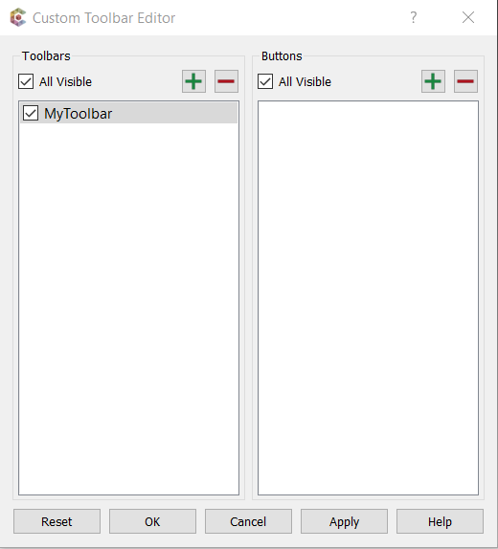
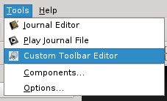
Custom Toolbars
Example custom toolbar
2
1
1
Open the Toolbar Editor through the Tools menu or using the toolbar shortcut.
1
Click the ‘+’ button in the Toolbars column.
Toolbar Editor
2
Notes:
Clicking on a button in a custom toolbar will cause the associated tool to run. It serves as convenient access for frequently used functions, scripts, command panels, etc.

Slide 5
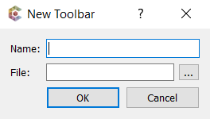
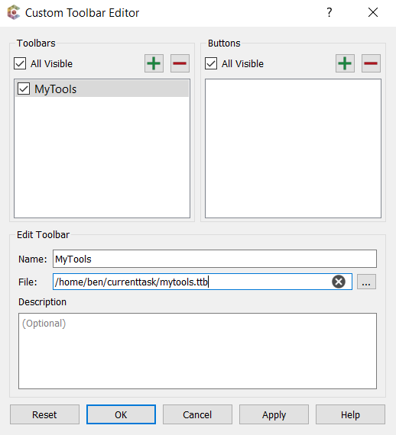
New Toolbar
3
4
3
Give the toolbar a name and a filename. Click OK.
4
Click the ‘+’ button in the Buttons column.

Slide 6
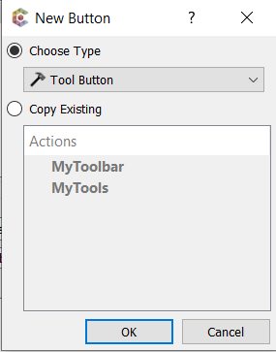
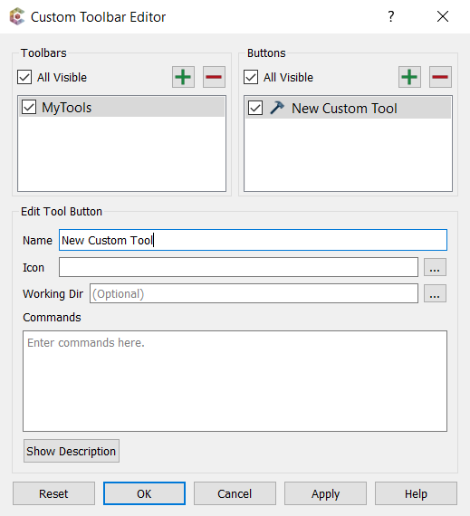
New Tool Button
5
Accept the default Tool Button type and click OK.
6
5
6
Give the tool button a name.
7
Enter Cubit commands here (e.g., ‘brick x 10’, ‘mesh volume 1’, etc.)
7
8
Click OK to save the toolbar. A new toolbar should appear in the GUI.
8

Slide 7
Custom Toolbar Button Types
Tool Button – execute a series of CUBIT™ or Python commands.
Journal File – run a specified journal file
Python Script – run a specified Python script
Command Panel – open a specific command panel (acts as a shortcut)
Copy Existing allows you to create a new tool by copying an existing one.

Slide 8
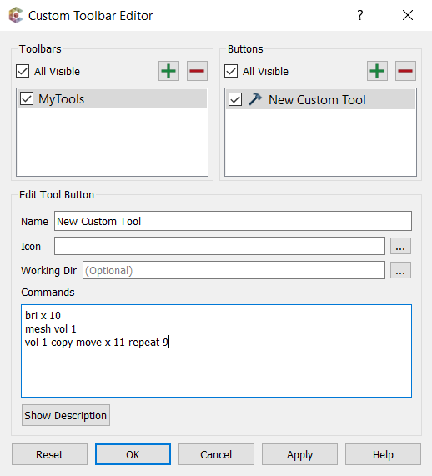
Tool Button
Tool display name.
Tool icon file. If unspecified, uses the default icon
Browse Files
Working Dir – changes the working directory during tool execution. Upon completion, the original working directory is restored.
Cubit commands to run. To run Python commands, the first line should be ‘#!python’.

Slide 9
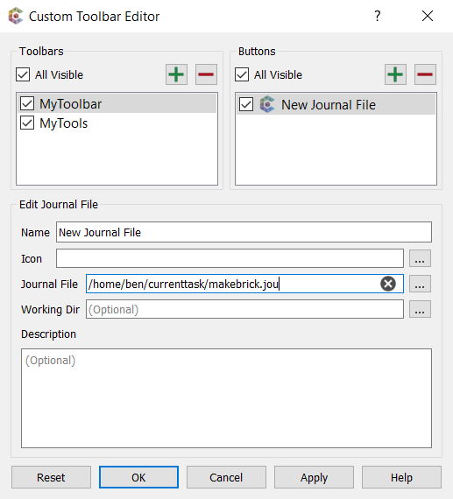
Journal File Tool
Tool icon file. If unspecified, uses the default icon
Browse Files
Journal file to run.
Working Dir – changes the working directory before executing the journal file. Useful if the journal file has relative file paths for imports or exports. Restores the original working directory upon completion.

Slide 10
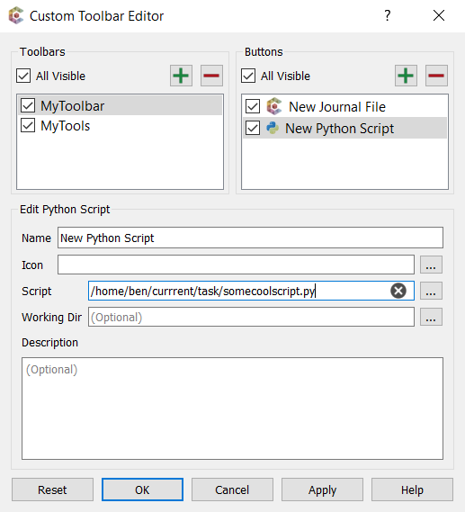
Python Script Tool
Tool icon file. If unspecified, uses the default icon
Browse Files
Python script to run.
Working Dir – changes the working directory before executing the Python script. Useful if the script uses relative paths or imports other Python scripts. Restores the original working directory upon completion.

Slide 11
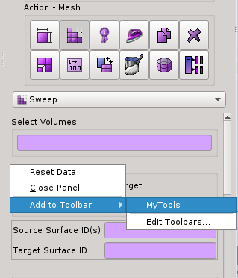
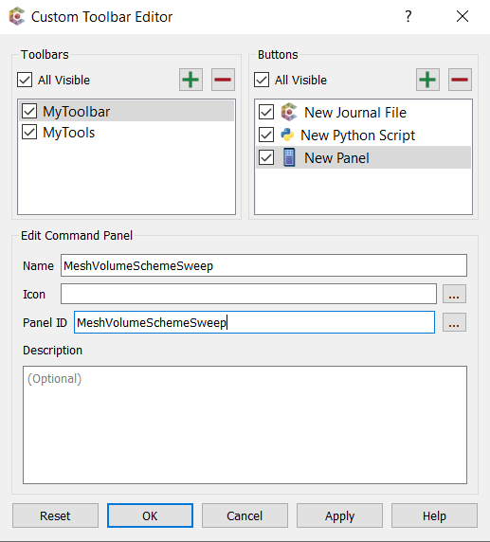
Command Panel Shortcut
Command panel ID
Browse command panels
Can create by right clicking on a blank area of the desired command panel. The panel’s icon is used as the tool’s default icon.
Notes:
Note: It is also possible to drag a command panel directly onto the toolbar to create a shortcut. To do so, left-click on a blank space in the command panel and drag the mouse over the custom toolbar, then release the mouse button.

Slide 12
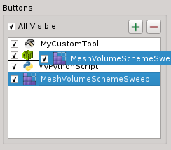
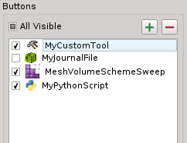
Toolbar Button Appearance
Check/uncheck individual buttons to show/hide them on the toolbar (also works for entire toolbars).
Drag buttons in the editor to re-order appearance on the toolbar.
(Before)
(Before)
(After)
(After)

Slide 13
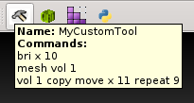
Custom Toolbars
Right click for quick access to edit tools (opens editor)
Features descriptive tooltips to help identify tools.

Slide 14
Custom Toolbars Exercise
Create a new Tool button
Enter the commands:
mesh volume all
draw volume with not is_meshed
3. Save the toolbar button.
4. Import the model “schemes.sat”
5. Click the new tool button to run the commands
Notes:
This example demonstrates how a tool button can be used to quickly mesh many volumes and visually identify which ones were not meshed.

Slide 15
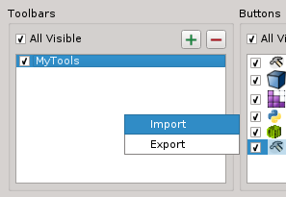
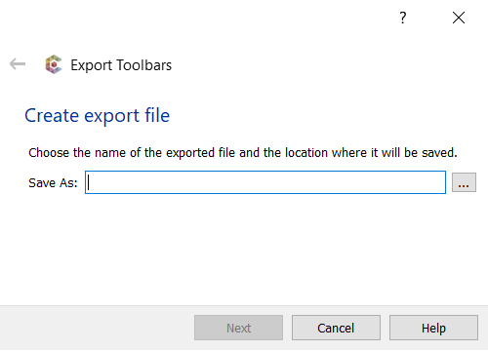
Export Toolbar
1
2
Right-click in the toolbars column of the editor. Select Export.
1
2
Choose where to save the exported toolbar.
3
3
Click Next.
Notes:
Exporting a toolbar allows you to share your tools with colleagues.

Slide 16
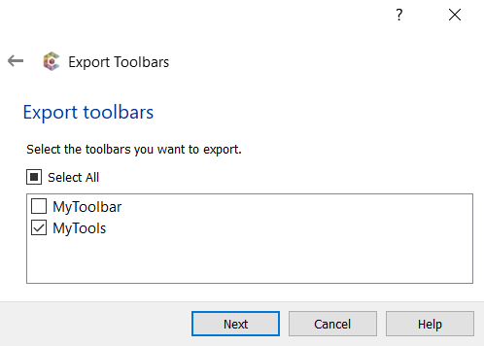
Export Toolbar
4
Select the toolbars to export.
5
Click Next.
4
5

Slide 17
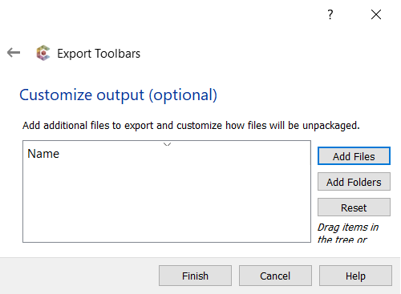
Export Toolbar
Scripts used by the exported toolbar are automatically gathered.
6
Review additional files to export and click Finish.
6
Notes:
This page of the wizard gives you an opportunity to add other files to the export and customize the file/folder layout when the toolbar is unpackaged. This can be useful if you want to include geometry or mesh files as part of the export.

Slide 18
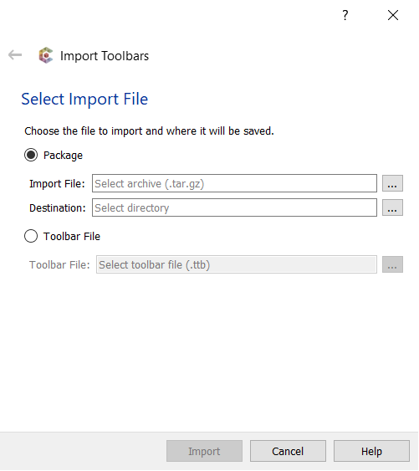
Import Toolbar
1
2
Right-click in the toolbars column of the editor. Select Import.
1
Alternatively, select a toolbar file to import.
2
Choose a toolbar package and a directory to unpack it.
3
Click Import.
3

Slide 19
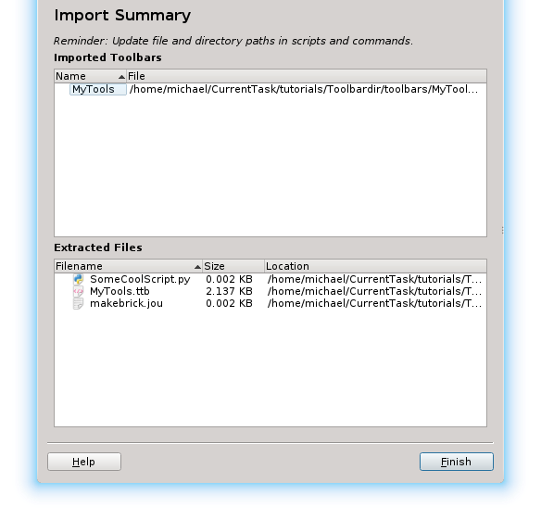
Import Toolbar
4
Review the Import Summary and click Finish.
4

Slide 20
Extended Selection

Slide 21
Extended Selection
Gives users the ability to use more complex selection tools.
Can create new selection filters using Python
Start with a larger selection and narrow it down based on some user-defined criteria

Slide 22
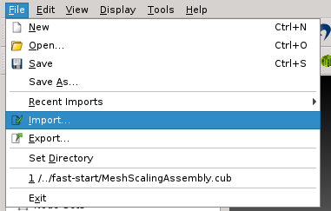
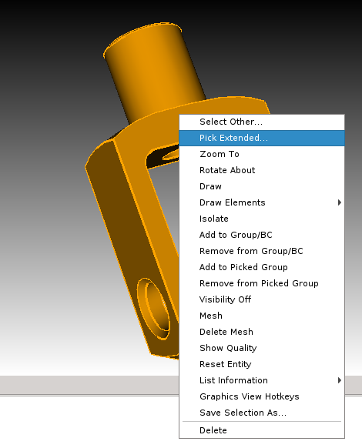
Pick Extended
1
2
1
Import ‘knuckle.sat’
2
Select the volume, right-click and choose Pick Extended… from the context menu. The Extended Selection Dialog will appear.

Slide 23
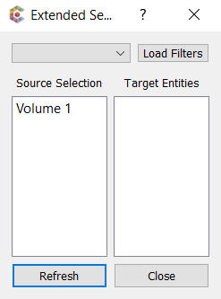
Extended Selection Dialog
Selection filters – create a new selection based on some scripted criteria. If no filters have been loaded, this will appear empty.
3
Target Entities – new selection based on the filter script’s criteria. Selecting entities here will result in a selection in the graphics view as well.
Source selection – selected entities from which the target selection is derived. Selecting one or more items in this column will update the Target Entities list.
Close the dialog.
Refresh – updates the Target Entities list.
3
Click the Load Filters button to open the Load Filters dialog.

Slide 24
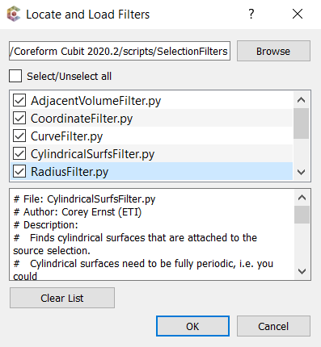
Load Filter Dialog
Directory containing filter scripts. Note: default scripts are provided in <install_dir>/scripts/SelectionFilters
List of enabled filters.
4
Script viewer – provides a read-only view of the script’s contents.
4
Select all filters.
5
Click OK to save and close the dialog.
5

Slide 25
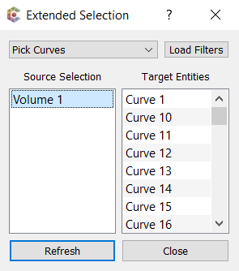
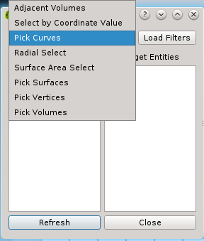
Run Filter
6
7
8
6
Change the filter to Pick Curves
7
Select the volume in the Source Selection column
8
Select several curves in the Target Entities column
Notes:
Let’s get all the curves in the volume

Slide 26
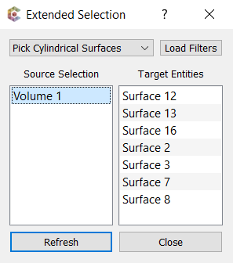
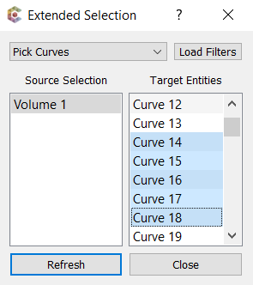
Drag Target Selections
10
9
9
Drag the curves into the Source Selection column
10
Change the filter to Pick Surfaces

Slide 27
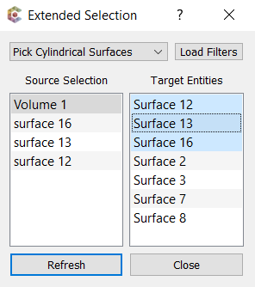
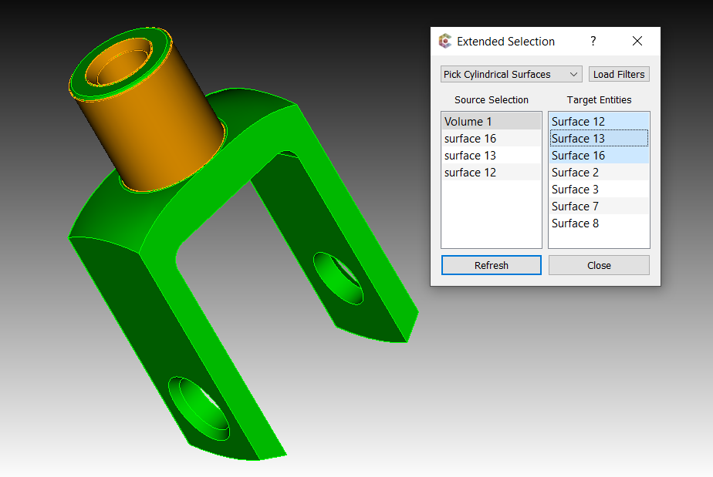
Select Targets
12
11
11
Select a curve (or two) to update the Target Entities column with surfaces.
Select a surface in Target Entities column and note the updated selection in the graphics view.
12

Slide 28
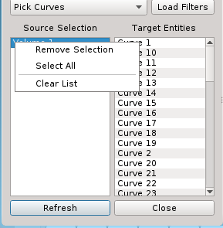
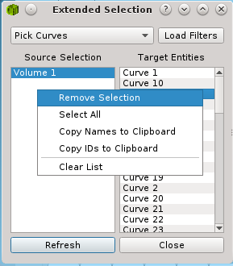
Context Menu Options
Remove selected entities from the list.
Select all entities in the list.
Copy names to use in paste operations.
Copy IDs to use in paste operations.
Clear all entities from the list.
Source entity context menu
Target entity context menu

Slide 29
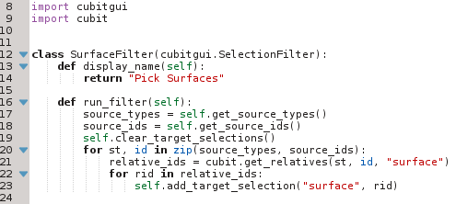
Filter Script
Class name matches script name
Inherits from SelectionFilter
SurfaceFilter.py
display_name - defines the text shown in the list of available filters.
run_filter - creates a new selection from the source selection. Called when a source selection changes or Refresh is clicked.
Uses functions from the CUBIT™ module.
Source selection type and IDs retrieved using get_source_types() and get_source_ids().
Target selections added using add_target_selection(type, id)

Slide 30
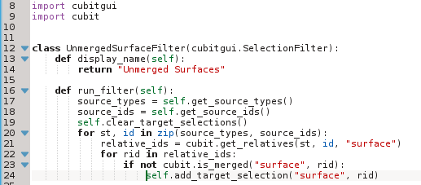
Filter Script Exercise
UnmergedSurfaceFilter.py
1
2
3
4
1
Copy the file SurfaceFilter.py and rename it to UnmergedSurfaceFilter.py.
Update the class name to UnmergedSurfaceFilter.
2
3
Update the display_name text to “Unmerged Surfaces”.
4
Add a check for the merge status of a surface and save the filter. Remember indentation is important in Python.
Notes:
SurfaceFilter.py should be located in <install_dir>/scripts/SelectionFilters.
If you don’t have write permissions for the scripts directory, copy the filters and paste them into a directory where you do have write permissions. You can specify this other directory in the Load Filters dialog.

Slide 31
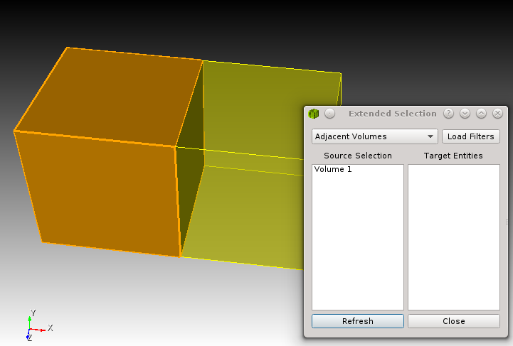
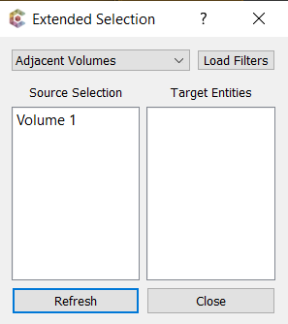
Filter Script Exercise
In CUBIT™, run the commands:
reset
brick x 10
volume 1 copy move x 10
merge all
5
6
5
6
Select a volume, right-click and open the Pick Extended dialog. Click Load Filters.

Slide 32
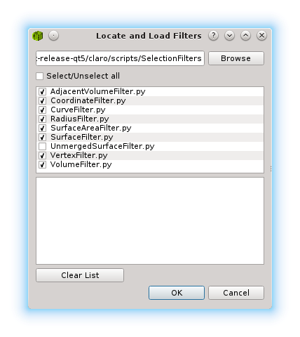
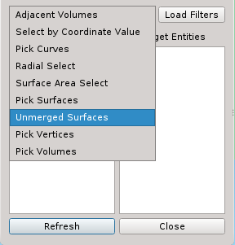
Filter Script Exercise
7
8
7
Select the new UnmergedSurfaceFilter. Click OK.
Select the new filter and run it on Volume 1. The resulting target list should have 5 surfaces.
8
Notes:
Feel free to experiment with the new filter. For example, what if you change the script to only allow merged surfaces to be added?

Slide 33
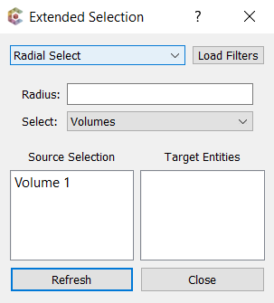
Filter UI
Filters can add very basic UI.
Uses a Qt .ui file. These can be generated using Qt Designer. See http://doc.qt.io/qt-5/qtdesigner-manual.html
In the Python filter script, the desired .ui file is specified by implementing the function get_ui_file().
UI elements are referenced by their objectName, as specified in the .ui file.
For an example of how this is done, please refer to the included filter RadiusFilter.py.

