Slide 1
CUBIT™ Fast-Start Tutorial
23. Boundary Layers
Notes:
Type: FORMAL - Training
Title: Cubit 200 Training
SAND Number: SAND2020-0682 TR
Contact: Hensley,Trevor Michael

Slide 2
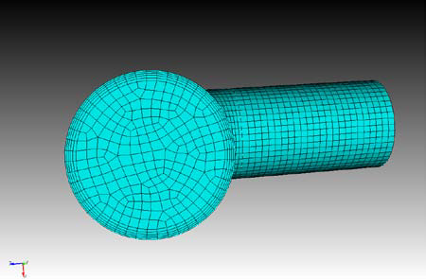
Overview
In this tutorial, you will learn how to use the Cubit boundary layer feature to create a more specific mesh. A boundary layer is a user-created mesh with specific dimensions, growth rate, and number of layers. In this tutorial you will learn how to:
Add a boundary layer to a simple geometry model
How to use boundary layers with exterior flow
How to use boundary layers with interior flow
Notes:
2

Slide 3
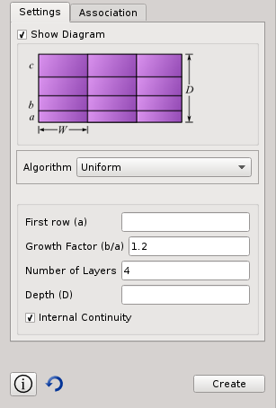
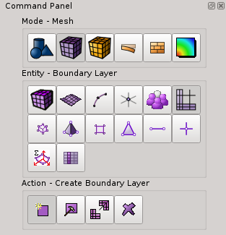
Boundary Layer in GUI
1
2
3
Notes:
3

Slide 4
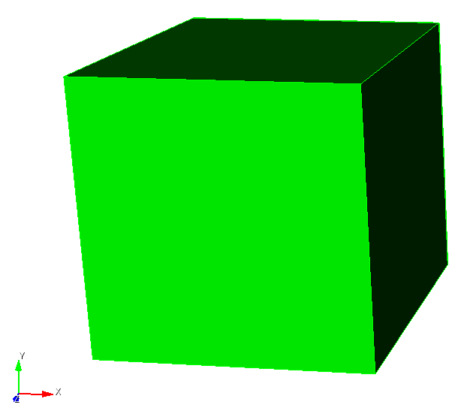
Adding a Boundary Layer to Simple Geometry
Before creating a boundary layer, you need to create a geometry. For this example we will create a simple brick. To create a brick:
1
On the Command Panel, click on Geometry > Volume > Create.
Select Brick from the drop-down menu.
Enter 10 in the X(width) field. (10 should be there by default)
Click Apply.
2
3
4
Notes:
4

Slide 5
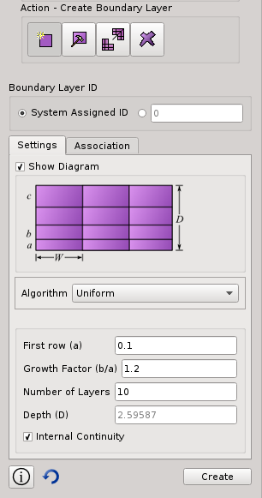
Adding a Boundary Layer to Simple Geometry
1
Now that you have created a brick, you can add a boundary layer to it. To create a boundary layer from the
On the Command Panel, click on Mesh > Boundary Layers > Create.
Click on the Settings tab.
Enter 0.1 in the First row (a) field.
Enter 1.2 in the Growth Factor (b/a) field.
Enter 10 in the Number of Layers field.
Note: First row is the size of the first row of the boundary layer. Growth Factor is the amount that it will grow by each layer. Number of Layers is the amount of layers in the boundary layer.
1
2
2
3
4
5
3
4
5
Notes:
5

Slide 6
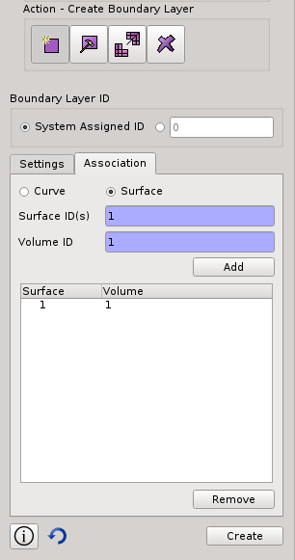
Adding a Boundary Layer to Simple Geometry
Now we have the specific measurements we want. We can apply these boundary layers to the specific surface we want.
Click on the Association tab.
Click the Surface radio button.
Enter 1 in the Surface ID(s) field.
Enter 1 in the Volume ID(s) field.
Click Add
Click Create.
6
6
7
7
8
8
9
10
9
10
11
11
Notes:
6

Slide 7
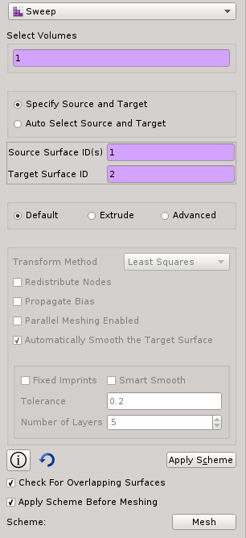
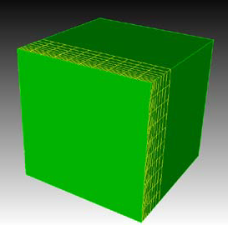
Adding a Boundary Layer to Simple Geometry
3
Surface 2
With the boundary layer created, you can now mesh the brick. To mesh the brick that has a boundary layer:
4
Surface 1
4
On the Command Panel, click on Mesh and then Volume.
Click on the Mesh action button.
Change the scheme to Sweep.
Enter 1 in the Select Volumes field and select Surface 1 as the source and Surface 2 as the target.
Click Apply Scheme
Click Mesh.
4
1
2
3
4
5
5
6
6
Notes:
7

Slide 8
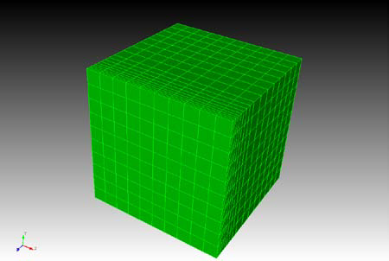
Adding a Boundary Layer to Simple Geometry
You will now be able to see the meshed model and the boundary layer in use. It should appear like the image shown below.
Notes:
8

Slide 9
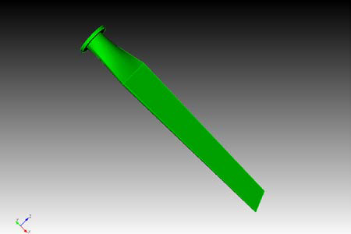
How to use a Boundary Layers For Exterior Fluid Flow
In this example we will use a blade from a windmill. We want to analyze the exterior flow of air that would be making contact with the blade. We will use the shape of the blade to set boundary layers on the exterior part of the blade, which will represent the air.
Notes:
9

Slide 10
How to use a Boundary Layers For Exterior Fluid Flow
To import the model and set boundary layers:
1
Click on the File and select Import from the drop-down menu.
Browse for the “Blade.sat” file and click Open.
Leave the default options selected on
Note: It may be easier to accomplish the remaining steps with the view on transparent mode.
Click on the View in transparent mode button located on the toolbar.
2
3
4
Notes:
10

Slide 11
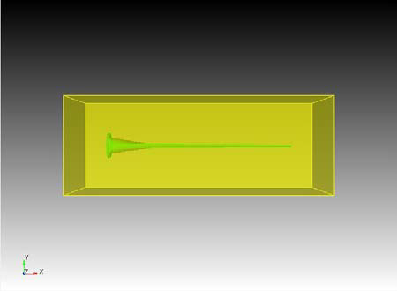
How to use a Boundary Layers For Exterior Fluid Flow
Create a bounding box surrounding the model. This bounding box represents the air that the blade cuts through. To set boundary layers to the exterior part of the blade, we set the boundary layers on the air where it touches the blade.
Enter the following command in the command line window:
create brick volume 1 extended absolute 150
Notes:
11

Slide 12
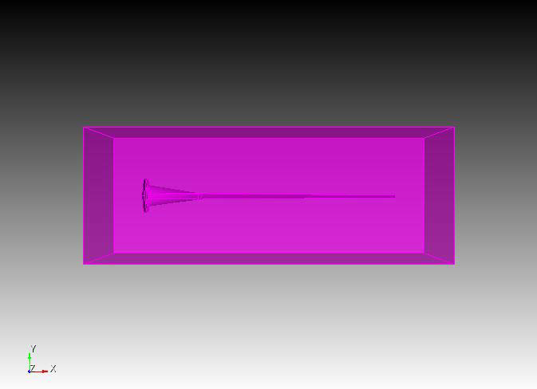
How to use a Boundary Layers For Exterior Fluid Flow
To subtract the blade from the bounding box
1
On the Command Panel, click on Geometry > Volume > Boolean.
Select Subtract from the drop down menu.
Enter 1 in the Volume ID(s) field.
Enter 2 in the From Volume ID(s) field.
Click Apply.
Next, isolate the blade. Click on Geometry > Volume > Webcut on the command panel.
Choose Surface Extended from Surface from the drop-down menu.
Enter 3 in the Volume ID(s) field and 28 in the Surface ID field, then click Apply.
Delete volume 3.
2
3
4
5
6
7
8
9
Notes:
12

Slide 13
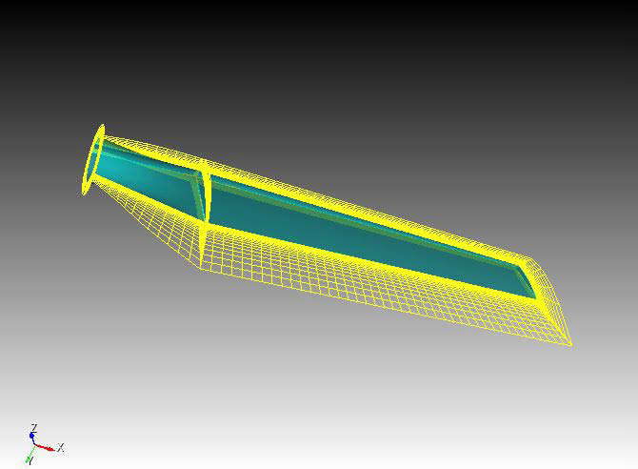
How to use a Boundary Layers For Exterior Fluid Flow
The remaining model is the air surrounding the blade. We can now set boundary layers the boundary layers to air surrounding the blade. To set boundary layers to the exterior of the blade:
1
Click on Mesh > Boundary Layer > Create.
Click on the Settings tab.
Enter 0.5 in the First row (a) field.
Enter 1.2 in the Growth Factor (b/a) field.
Enter 10 in the Number of Layers field.
Check the Internal Continuity box.
Click on the Association tab.
Click the Surface radio button.
Enter 20 to 26 in the Surface ID(s) field (all the interior surfaces).
2
3
4
5
6
7
8
10
Enter 4 in the Volume ID field.
Click on Add and then Create.
9
11
Notes:
13

Slide 14
How to use a Boundary Layers For Exterior Fluid Flow
Modify the boundary layer to be thicker:
Click on Mesh > Boundary Layer > Modify.
Select boundary layer 1.
Enter 0.2 in the First row (a) field.
Click the Apply button.
1
2
3
4
Notes:
14

Slide 15
How to use a Boundary Layers For Exterior Fluid Flow
With the boundary layers created, set the size and mesh scheme.
1
In the Control Panel, click on Mesh > Surface > Intervals.
Enter 20 to 26 in the Select Surfaces field.
Select Approximate Size from the drop-down menu.
Enter 7 in the Approximate Size field and press Apply.
In the Control Panel, click on Mesh>Volume>Mesh.
With the cursor in the Select Volumes field, click on the volume in the Graphics Window. The number 4 should appear in the field.
Select Tetmesh from the drop-down menu.
2
3
4
5
6
8
Enter 1.0 in the Growth Factor field.
Press Apply Scheme and then, Mesh.
9
7
Notes:
15

Slide 16
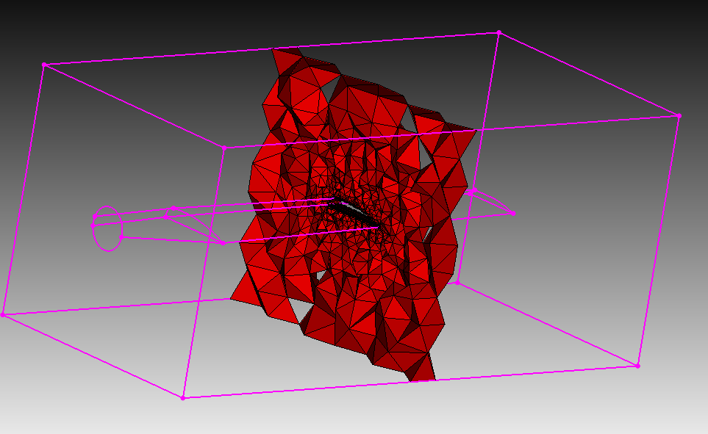
How to use a Boundary Layers For Exterior Fluid Flow
With the cursor in the Graphics Window, press the ‘x’, ‘y’, or ‘z’ key to slice through the mesh along an axis. Press the ‘k’ or ‘j’ key to move through the mesh layers. Press ‘q’ to exit this view.
As you can see from these steps, we have successfully set boundary layers to the exterior flow of the blade. By doing this we can effectively measure how the air moves around the shape of the blade
Notes:
16

Slide 17
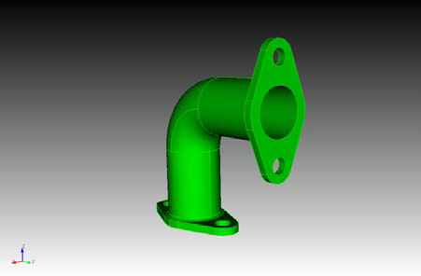
How to use Boundary Layers For Interior Fluid Flow
In this example we will use boundary layers to analyze interior flow. We will use a elbow pipe and set boundary layers to what would be the fluid flow inside the pipe.
Notes:
17

Slide 18
How to use Boundary Layers For Interior Fluid Flow
To import the model and set boundary layers
Click on the File and select Import from the drop-down menu.
Browse for the “Bend.sat” file and click Open.
1
2
Notes:
18

Slide 19
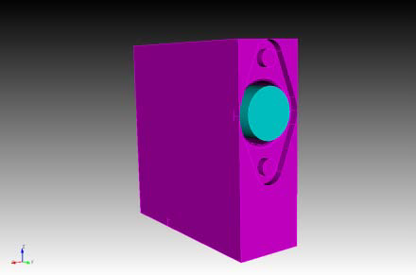
How to use Boundary Layers For Interior Fluid Flow
We want to analyze the fluid flow inside the pipe by setting boundary layers. We will first create a volume going through the pipe. Then we will remove the pipe, leaving us with the flow from inside the pipe. To create a bounding box and remove the pipe:
1
From the command line, enter:
create brick bounding box volume 1 tight
Select Geometry > Volume > Boolean action button.
Select Subtract from the drop-down menu.
Enter 1 in the Volume ID(s) field and 2 in the From Volume ID(s) field, then press Apply.
2
3
5
In the command line, enter: Split volume 3.
Click the Delete action button.
Enter 3 in the Volume ID(s) field and click Apply.
4
6
7
Notes:
19

Slide 20
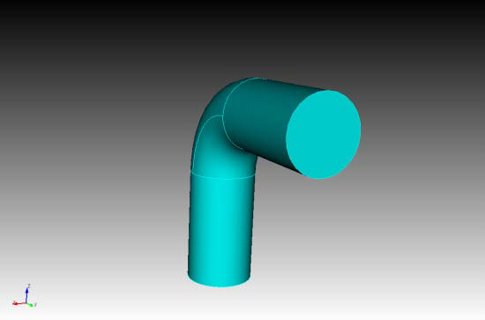
How to use Boundary Layers For Interior Fluid Flow
The model that remains is the flow that exists inside the pipe. Now we will add boundary layers to the flow to help simulate the properties of the fluid inside.
1
Click on Mesh > Boundary Layer > Create action button.
Click the Settings tab.
Enter .5 in the First row (a) field.
Enter 1.2 in the Growth Factor (b/a) field.
Enter 5 in the Number of Layers field.
Click Internal Continuity on.
2
3
4
5
Note: The Depth field number will auto-adjust based on the numbers entered in the previous fields. Be sure to adjust your numbers so the depth isn’t greater than your model.
6
Notes:
20

Slide 21
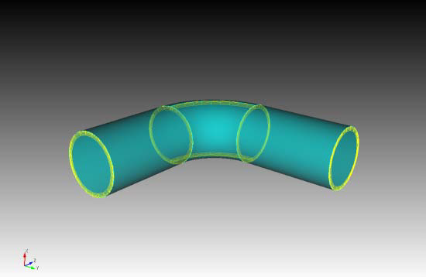
How to use Boundary Layers For Interior Fluid Flow
7
Click on the Association tab.
Click the Surface radio button.
Enter 123 to 129 in the Surface ID(s) field.
Enter 4 in the Volume ID field.
Click Add and then Create.
8
9
10
11
Notes:
21

Slide 22
How to use Boundary Layers For Interior Fluid Flow
Now that we have boundary layers throughout the model, we can mesh it. To mesh the model:
1
With the same settings on the Command Panel, click Volume > Mesh action button.
Enter 4 in the Select Entities to Mesh field.
Select Sweep from the drop-down menu.
Enter 121 in the Source Surface ID(s) field.
Enter 122 in the Target Surface ID field.
Click Apply Scheme and then click Mesh.
2
3
4
5
6
Notes:
22

Slide 23
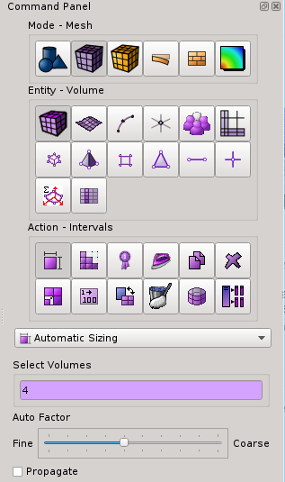
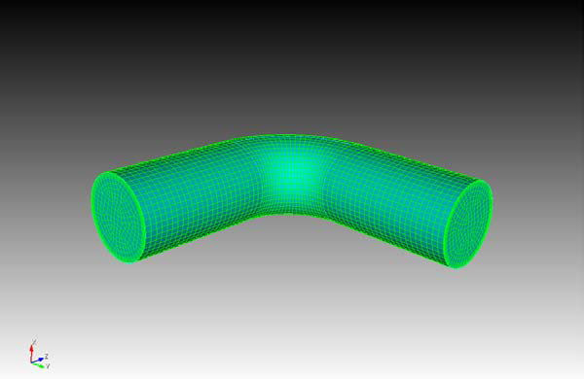
How to use Boundary Layers For Interior Fluid Flow
7
Select the volume and right-click. Click Delete Mesh.
Click the Intervals action button.
Enter 4 in the Select Volumes field.
Adjust the slider to specify a finer or coarser mesh.
Click Apply then Mesh.
8
9
10
11
Note: The mesh size can be adjusted to generate a desired mesh.
Notes:
23

