Slide 1
CUBIT™ Fast-Start Tutorial
20. Improving the Quality of Existing Hex Meshes
Notes:
1
1
Type: FORMAL - Training
Title: Cubit 200 Training
SAND Number: SAND2020-0682 TR
Contact: Hensley,Trevor Michael

Slide 2
Tools to Improve Quality of Existing Hex Meshes
Smoothing
Unite Meshed Volumes
Mesh Surgery
Pillowing
Notes:
2

Slide 3
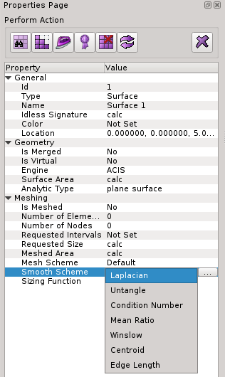
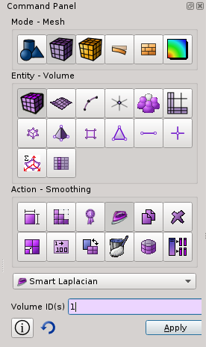
Smoothing
Smoothing adjusts node locations without changing element connectivity.
Many different smoothing schemes with different characteristics
Usually iterative algorithms that attempt to improve the local mesh quality
Short cut to smoothing command panel
Smoothing schemes for surfaces and volumes
Smoothing schemes applied as an attribute, (similar to meshing scheme)
Surface and volume schemes are independent (unless free boundary option selected)
Smooth scheme can be set from the property panel
Smooth scheme can also be set from the command panel
Notes:
3

Slide 4
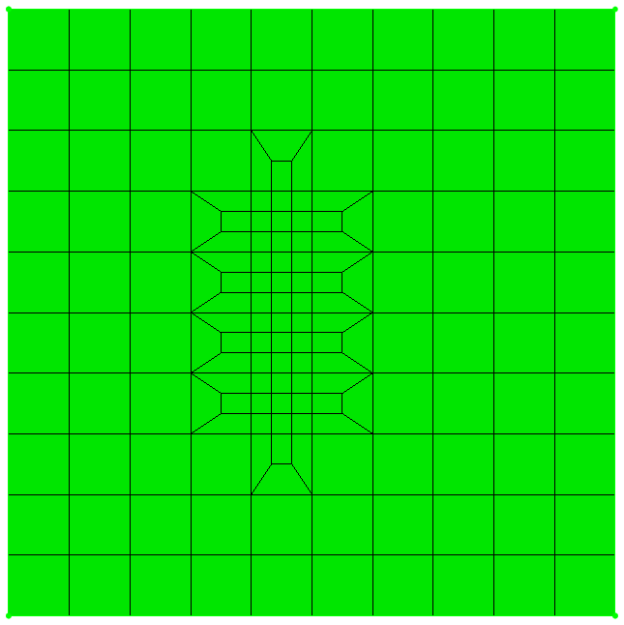
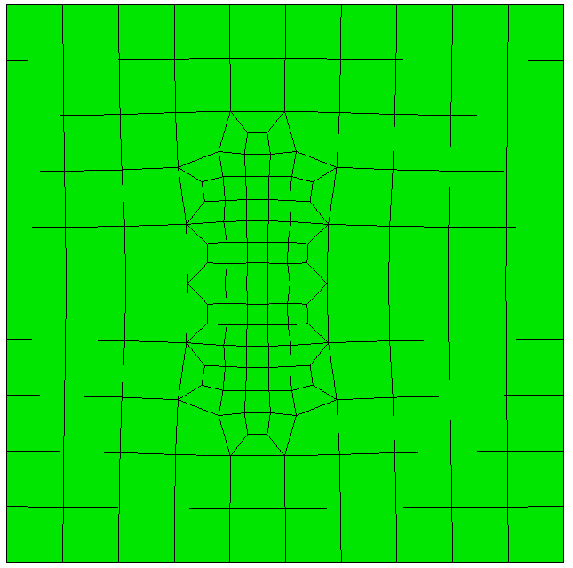
Smoothing
Without Smoothing
With Smoothing
Smoothing adjusts only node locations in order to improve element quality. Some smoothing algorithms adjust nodes based on geometric criteria. Other smoothing algorithms optimize element quality metrics directly.
Notes:
4

Slide 5
Smoothing
When smoothing a surface, the nodes on the boundary curves remain fixed. If nodes on boundary need adjustment, smooth the curves first.
Likewise, when smoothing a volume, the nodes on the boundary surfaces remain fixed. If nodes on boundary need adjustment, smooth the surfaces first.
Smoothing Process:
Smooth Curves
Smooth Surfaces
Smooth Volumes
Notes:
5

Slide 6
Smoothing
Surface Smoothing Schemes
Volume Smoothing Schemes
Equipotential
Centroid Area Pull
Optimize Jacobian
Winslow
longtime favorite for structured meshes has been extended to unstructured in CUBIT - theoretical guarantee against mesh folding
fast and high quality, try first
Laplacian, centroid area pull (smart Laplacian)
fast, poor near concave features
Untangle
remove stubborn inverted elements
Condition number, Mean Ratio
improve stubborn low-quality elements
must be non-inverted to start
Edge Length
Targets to have each edge equal length
Laplacian/Smart Laplacian
fast, poor quality near concave features
Equipotential
medium fast and medium quality
Untangle
remove stubborn inverted elements
Can take a long time, Control time limit: [cpu <double=10>]
Mean Ratio
Element quality optimization based
Can take a long time, Control time limit: [cpu <double=10>]
Condition number
Guarantees the same or better quality
improve stubborn low-quality elements
Can take a long time, Control time limit: [cpu <double=10>]
Runs untangle first if input is inverted
Notes:
6

Slide 7
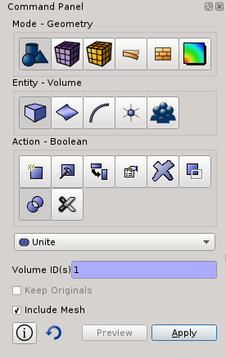
Unite Meshed Volumes
An option is included on the Geometry Boolean “Unite” command which allows you to unite volumes which are already meshed.
1
2
3
4
5
Notes:
7

Slide 8
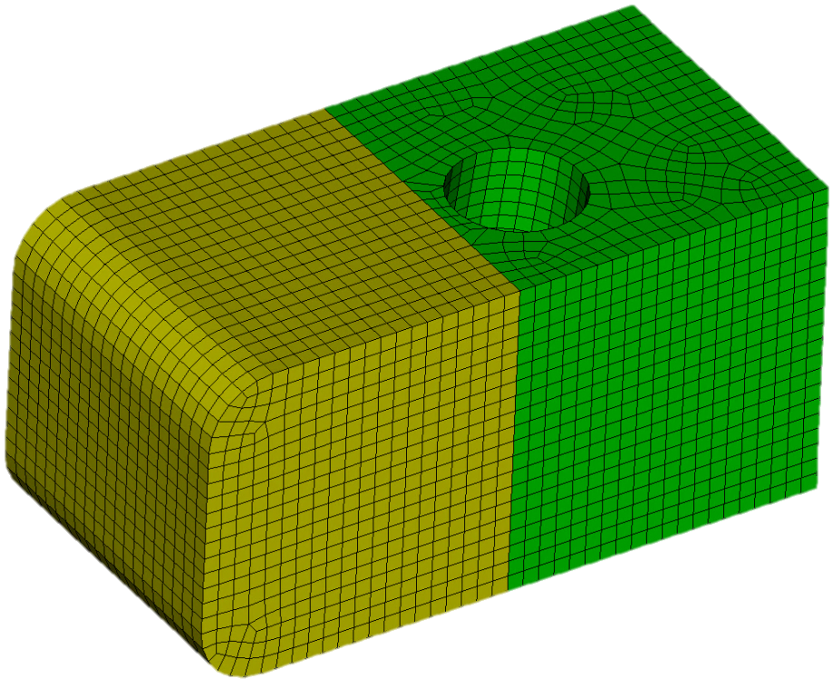
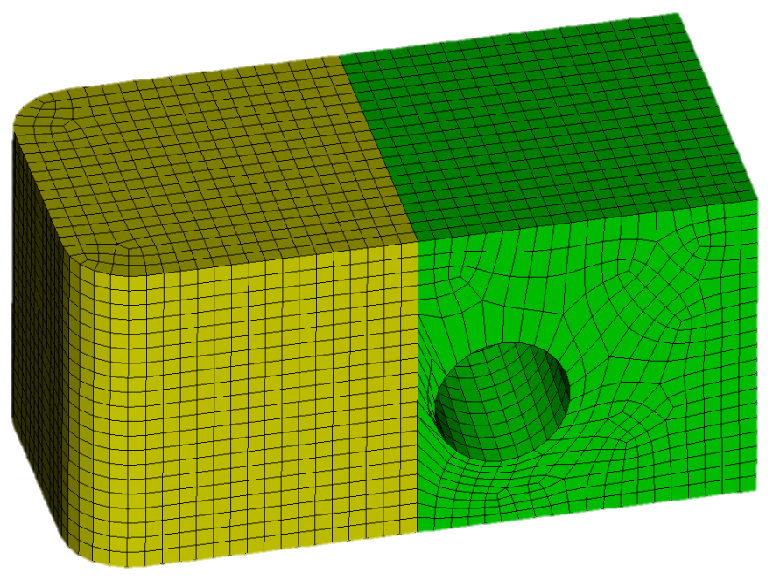
Unite Meshed Volumes
Top View
Sweep
Direction
The hole is at an angle. When the source surface is swept through the volume, skew is introduced in the mesh.
Sweep
Direction
Bottom View
Notes:
8
8

Slide 9
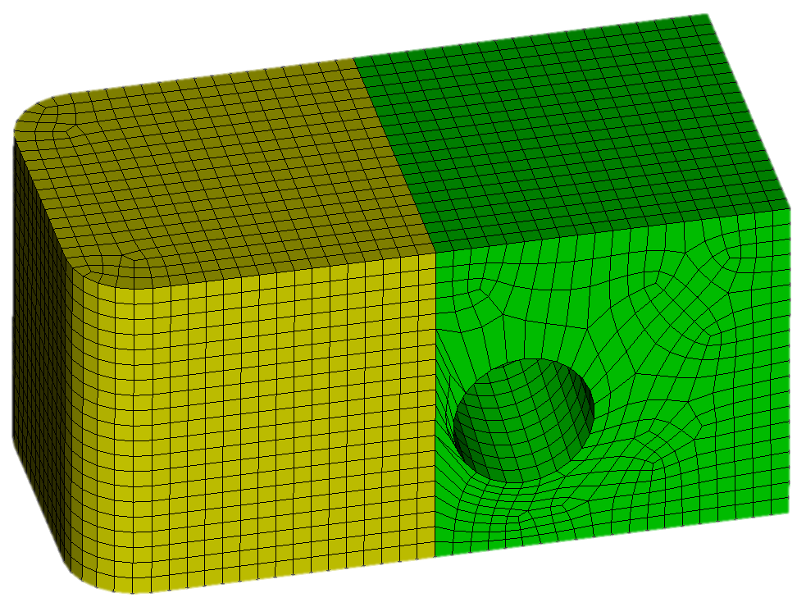
Unite Meshed Volumes
Because the hole is near the interface between the 2 volumes, smoothing alone will not improve the element quality.
However, the interface between the 2 volumes was added only to make the volume sweepable. Now that the mesh is generated, there is no need to keep the volumes separate.
Notes:
9
9

Slide 10
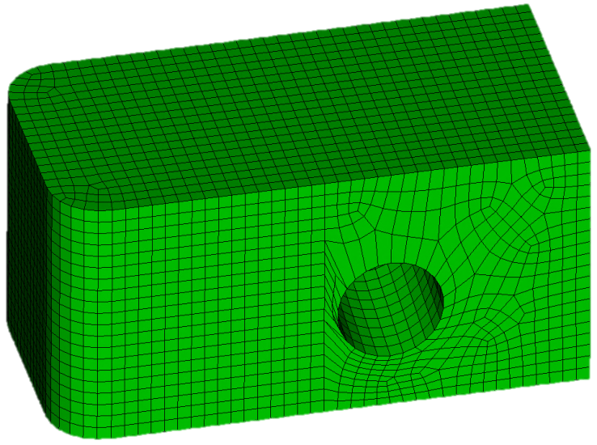
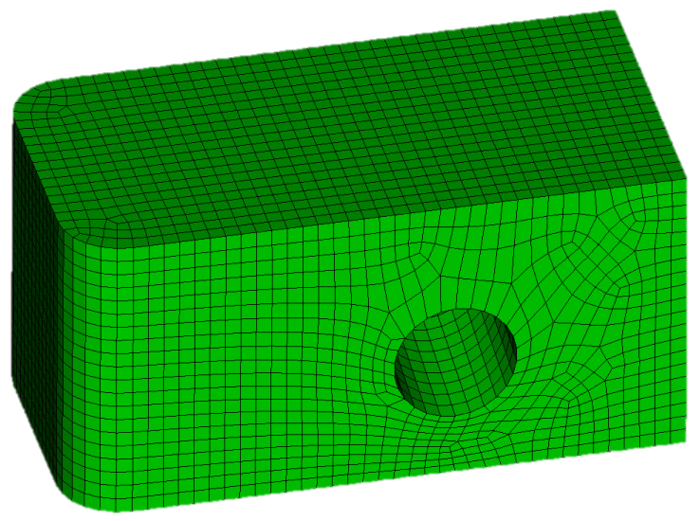
Unite Meshed Volumes
Uniting the volumes together removes the geometric constraint between the 2 volumes.
Smoothing can then optimize node locations to improve quality
Notes:
10
10

Slide 11
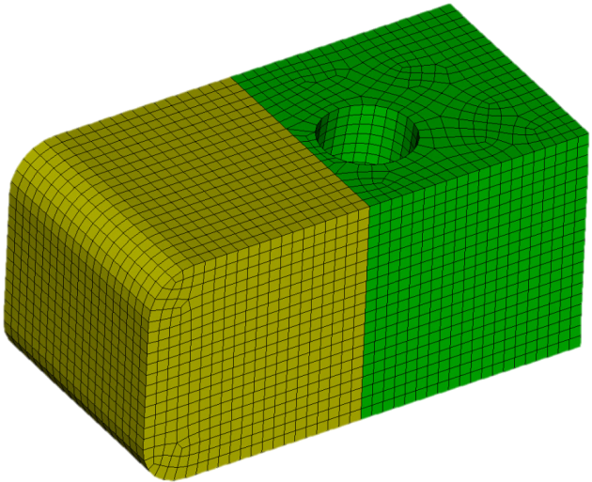
Exercise 1
Open UniteMeshedVolumes.cub.
Set a mesh size of 0.5
Mesh both volumes
Examine the quality of the mesh. Why is the quality so poor?
Unite the 2 volumes together. Make sure to use “include_mesh”.
Experiment with the different smoothing schemes to improve the quality. Remember to first smooth the surfaces, and then the volume mesh. Keep running the smoother again and again until the element quality stops improving.
Re-examine element quality. Did it improve? How high can you get the element quality?
Notes:
11

Slide 12
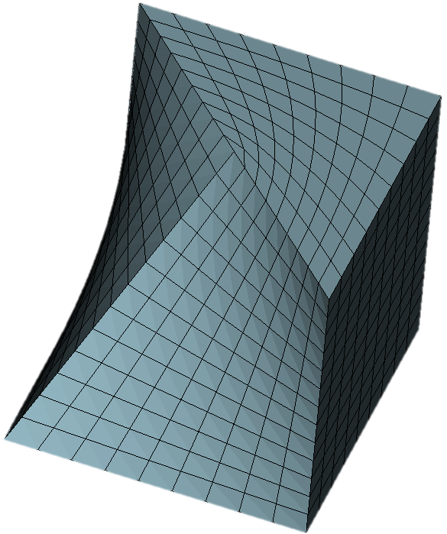
Mesh Surgery
Sometimes adjusting node locations alone (i.e. smoothing) is not enough to fix poor element quality. Sometimes we need to change the element connectivity also. For example:
Geometric constraints force this element to have a 180 degree angle.
Rather than remesh and hope for better quality, a few minor tweaks to element connectivity can improve element quality dramatically
Notes:
12
12

Slide 13
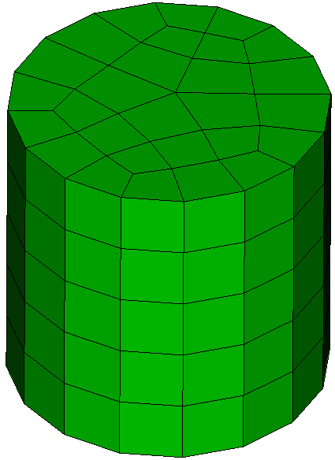
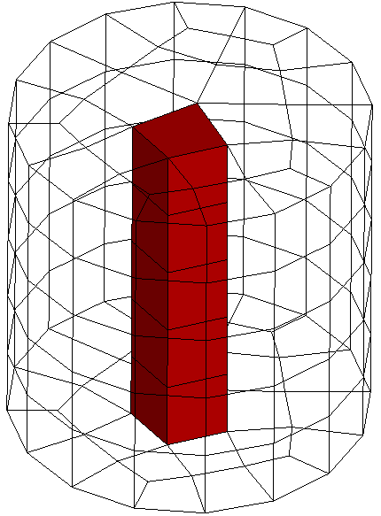
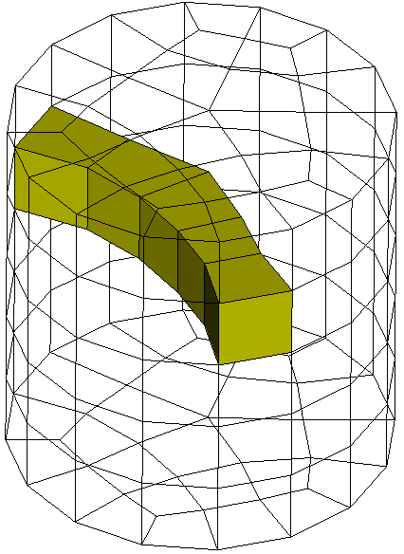
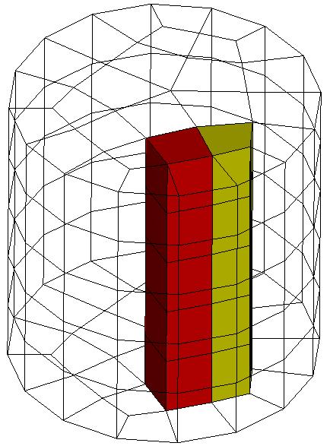
Mesh Surgery
Mesh Surgery can be used to import legacy meshes or meshes from other meshing packages to improve their quality.
Mesh Surgery is based on performing “Column operations”
A column is a stack of hexahedra within the mesh.
You can draw a column of hexes with the following command: draw column face <id>, where the id refers to a quad face which is at one end of the column.
An example hex mesh
A column running along the sweep direction.
A column running perpendicular to the sweep direction
Two adjacent columns
Notes:
13
13

Slide 14
Exercise 2 – Drawing Hex Columns
Create a cylinder and mesh it with hexes
Pick different faces on the boundary of the mesh and draw the corresponding columns.
Use the Cubit command: draw column face <id>
After drawing a column, type “draw edge all add” so you can see the column with respect to the rest of the model.
After visualizing one column, reset the display by hitting F5 so you can pick and draw a different column.
Notes:
14

Slide 15
Mesh Surgery
There are 3 basic mesh surgery operations:
Column Collapse
Column Split
Column Swap
Notes:
15
15

Slide 16
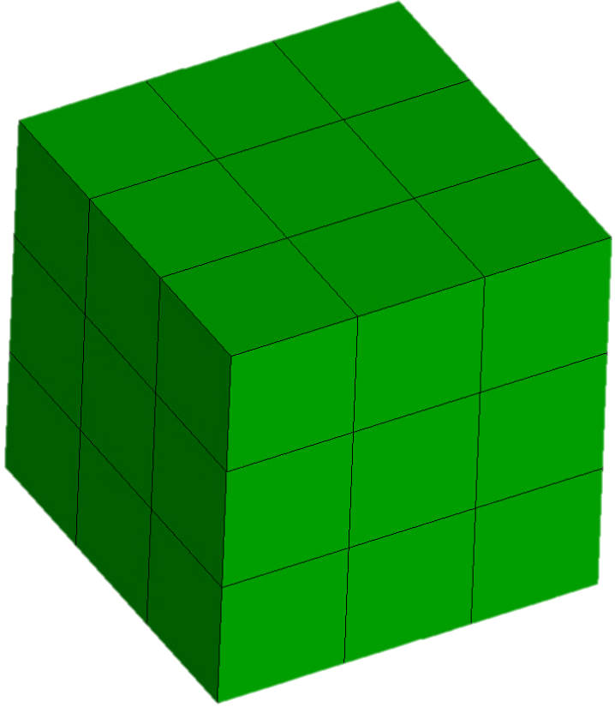
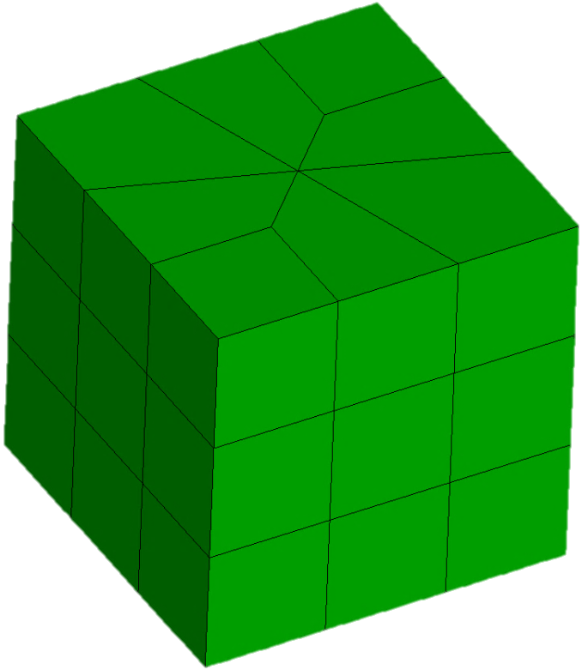
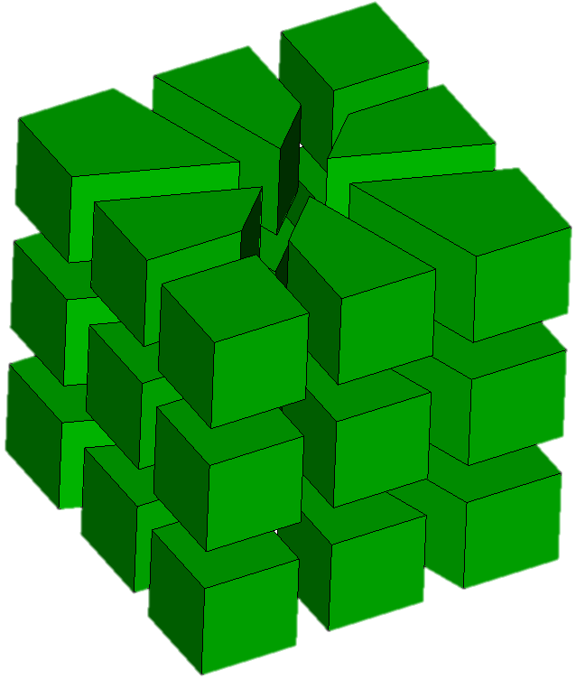
Mesh Surgery – Column Collapse
CUBIT™ Command syntax:
Column collapse node <node_id> <opposite_node_id>
Node 17
Node 23
For Example: Column collapse node 17 23
Notes:
16
16

Slide 17
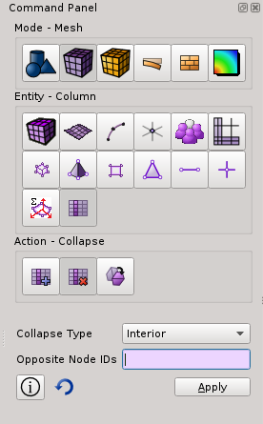
Mesh Surgery – Column Collapse - GUI
In the Command Panel Select:
1. Mode - Mesh
2. Entity – Column
3. Action - Collapse
1
2
3
Notes:
17

Slide 18
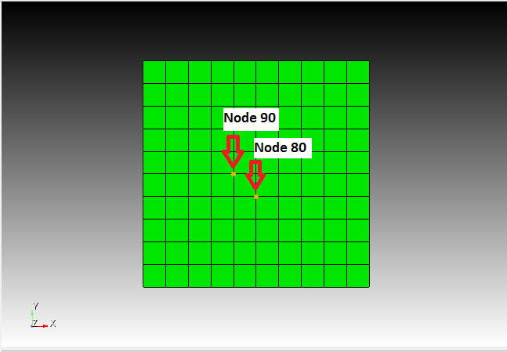
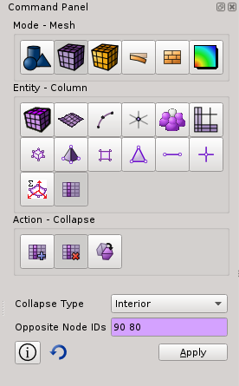
Mesh Surgery – Column Collapse - GUI
1. Click Cursor in the Opposite Node Box
2. Select the nodes you wish to collapse
3. With two opposite nodes in the Opposite Node ids Box click Apply
Notes:
18

Slide 19
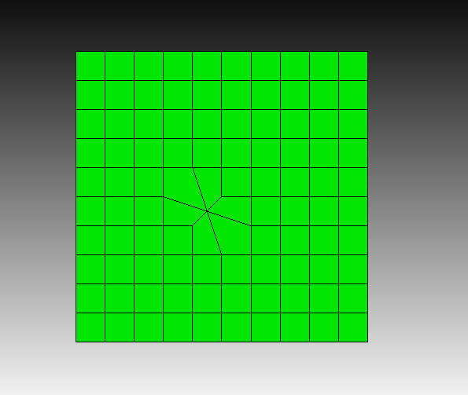
Mesh Surgery – Column Collapse - GUI
Collapse Result
Column Collapse Result
Notes:
19

Slide 20
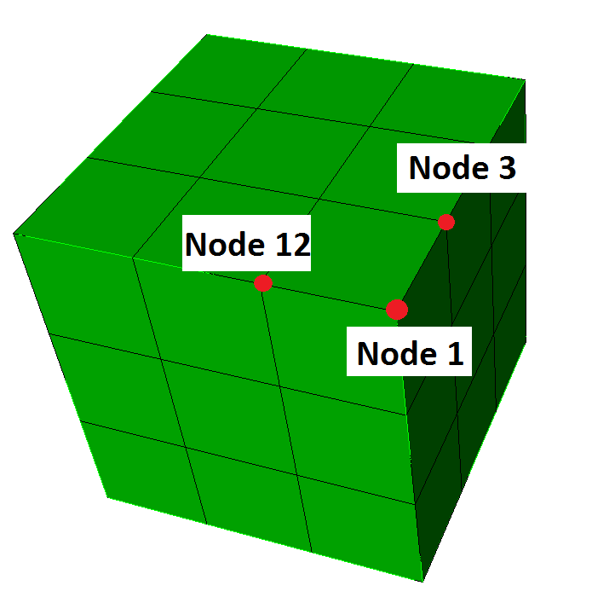
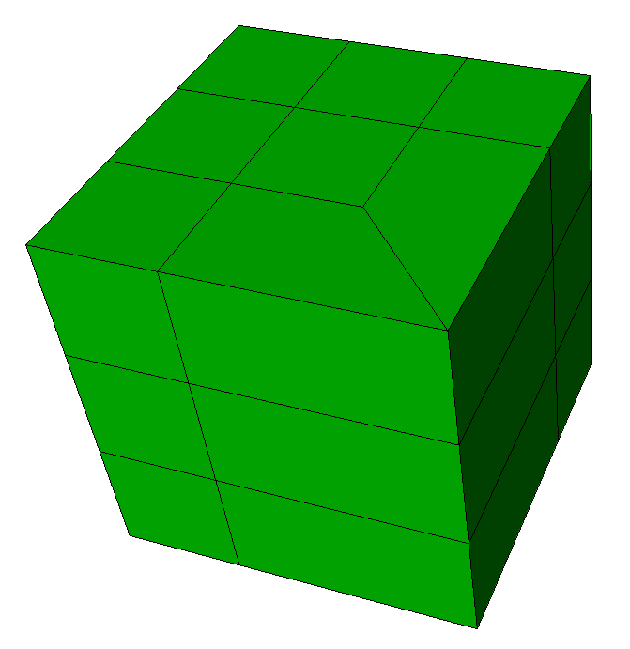
Mesh Surgery – Column Collapse Boundary
CUBIT™ Command syntax:
Column collapse boundary node <node id> <corner node id> <node_id>
Node 17
Node 23
Collapses adjacent boundary nodes onto corner node
For Example: column collapse boundary node 3 1 12
Notes:
20
20

Slide 21
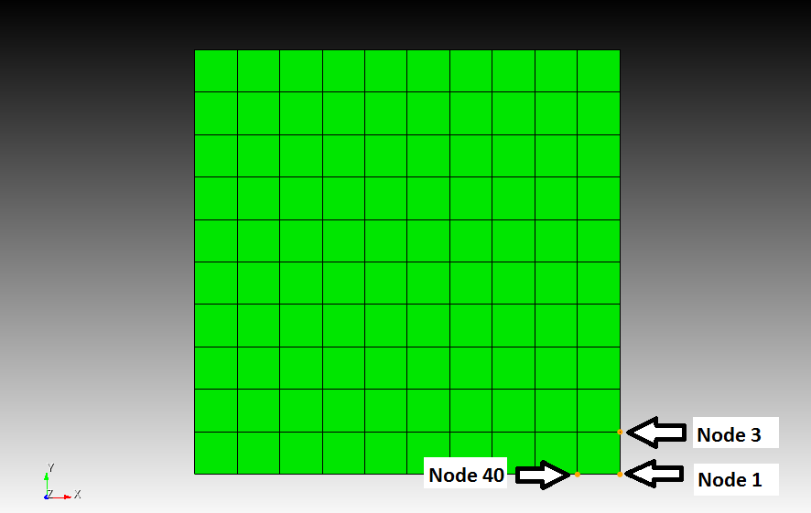
Mesh Surgery – Column Collapse Corner - GUI
To collapse at a corner, select boundary node, corner node, boundary node, in that order, where the two boundary nodes must be opposite one another. Hit the apply button.
Notes:
21

Slide 22
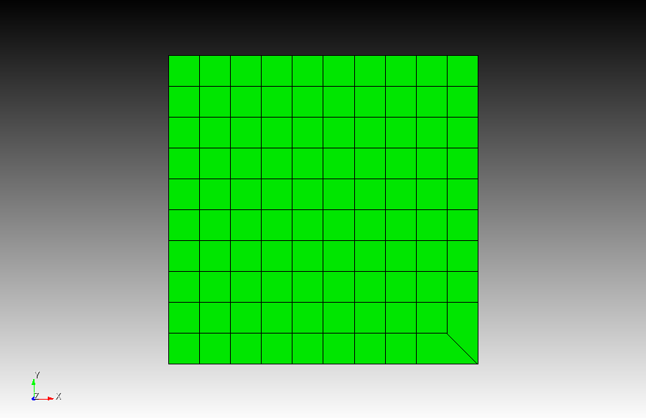
Mesh Surgery – Column Collapse Corner - GUI
Collapse Corner Result
Notes:
22

Slide 23
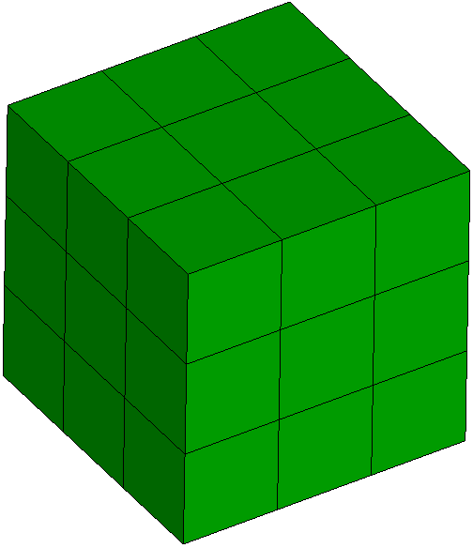
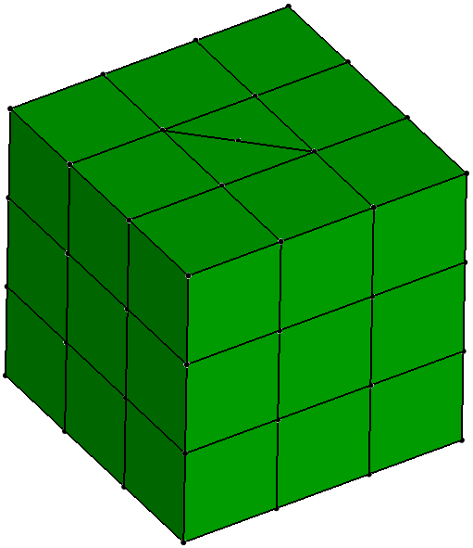
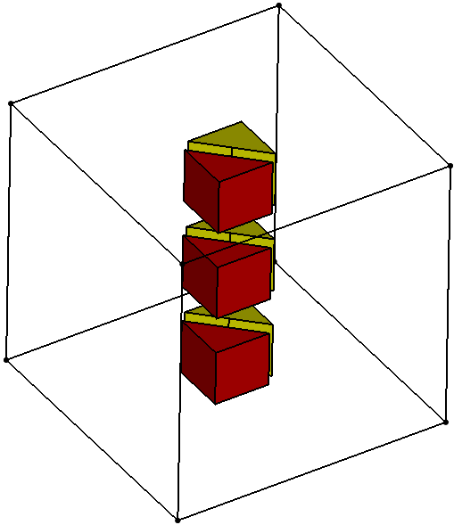
Mesh Surgery – Column Split
CUBIT™ Command syntax:
Column split node <node_id> <opposite_node_id>
Node 17
Node 23
Creates 2 columns of very poorly shaped flat hexes. Always an intermediate step, followed by something else.
For Example: Column split node 17 23
Notes:
23
23

Slide 24
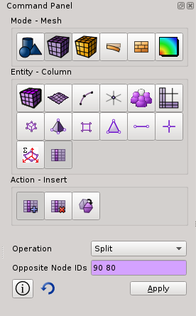
Mesh Surgery – Column Split - GUI
1
In the Command Panel select:
1. Mode – Mesh
2. Entity – Column
3. Action – Insert
4. Operation – Split
2
3
4
Notes:
24

Slide 25
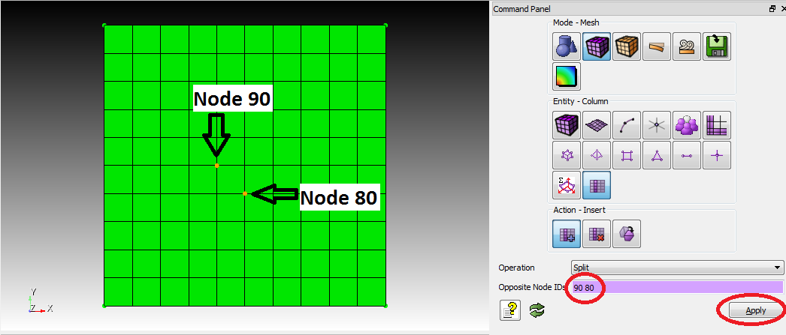
Mesh Surgery – Column Split - GUI
To Use the Split command:
-click cursor in Opposite Node ID box
-Selection two opposite nodes on the meshed volume.
-Hit the apply button.
Notes:
25

Slide 26
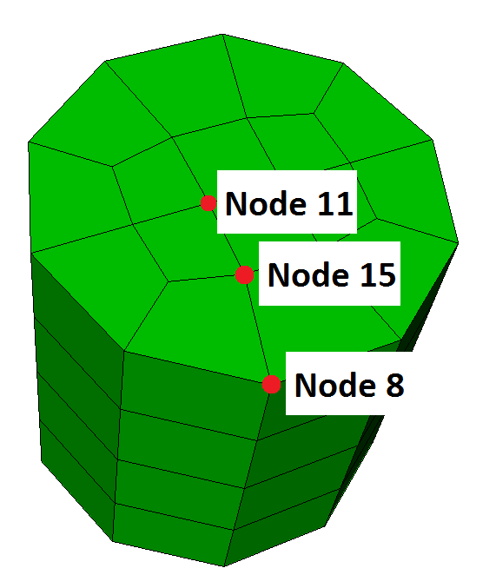
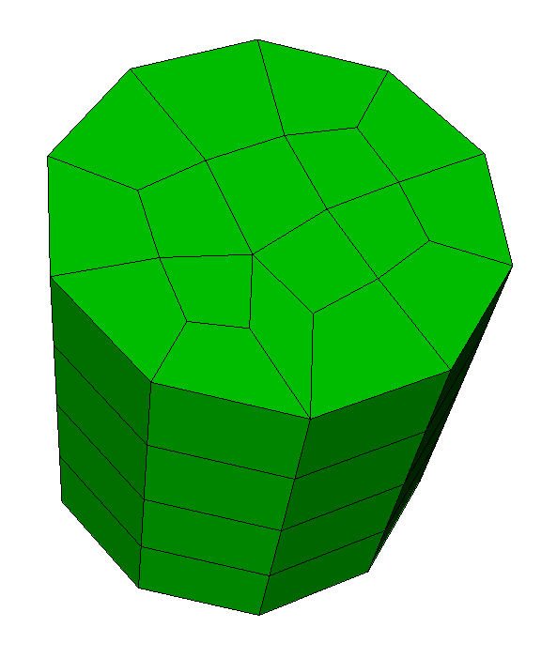
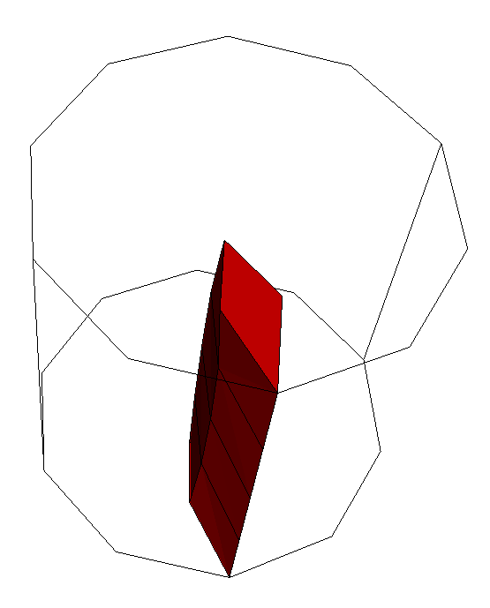
Mesh Surgery – Column Open
CUBIT™ Command syntax:
Column open node <center node id> <orientation node ids>
For Example: Column open node 11 15 8
Center node must be 4-valent and orientation nodes must be opposite one another about center node.

Slide 27
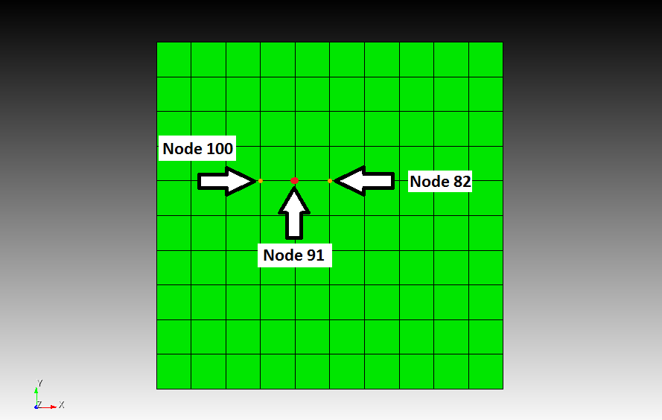
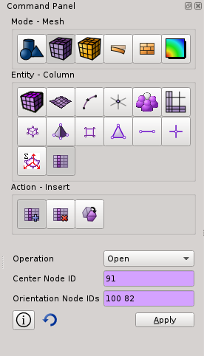
Mesh Surgery – Column Open - GUI
To perform a column open operation, specify 'open' as the operation, then select a center node, then two orientation nodes, which must be opposite one another about the center node. Hit the apply button.
Notes:
27

Slide 28
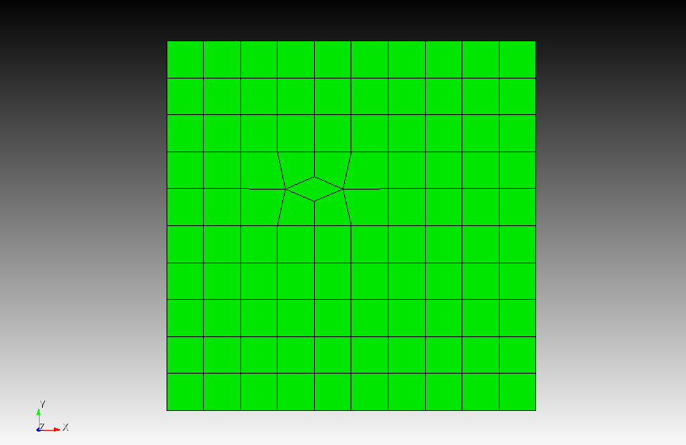
Mesh Surgery – Column Open - GUI
Column Open Result
Notes:
28

Slide 29
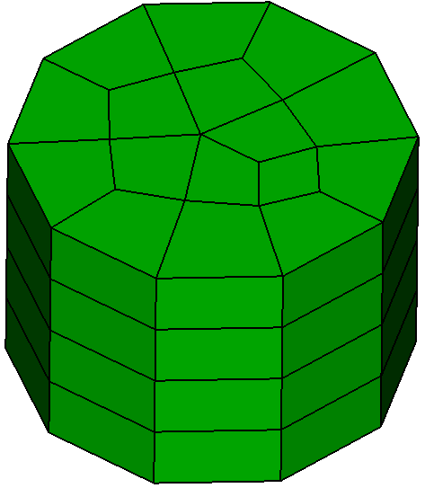
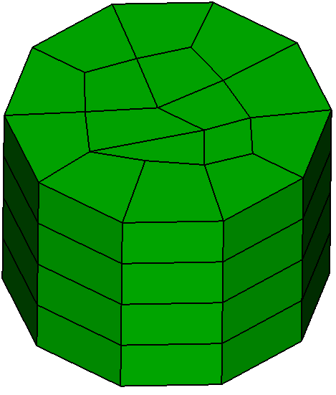
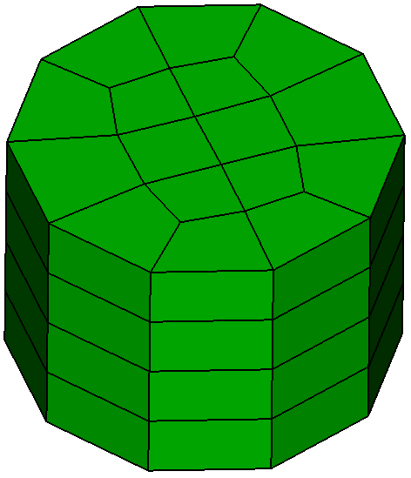
Mesh Surgery – Column Swap
CUBIT™ Command syntax:
Column swap node <node_id1> <node_id2> <node_id3> <node_id4>
Node 17
Node 23
Node 24
Node 18
Smoothing is then performed to smooth out topology
For Example: Column swap node 17 18 23 24
Column swapping is performed on 2 adjacent columns, which must be parallel along their entire path.
Notes:
29
29

Slide 30
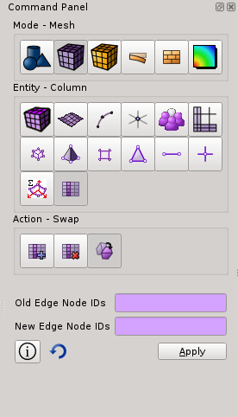
Mesh Surgery – Column Swap - GUI
In the Command Panel Select:
1. Mode – Mesh
2. Entity – Column
3. Action – Swap
1
2
3
Notes:
30

Slide 31
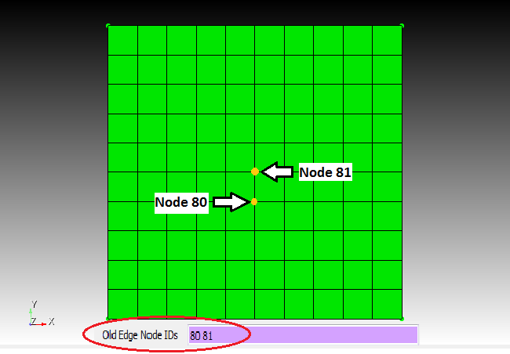
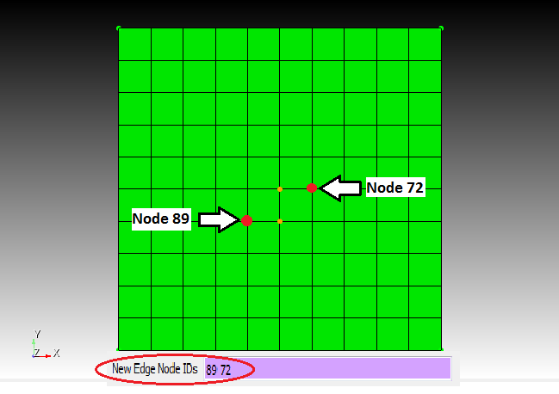
Mesh Surgery – Column Swap - GUI
In the Command Panel move the cursor into the Old Edge Node box.
Then select two end nodes of the old edge.
Next select the New Edge Node box. In the picture on the right the yellow dots represent the nodes chosen for old edge nodes. Select the two nodes that you want to connect with the new edge.
When you have two correct nodes in both the new and old edge boxes hit apply.
Notes:
31

Slide 32
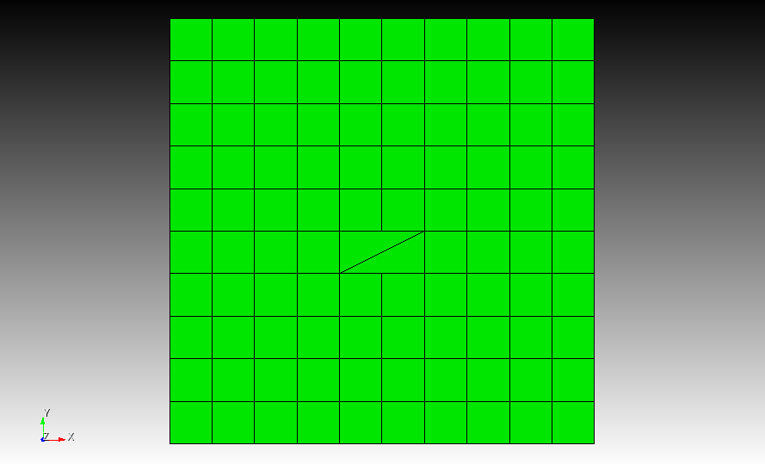
Mesh Surgery – Column Swap - GUI
Column Swap
Result
Notes:
32

Slide 33
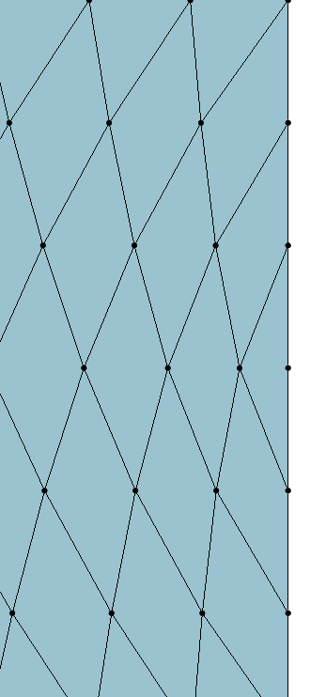
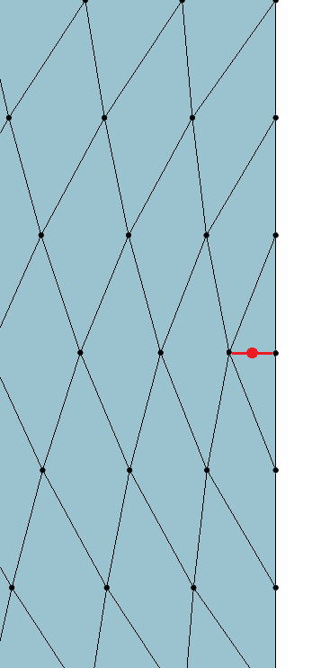
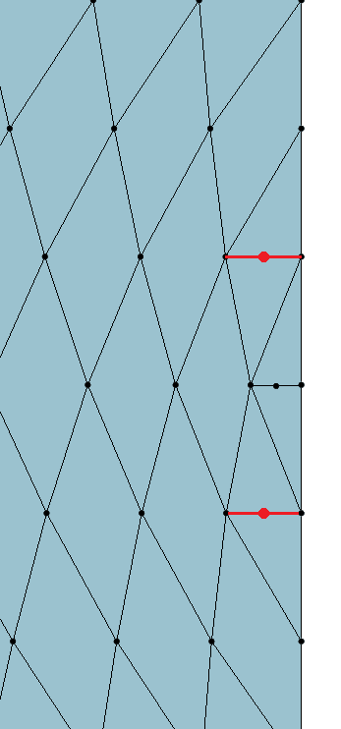
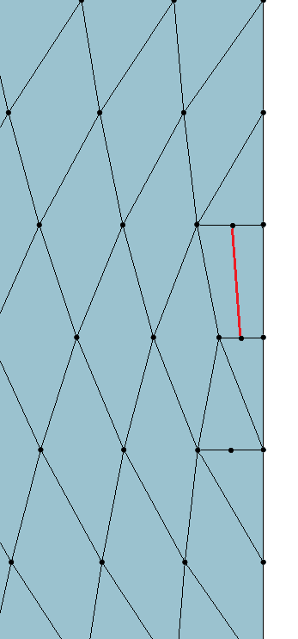
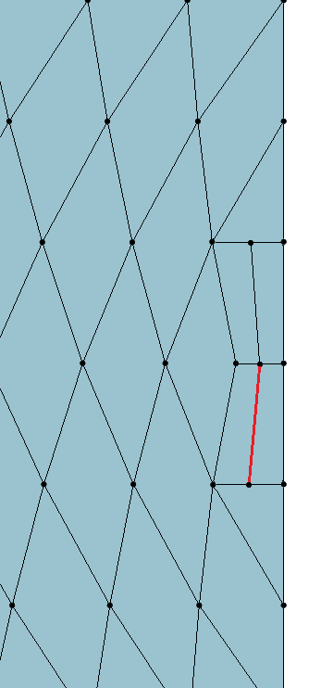
Mesh Surgery
Several Column operations are normally done in sequence to effect a change.
Min Scaled Jacobian: 0.0
Min Scaled Jacobian: 0.47
Initial Mesh
Step 1: split column
Step 2: Split two more columns
Step 3: Swap between two columns
Step 4: Another swap between two columns
Step 5: Smooth to improve element quality.
Notes:
33
33

Slide 34
Exercise 3 – Mesh Surgery
Create a cylinder and mesh it with hexes
Practice using the column collapse operation on a few columns:
Column collapse node <node_id> <opposite_node_id>
Practice using the column split operation on a few columns:
Column split node <node_id> <opposite_node_id>
Practice using the column swap operation on a few pairs of adjacent columns:
Column swap node <node_id1> <node_id2> <node_id3> <node_id4>
Try these operations on columns that are parallel to sweep direction as well as perpendicular to sweep direction.
Remember to smooth the mesh after performing a column operation.
Do column operations always improve element quality?
Notes:
34

Slide 35
Hex Mesh Sheets
A hex mesh sheet is a continuous layer of hexes in a mesh.
You can draw a sheet of hexes with the following command: draw sheet edge <id> mesh, where the id refers to an edge which is in the sheet.
Note: draw sheet is a developer command. Use the follow command before using: set dev on
An example hex mesh
A sheet perpendicular to the sweep direction
A sheet parallel to sweep direction
Notes:
35
35

Slide 36
Exercise 4 – Drawing Sheets
Create a cylinder and mesh it with hexes
Pick different edges on the boundary of the mesh and draw the corresponding sheets.
Use the Cubit command: draw sheet edge <id> mesh
After drawing a sheet, type “draw edge all add” so you can see the sheet with respect to the rest of the model.
After visualizing one sheet, reset the display by hitting F5 so you can pick and draw a different sheet.
Notes:
36

Slide 37
Inserting sheets
Bad aspect ration
Rotational pave-sweep
Insert sheets to refine only the bad aspect ratio elements without refining the good
Aspect ratio of element is OK

Slide 38
Inserting sheets
Aspect ratio OK
Rotational pave-sweep
Insert sheets to refine only the bad aspect ratio elements without refining the good
refine mesh sheet [intersect] {node <ids>|edge <ids>}
{factor <value>|greater_than <value>}
[smooth] [in volume <ids> [depth <num_layers>]]
Aspect ratio of element is OK

Slide 39
Inserting sheets
In the Command Panel Select:
1. Mode – Mesh
2. Entity – Volume
Action – Refine
Drop Down – Mesh Sheet Refinement
1
2
3
4

Slide 40
Exercise 5
Import ACIS file “ra.sat”
Mesh the volume with hexes using default options
Use the mesh sheet refine command to refine high aspect ratio elements greater than 1.0
Use the Cubit command: draw sheet edge <id> mesh to display at least one of the inserted sheets

Slide 41
Pillowing
Pillowing adds a new sheet of hex elements to the mesh, surrounding a user specified set of hexes called the shrink set.
Cubit Syntax: pillow hex <range> through surface <range>
Notes:
41

Slide 42
Pillowing
Mesh surgery solution
Geometric constraints force this element to have a 180 degree angle.
Pillowing solution
Cubit Command:
pillow hex all through surface all except surface 1 2
Notes:
42

Slide 43
Pillowing
You can access pillowing either from the GUI or from the command line.
The set of hexes to pillow should be strategically chosen to improve element quality.
The list of hexes can often be quite long. It is often easiest to create a group of the hexes you want to pillow.
1
2
3
4
Advanced options not covered in this tutorial
Notes:
43

Slide 44
Pillowing
The through surfaces define how the sheet will exit the boundaries of the mesh.
Surface 3
Only the through surfaces are modified
Surface 2
Surface 1
Through surfaces 1, 2, and 3
Through surfaces 2, and 3
Through surfaces 1 only
Notes:
44

Slide 45
Exercise 5 - Pillowing
Create a brick “create brick x 10 y 10 z 10”
Mesh it with hexes
Pillow different groups of hexes experimenting with different through surfaces.
Notes:
45

Slide 46
Exercise 6 - Pillowing
Open the model “example20_1.cub”
Do an element quality check. What is the lowest element quality? Why does it have poor element quality?
Use the pillow surface option in the GUI to insert a pillow adjacent surfaces 34 and 35
After pillowing use smoothing to improve the quality of the mesh. How high can you raise the quality?
Draw the new sheet of hexes you added using the ‘draw sheet edge <id> mesh’ command. It should look like the drawing below.
Notes:
46

Slide 47
Example 7: Pillowing
Open the model “example19_3.cub”
Use pave-sweep to mesh the volume using the sweep direction indicated
Insert a layer of hexes using the pillow command to improve the mesh quality
Sweep
Direction

Slide 48
Exercise 8 - Pillowing
Open the model “example20_2.cub”
Do an element quality check. What is the lowest element quality? Why does it have poor element quality?
Create a group of hexes (called “topillow”) to use as the shrink set for pillowing.
Add all hexes in volume 5 to “topillow”
Add all hexes that have one of their faces in surface 31 to “topillow”
Decide which surfaces to use as the through surfaces. (hint, you should have 2)
Put in the pillow (hint: pillow hex in topillow through surface X Y)
After pillowing use smoothing to improve the quality of the mesh. How high can you raise the quality? With a combination of smoothing schemes, you should be able to get the Minimum Scaled Jacobian: 0.5.
Draw the new sheet of hexes you added using the ‘draw sheet edge <id> mesh’ command. It should look like the drawing below.
Notes:
48

Slide 49
Exercise 9
Open the file “ImproveQuality.cub”
Perform a quality check to see where the bad elements are?
Why do you think there are bad elements?
Use a combination of uniting meshed volumes, smoothing, and mesh surgery to improve the quality of the mesh. You should be able to get the Min Scaled Jacobian metric up to about 0.24, from the original value of 0.03.
Avoid just uniting all of the volumes together. Instead, choose just a subset of the volumes in the model to do the unite meshed volumes command on.
Notes:
49

