Slide 1
CUBIT™ Fast-Start Tutorial
19. Vertex Types and Sweeping
Notes:
Type: FORMAL - Training
Title: Cubit 200 Training
SAND Number: SAND2020-0682 TR
Contact: Hensley,Trevor Michael

Slide 2
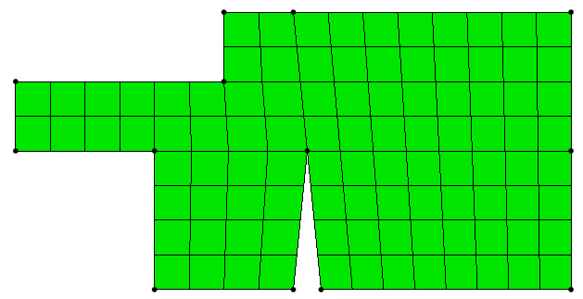
Vertex Types
e
s
e
e
c
r
s
e
c
e
e
e
End (e) = ~90⁰, Side (s) = ~180⁰,
Corner (c) = ~270⁰, Reversal (r) = ~360⁰
Vertex types determine how many quads will be around the vertex
Vertex types help determine the “flow” of a swept mesh (see example 1)
Types are assigned by comparing the interior angle against vertex type angle ranges
The user can force specific vertex types even if the angle does not match the specified type

Slide 3
Example 1: CUBIT™ Automatically Chooses Vertex Types
Mesh using the default scheme:
open “example19_1.cub”
mesh vol 1
draw surf 1 vertex type
Force a swept mesh:
delete mesh
Reset vol 1
volume 1 scheme sweep source surface 12 target surface 17
mesh volume 1
draw surf 1 vertex type

Slide 4
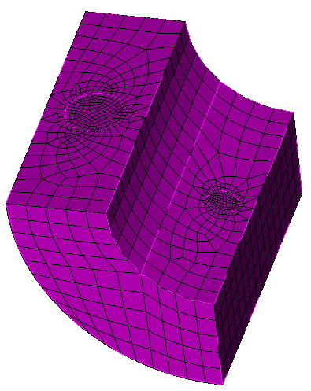
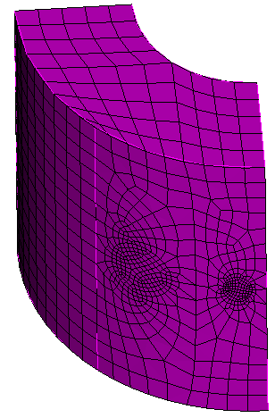
Example 2: Forcing Vertex Types for Sweeping
Manually set vertex types to generate the mesh on the left for “example19_2.cub”.
Hints:
Use the default mesh size for the volume
Use a size of .03 and .05 for the small and large circular surfaces respectively
There are 4 source surfaces and 1 target surface
Command for setting vertex types is
“surf <id> vert <id> type <type_name>”

Slide 5
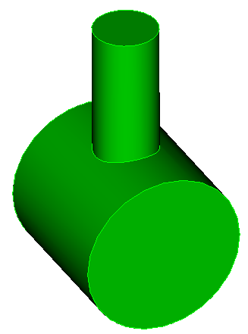
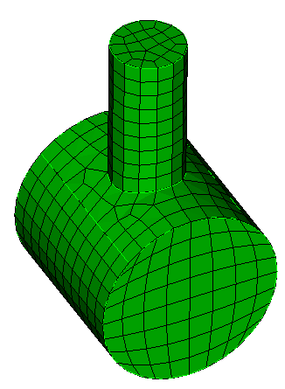
Example 3: Using Surface Splits and Vertex Types for Sweeping
Use only curve splits, surface splits, and setting vertex types (no webcutting!) to generate a hex mesh for “example19_3.cub”.

Slide 6
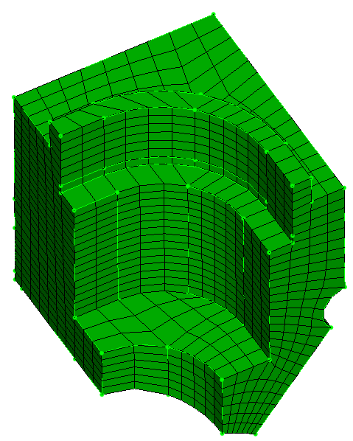
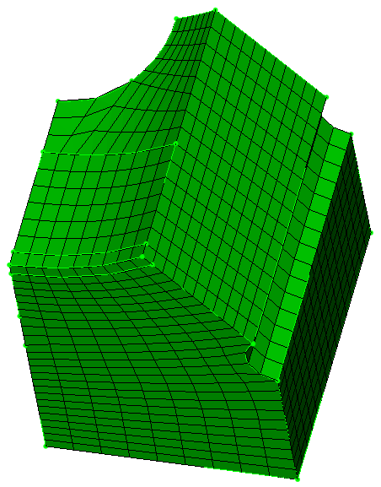
Example 4: Using Vertex Types for Sub-mapping
Use only manually set vertex types to generate a sub-mapped hex mesh for “example19_4.cub”.

