Slide 1
CUBIT™ Fast-Start Tutorial
18. Local Mesh Modification
Notes:
Type: FORMAL - Training
Title: Cubit 200 Training
SAND Number: SAND2020-0682 TR
Contact: Hensley,Trevor Michael

Slide 2
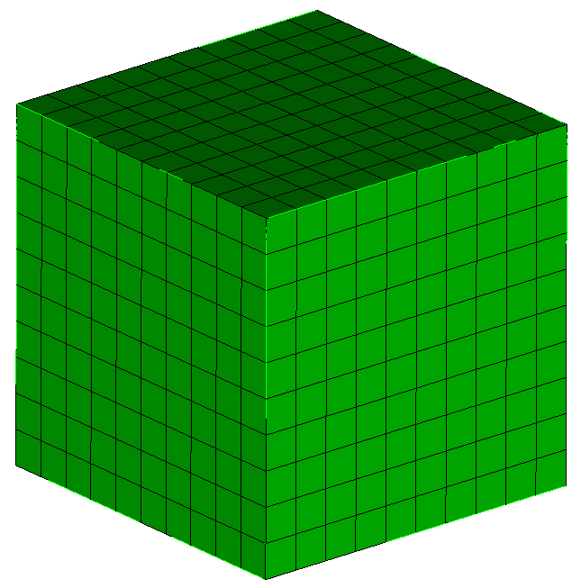
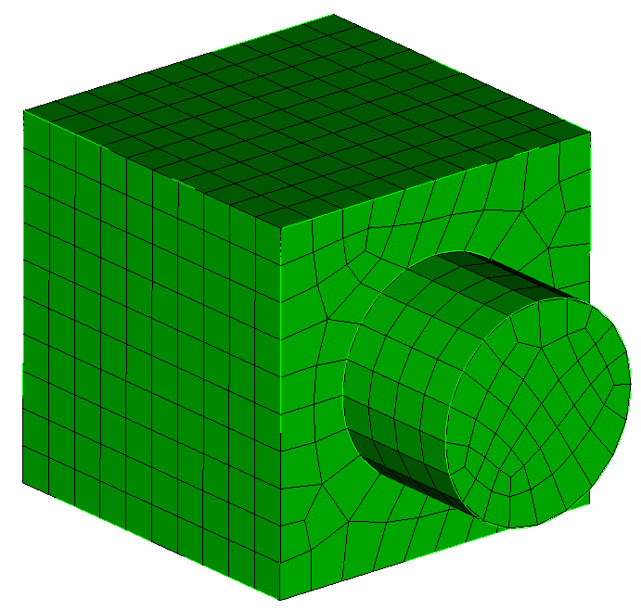
Example 1: Single Volume Modifications
Initial geometry and mesh:
brick x 10
mesh vol 1
Geometry modification requires remeshing:
delete mesh
cylinder radius 3 height 4
vol 2 move 0 0 7
unite vol 1 2
reset vol 1 (to remove corrupt mesh settings)
mesh vol 1

Slide 3
Example 1 Notes
In general it is not good to do geometry modifications when mesh is present—thus, delete mesh first.
Mesh settings (size, interval counts, schemes, …) from meshing geometry previously will often be affected by modifying the geometry and as a result become corrupt—thus, the “reset volume” command in the previous example.

Slide 4
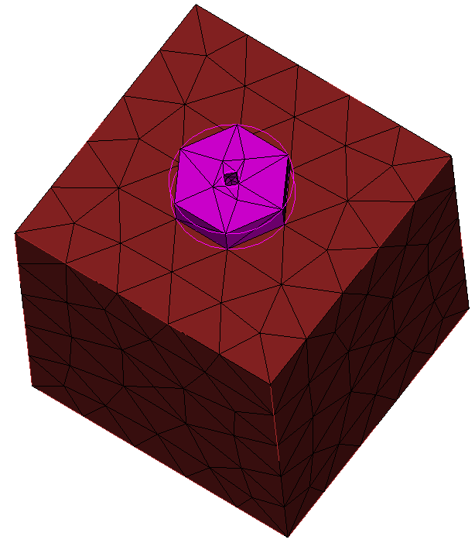
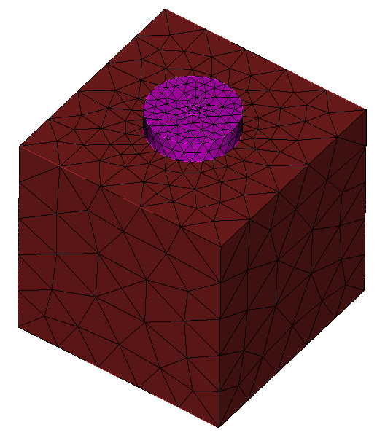
Example 2: Mesh Re-sizing
Fix the size on the small hole:
reset
open “example2_coarse_mesh.cub"
delete mesh vol 3 prop
curve 46 45 interval default #remove hard setting
curve 46 45 size 0.3
mesh vol 3
Fix the size on the bolt head to be a little bit finer:
draw surf is_merged
draw curve all add
unmerge vol 3
delete mesh vol 3 prop
draw vol 3
draw vol 7
delete mesh curve 24 37 23
vol 3 size 0.5
mesh vol 3
merge all
mesh vol 7

Slide 5
Example 2 Notes
Local tet remeshing is much easier than local hex remeshing
When remeshing is localized to entities that are not merged typically only a single volume must be remeshed (first part of exercise)
To get the desired size on the bolt it was necessary to unmerge the bolt from the block and mesh it independently first
Deleting the mesh on curves of the block also forced deleting of mesh on higher order entities (surfaces and volume)

Slide 6
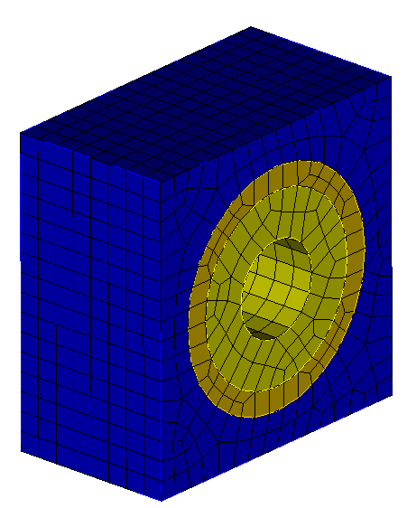
Example 3: Grouping Neighbors
reset
open "example3.cub"
group "adj_vols" add vol in surf in vol 2
draw adj_vols
disp
unmerge vol 2
delete mesh vol 2 prop
cylinder radius 2 height 10
sub 11 from 2
reset vol 2
merge adj_vols
mesh vol 2

Slide 7
Example 3 Notes
Extended parsing using the “surf in vol…” syntax makes it easy to group neighbors that share either surfaces, curves, or vertices with the volume being modified
When modifying hex meshes you will generally want to remerge before meshing to inherit existing meshes from neighbors

