Slide 1
CUBIT™ Fast-Start Tutorial
17. Id-less Journal Files
Notes:
Type: FORMAL - Training
Title: Cubit 200 Training
SAND Number: SAND2020-0682 TR
Contact: Hensley,Trevor Michael

Slide 2
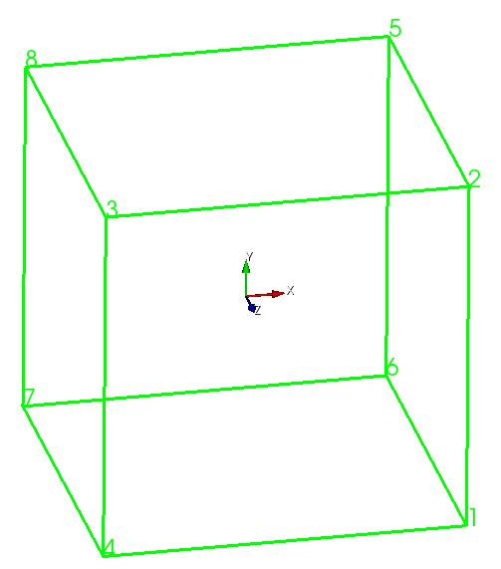
ID-less References
Create a brick with size 1:
“brick x 1”
Vertex 3:
“list vertex 3”
Coords: -0.5 0.5 0.5
“list vertex at -0.5 0.5 0.5”
What do you get?
Try “list vertex at 0.1 0.1 0.1”
What do you get? Why?3

Slide 3
ID-less References
ID-less references use a spatial location to identify an entity rather than an ID
An ID-less reference is usually made up of the spatial “center” of the entity plus an ordinal value
Ordinal value is used to differentiate between two entities with the same “center” location
“vertex ( at -0.5 0.5 0.5 ordinal 1 ordered )”

Slide 4
ID-less Commands
[set] Journal IDless [On|Off|Reverse]
“journal idless on” sets the current journaling mode to journal using idless references
“journal idless off” sets the current journaling mode to journal using ids
“journal idless reverse” causes cubit to journal using ids even if the commands issued are idless
“journal idless” reports what the current mode is

Slide 5
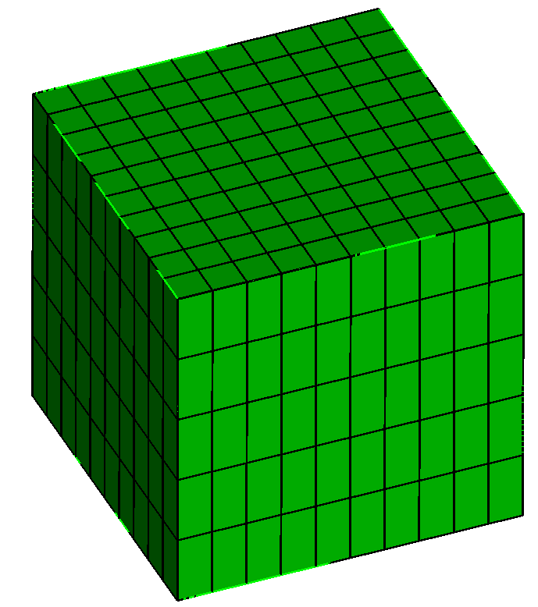
Exercise 1
Convert the following commands to ID-less commands:
Reset
Brick x 10
Curve 1 3 5 7 interval 5
Mesh vol 1
Solution:
Reset
Journal idless on
Record “tmp.jou”
<copy/paste the above commands to cubit>
Record stop
<open “tmp.jou” in an editor>

Slide 6
Converting Entire Journal Files
From ID to IDless:
journal idless on record "my_idless.jou" playback "my_journal.jou" record stop journal idless off
From IDless to ID:
journal idless reverse record "new_id_based.jou" playback "my_idless.jou" record stop journal idless off

Slide 7
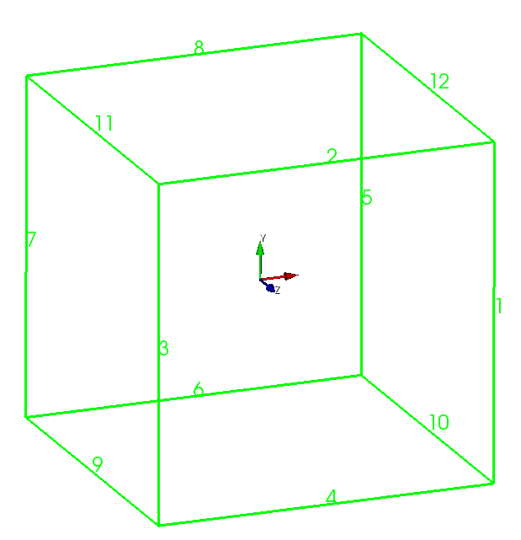
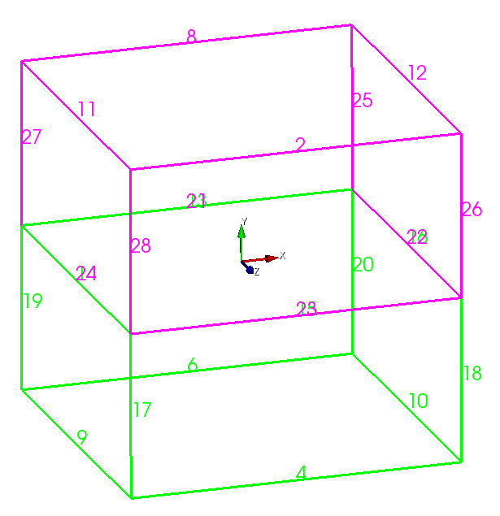
Problems with IDs
Commands that once worked…
Reset
Brick x 10
Curve 1 3 5 7 interval 5
Mesh vol 1
…may be broken by upstream geometry modifications…
Reset
Brick x 10
Webcut vol 1 yplane ## New command
Curve 1 3 5 7 interval 5 ## No longer works!
Mesh vol 1

Slide 8
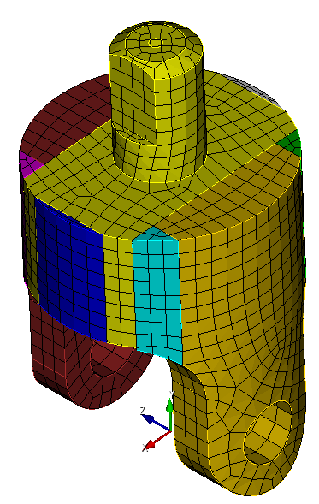
Exercise 2
Play exercise2.jou back line by line to see how the part is meshed
Customer decides an extra hole is needed and does this at the beginning of exercise2_with_hole.jou. Step through the rest of exercise2_with_hole.jou to see what problems it causes. Try fixing the “remove surface…” command to use the new ids (experience the pain of changing ids and then move onto the next step ☺).
Convert exercise2.jou to be an idless journal file and then insert the same new commands introduced in step #2 for the extra hole and then run the rest of the journal file.

Slide 9
Fixing an ID-less Journal File
Suppose the following command used to work but is now broken…
“Mesh vol (at 0.5 2 3.7 ordinal 1 ordered)”
One way to determine which volume should now go in the command is to draw the location in the broken command to see if there is a volume whose center is close to the old location. This can be done using the “draw location x y z” command.
“Draw location 0.5 2 3.7”

Slide 10
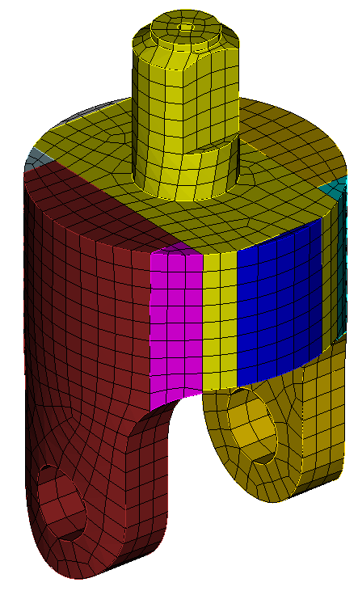
Exercise 3
Exercise3.jou is the solution journal file for Exercise 2 but with another geometry modification added at the top of the journal file to lengthen the cylindrical protrusion. Play the commands line by line until you find one that doesn’t work. Why doesn’t it work anymore?
Modify exercise3.jou so that it works correctly.
Hint: Modifying the command
“mesh vol (at 0 0 0 ordinal 1 at 1 1 1 ordinal 1 ordered)”
so that the second volume is now volume 4 would look like this:
“mesh vol (at 0 0 0 oridnal 1 ordered) vol 4”

