Slide 1
CUBIT™ Fast-Start Tutorial
16. CUBIT™ Scripting with Python
Notes:
Type: FORMAL - Training
Title: Cubit 200 Training
SAND Number: SAND2020-0682 TR
Contact: Hensley,Trevor Michael

Slide 2
Python
Python is a well established, widely accepted scripting language. Its use within the engineering community continues to grow.
Abaqus
Paraview
PyTrilinos
Some useful links to learn Python
Official website: www.python.org
Getting started: www.python.org/about/gettingstarted/
Tutorial (2.7): docs.python.org/2/tutorial/index.html
Reference (2.7): docs.python.org/2/reference/index.html
Notes:
Students who are not familiar with python are advised to become so. This course includes a tutorial, just enough to get started and to understand the examples. Python is an integral part of the Claro Framework. Claro uses Python to load, unload, and otherwise manage all components.

Slide 3
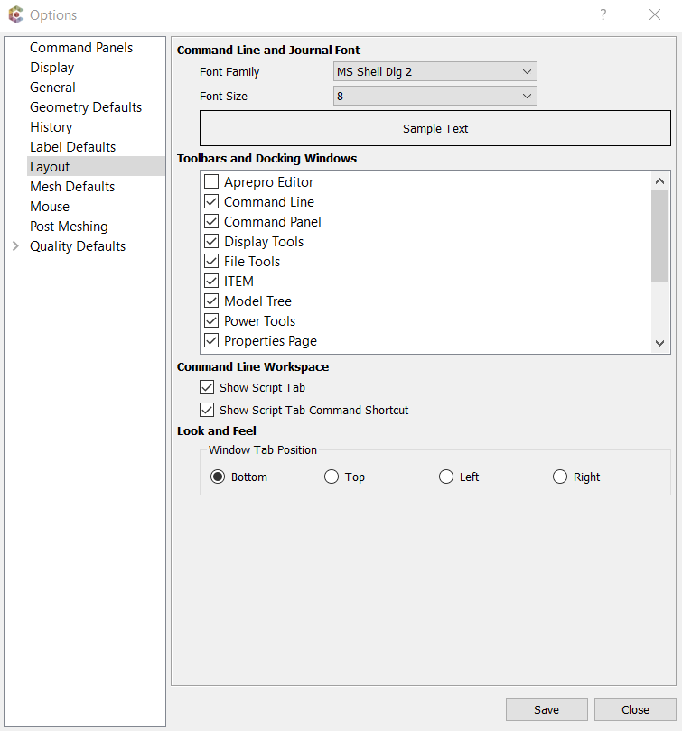
Enabling the Script Tab from CUBIT™
Select Tools – Options – Layout
Select “Show Script Tab”
The script tab will allow direct entry of python commands.

Slide 4
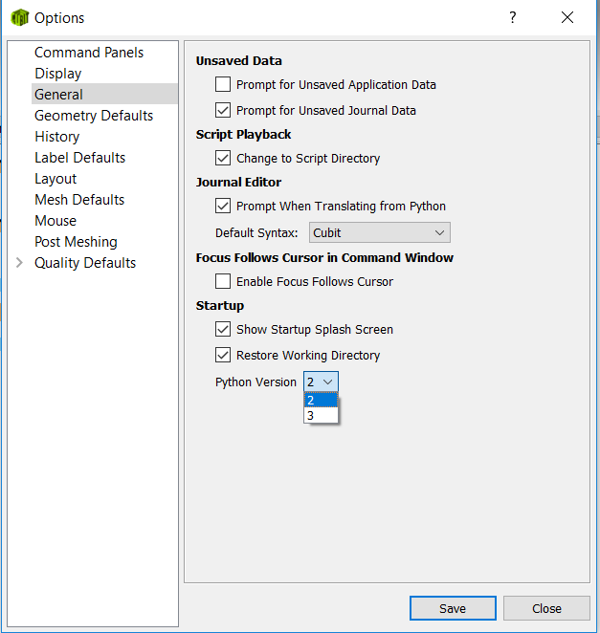
Python Version 2 and 3
Python version can be set in Options > General
Changes after restart

Slide 5
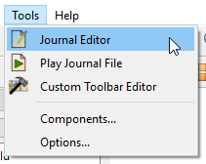
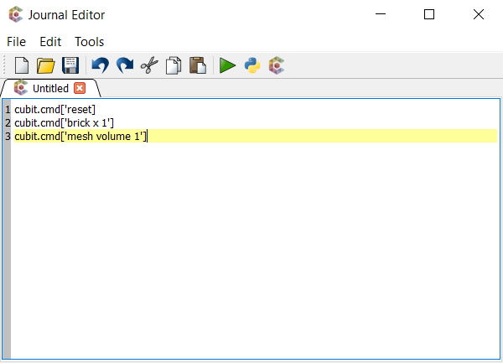
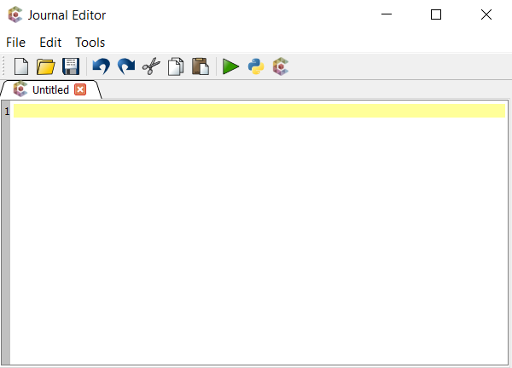
Python Journal Editor
Access from menu
Access from toolbar
Journal Editor with Cubit commands
Journal Editor with Python commands

Slide 6
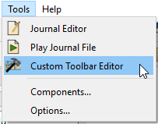
Custom Toolbars
Access editor from menu
Access editor from toolbar
Execute a series of Python commands at the click of a button
Execute a Python script
Example custom toolbar

Slide 7
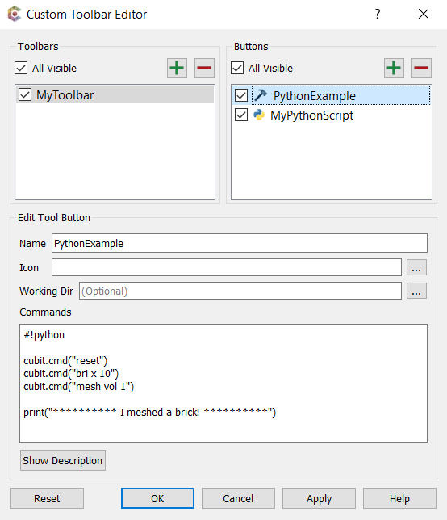
Custom Toolbars
Create a custom tool button and write Python commands in place, just like Cubit commands.
Include “#!python” to tell CUBIT™ to interpret the commands as Python (necessary for this tool only)

Slide 8
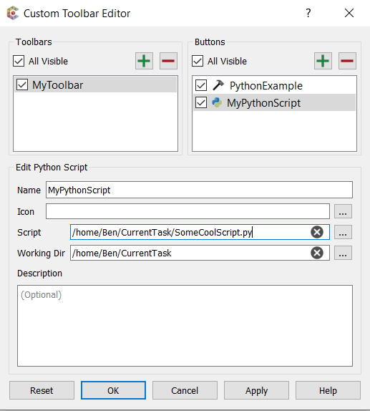
Custom Toolbars
Create a Python script button and choose a Python script to run.
Select the Python script to run.
(Optional) choose a directory from which to run the script.

Slide 9
CUBIT™ Interface
Primarily, a query interface into CUBIT™
double mesh_size = cubit.get_mesh_size(“volume”, 22);
Accessible via C++ or python
Change state by using cubit.cmd(“ ... “)
import cubit
cubit.cmd(“create brick x 10 y 10 z 10”)
cubit.cmd(“mesh volume 1,3,5”)

Slide 10
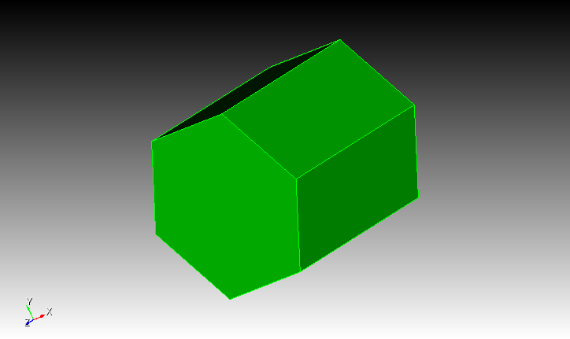
Example 1
Open ngon.py with the journal editor
Play the script
Change the parameters
Play again

Slide 11
Example 2
In the CUBIT™ Journal File (Python) Editor
Create a python script to compute and print the minimum shape metric for all volumes. Consider using the following CubitInterface functions
get_entities()
get_volume_hexes()
get_quality_value()

Slide 12
Example 2
all_vols = cubit.get_entities("volume")
min_quality = 1.0
for vol in all_vols:
vhexes = cubit.get_volume_hexes(vol)
for hex in vhexes:
q = cubit.get_quality_value("hex", hex, "shape")
if q < min_quality:
min_quality = q
print 'min quality = ', min_quality

Slide 13
CUBIT™ Extended Interface
Create “pythonic” objects in CUBIT™
Reduce (but not eliminate) id issues
bri = cubit.brick(10,5,3)
cyl = cubit.cylinder(12,2,2,2)
vols = cubit.subtract([cyl], [bri])
v = vols[0].volumes()
v[0].mesh()
print dir(v[0])
print v[0].id()
v[0].mesh()

Slide 14
Python Help
Documentation
Help Manual online or built-in Appendix/Python
Python prompt
print dir(object)

Slide 15
Black Box Cubit
CUBIT™ can also be run from inside python
Set your environment variable PATH to include the installed CUBIT™ libraries
You may also need to set PYTHONPATH to the same place
Run Python
import cubit
cubit.init([“”])
cubit.cmd(“brick x 10”)
This allows you to run CUBIT™ programatically and interact with other tools.

Slide 16
Example 3
In the native operating system using python 2.7
Copy your script from Example 2 to a text editor
Add the ability to import a mesh
Make the script you created above run on the hexes in the mesh and print the result

Slide 17
Example 3
#!python
import sys
# add Cubit libraries to your path
sys.path.append('/Applications/Cubit-15.4/Cubit.app/Contents/MacOS')
import cubit
cubit.init(['cubit','-nojournal'])
cubit.cmd('import mesh geom "mesh.g"')
all_vols = cubit.get_entities("volume")
min_quality = 1.0
for vol in all_vols:
vhexes = cubit.get_volume_hexes(vol)
for hex in vhexes:
q = cubit.get_quality_value("hex", hex, "shape")
if q < min_quality:
min_quality = q
print 'min quality = ', min_quality
Notes:
On Windows
sys.path.append("C:\\Program Files\\Cubit-beta\\bin")
In CMD window
“C:\Python27\python.exe” filename.py

Slide 18
Customization
CUBIT™ can support some additions to the GUI
Add new menu items
Add new dialogs
Cannot currently add new control panels
Use PyQt5 - a python interface to Qt
from PyQt5 import QtGui
QtGui.QMessageBox.question(None, “Title”, “Hello”)
Notes:
Qt4 and Qt5 are incompatible. If you already have scripts that use PyQt4, they will need to be upgraded to use PyQt5.

