Slide 1
CUBIT™ Fast-Start Tutorial
15. Customization and
Scripting
Notes:
Type: FORMAL - Training
Title: Cubit 200 Training
SAND Number: SAND2020-0682 TR
Contact: Hensley,Trevor Michael

Slide 2
Cubit Command Language
CUBIT™ is controlled by a command language.
This command language is generated by the GUI and passed into the CUBIT™ processor.
The commands can be journaled to a file to provide a history.
The commands are echoed to the command window in the GUI.
User help via email is frequently given in terms of CUBIT™ commands.
CUBIT™ can be programmed via this language.
It is VERY helpful to understand the syntax and power of the CUBIT™ command language.

Slide 3
CUBIT™ Command Syntax
Case is not significant.
Commands may be abbreviated to the smallest unique set of characters.
A hash mark (#) denotes a comment.
Lines may be continued to the next line with a backslash (\) at the end of the continuing line.

Slide 4
CUBIT™ Command Syntax
Commands are typically verb noun format.
mesh volume 1
Mesh is the verb acting on volume 1.
However . . . the verb may be optional
cylinder radius 2 height 10
This is really
create cylinder radius 2 height 10
The create keyword is optional.
Or . . . the syntax is just noun first
surface 1 scheme pave
This is frequently used when setting an attribute on an entity.
Notes:
Each time you enter a command, the command is written to a journal file.
Playback
Options determine what commands are journalled, or how

Slide 5
CUBIT™ Help
Help on any command can be obtained by typing a question mark (?) or an ampersand (&) at the command line prompt.
The question provides completion options of a given command.
The ampersand gives matches of command words ignoring the order of the words.
You can also type help and give any command word for help on that command.
Notes:
Each time you enter a command, the command is written to a journal file.
Playback
Options determine what commands are journalled, or how

Slide 6
Specifying Ranges
CUBIT™ commands frequently take a range of ids and there are specific keywords that can be used in ranges.
draw surface all
list volume 1 to 10 by 2
volume all except 3 scheme auto
Notes:
Each time you enter a command, the command is written to a journal file.
Playback
Options determine what commands are journalled, or how

Slide 7
Ranges by Topology Traversal
Ranges may also be specified by topological relations.
Draw vertex in volume 1
List volume in vertex 1 and 10
Curve in surf 2 size .3
If there is a range of entities on both sides of the “in” keyword the result is the intersection of the ranges.
curve 1 to 3 in body 4 to 8 by 2
Topology may include mesh entities
draw node in surface 3
draw surface in node 3
Notes:
Each time you enter a command, the command is written to a journal file.
Playback
Options determine what commands are journalled, or how

Slide 8
Specifying by Criteria
CUBIT™ allows specification by a given criteria using the “with” keyword.
{Entity_Type} With {Criteria}
draw curve with length <1
locate surface with is_meshed = false
highlight volume with not is_virtual
The boolean operators “and” “or” control how statements are combined.
node with x_coord > 10 And y_coord > 0
The “of” keyword returns the value of a single entity for comparison
list curve with length < length of curve 5 ids

Slide 9
Operators on Criteria
Boolean operators
= or ==
<=, >=, <, >
<> not equal
draw surface with x_max <= 3
draw volume with z_max <>12.
Arithmetic operators
+, -, *, /
draw surface with length * 3 + 1.2 > 10

Slide 10
Criterion Functions
ID | ID of an entity
Length | The length of a curve or edge
Is_Meshed | Whether an entity is meshed
Is_Spline | Whether an entity is a NURBS
Dimension | Topological dimension of entity
X_Coord, Y_Coord, Z_Coord | The x, y, or z coordinate of the centroid of an entities bounding box.
X_Min, Y_Min, Z_Min | The x, y, or z coordinate of the minimum extent of the entity's bounding box
Is_Merged | If the entity is merged
Notes:
Each time you enter a command, the command is written to a journal file.
Playback
Options determine what commands are journalled, or how

Slide 11
Criterion Functions
Is_Virtual | Whether an entity is virtual geometry.
Has_Virtual | An entity "has_virtual" if it is virtual itself, or has at least one child virtual entity
Is_Real | An entity "is_real" if it has at least one real (non-virtual) entity.
Num_Parents | specify geometry entities with a specified number of parent entities. May be used to find "free curves" where num_parents=0 or non-manifold curves where num_parents>2.
Notes:
Each time you enter a command, the command is written to a journal file.
Playback
Options determine what commands are journalled, or how

Slide 12
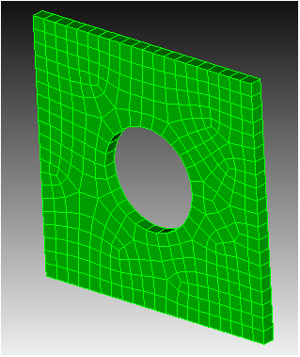
Example 1
bri x 10
cyl radius 2 z 12
subtract vol 2 from vol 1
vol 1 size .5
vol 1 scheme auto
mesh vol 1
draw surf in vert 1
draw hex in node in surf 11

Slide 13
Introduction to Aprepro
Aprepro = Algebraic Pre-Processor
A built-in miniature programming language
Purposes
Parameterize a journal file
Error checking
Other control logic

Slide 14
Basic Aprepro Syntax
Aprepro expressions are wrapped in curly braces
Aprepro evaluated first, results inserted into command:
Brick X {10}
And
Brick X {5*2}
Are Equivalent To
Brick X 10

Slide 15
Aprepro Variables
Variables are named values
Names are case sensitive
Variable type is Number or String
Defined in a comment
# {width=2} # {r=“radius”}
Use anywhere in a command, as if you typed the variable’s value:
brick x {width} cylinder height 5 {r} 10

Slide 16
Aprepro Equations
Variable values can be changed
# {x = 1} # {x = 5} ##This will give you a warning # {x++} ## Increase value of x by one, no warning
To avoid warnings, make variable name start with an underscore (_), or use ++ and --
Convenient way to see variable value: comment command
Comment x User Comment: 6
Comment “x is” x “and y is” y
User Comment: x is 6 and y is <undefined>

Slide 17
Operators
Addition: +
Subtraction: -
Multiplication: *
Division: /
Power of: ^ ({3^2} = 9)
Math expressions can be used just about anywhere:
# {width=3} # {width_squared = width^2} brick x {width} y {width*2} z {width_squared}

Slide 18
Aprepro Functions
Functions calculate or look up values
Function name followed by parameters in parentheses
The number and type of parameters depends on the function
Commas between parameters
Parameters can be constants, variables, or equations
# {errs = get_error_count()} # {x=cos(PI/2)} # {vertex_x = Vx(30)} # {random_number = rand(10, 20)} # {Print ("Hello World")}
CUBIT Basic Tutorial

Slide 19
Types of Functions
Math Functions
sin(num), cos(num), asin(num), etc…
sqrt(num), exp(num), log(num), ln(num), etc…
String Manipulation Functions
Quote(string), toupper(string), tolower(string)
Utility Functions
Print(string), PrintError(string)
FileExists(string), HasFeature(string)

Slide 20
Types of Functions
Session Information Functions
NumVolumes(), NumSurfaces(), etc…
get_error_count(), set_error_count(num)
Entity Information Functions
Vx(num), Nz(num)
Radius(num), SurfaceArea(num), Length(num)
CurveAt(num, num, num), HexAt(num, num, num)

Slide 21
Flow Control
Three types of flow control
If statements
Loops
Include files

Slide 22
If Statements
If true then do
#{if (my_variable < 3)} brick x 3 #{else} brick x {my_variable} #{endif}
If defined and not zero then do
#{ifdef(make_a_brick)} brick x 3 #{endif}
If zero or not defined then do
#{ifndef(skip_the_brick)} brick x 3 #{endif}

Slide 23
Loops
Repeat a set of commands some number of times
# Create 3 bricks #{Loop(3)} brick x 10 #{EndLoop}
Loop statement accepts numbers or variables, but not expressions
# {Loop(3)} #OK # {Loop(x)} #OK # {Loop(x-1)} #error

Slide 24
Example 1 – Accurate Coordinates
Create Vertex {Vx(1) + 10} {Vy(1)} {Vz(1)}

Slide 25
Example 2 – Name that Volume
Create Brick Width 1
Create Brick Width 1
Volume 2 move x 1
Volume {Id("volume")-1} Name "Martha"
Volume {Id("volume")} Name "George"

Slide 26
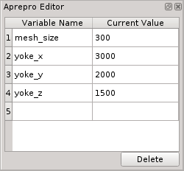
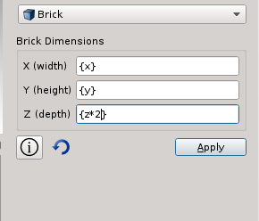
Aprepro in the GUI
Use aprepro anywhere in the GUI, using curly braces
See and modify aprepro variables in the power tools

Slide 27
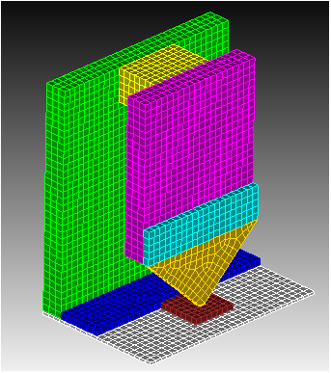
Example 3 - Write Head
Play ‘write_head.jou’
Open the file in the journal editor
Change the values of yoke_x, yoke_y, yoke_z
Play the journal file again.
Set hex_mesh = 1
Play again
Set up a new variable for the return pole z
Why doesn’t everything move correctly?

