Slide 1
CUBIT™ Fast-Start Tutorial
14. Geometry Cleanup for Contiguous Assembly Meshing
Notes:
Type: FORMAL - Training
Title: Cubit 200 Training
SAND Number: SAND2020-0682 TR
Contact: Hensley,Trevor Michael

Slide 2
Outline
Why contiguous meshes? How does CUBIT™ enforce contiguous meshes between parts?
What are the difficulties with generating contiguous assembly meshes?
What are the tools in CUBIT™ that will help me identify problems early?
What are the tools in CUBIT™ that will help me fix the problems?

Slide 3
Outline
Why contiguous meshes? How does CUBIT™ enforce contiguous meshes between parts?
What are the difficulties with generating contiguous assembly meshes?
What are the tools in CUBIT™ that will help me identify problems early?
What are the tools in CUBIT™ that will help me fix the problems?

Slide 4
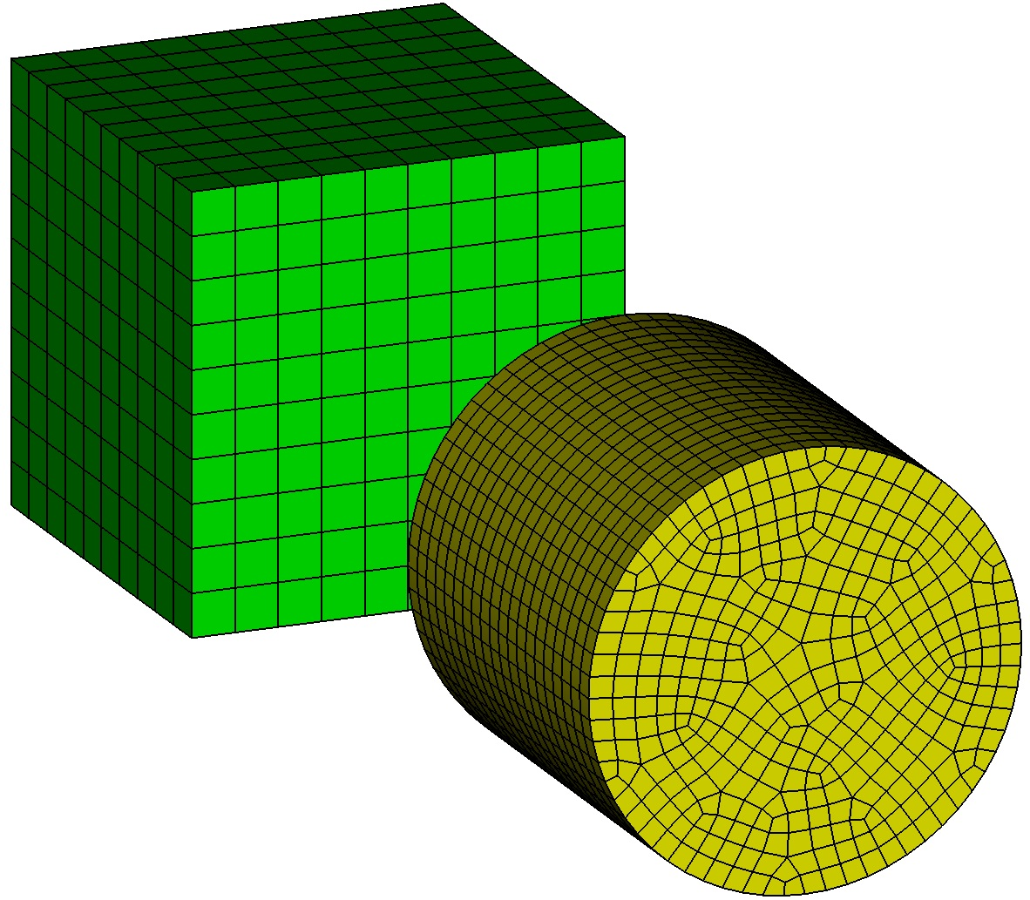
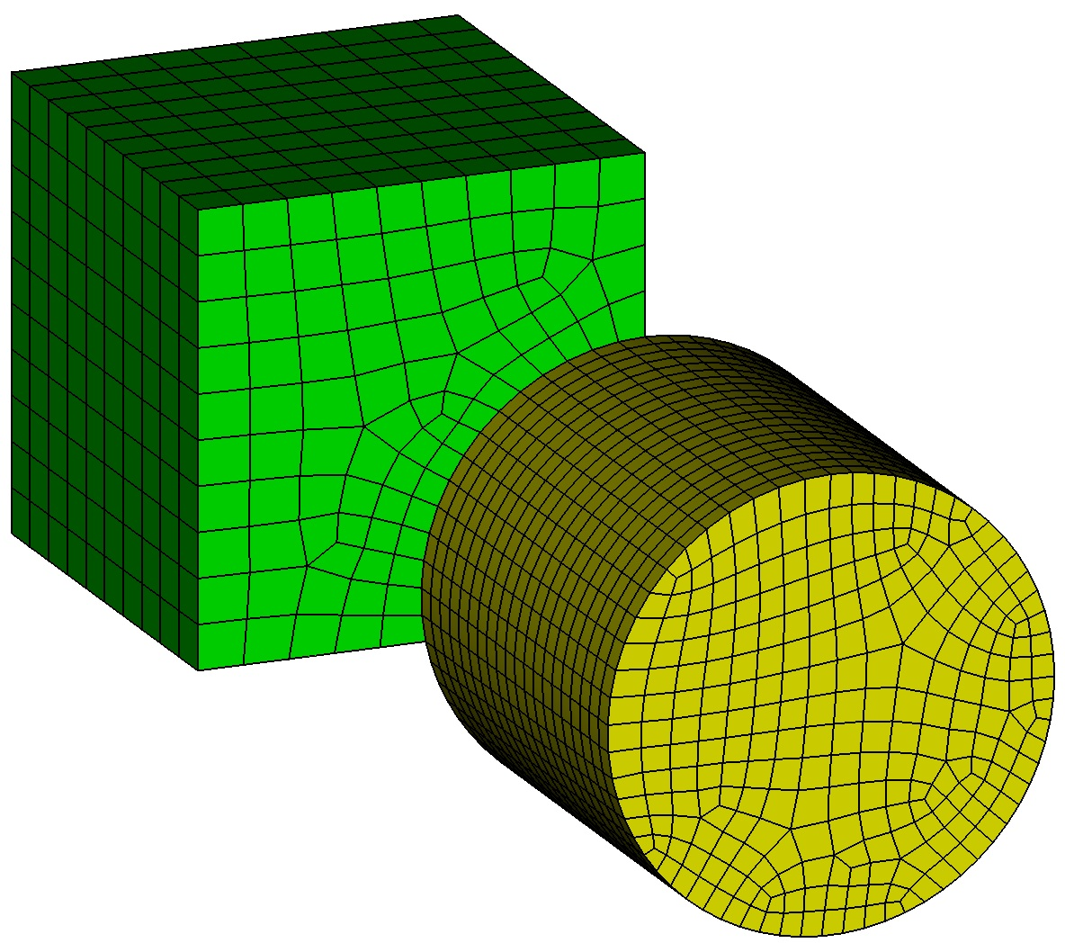
Contiguous Meshing Exercise 1
1
Import “contig_exercise1.sat”.
Mesh the brick with size 1 and the cylinder with size 0.5.
Issue the command “draw surf 1 8” at the command line and notice mesh is not contiguous.
Delete the mesh.
Imprint and Merge the two volumes.
Set the sizes on the volumes again as imprinting may have destroyed mesh settings.
Mesh the volumes.
Issue the commands “draw vol 1” and “draw vol 2” to examine the mesh where the volumes touch.
Turn mesh visibility off, turn surface labels on, and reissue the commands “draw vol 1” and “draw vol 2”. Notice the shared surface at the interface between the 2 volumes.
2
3
4
5
6
7
8
9

Slide 5
Outline
Why contiguous meshes? How does CUBIT™ enforce contiguous meshes between parts?
What are the difficulties with generating contiguous assembly meshes?
What are the tools in CUBIT™ that will help me identify problems early?
What are the tools in CUBIT™ that will help me fix the problems?

Slide 6
Contiguous Meshing Exercise 2
1
Import “contig_exercise2.sat”.
Mesh the brick with size 1 and the cylinder with size 0.5.
Issue the command “draw surf 1 8” at the command line and notice mesh is not contiguous.
Delete the mesh.
Imprint and Merge the two volumes.
Mesh the volumes with the same sizes as before.
Did you get what you expected? Why or why not?
Was there any output from CUBIT™ that would have led you to expect the result you got?
Hint: Measure the distance between vertex 1 and surface 8.
2
3
4
5
6
7
8
9

Slide 7
Gaps
ACIS has a default geometric tolerance of 1e-6.
Entities are not “touching” unless they are closer than 1e-6
Positions in space are not considered the same unless they are closer than 1e-6
Imprinting in CUBIT™ is done using the ACIS kernel and therefore will not occur unless entities are within 1e-6 of one another
Continue with Exercise 2 by doing the following: move the cylinder 9.9e-6 in the negative z direction (the measured distance between vertex 1 and surface 8 should then be 1e-7), delete the mesh, redo the imprint/merge, and remesh.
10

Slide 8
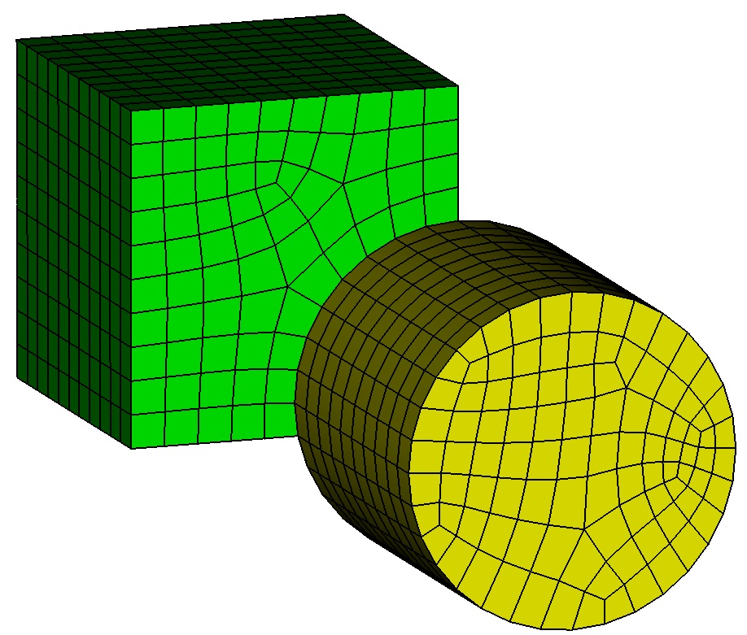
Contiguous Meshing Exercise 3
1
Import “contig_exercise3.sat”.
Imprint and Merge the two volumes.
Mesh the volumes.
Did you get what you expected? Why or why not?
Was there any output from Cubit that helps shed light on the results?
Hint: zoom in on vertex 14.
2
3
4
5
6

Slide 9
Volume Overlaps
Volume overlaps usually create sliver geometry during imprinting
ACIS has some “remove sliver” capabilities to prevent slivers but only within some tolerance

Slide 10
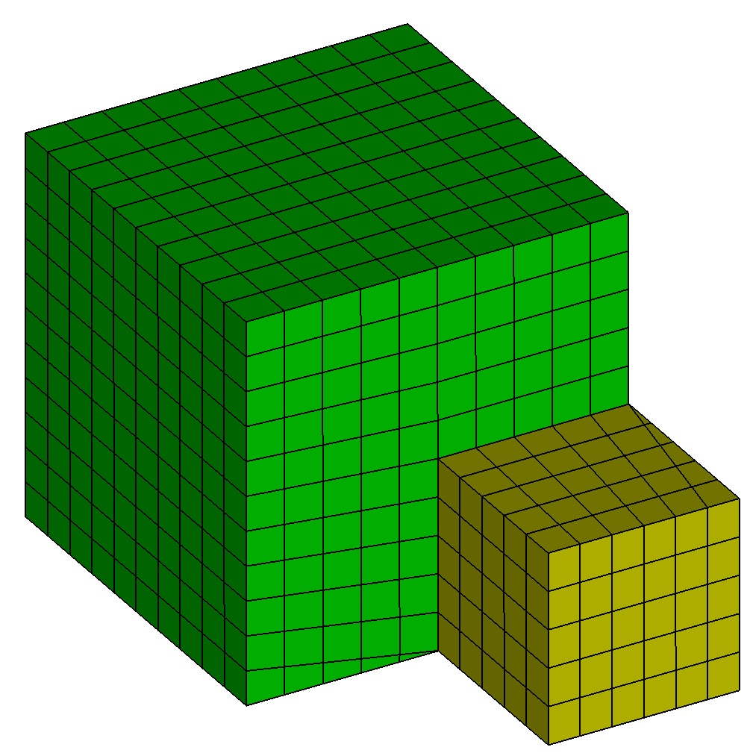
Contiguous Meshing Exercise 4
1
Import “contig_exercise4.sat”.
Imprint and Merge the two volumes.
Mesh the volumes.
Did you get what you expected? Why or why not?
Was there any output from CUBIT™ that helps shed light on the results?
Hint: zoom in on vertex 15.
2
3
4
5

Slide 11
Summary of Adverse Effects of Gaps/Overlaps/Misalignments
Gaps
Imprinting fails to occur and volumes are not connected at a merged surface
Volume Overlaps
Imprinting creates sliver geometry resulting in poor mesh quality
Volume Misalignments
Imprinting creates sliver geometry resulting in poor mesh quality
Unfortunately, if you haven’t looked for these problems you may not even know they exist until your analysis run!

Slide 12
Outline
Why contiguous meshes? How does CUBIT™ enforce contiguous meshes between parts?
What are the difficulties with generating contiguous assembly meshes?
What are the tools in CUBIT™ that will help me identify problems early?
What are the tools in CUBIT™ that will help me fix the problems?

Slide 13
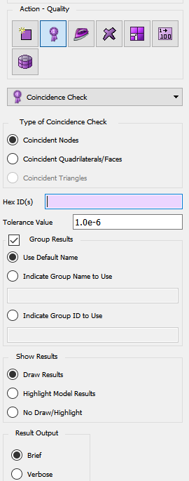
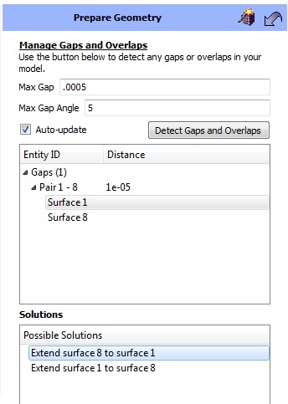
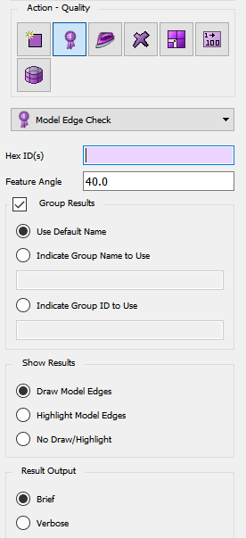
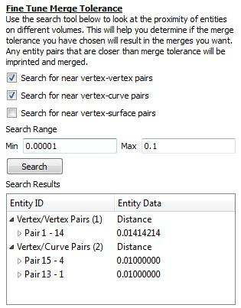
Tools for Finding Gaps/Overlaps/Misalignments
Manage Gap/Overlap Tool in ITEM
Coincidence Check
Model Edge Check
Proximity Check Tool in ITEM
Imprint/Merge + Overlapping Surface Check in ITEM
Imprint/Merge + Small Feature Tool in ITEM
Geometry-Based
Mesh-Based
(post meshing)

Slide 14
Tools for Finding Gaps/Overlaps/Misalignments
Manage Gap/Overlap Tool in ITEM
Coincidence Check
Model Edge Check
Proximity Check Tool in ITEM
Imprint/Merge + Overlapping Surface Check in ITEM
Imprint/Merge + Small Feature Tool in ITEM
Geometry-Based
Mesh-Based
(post meshing)

Slide 15
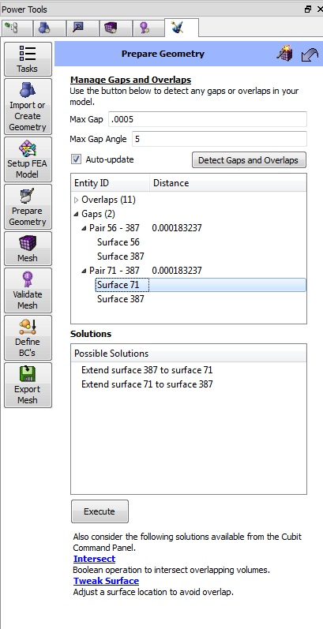
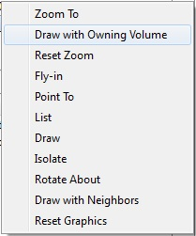
ITEM Manage Gap/Overlap Tool
Tolerance specifying how large a gap to consider in the results.
Tolerance specifying how far off of parallel pairs of surfaces can be when being considered in the gap analysis.
Button to execute search.
Toggle whether to rerun search after a solution is executed.
Lists of Gaps and Overlaps that were found in the model.
Right-click menu for viewing a particular gap/overlap.
Possible solutions for fixing the gap/overlap
This tool can be found in ITEM by clicking on the following links: Prepare Geometry->Connect Volumes->Manage Gaps/Overlaps
Button to execute a solution.
Links to other possible solutions.

Slide 16
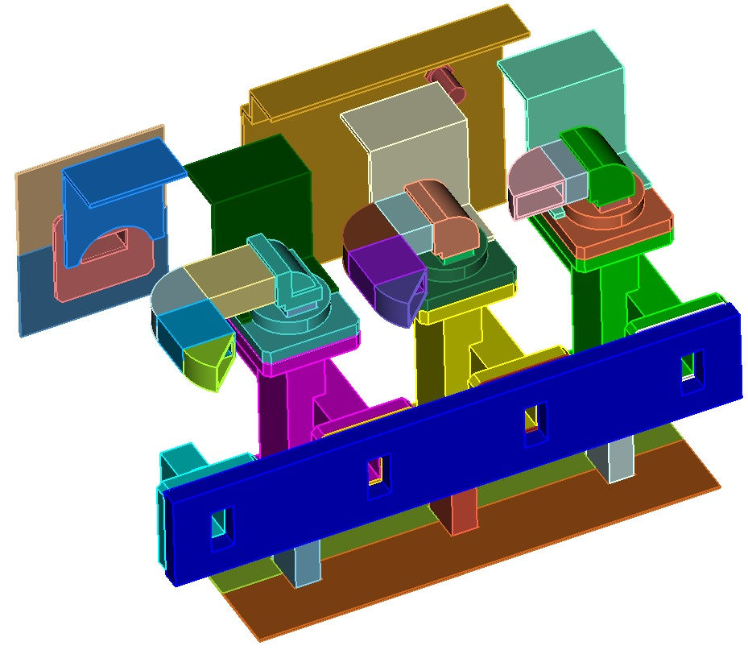
Contiguous Meshing Exercise 5
1
Import “contig_assembly.sat”.
Go to the Manage Gap/Overlap Tool in ITEM (Prepare Geometry->Connect Volumes->Manage Gaps and Overlaps).
Search for gaps/overlaps using the default settings.
Use the right-click menus to visualize the gaps and overlaps.
2
3
4

Slide 17
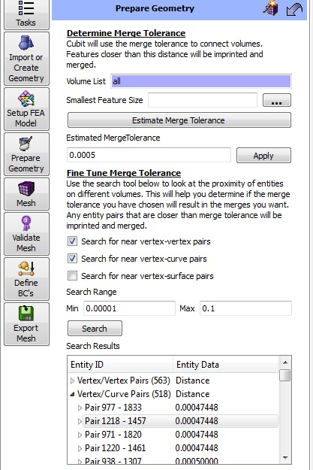
ITEM Proximity Check Tool
The ITEM proximity check tool is found in the “Determine Merge Tolerance” panel in ITEM. The proximity check tool allows you to search for entities that are with close proximity to one another to identify potential problems.
List of volumes to include in proximity checks.
Filter toggles to determine which entities will be considered during the proximity check.
Proximity distance range within which to search.
Button to start search.
Proximity pairs that were located.
This tool can be found in ITEM by clicking on the following links: Prepare Geometry->Connect Volumes->Imprint and Merge->”…” button next to the merge tolerance.

Slide 18
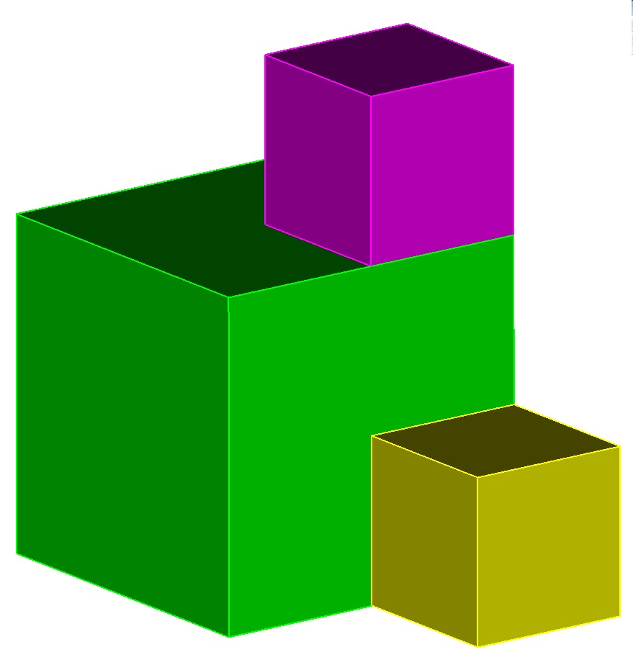
Contiguous Meshing Exercise 6
1
Import “contig_exercise6.sat”.
Go to the Proximity Check tool by following the links: Prepare Geometry->Connect Volumes->Imprint and Merge->”…” button next to the merge tolerance field.
Identify potential imprint/merge problems by looking for vertex/vertex and vertex/curve proximities.
Hint: To filter out geometry entities that are right on top of each other (distance of 0.0—or at least less than ACIS’ tolerance of 1e-6) you may want to set the lower range value to 1e-6. This will filter out cases that should not create slivers when imprinting.
Import “contig_assembly.sat” and see how useful the tool is on a more complex assembly model. See if you are able effectively find potential imprint/merge problems.
2
3
4

Slide 19
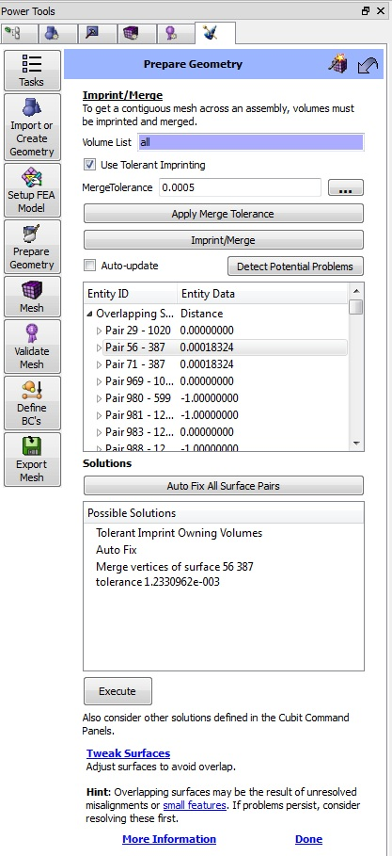
ITEM Overlapping Surface Tool
The ITEM overlapping surface tool is found in the “Imprint/Merge” panel in ITEM. The overlapping surface tool allows you to search for surfaces that are “parallel” and are within some tolerance of each other. After imprinting and merging this check is a good way to find surfaces that should have merged because they are close enough but didn’t.
List of volumes to include in checks.
Allowable distance between overlapping surfaces.
Button to execute the search for post-imprint/merge problems.
Results.
Potential solutions for fixing problems that were found.
Button to execute highlighted solution.
This tool can be found in ITEM by clicking on the following links: Prepare Geometry->Connect Volumes->Imprint and Merge.

Slide 20
Contiguous Meshing Exercise 7
1
Import “contig_assembly.sat”.
Go to the Imprint/Merge panel in ITEM: Prepare Geometry->Connect Volumes->Imprint and Merge.
Uncheck the “Use Tolerant Imprinting” check box.
Click on the “Imprint/Merge” button.
Click on the “Detect Potential Problems” button.
Use the right-click menu options on the results to visualize the problems that were found. Can you identify why things failed to imprint/merge correctly?
2
3
4
5
6

Slide 21
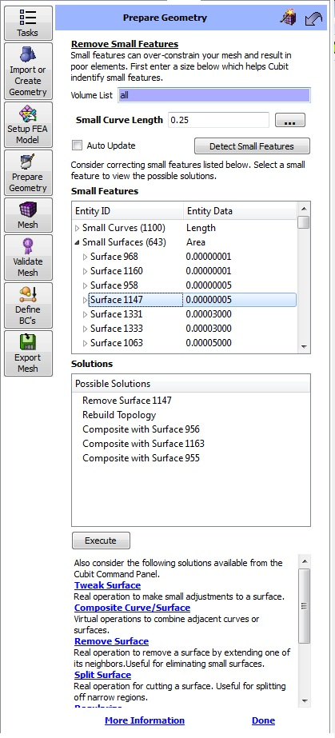
ITEM Small Feature Tool
The ITEM small feature tool allows you to search for small features in your model. It is usually a good idea to run the small feature search in the tool before and after doing imprint/merge. This will tell you if any new small features were introduced into the model during the imprinting process. Newly introduced small features are usually an indication of a problem.
List of volumes to include in checks.
Tolerance to determine whether something is “small”.
Button to execute the search for small features.
Results.
Potential solutions for fixing problems that were found.
Button to execute highlighted solution.
This tool can be found in ITEM by clicking on the following links: Prepare Geometry->Remove Small Features.

Slide 22
Contiguous Meshing Exercise 8
1
Import “contig_assembly.sat”.
Run a small feature check before imprint/merge: Go to the Small Features panel in ITEM by clicking on the links: Prepare Geometry->Remove Small Features.
Right-click in the volume list field and choose “Select All”. Enter a small curve length of 0.03
Click on the “Detect Small Features” button.
Jot down the current number of small curves, small surfaces, and narrow surfaces.
From the command line execute the two commands: “imprint all” and “merge all”.
Rerun the small feature search by clicking on the “Detect Small Features” button again.
Compare the new number of small curves, small surfaces, and narrow surfaces. Note: In a model with no problems you should not have introduced any new small features when doing the imprint/merge!
2
3
4
5
6
7
8

Slide 23
Tools for Finding Gaps/Overlaps/Misalignments
Manage Gap/Overlap Tool in ITEM
Coincidence Check
Proximity Check Tool in ITEM
Model Edge Check
Imprint/Merge + Overlapping Surface Check in ITEM
Imprint/Merge + Small Feature Tool in ITEM
Geometry-Based
Mesh-Based
(post meshing)

Slide 24
Coincident Mesh Check
Coincident mesh is often an indicator that imprint/merge failed and that the mesh is not contiguous. Coincident nodes and mesh faces are key indicators that there is a problem. The coincident mesh tool, found in the command panels under the Mesh->Entity->Quality sections allows the user to search for coincident nodes or mesh faces in the model. The input can be a list of geometry or mesh entities.
Option to specify which type of coincident mesh entity to search for.
Range of elements to search. Depending on which section of the mesh command panels you are in this can be geometry or mesh entities.
Tolerance for the coincidence check.
Options for grouping the results.
Options for displaying the results.
Option for specifying verbosity of text output to the command line.
This tool can be found by clicking the following links in the command panels: Mesh->(Some entity type)->Quality->Coincident Check (in the drop-down box).

Slide 25
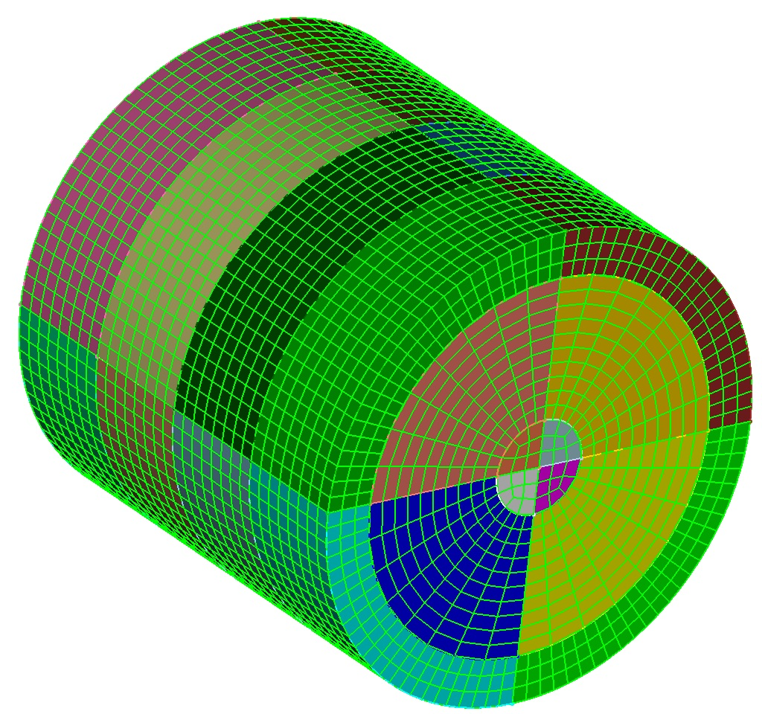
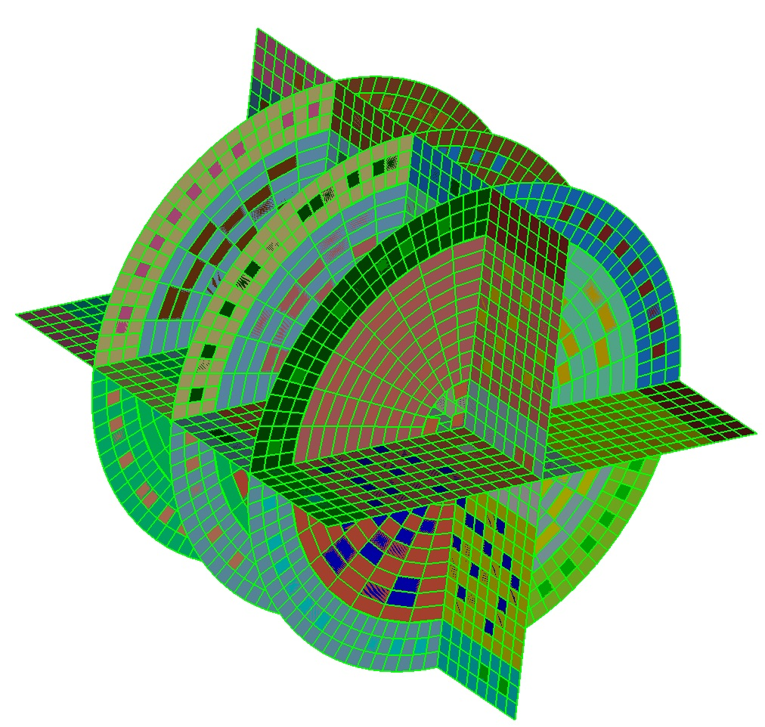
Contiguous Meshing Exercise 9
1
Import “contig_cyl_assem.sat”.
Mesh all of the volumes with the command “mesh vol all”.
Go to the coincident mesh tool in the command panels: Mesh->Volume->Quality->Coincidence Check.
Right-click and choose “Select All” in the volume list.
Check that you want to search for coincident quads.
Click on the “Apply” button to run the check. Did you get what you expected?
Delete the mesh: “delete mesh”.
Imprint/merge all of the volumes: “imprint all”, “merge all”.
Mesh the volumes again: “mesh vol all”.
Rerun the coincident quad check. Did you get what you expected?
2
3
4
5
6
7
8
9
10

Slide 26
Model Edge Check
Another quick way to see if there is coincident mesh is to do the model edge check. This check will identify and draw all of the “edges” of the mesh found by skinning the set of elements specified as input. If there were merges that didn’t happen correctly during imprint/merge these will usually show up as interior edges in the display of the model edge check. The input can be a list of geometry or mesh entities.
Range of elements to search. Depending on which section of the mesh command panels you are in this can be geometry or mesh entities.
Feature angle to be used in determining the model edges.
Options for grouping the results.
Options for displaying the results.
Option for specifying verbosity of text output to the command line.
This tool can be found by clicking the following links in the command panels: Mesh->(Some entity type)->Quality->Model Edge Check (in the drop-down box).

Slide 27
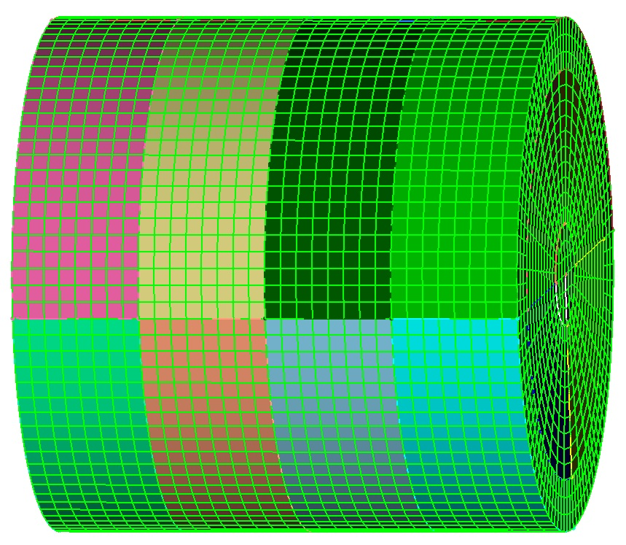
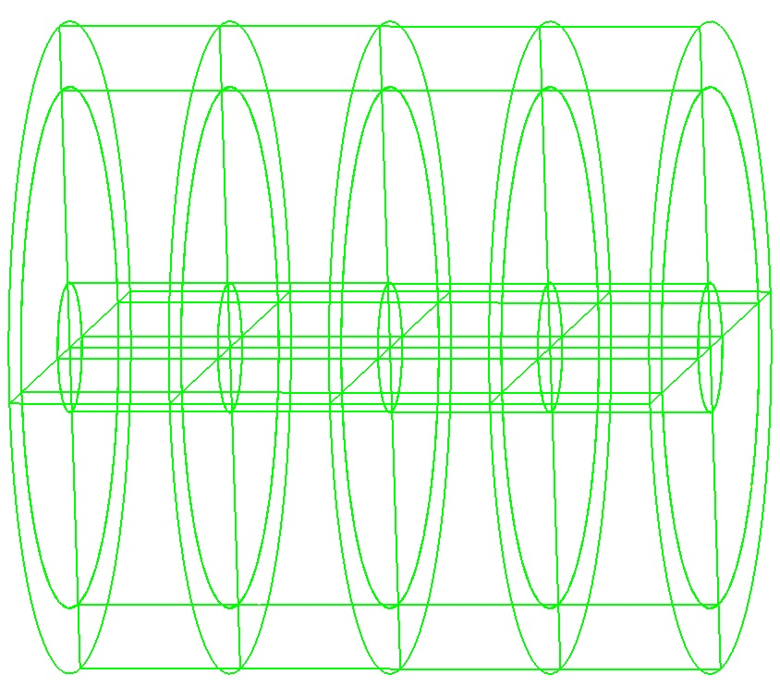
Contiguous Meshing Exercise 10
1
Import “contig_cyl_assem.sat”.
Mesh all of the volumes with the command “mesh vol all”.
Go to the model edge tool in the command panels: Mesh->Volume->Quality->Model Edge Check.
Right-click and choose “Select All” in the volume list.
Click on the “Apply” button to run the check. Did you get what you expected?
Delete the mesh: “delete mesh”.
Imprint/merge all of the volumes: “imprint all”, “merge all”.
Mesh the volumes again: “mesh vol all”.
Rerun the model edge check. Did you get what you expected?
2
3
4
5
6
7
8
9

Slide 28
Outline
Why contiguous meshes? How does CUBIT™ enforce contiguous meshes between parts?
What are the difficulties with generating contiguous assembly meshes?
What are the tools in CUBIT™ that will help me identify problems early?
What are the tools in CUBIT™ that will help me fix the problems?

Slide 29
Tool Applicability Chart
 | Gaps | Volume Overlaps | Misalignments
Move Volume
Volume Booleans
Tweak Surface
Packaged Tweak Solutions in Manage Gap/Overlap Tool
Tolerant Imprint/Merge

Slide 30
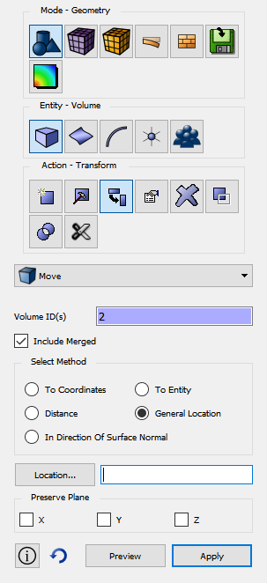
Moving Volumes
Many misalignments are simply a by-product of inaccurate assembling of parts or of tolerance differences between cad systems.
Many gaps/overlaps/misalignments can be fixed simply by moving a volume.
However, moving a volume to fix one problem may introduce another.

Slide 31
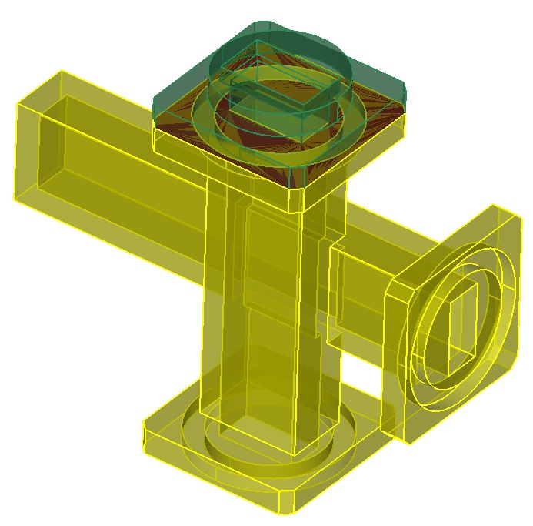
Move Volume Exercise
1
Import “contig_assembly.sat”.
Use the Manage Gap Overlap tool in ITEM to find all of the volume overlaps in the model.
Fix the overlap between volumes 2 and 20 (first one in list) by moving a volume. Hint: you may actually find the easiest way to do it is to move a vertex or use the align command to move the volume.
Did your solution have any adverse effects? If so, what can you do to avoid them.
2
3

Slide 32
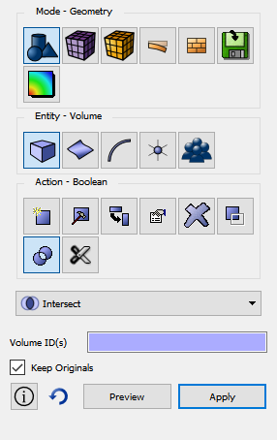
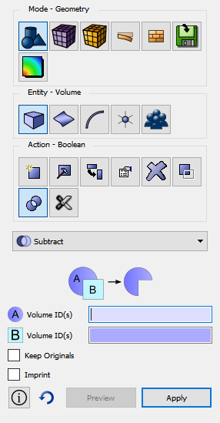
Volume Booleans
Mostly effective for removing volume overlaps.
The process is to intersect the two volumes with the “keep originals” option. Then subtract the new intersection volume from one of the originals.

Slide 33
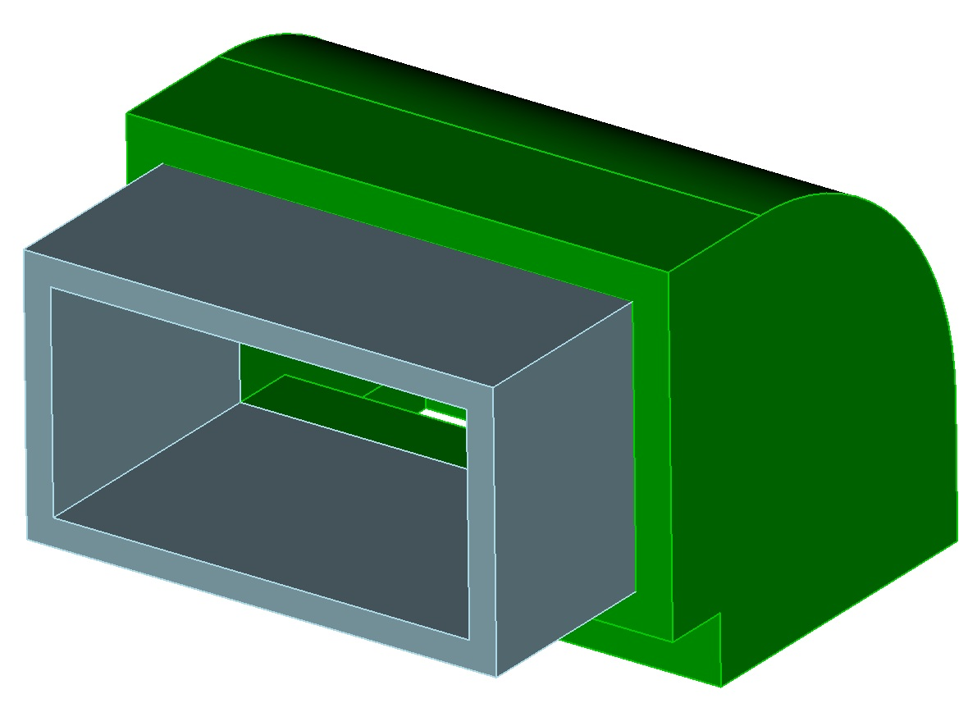
Boolean Exercise
1
Import “contig_assembly.sat”.
Use the Manage Gap Overlap tool in ITEM to find all of the volume overlaps in the model.
Fix the overlap between volumes 9 and 10 using an intersection and then a subtraction.
Does it matter which volume (9 or 10) you subtract the intersection volume from? Why?
2
3

Slide 34
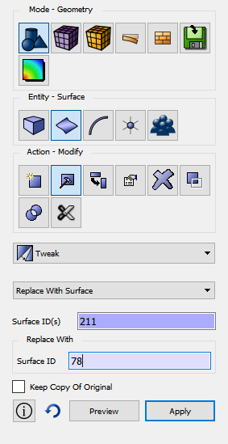
Tweaking Surfaces
Modifies the volume by locally modifying a surface.
Extremely powerful way to fix misalignments and probably the most commonly used.
Many different ways to tweak a surface to get the desired effect.

Slide 35
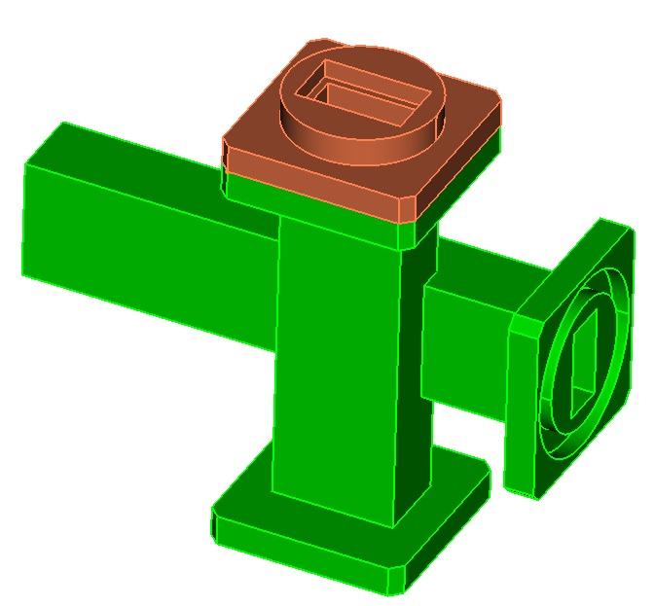
Tweak Surface Exercise
1
Import “contig_assembly.sat”.
Use the Manage Gap Overlap tool in ITEM to find all of the volume overlaps in the model.
Fix the overlap between volumes 9 and 10 by tweaking a surface. Try using both the “Replace With Surface” and “Offset” options. Hint: Make sure “undo” is turned on so that you can undo operations before trying a new one instead of having to reimport the model.
Fix the gap between surfaces 56 and 387 (found in Manage Gap Overlap tool) using a tweak. What other approach could be taken to fix both the gap and the misalignment in one operation?
2
3
4

Slide 36
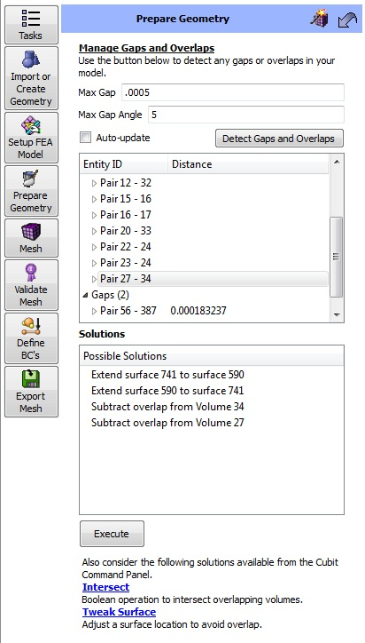
Packaged Solutions
Packaged solutions are available in the lower part of the Manage Gaps and Overlaps tool in ITEM.
Packaged solutions currently only exist for gaps and overlaps.
The tweak and intersect/subtract approaches are use in the package's solutions.
Clicking on a solution will show a visual queue in the graphics window of what entity will be modified so that the user can choose the best option.

Slide 37
Using a Packaged Solution Exercise
1
Import “contig_assembly.sat”.
Use the Manage Gap Overlap tool in ITEM to find all of the volume overlaps in the model.
Fix the overlap between volumes 9 and 10 using one of the packaged solutions.
Does it matter which volume (9 or 10) you subtract the intersection volume from? Why?
2
3

Slide 38
Tolerant Imprint/Merge
Same as regular imprint/merge but effectively allows the user to set the tolerance used during imprinting (and merging).
Instead of using 1e-6 to decide what is coincident it uses whatever the current merge tolerance is.

Slide 39
Tolerant Imprint/Merge
Two characteristics:
Tolerant imprint/merge should not introduce any geometry smaller than merge tolerance.
Tolerant imprinting can imprint geometry that is as far away as merge tolerance.
Requirement: No features smaller than merge tolerance can exist in the model or it may try to “merge away” features.
*These characteristics are no different from regular imprint/merge but now the user can specify the tolerance that drives them rather than just using the ACIS default of 1e-6.

Slide 40
Tolerant Imprint/Merge
The advantage:
If there is an appropriate merge tolerance that could be used for the whole assembly, there is no need for any geometry modifications prior to imprinting/merging.
The challenge:
Finding an appropriate merge tolerance.

Slide 41
Tolerant Imprint/Merge Exercise
1
Import “contig_assembly.sat”.
Go to the Imprint/Merge panel in ITEM (Prepare Geometry->Connect Volumes->Imprint and Merge).
Determine an appropriate merge tolerance: Click on the “…” button next to the Merge tolerance field.
To find a good merge tolerance we must first know what the smallest feature in our model is. Click on the “…” button next to the “Smallest Feature Size” field.
Go to the next slide…
2
3
4

Slide 42
Tolerant Imprint/Merge Exercise
Click on the “Find Small Features” button. Right-click on the smallest feature in the sorted list and choose “Draw Pair”. The smallest feature in the list does appear to be a valid thickness of the model and so that is our smallest feature. Choose the “Done” link.
The “Smallest Feature Size” field should be populated with the value from the previous panel. Click on the “Estimate Merge Tolerance” button. Cubit will estimate a merge tolerance based on the smallest feature size and based on other proximity searches it performs.
Go to the next slide…
5
6

Slide 43
Tolerant Imprint/Merge Exercise
Check to see if the merge tolerance will result in the merges you want by using the proximity check tool in the lower part of the panel. Remember that entities that are closer than merge tolerance will get merged and entities larger than merge tolerance will not get merged. (It looked to me that 0.005 would result in the merges I want).
Change the value in the “Estimated Merge Tolerance” field to be 0.005 and click the adjacent “Apply” button. Then click the “Done” link at the bottom of the page.
Go to the next slide…
7
8

Slide 44
Tolerant Imprint/Merge Exercise
Before running imprint/merge check the number of small curves/surfaces in the model using our merge tolerance (0.005) as the small curve tolerance. Go to the “Small Features” panel in ITEM, enter 0.005 as the small curve length, and then click on “Detect Small Features”. Jot down the numbers of small curves and surfaces so we can check after imprinting to see if we introduced any new ones.
Go back to the “Imprint and Merge” panel in ITEM, make sure “Use Tolerant Imprinting” is checked and that the merge tolerance shown is 0.005 and click on the “Imprint/Merge” button.
Go to the next slide…
9
10

Slide 45
Tolerant Imprint/Merge Exercise
Click on the “Detect Potential Problems” button. There should be 2 floating volumes but that is ok for this model (you can right-click and visualize these to convince yourself that they shouldn’t be connected to any other volumes).
Go back to the “Small Features” panel and rerun the diagnostic. No new small curves/surfaces should exist.
From the command line type “vol all scheme tetmesh” and “mesh vol all” to mesh all of the volumes.
Go to the next slide…
11
12
13

Slide 46
Tolerant Imprint/Merge Exercise
All of the volumes should successfully mesh giving you a contiguous mesh. Check this by doing a coincident node and tri check in the mesh command panels under quality.
Zoom into some the areas where you know there were gaps/overlaps/misalignments to see how the tolerant imprint/merge took care of these problems. Toggle the display of the mesh/geometry on and off while zoomed into these areas to better see what is going on.
14
15

Slide 47
Proposed Workflow
Run the ACIS healer check on your geometry to make sure it doesn’t have problems. If it does you can try running the healer to rebuild it and fix any problems.
Inspect your model and determine if you can use tolerant imprint/merge to take care of any gaps/overlaps/misalignments. If you can you will save yourself a lot of time. Otherwise continue on with step 3.
Use the “Manage Gaps and Overlaps” tool to find any volume overlaps. Fix these first.
If possible, use the packages solutions to get rid of any gaps/misalignments.
Check for small curves/surfaces in your model for a reference point.
Imprint and merge.
Check for potential problems in the ITEM Imprint/Merge panel.
Double check small curves/surfaces to make sure you didn’t introduce any during imprinting.
Mesh the assembly.
Check for coincident nodes and mesh faces. Do a model edge check.

