Slide 1
CUBIT™ Fast-Start Tutorial
13. Defining the FEM
Notes:
Type: FORMAL - Training
Title: Cubit 200 Training
SAND Number: SAND2020-0682 TR
Contact: Hensley,Trevor Michael

Slide 2
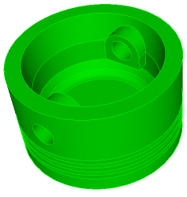
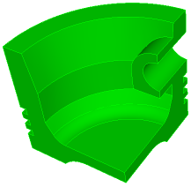
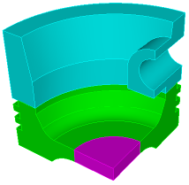
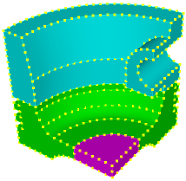
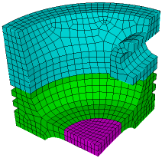
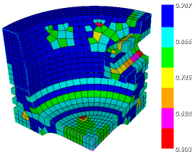
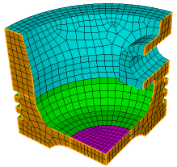
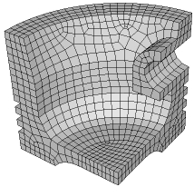
The Basic CUBIT™ Process
1
2
3
Import Solid Model
Simplify Geometry
Decompose Geometry
4
5
6
Imprint & Merge
Set Schemes
& Intervals
Mesh
7
8
9
Check
Quality
Apply B.C.s
Export
Mesh

Slide 3
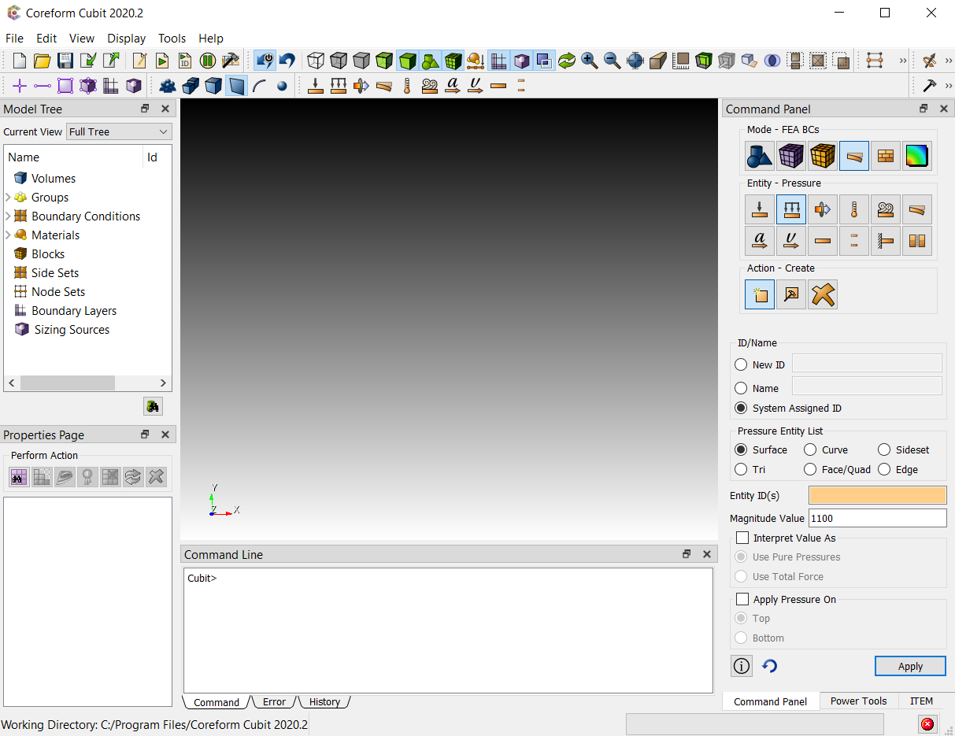
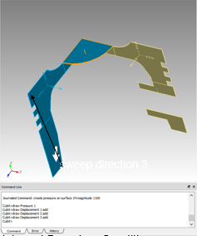
8
Apply B.C.s
Assign boundary condtions
and material properties.
Pressure
Displacement BC’s
sweep direction 3
Materials and Boundary Conditions are applied

Slide 4
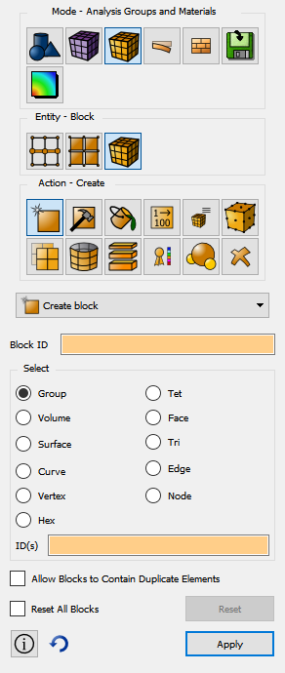
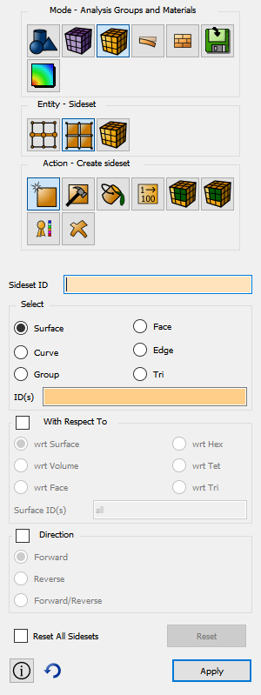
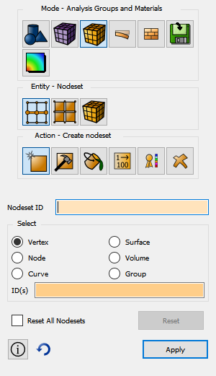
Exodus Grouping Mechanisms
The Exodus grouping mechanisms can also be used with non-Exodus based analysis codes.
The grouping mechanisms can be referenced as the basis for defining boundary conditions on sidesets or nodesets or for defining material groups with blocks.
Blocks
Sidesets
Nodesets

Slide 5
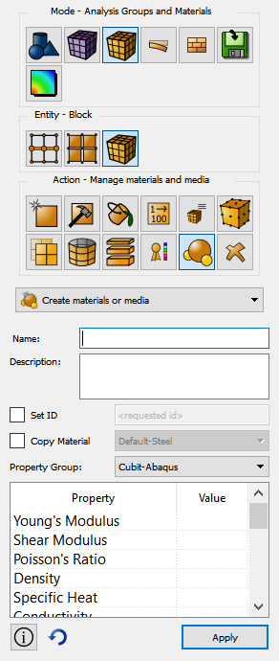
Material Definitions
CUBIT™ allows for the definition of simple isotropic materials and CFD media.
The isotropic material is supported in Abaqus and LS-Dyna. It can be used as a place holder for more complex materials.
CFD media is used to define zones in Fluent and actual material properties are typically assigned in the Fluent set up application.

Slide 6
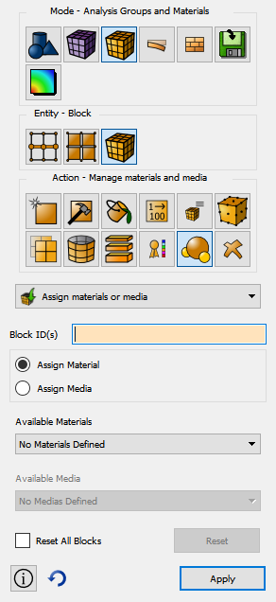
Assigning Materials to Blocks
The same material can be associated with multiple blocks.
A material must be associated with at least one block for
It to show up in the export file.

Slide 7
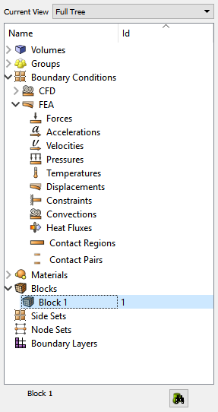
Manipulating Blocks
Blocks can be manipulated from the tree
Select “Blocks”
right click
Create new block
Drag and drop geometry into block
Select created block
Draw
List
Delete
Tet specific options

Slide 8
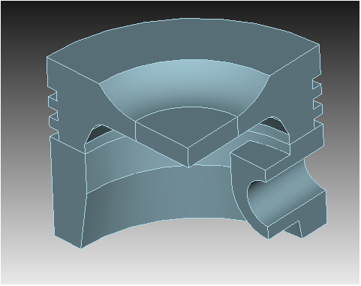
Exercise 1
Import quarter_piston.sat
Create material steel1040
E = 30.0e6
ν = 0.3
ρ = .284 lb / in^3
Create block 9 with all volumes
Assign material to the block
Use the tree to draw the block

Slide 9
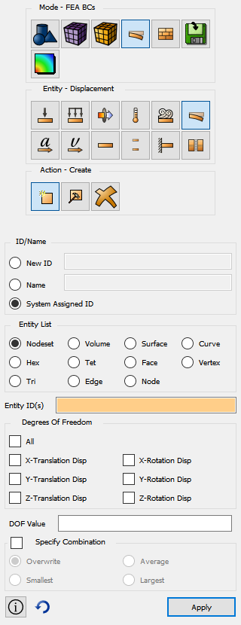
Defining Boundary Conditions
Boundary conditions can be defined for Abaqus, I-DEAS, LS-Dyna and Fluent
Boundary conditions can be assigned to either the mesh or the geometry.
Assigning BC’s to geometry allows the mesh to be refined or changed without having to modify the BC set.

Slide 10
Manipulating Boundary Conditions
Select Exodus Groups
Toggle boundary condition display
Select FEA BC’s
Force
Pressure
Heatflux
Displacement
Temperature
Convection
Acceleration
Velocity
Contact Region
Contact Pair
Select CFD BC’s
Inlet mass flow
Inlet pressure
Inlet velocities
More . . .

Slide 11
Define Displacement
User can define displacements with either an id or a name
Displacements can be defined on geometry or mesh
Specify both constraints and enforced displacements
Boundary conditions specified on geometry persist across webcuts.

Slide 12
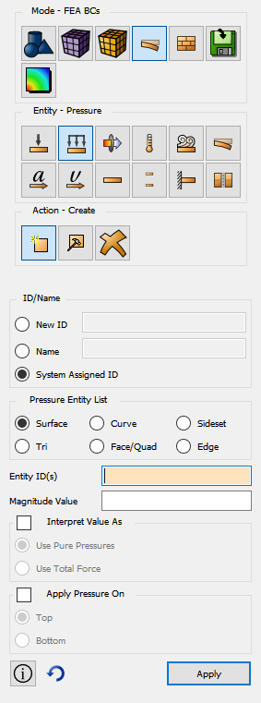
Define Pressure
User can define pressures with either an id or a name
Pressures can be defined on geometry or mesh
Specify pressure value
Specify shell side

Slide 13
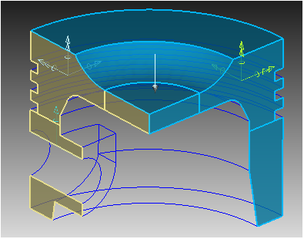
Exercise 2
Toggle on the BC display
Create symmetry displacement constraints on the symmetry surfaces
Fix plane normal direction
Fix rotations across plane normal
Fix curve on top of piston pin
Create 1100 psi pressure on the top surfaces of the piston.
Check that at least one constraint exists in every DOF.

Slide 14
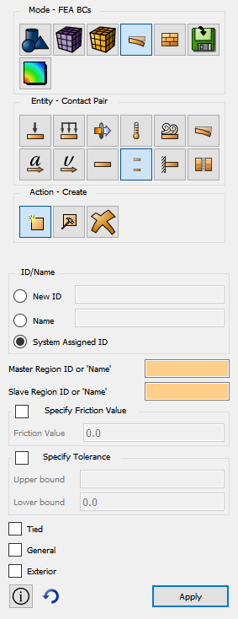
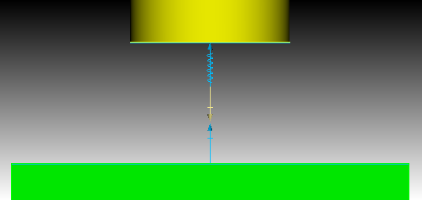
Specifying Contact
Specifying contact requires two steps
Create contact regions
Areas where contact is defined
Create contact pairs
Contact regions that interact
Create Contact Region
Create Contact Pair

Slide 15
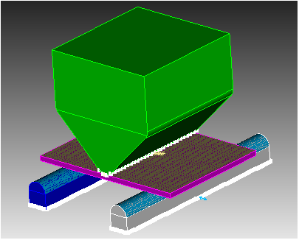
Example 3
Play three_point_bending.jou (regularize vol all)
Define contact regions at the top and the bottom of the plate
Define a contact region at the tip of the punch
Define a contact region on the cylindrical support surfaces
Define a contact pair between the
supports and the plate bottom
Define a contact pair between the
punch and and the plate top
Fix the bottom of the supports
in all 6 DOFs
Apply a velocity of .1 in/s to the
tip of the punch

