Slide 1
CUBIT™ Fast-Start Tutorial
12. Geometry for Sweeping II
Notes:
Type: FORMAL - Training
Title: Cubit 200 Training
SAND Number: SAND2020-0682 TR
Contact: Hensley,Trevor Michael

Slide 2
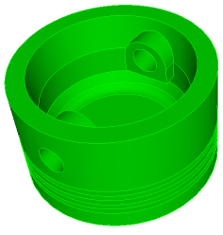
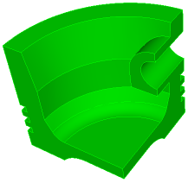
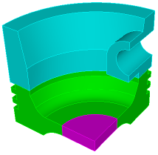
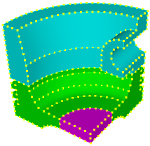
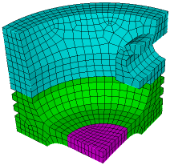
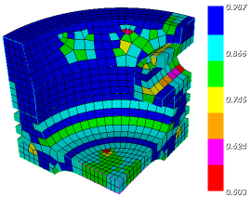
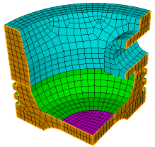
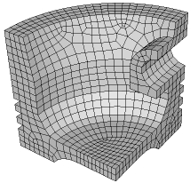
The Basic CUBIT™ Process
1
2
3
Import Solid Model
Simplify Geometry
Decompose Geometry
4
5
6
Imprint & Merge
Set Schemes
& Intervals
Mesh
7
8
9
Check
Quality
Apply B.C.s
Export
Mesh

Slide 3
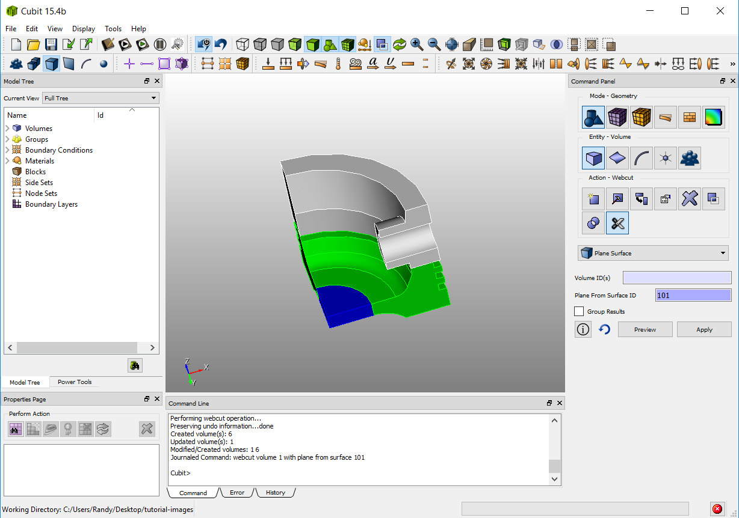
3
Decompose Geometry
Cut the model into
sweepable volumes
sweep
direction 2
sweep direction 1
sweep direction 3
Volumes are now individually sweepable

Slide 4
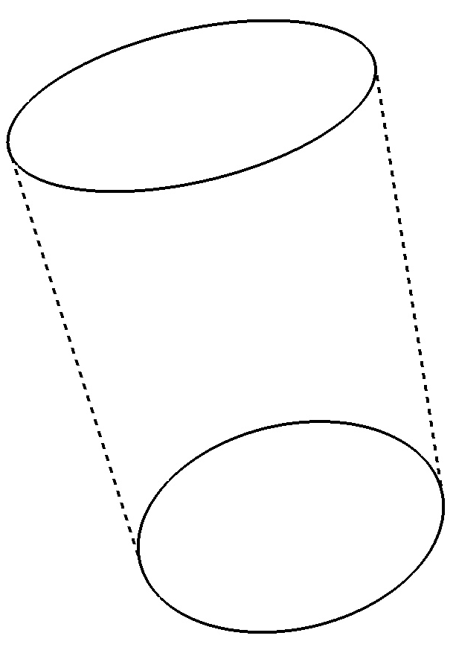
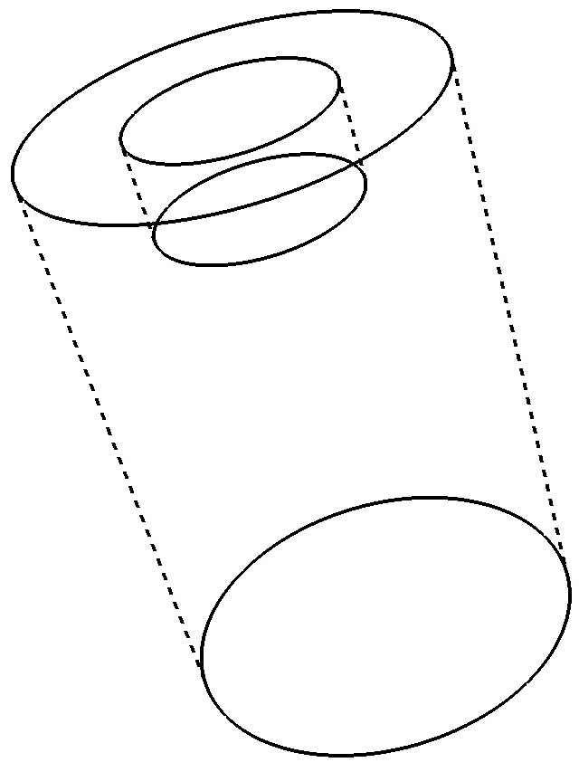
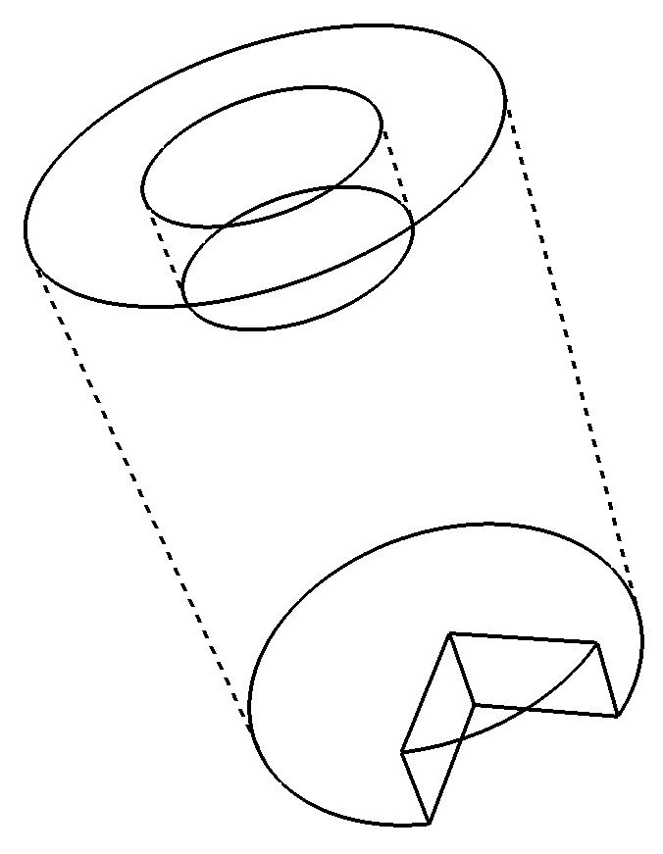
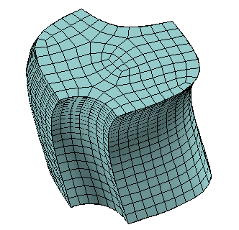
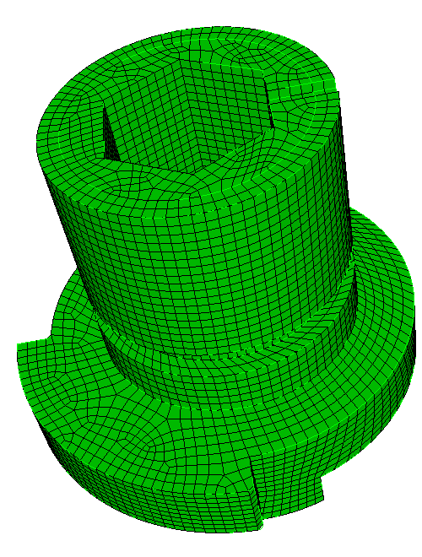
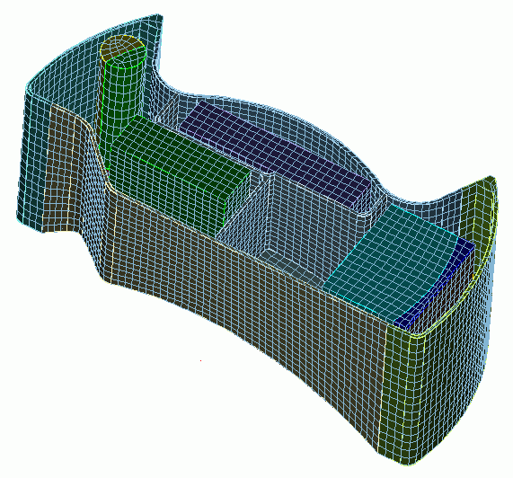
Sweep Scheme (Review)
One-to-one
Many-to-one
Many-to-many
Multiple
Sources
Multiple
Sources
Source
Sweep Direction
Sweep Direction
Sweep Direction
Target
Target
Multiple
Targets

Slide 5
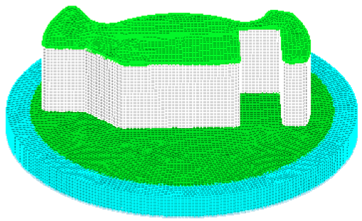
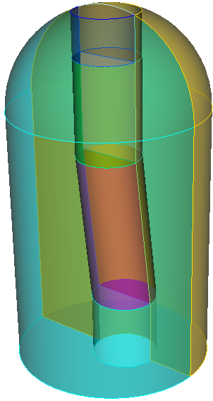
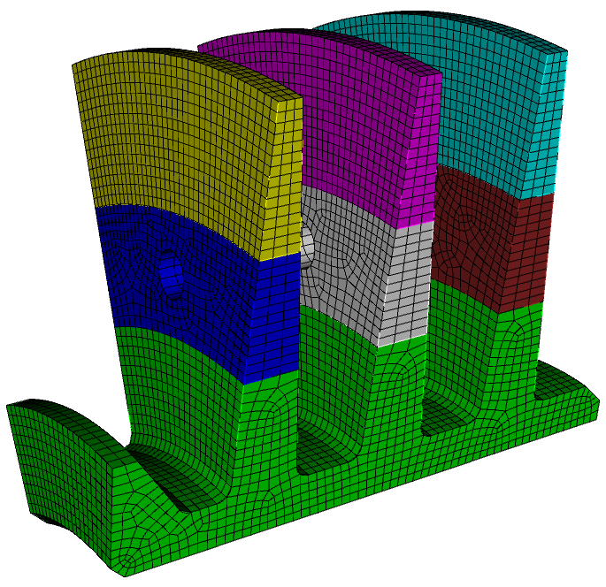
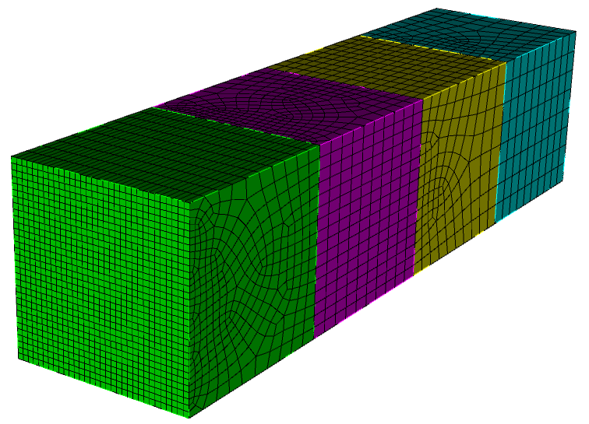
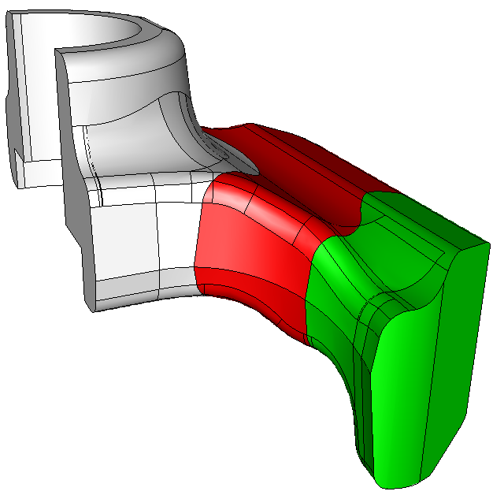
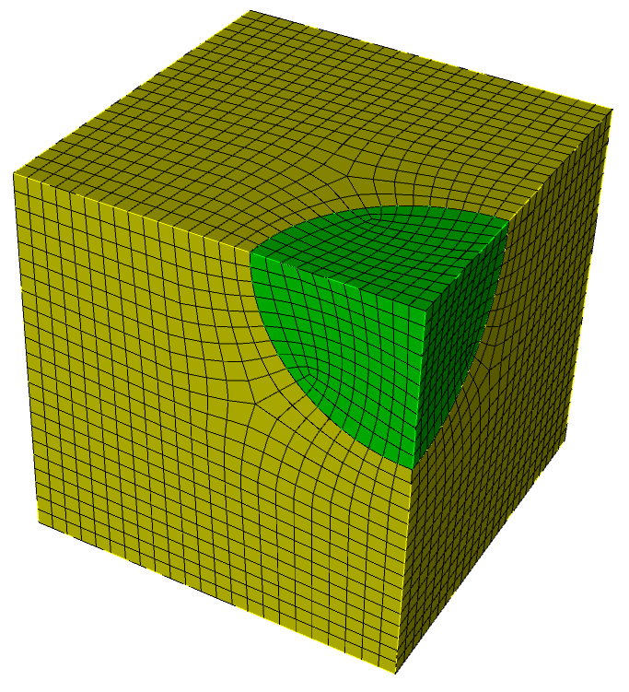
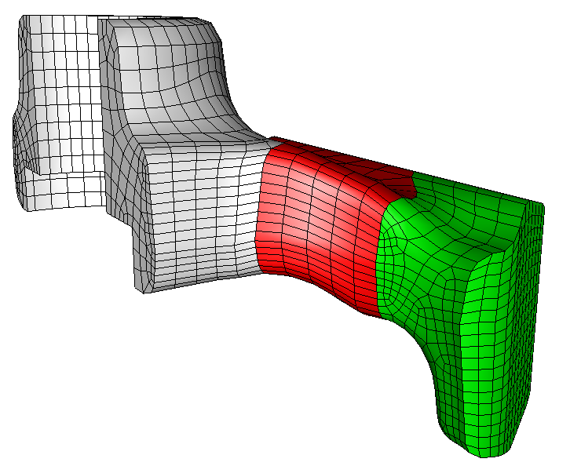
Common Techniques for Sweep Decomposition
1. Find One-to-one: Locate the logical one-to-one and many-to-one sweep paths and webcut to isolate (see exercise 1 from fast-start 10)
2.
1.
2. Coring: Core out the center of a cylindrical type object. Use a radial sweep and a top-to-bottom sweep (see exercise 2 from fast-start 10)
3. Multiple sweep directions: Cut to avoid features not in the sweep direction
3.
4.
4. Graded Meshes with pave-sweep: Cut multiple times in direction of grade. Alternate pave-sweep directions
5. Midpoint Subdivision: Cut volumes so the polyhedron scheme can be used
6. Modify surfaces with tweak and composite tools to make volumes sweepable
6.
5.

Slide 6
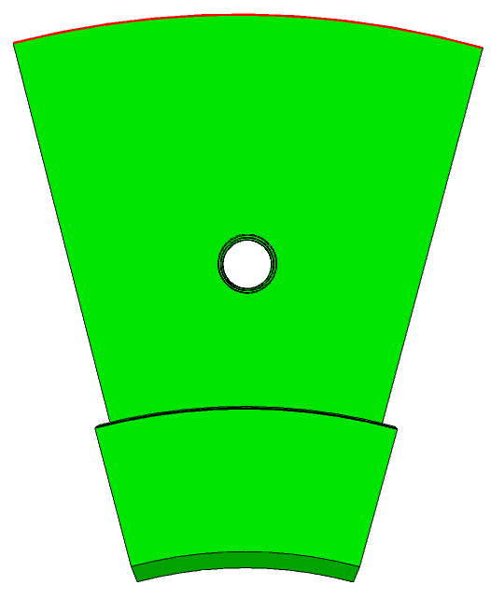
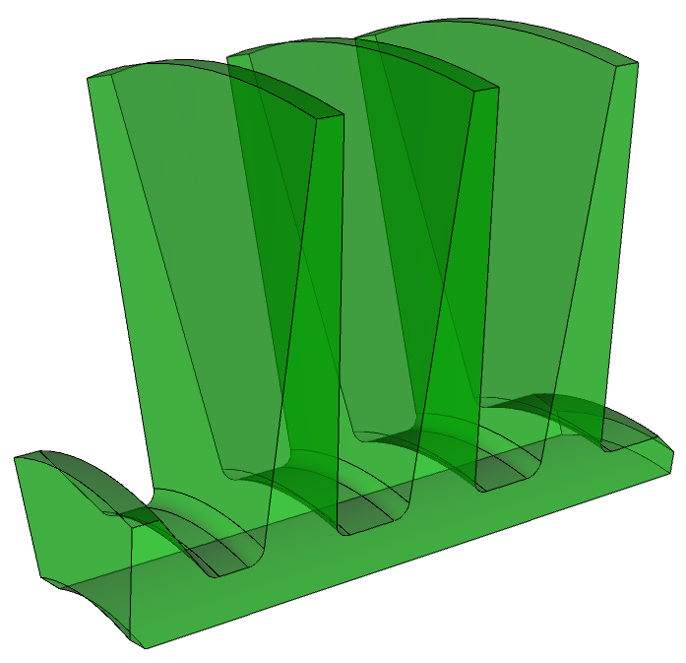
Multiple Sweep Directions
sweep direction
source
target

Slide 7
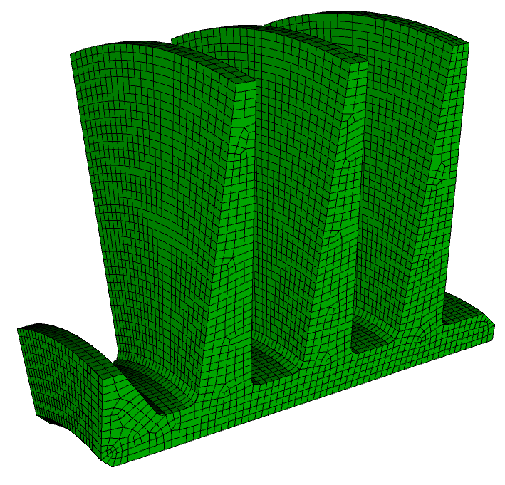
Multiple Sweep Directions
sweep direction
source
target
One-to-one sweep
“Easy” to mesh

Slide 8
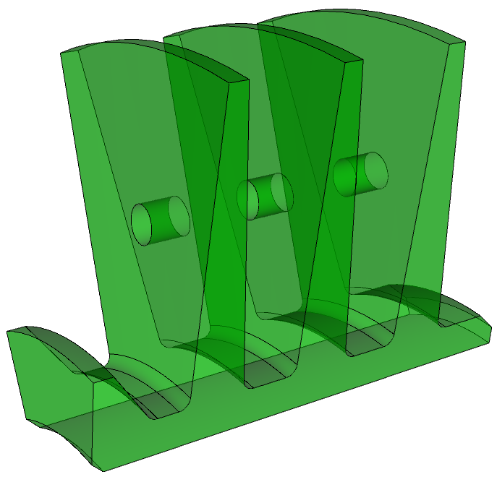
Multiple Sweep Directions
sweep direction
source
target
What do we do now?

Slide 9
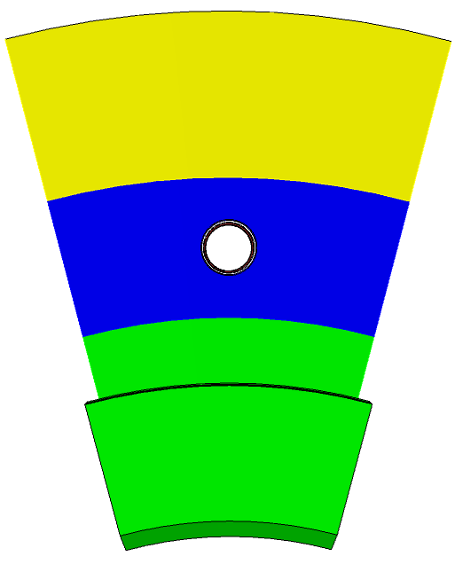
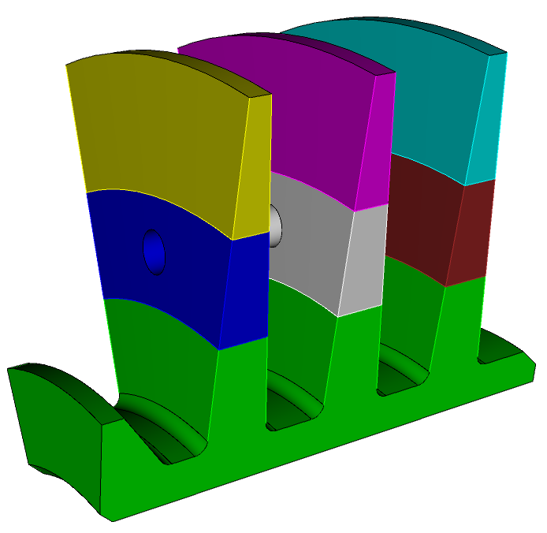
Multiple Sweep Directions
sweep direction
webcut
webcut
sweep
direction
sweep direction
Cut around the feature that is stopping us from sweeping
In this case we have used the webcut with cylinder tool

Slide 10
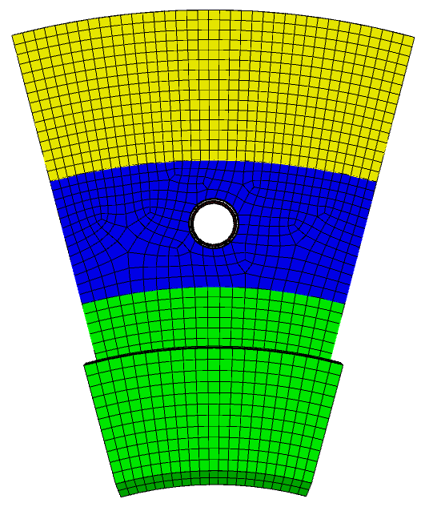
Multiple Sweep Directions
Resulting mesh with 2 sweep directions

Slide 11
Exercise 1
Import the model “blades.sat”
Generate a mesh with a size of about 2.0
Hint: Use the webcut with cylinder operation to cut out the features that don’t line up with the principal sweep direction

Slide 12
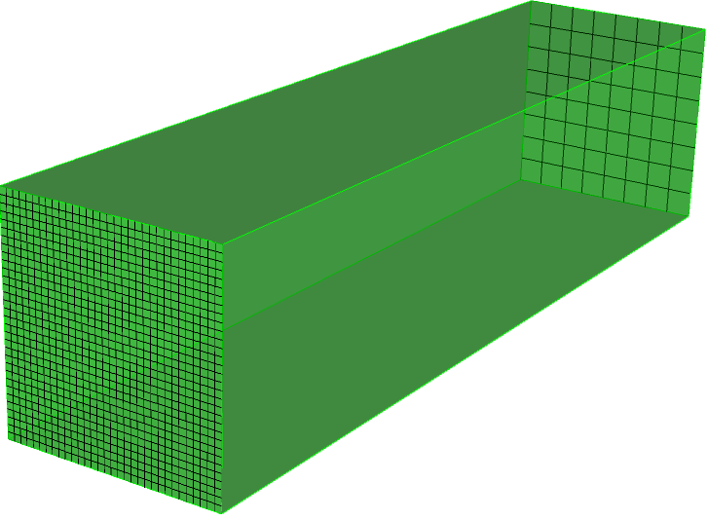
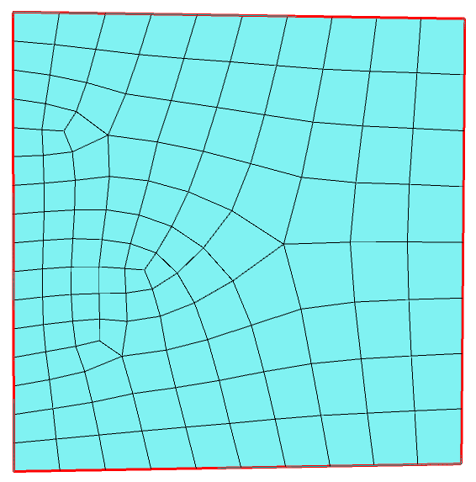
Generating a graded mesh
8
How to generate a graded mesh using sweeping
Coarse Mesh
Sweep Direction
8
32
Sweeping requires a constant number of elements through the entire sweep direction
Fine Mesh
32
But Paving can provide a way to transition the mesh. (However paving is only a 2D procedure)
16
8

Slide 13
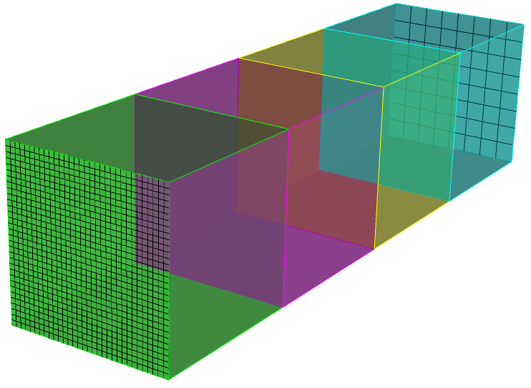
Generating a graded mesh
8
How to generate a mesh using sweeping
Coarse Mesh
8
32
Fine Mesh
32
Webcut the model multiple times along the direction from fine to coarse

Slide 14
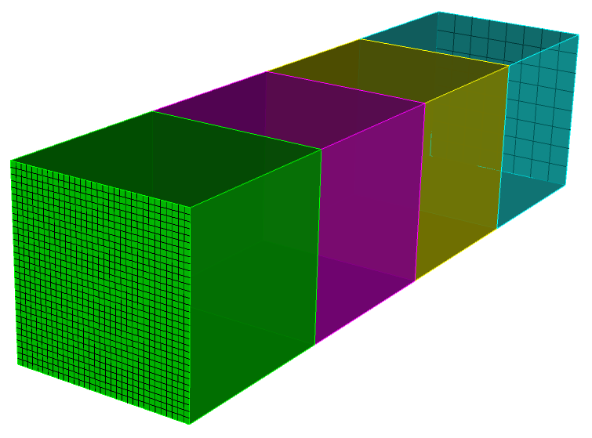
Generating a graded mesh
8
How to generate a mesh using sweeping
16
16
Coarse Mesh
32
8
8
32
16
16
Fine Mesh
32
Set up alternating matched intervals on curves

Slide 15
Generating a graded mesh
8
How to generate a mesh using sweeping
16
Pave
Sweep
16
Coarse Mesh
Pave
Sweep
8
32
Pave
Sweep
8
32
Sweep
16
16
Pave
Fine Mesh
32
Alternate pave and sweep directions in each volume

Slide 16
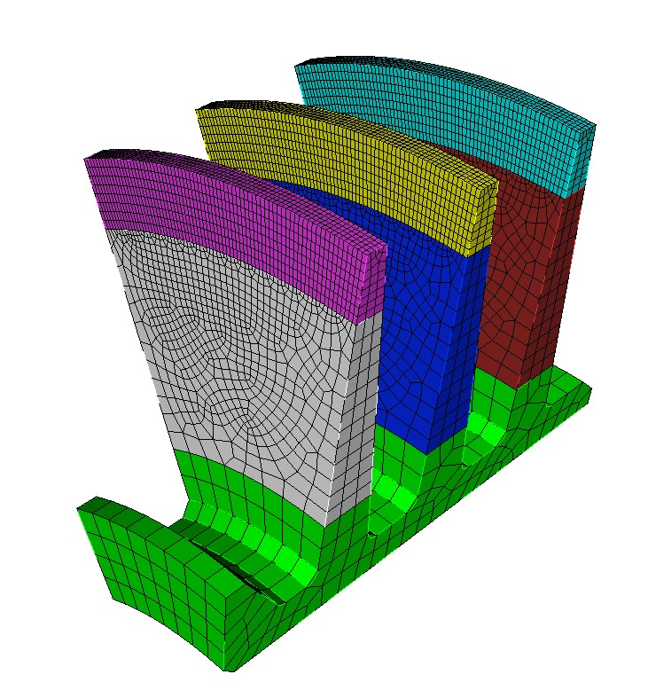
Exercise 2
Import the model “blades0.sat” and generate a graded mesh. Try grading the mesh from a mesh size of 1.0 to 5.0 as shown here
Size = 1.0
Hints: Use the graded mesh procedure described in the previous slides. Use the webcut with cylinder operation to cut the geometry. Try using the “copy mesh” scheme to avoid having to set up the intervals for each paved mesh.
Size = 5.0

Slide 17
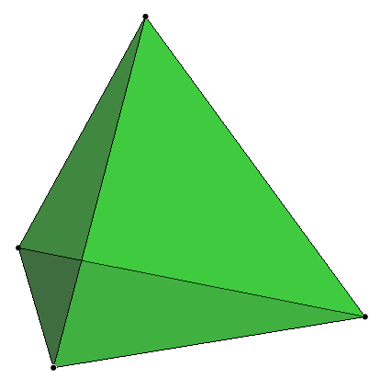
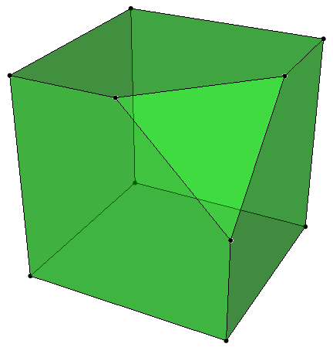
Midpoint subdivision
3D Midpoint subdision
Requires 3-valent vertices and convex polyhedron

Slide 18
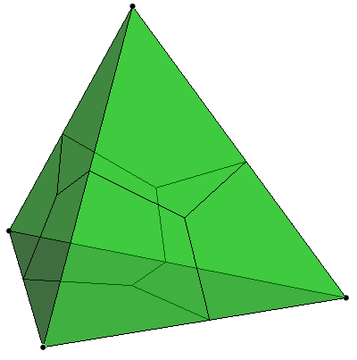
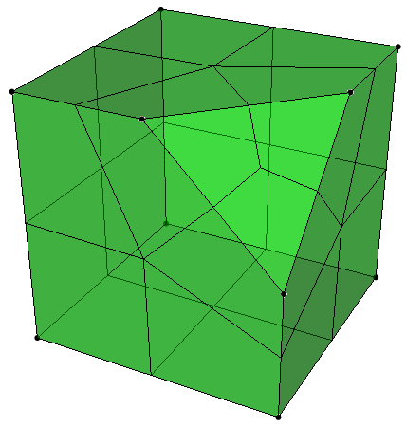
Midpoint subdivision
All surfaces must be convex

Slide 19
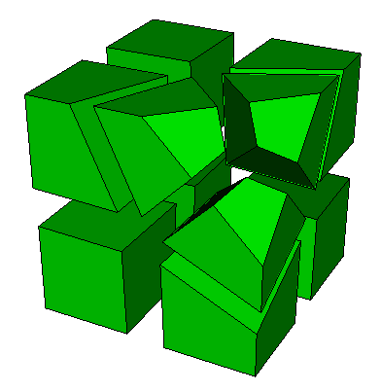
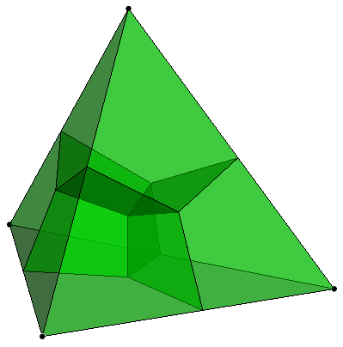
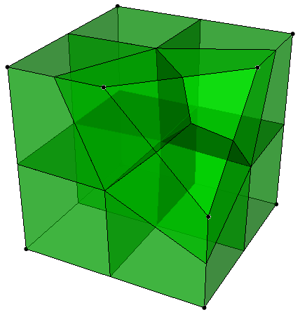
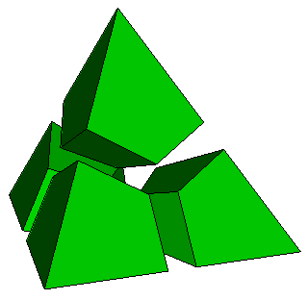
Midpoint subdivision
CUBIT™ will subdivide the geometry into logical mapped regions

Slide 20
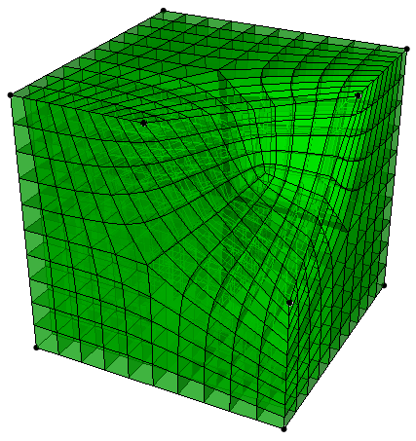
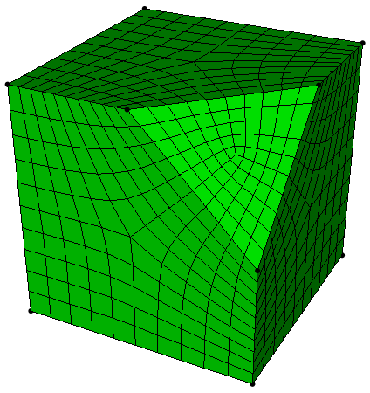
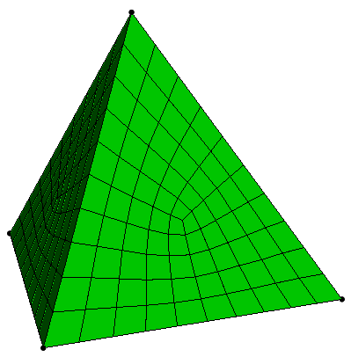
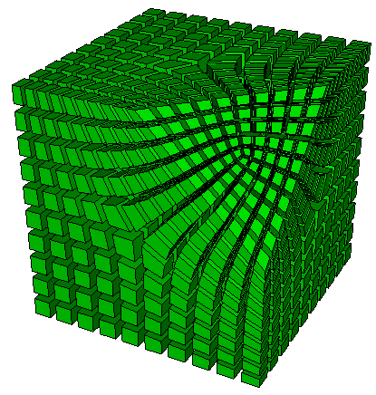
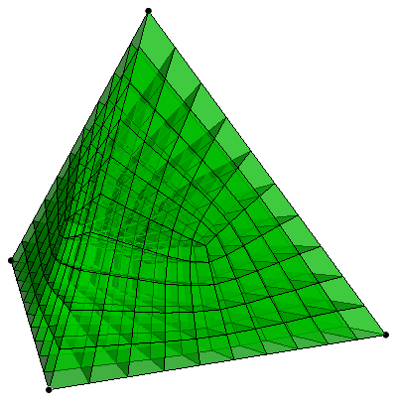
Midpoint subdivision
A mapped mesh will be applied to each logical region

Slide 21
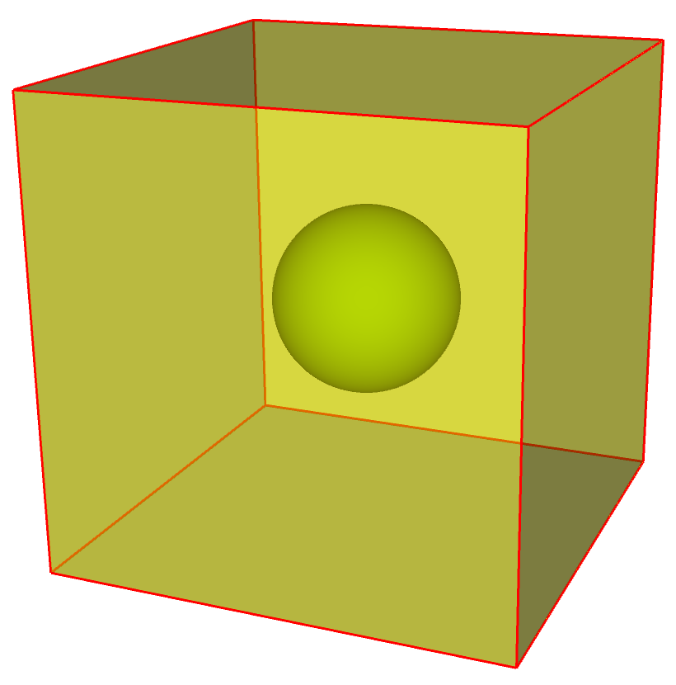
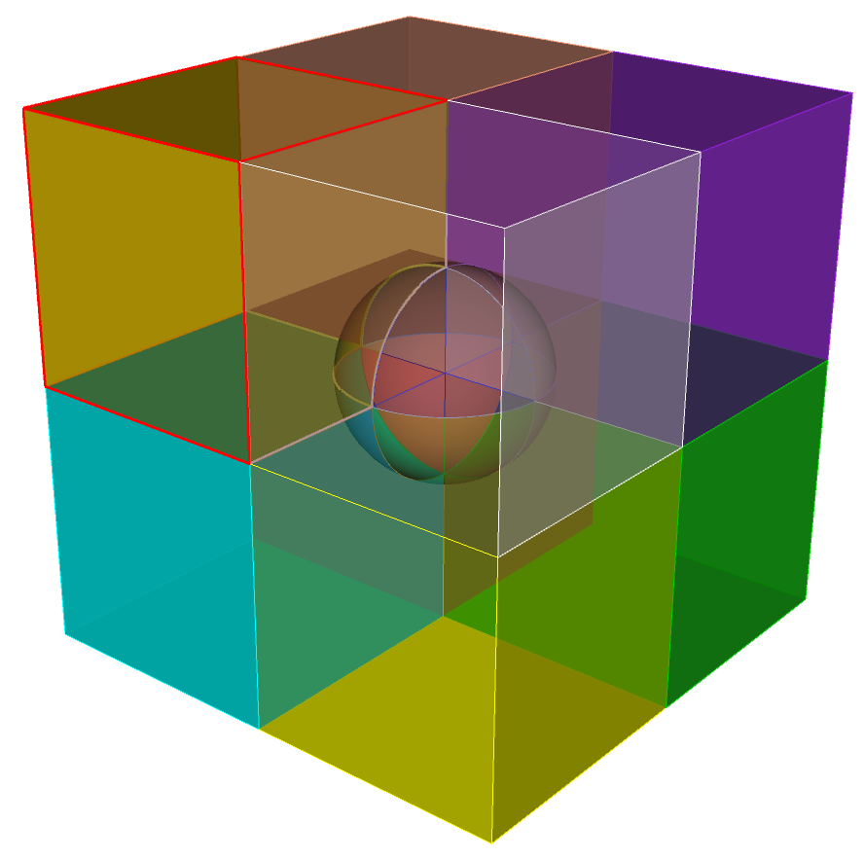
Exercise 3
Create a cubit model using the following commands
sphere radius 10
brick x 50
subtract vol 1 from vol 2 keep
delete vol 2
compress all
Mesh the two volumes with a size of 1.0. Make sure the mesh matches between the volumes
Hints: Try cutting the volumes on the 3-coordinate axis. This should result in 16 volumes. You should be able to mesh each of the volumes with scheme Polyhedron. You may want to simplify the model and work on one quadrant, and then use copy/reflect for the other quadrants.

Slide 22
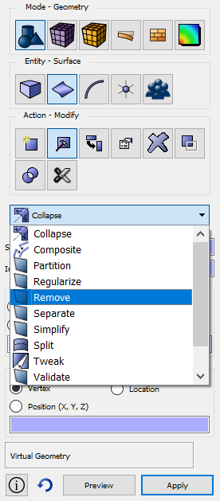
Surface Geometry Tools
CUBIT™ includes several tools to modify the surface geometry.
Tools can be used to enforce source-link-target topology for sweeping
Composite
surfaces
Surface Modify Command Panels
Split surfaces
Remove surfaces

Slide 23
Remove Surface
Use CUBIT™’s remove surface command to remove and extend the neighboring surfaces
Sweep direction

Slide 24
Splitting Surfaces
Mesh the existing topology gives a poor-quality mesh
By splitting the surface and then using virtual geometry will result in a higher quality mesh

Slide 25
Split Surfaces
Sweep direction
Sweep direction
Watch quality!
fillet splits
Sweep direction

Slide 26
Split Surface
Use CUBIT™’s split surface command to split fillets down the axis of the fillet
Choose split method (along fillet)
Select surfaces to split
Preview/Apply

Slide 27
Composite Surfaces
Virtual Geometry is most often used to cover a set of surfaces which normally prevent the volume from being swept.
Sweep direction
Note this is a virtual geometry operation
This surface is now mappable and can be used as a linking surface.

Slide 28
Composite Surfaces
Virtual Geometry is used to cover small surfaces and short curves.
IMPORTANT:
Virtual geometry is not ACIS geometry. It is stored only as an attribute in the .sat file. Also saved in .cub file. Non-CUBIT™ applications will not recognize it.
Real operations can be done before or after composite command

Slide 29
Composite Surfaces
Use this button to toggle the dotted line display on virtual composite surfaces
Notice a (v) displayed next to virtual surfaces in the model tree
Use Delete toggle to remove virtual

Slide 30
Exercise 4
Mesh the geometry in the file Mbracket.sat with an all-hex mesh. Use a mesh size of about 0.3
Hints:
Consider surface modification to improve mesh quality. Try split surface and composite operations
Decompostion for sweeping may require multiple sweep directions
At least one of your decomposed volumes should not be sweepable. Try the polyhedron scheme
Even though your topology following split/composite is sweepable, CUBIT™ may not recognize it as such. You may need to explicitly set source and target surfaces.

