Slide 1
CUBIT™ Fast-Start Tutorial
9. Meshing Schemes
Notes:
Type: FORMAL - Training
Title: Cubit 100 Training
SAND Number: SAND2020-0679 TR
Contact: Hensley,Trevor Michael

Slide 2
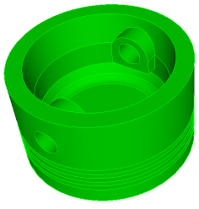
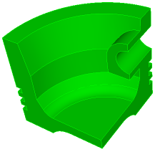
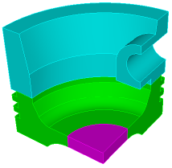
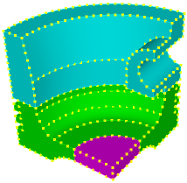
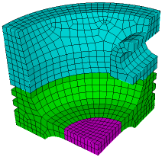
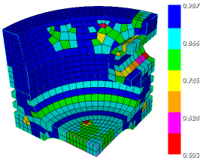
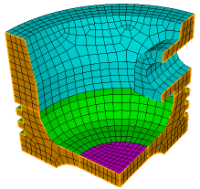
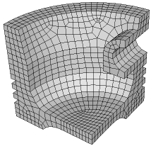
The Basic CUBIT™ Process
1
2
3
Import Solid Model
Simplify Geometry
Decompose Geometry
4
5
6
Imprint & Merge
Set Schemes
& Intervals
Mesh
7
8
9
Check
Quality
Apply B.C.s
Export
Mesh

Slide 3
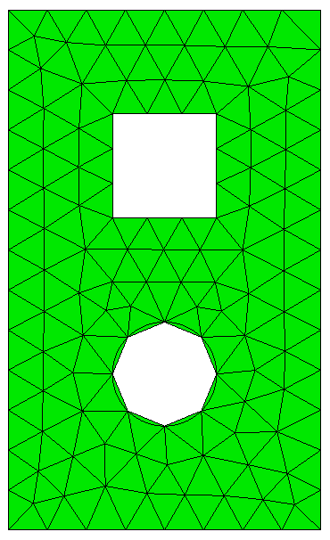
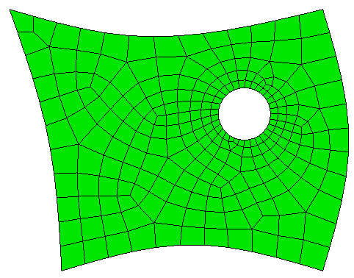
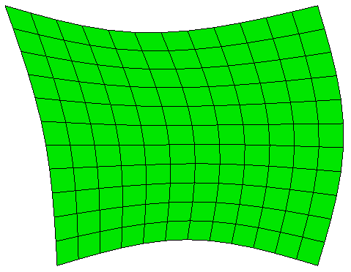
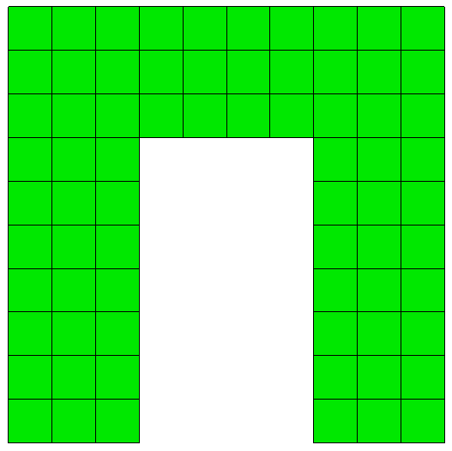
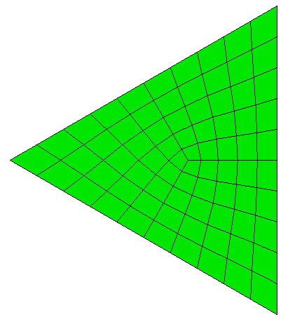
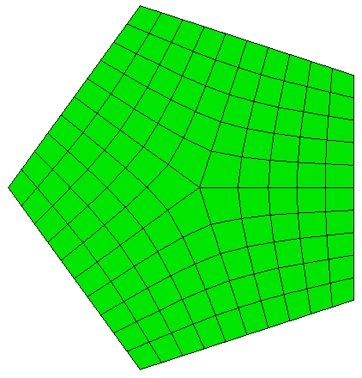
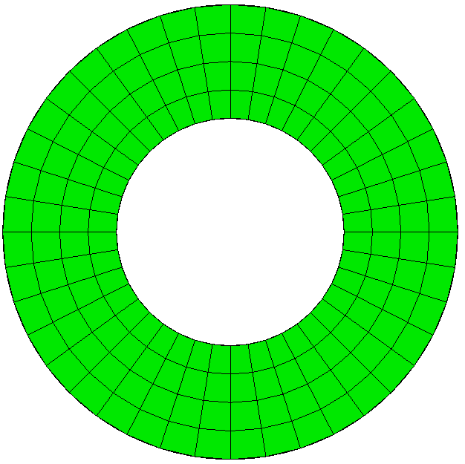
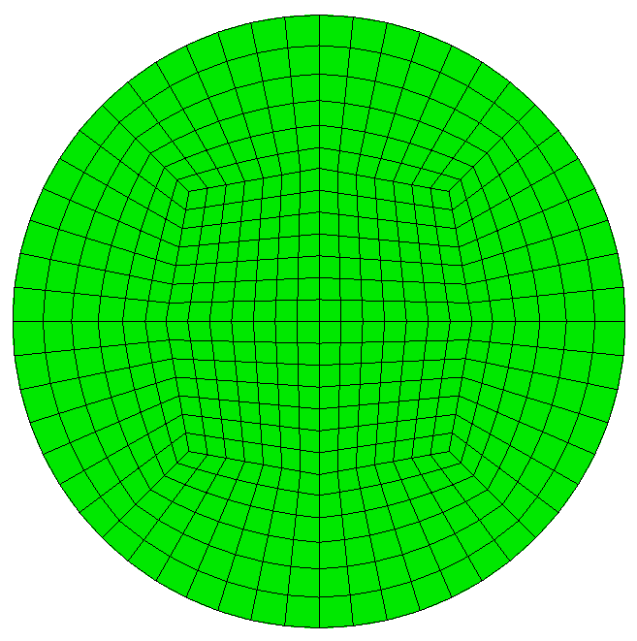
Surface Meshing Schemes
CUBIT™ Provides a number of different surface mesh schemes. Choosing the best scheme depends on the shape and number of curves in the surface. Your choice also depends on how you plan to mesh the volume.
TriMesh
Map
SubMap
Pave
TriPrimitive
Polyhedron
Hole
Circle

Slide 4
TriAdvance Scheme
Advancing Front: Starts from the boundaries, placing elements one at a time.

Slide 5
TriAdvance Scheme
Advancing Front: Starts from the boundaries, placing elements one at a time.

Slide 6
TriDelaunay Scheme
Delaunay: Inserts points into triangulation to satisfy Delaunay Criteria

Slide 7
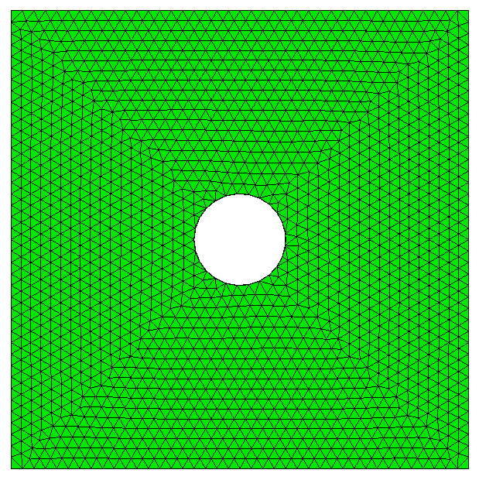
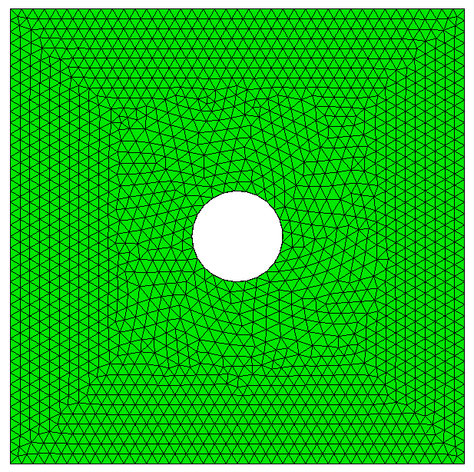
TriMesh Scheme
TriAdvance
TriDelaunay
TriMesh Scheme = Defaults to TriAdvance. If fails will automatically use TriDelaunay

Slide 8
Quad Meshing Schemes
Map
Pave
Interior node valence is constant.
ie. number of elements at each interior node=4
Meshing algorithm relies on specific topology constraints.
ie. number of sides=4
Interior node valence varies.
ie. number of elements at each node=3,4,5…
Meshing algorithm applies to arbitrary topology
ie. number of sides is arbitrary

Slide 9
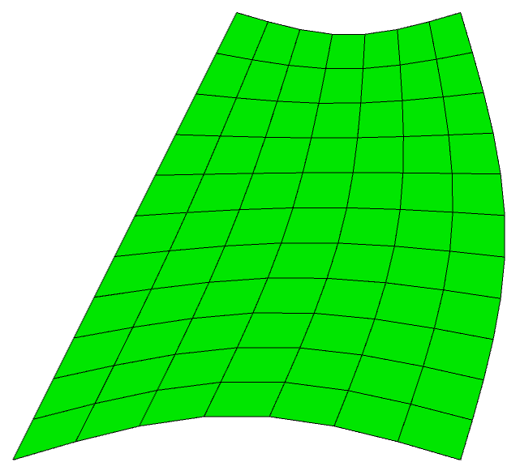
Map Scheme
straight segment
Transfinite
Interpolation

Slide 10
Submap Scheme
Blocky-type surfaces (principally 90 degree angles)
Automatically decomposes surface into mappable regions based on assigned intervals

Slide 11
Paving Scheme
Form new row and check for overlap
Seams
Insert “Wedge”
Advancing Front: Begins with front at boundary
Forms rows of elements based on front angles
Must have even number of intervals for all-quad mesh

Slide 12
Paving
Close Loops and smooth
Advancing Front: Begins with front at boundary
Forms rows of elements based on front angles
Must have even number of intervals for all-quad mesh

Slide 13
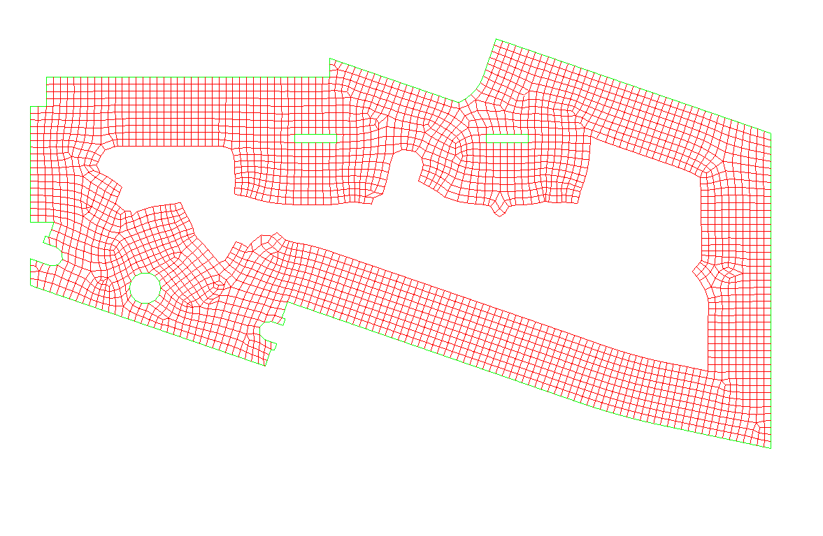
Paving
Example
Show the paving algorithm in action
Import the Acis file cad6.sat
Use the following commands to display the paver in action
draw surface 109
vol all size 1
set debug 9 ON
mesh surf 109
set debug 9 OFF
The debug option 9 will display the paver’s progress as it meshes

Slide 14
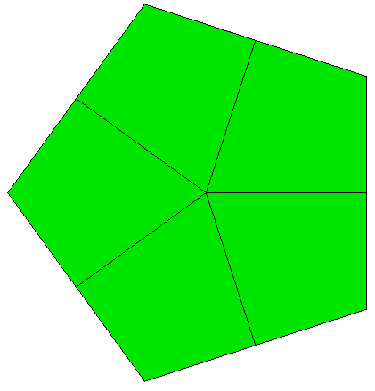
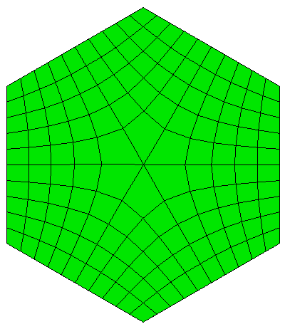
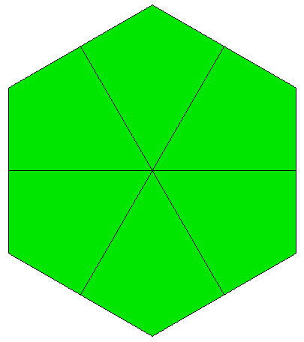
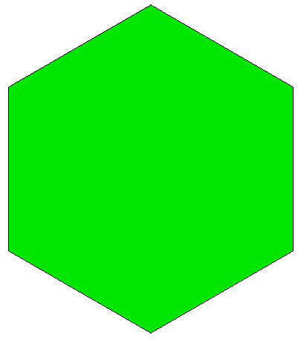
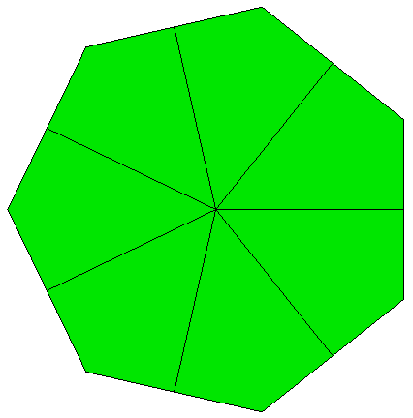
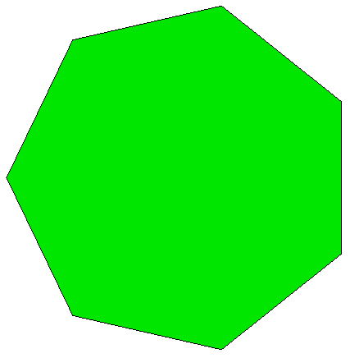
Polyhedron Scheme
Regular convex polygons
Each side is subdivided, and one node placed at the interior to create quadrilaterals
TriPrimitive is special case of Polyhedron
Each individual quadrilateral is map meshed
Each side must have matching intervals

Slide 15
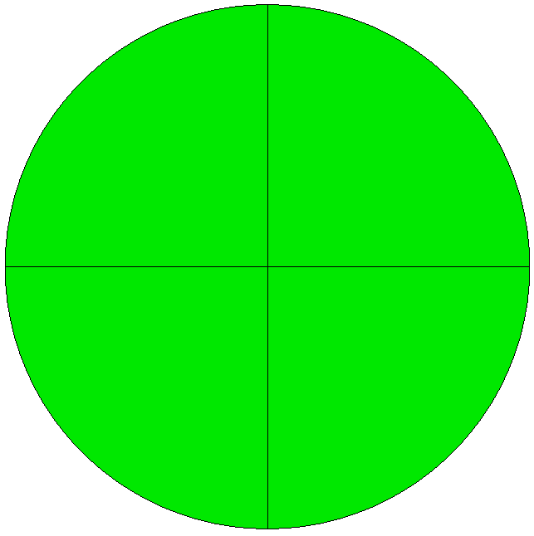
Circle and Hole Schemes
Circle Scheme
Hole Scheme
Uses four TriPrimitives
Uses Mapped Mesh

Slide 16
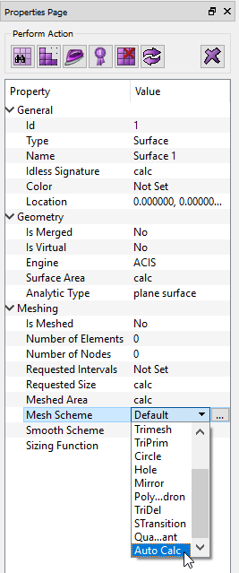
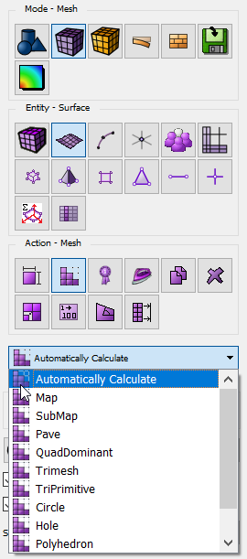
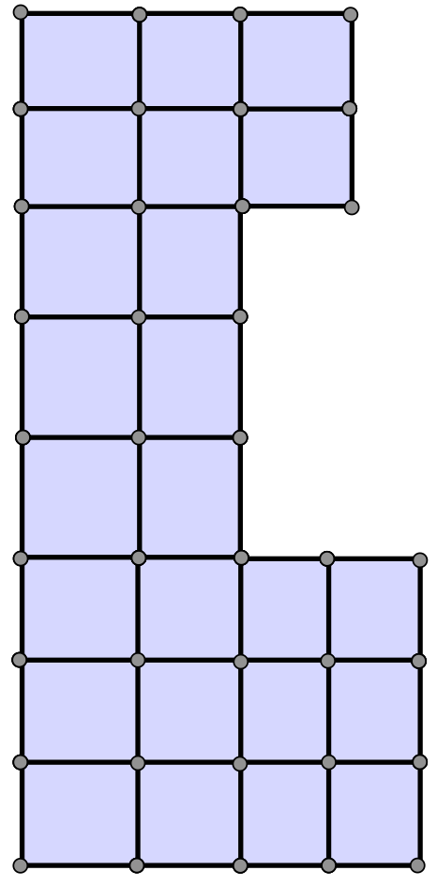
Surface Auto Scheme Selection
By default all volumes and surfaces are assigned the scheme Auto.
Schemes can be manually applied from the Property Page or from the CUBIT™ Surface Meshing Command Panel.
By choosing Automatically Calculate, Cubit will attempt to select the
best mesh scheme for the surface
Scheme will be set based on characteristics of geometry.
1. Map
2. SubMap
3. TriPrim
4. Pave
CUBIT™ Property Page
CUBIT™ Surface Meshing
Command Panel
Priority of surface meshing schemes for auto

Slide 17
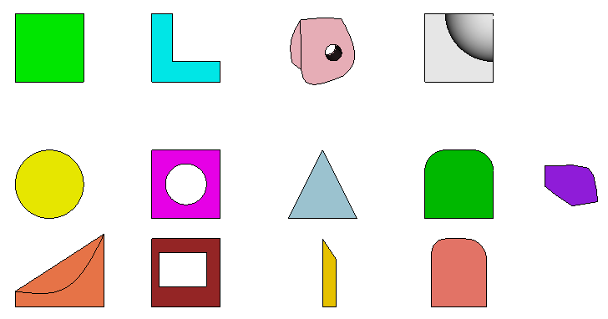
Surface Meshing Schemes
What surface meshing schemes would you select for each shape?

Slide 18
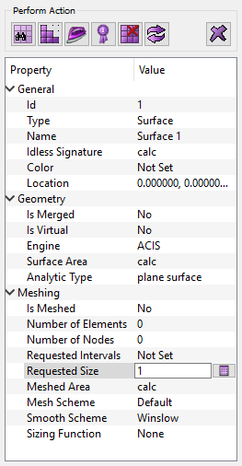
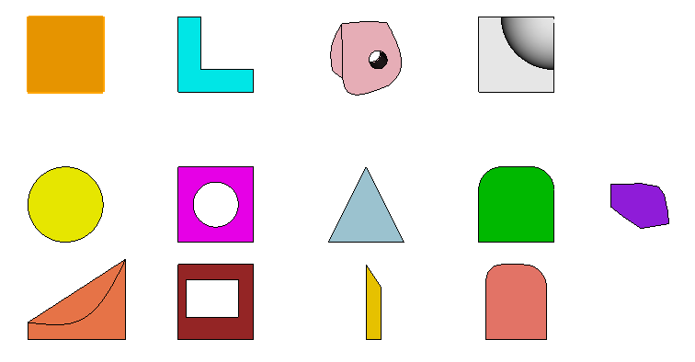
Surface Meshing Schemes Exercise
1
Import file schemes.sat
2
Set surface selection mode
2
3
Select a surface to mesh
6
4
Set a requested size of 1.0 in property panel
5
Choose a meshing scheme from property panel
or choose auto
6
Mesh the surface
Repeat for each surface
4
3
5

Slide 19
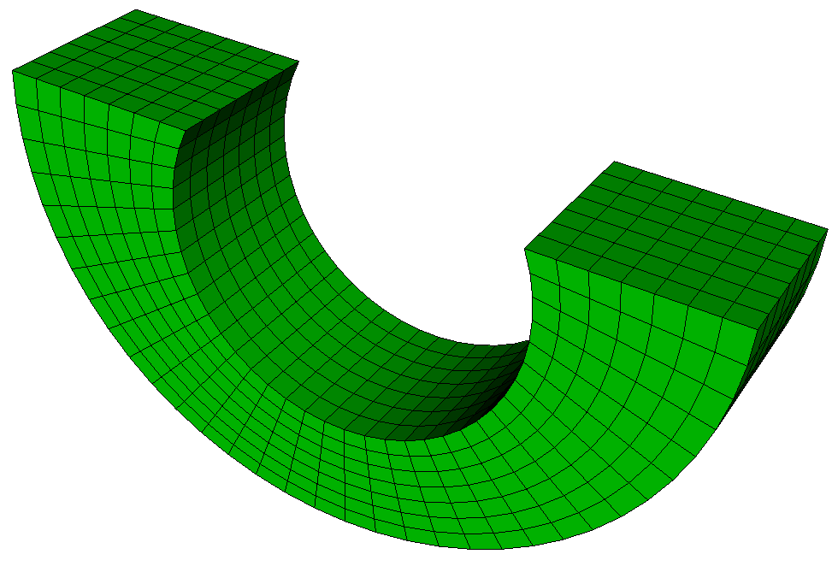
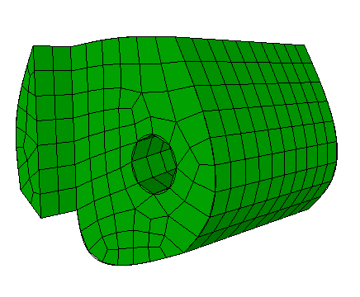
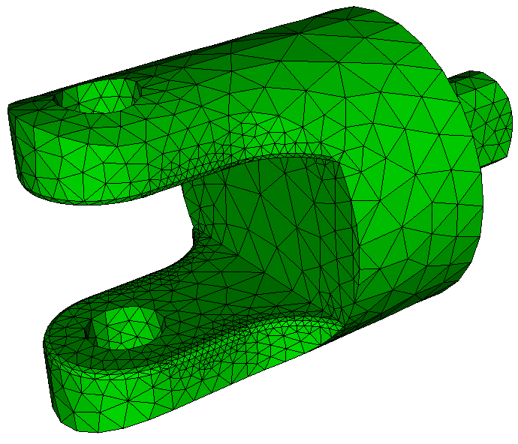
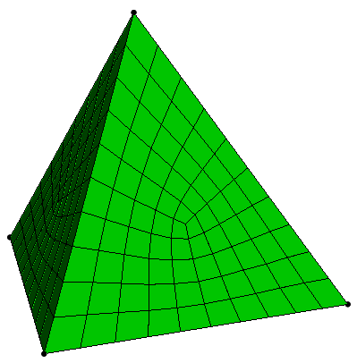
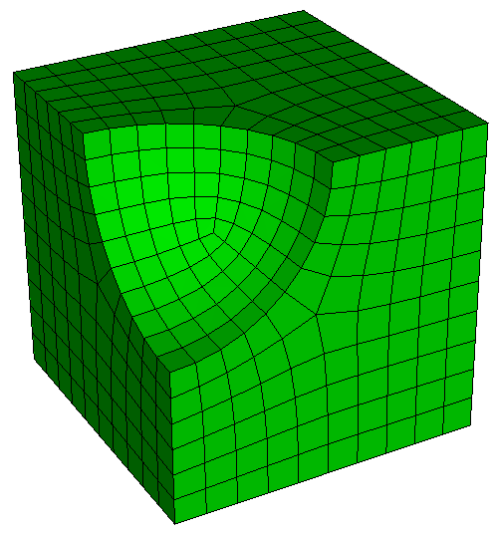
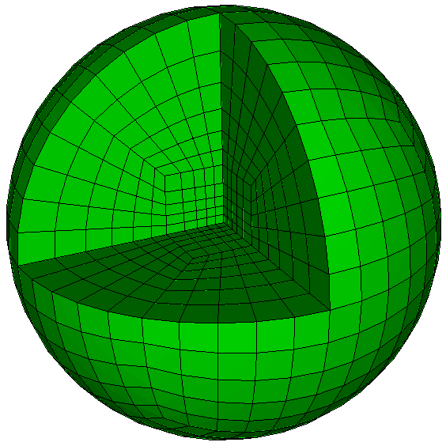
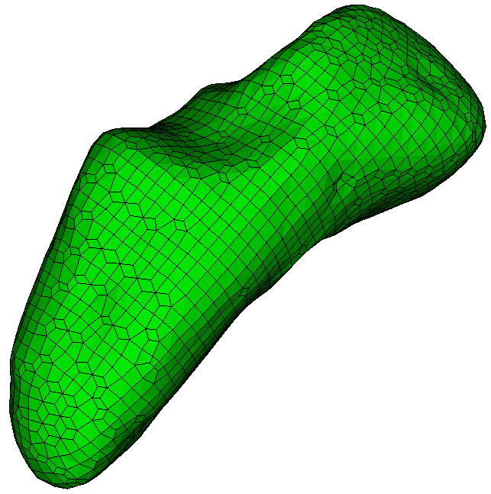
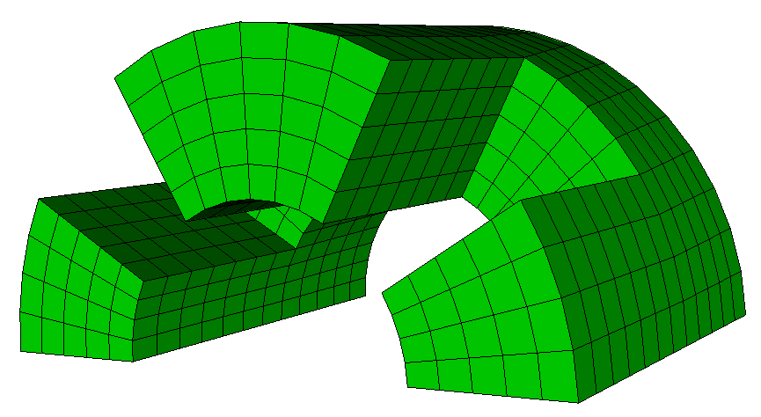
Volume Meshing Schemes
CUBIT™ Provides several different volume mesh schemes. Similar to Surface Scheme Selection, Volume Scheme Selection is based on the shape of the geometry and the requirements of the analysis code.
Map
Sweep
TetMesh
TetPrimitive
SubMap
Polyhedron
Sphere
Sculpt Parallel

Slide 20
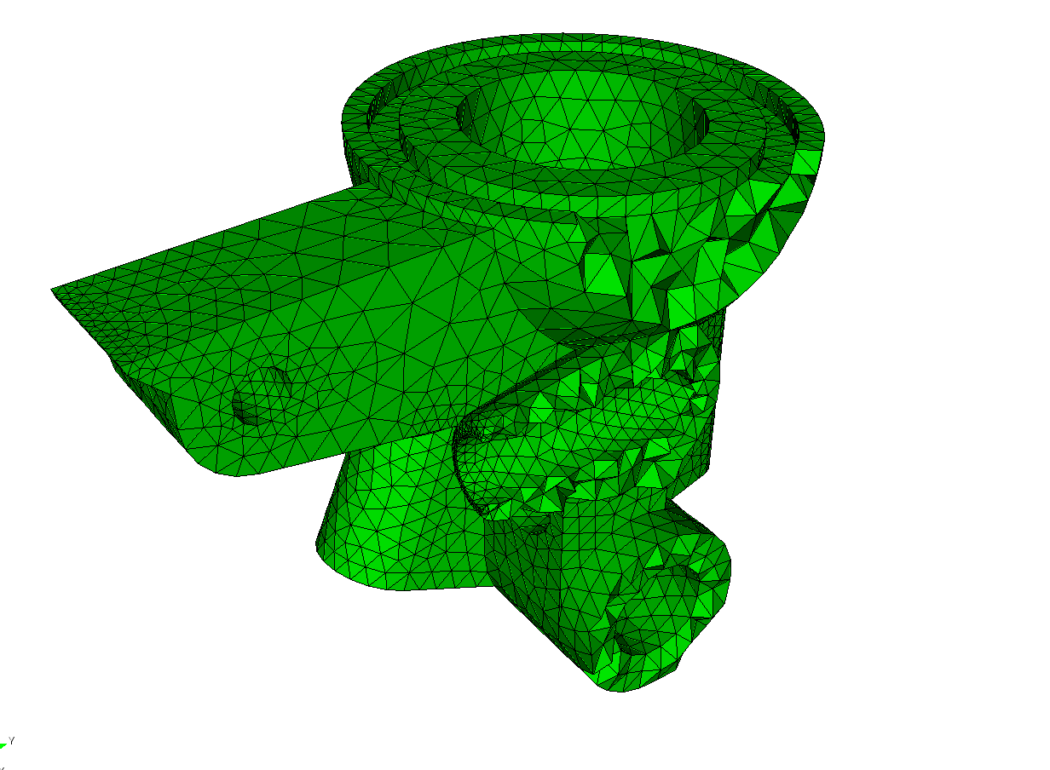
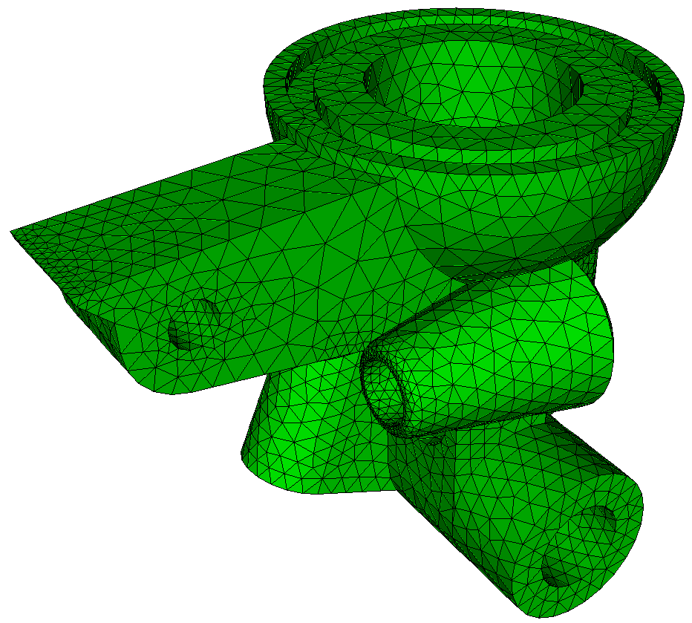
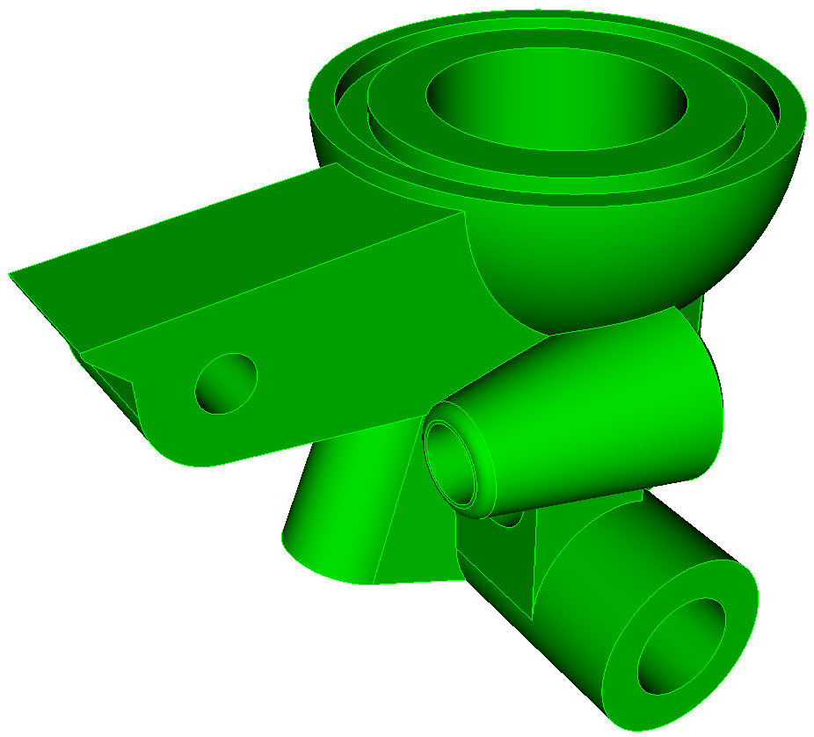
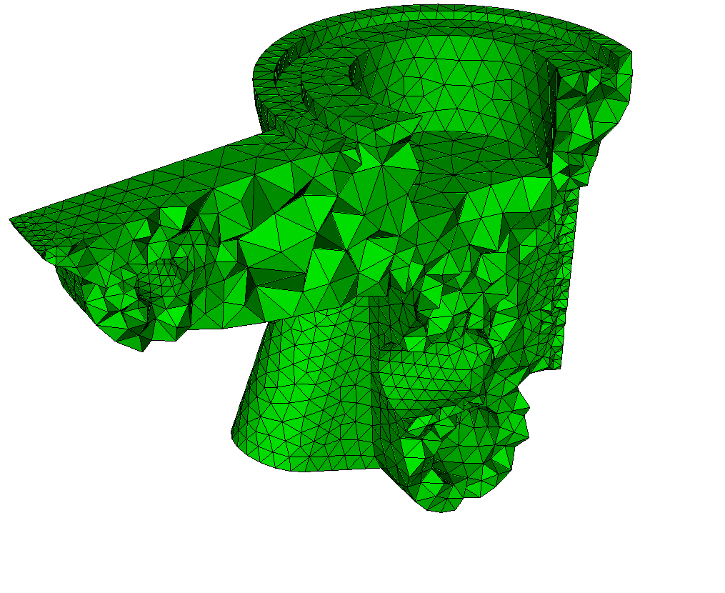
TetMesh Scheme
Arbitrary geometry
Mostly push-button/automatic
May still require geometry clean-up

Slide 21
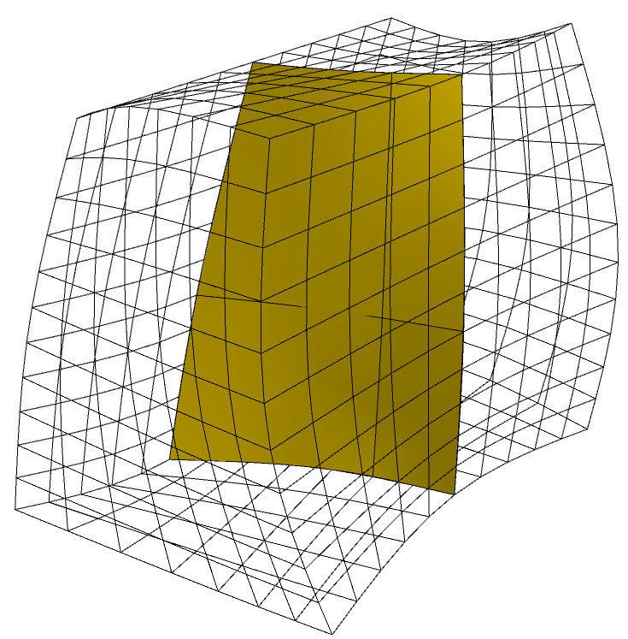
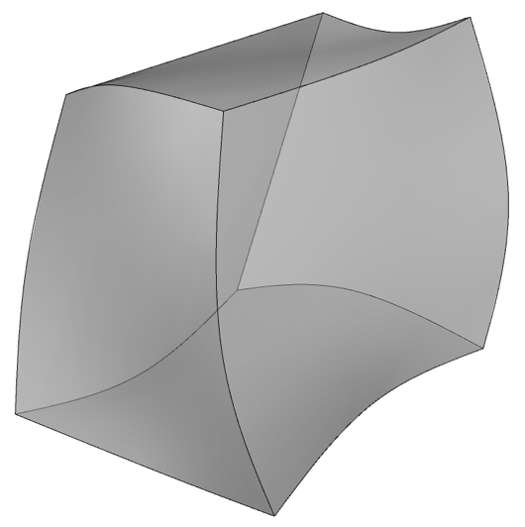
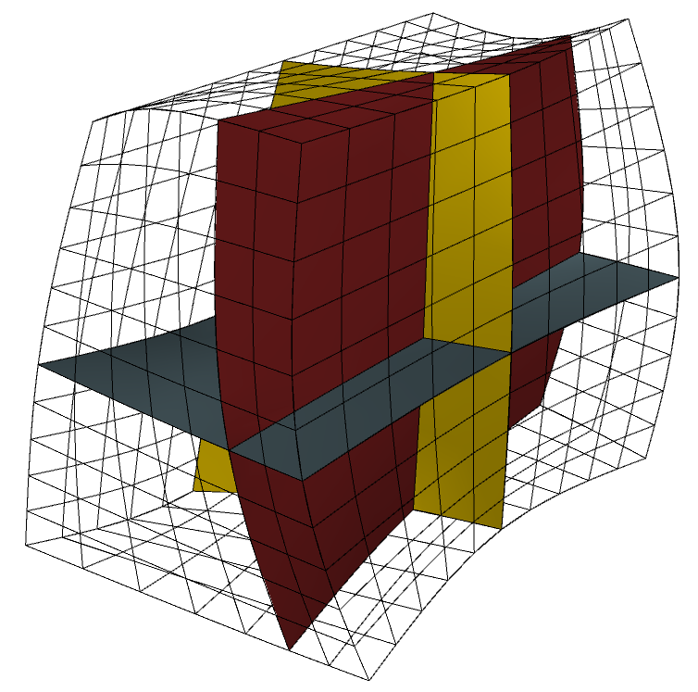
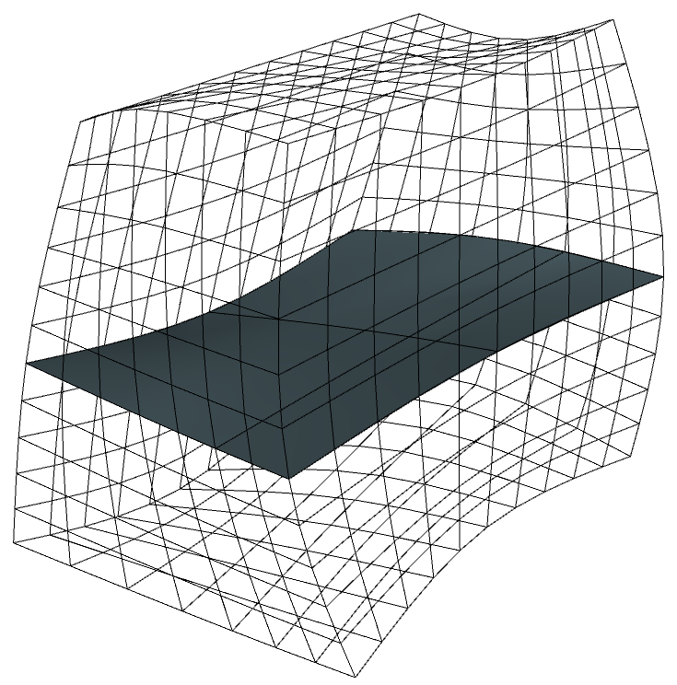
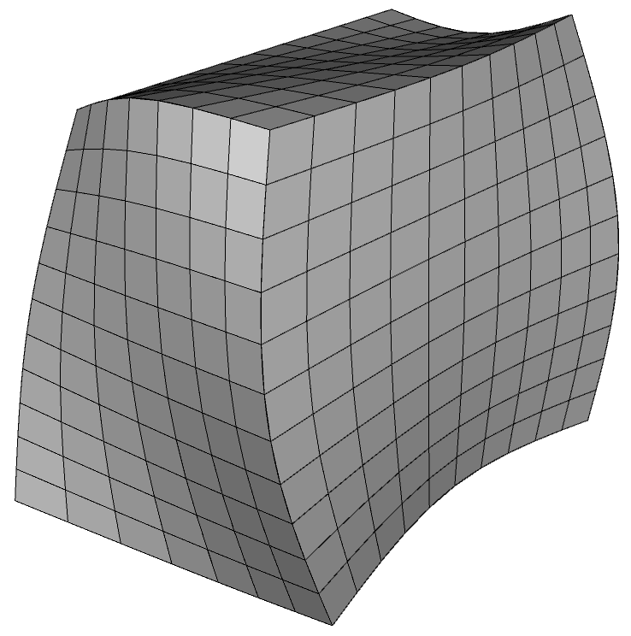
Map Scheme
6 surfaces
Angles near 90 degrees
All surfaces mappable

Slide 22
SubMap Scheme
Blocky Shapes
Angles near 90 degrees
All surfaces mappable

Slide 23
Polyhedron Scheme
TetPrimitive: Special case of Polyhedron
Requires 3-valent vertices and convex polyhedron
Breaks volume into mappable regions

Slide 24
Sphere Scheme
Spheres: treat as 8 TetPrimitives
Subdivide each triangle face into quadrilaterals
Insert an interior node
Generate tetrahedron subdivision in each octant
Generate mapped mesh in each hexahedron region

Slide 25
Sculpt Parallel
Ideal for non-mechanical/
organic shapes
But can be used for any geometry
Overlay Grid Method
Uses Cartesian Grid as Base Mesh
Adjusts nodes to geometry
Inserts Layer of Hexes

Slide 26
Sculpt Parallel
Sculpt is a separate companion application to CUBIT™ .
Does not use Scheme, instead uses Sculpt Parallel command.
Mesh
Can be run from CUBIT™ GUI or in batch from OS command line
Volume
Parallel application uses MPI to run on multiple cores/processors
Sculpt
See Lecture 21 for more details/exercises

Slide 27
Sweep Scheme
Source Surfaces
One or more surfaces
Can be meshed with any Quad Scheme (Pave, Map)
Source surfaces
Source surfaces
Source surfaces
Source surfaces
Source surfaces
Source surfaces
Source surfaces
Source surfaces
Source surfaces
Source surfaces
Source surfaces
Source surfaces
Source surfaces
Source surfaces
Source surfaces
Source surfaces
Source surfaces
Target surface
Target surface
Target surface
Target surface
Target surface
Target surface
Target surface
Target surface
Target surface
Target surface
Target surface
Target surface
Target surface
Target surface
Target surface
Target Surface
Must be a single surface
Must be unmeshed
Matches topology of source surfaces
Target surface

Slide 28
Linking surfaces
Linking surfaces
Linking surfaces
Linking surfaces
Linking Surfaces
Must be “Mappable”
Connect Sources with Target

Slide 29
Sweep Scheme
Most frequently used meshing scheme
Normally requires geometry to be decomposed to apply sweeping (webcutting)

Slide 30
Sweep Scheme
Setting Source and target Surfaces
Shortcut from property panel to scheme selection
1
1
Navigate to Scheme Selection Command Panel
2
Choose Sweep Scheme
2
3
Pick Sources and Targets
1
4
Apply Scheme
3
4

Slide 31
Sweep Scheme
One-to-one
Many-to-one
Many-to-many
Multiple
Sources
Multiple
Sources
Source
Sweep Direction
Sweep Direction
Sweep Direction
Target
Target
Multiple
Targets

Slide 32
Sweep Schemes
What type of sweep scheme is used on each of these meshes?
One-to-one
One-to-one
Many-to-many
Many-to-many
Many-to-many
Many-to-one

Slide 33
Sweep Scheme
Typical one-to-one sweeps
translation
rotation
inside-out

Slide 34
Sweep Scheme
Volume Sweep questions to ask:
1. Do I have a single target surface?
2. Can all the linking surfaces be mapped or Submapped?
3. Do I see a path through the volume in which a layer by layer set of Hexes could reasonably be generated?

Slide 35
Sweep Scheme
Can this volume be swept as shown?
Mapped linking surface
Source surface
Target surface

Slide 36
Sweep Scheme
Can this volume be swept as shown?
No
The mesh needs to “flow“ in the direction of the target surface
Mesh “flow” direction
Source surface
Target surface

Slide 37
Sweep Scheme
Try to visualize a layer-by-layer creation of the mesh from the source surface to the target surface.
Sweepable source-link-target set
source surface
Target surface

Slide 38
Volume Auto Scheme Selection
Volume Schemes can be manually applied from the Property Page or from the CUBIT™ Surface Meshing Command Panel.
By choosing Automatically Calculate, CUBIT™ will attempt to select the
best mesh scheme for the surface
Scheme will be set based on characteristics of geometry.
1. Map
2. SubMap
3. Sweep
Priority of surface meshing schemes for auto
Auto scheme may need some help. May need to select sources/target manually
CUBIT™ Property Page
CUBIT™ Volume Meshing
Command Panel
Pave

Slide 39
Volume Meshing Schemes Exercise
1
Reset and reimport schemes.sat
Before meshing, inspect the volumes and try to determine what volume schemes should be used.
Using the Property Page set requested interval size to 1.00 before attempting to mesh.
Using the Property Page Reset each volume, set size and choose an appropriate Mesh Scheme and mesh
Using the Property Page Reset each volume and choose Auto Calc to allow Cubit to select the mesh scheme.
2
3
4
5

