Slide 1
CUBIT™ Fast-Start Tutorial
8. The Immersive Topology Environment for Meshing (ITEM)
Notes:
Type: FORMAL - Training
Title: Cubit 100 Training
SAND Number: SAND2020-0679 TR
Contact: Hensley,Trevor Michael

Slide 2
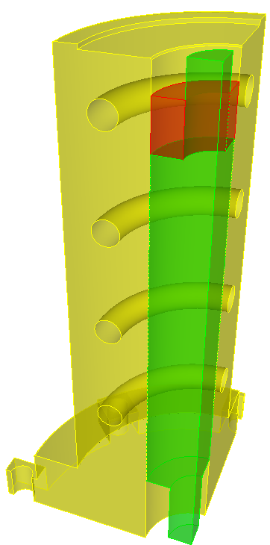
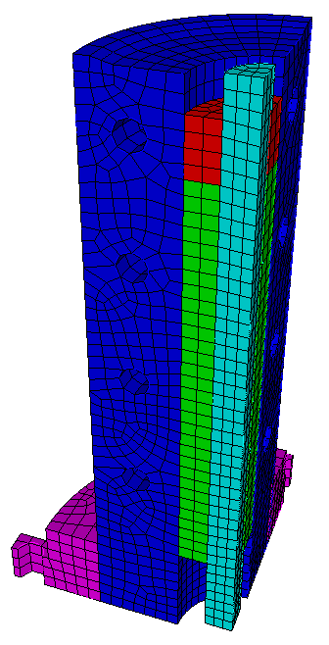
CAD to Mesh
Fix misalignments between volumes
Remove small/unwanted features
Decompose into sweepable volumes
Imprint and Merge Parts
Set Schemes and Intervals
Generate Mesh
Check quality and improve
CAD Model
Mesh
The CAD to mesh process can be a complex series of iterative steps requiring in-depth understanding of the model and its flaws, expertise in using the software, and creativity to infer and apply solutions.

Slide 3
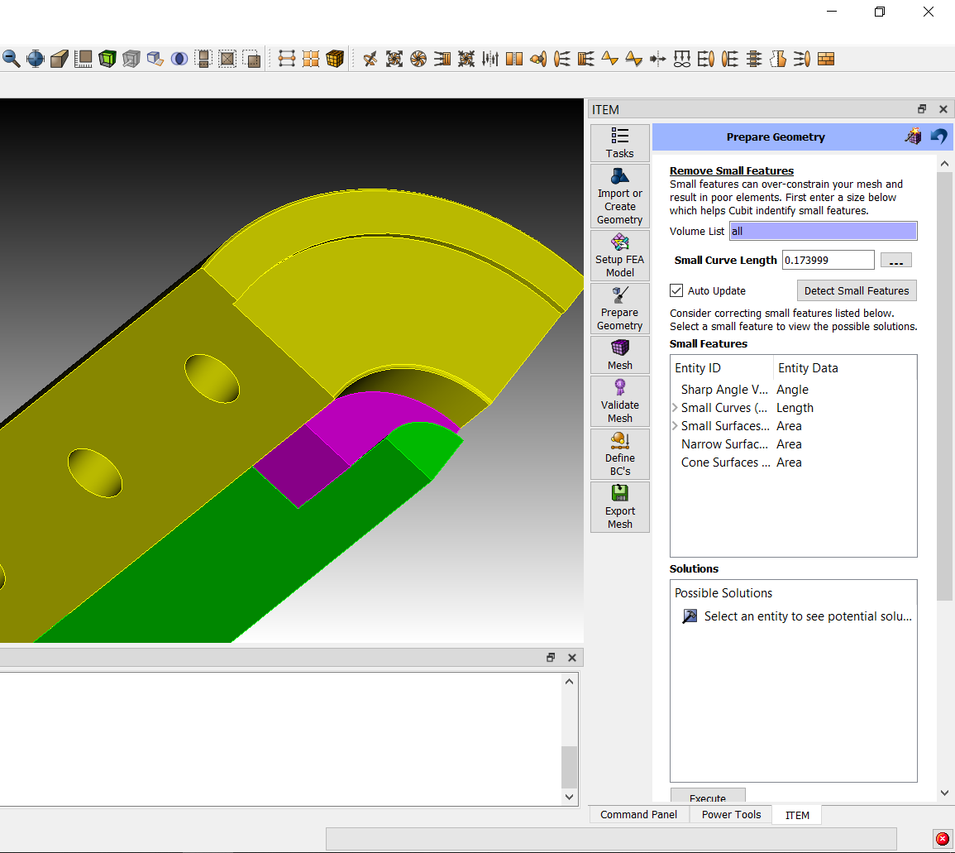
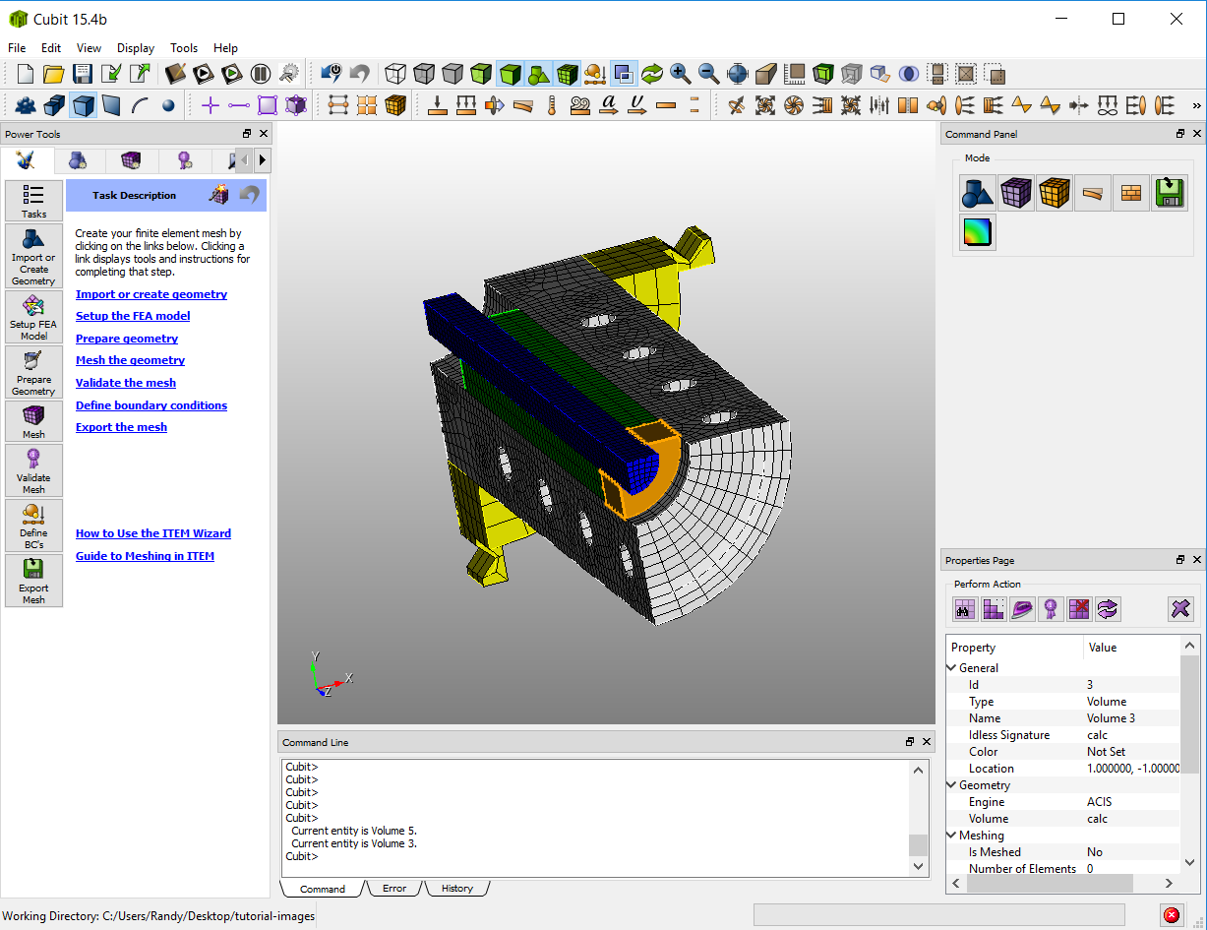
ITEM Overview
Immersive Topology Environment for Meshing
Designed to help the new or intermittent Cubit user
Guide the user through the simulation model preparation workflow
Provide the user with intelligent options based upon the current state of the model
Where appropriate, automate as much of the process as possible
To accomplish this, a ‘diagnostic + solution’ approach is taken.
Diagnose
Problems
Solutions

Slide 4
Summary of Problems/Diagnostics
Problem | Diagnostic | Solutions
Small Curves | Curve length < ε | composite surfaces collapse curve remove topology
Small Surfaces | Surface area < ε² | regularize remove/extend surfaces composite surfaces remove topology
Narrow Surfaces | d_{i} < ε for all curves on surface
Surfaces with Narrow Regions | d_{i} < ε for some curves on surface | split off narrow region and treat as narrow surface
Misaligned volumes | Near coincident vertex or misalignment check | tweak surf A to surf B tweak surf B to surf A
Unmerged surfaces | Overlapping surfaces check | force merge imprint vertices imprint curves
Non-sweepable/mapable topology | Autoscheme tool | cut locations based upon dihedral angles and connectivity graph
Nearly sweepable | Autoscheme tool + sweep suggestions | suggested source/target pairs
Linking surfaces not mapable | Linking surfaces: Curve length < ε Interior angles deviate significantly from 90° | composite surfaces
Poor mesh quality | Quality metric < threshold | Mean Ratio or Smart Laplacian smoothing applied to entire mesh element quality group individual elements

Slide 5
Select this icon

Slide 6
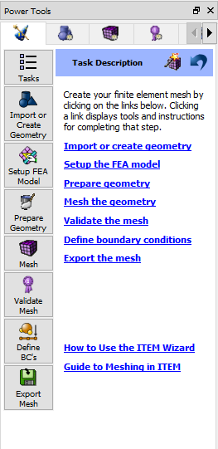
Interface is presented in the recommended order of operation.
Define geometry
Establish parameters
Prepare geometry
Mesh
Validate
Setup BCs
Export

Slide 7
This menu allows the user to skip from section to section in ITEM if necessary.
Press to Undo
“Magic” Mesh Button Will attempt to mesh the model in its current state
Help for ITEM

Slide 8
Use the Setup page to establish default mesh size and element shape.
Interactively preview mesh size on curves when changing mesh size or density
Change either element budget, element size or mesh density. Others will update

Slide 9
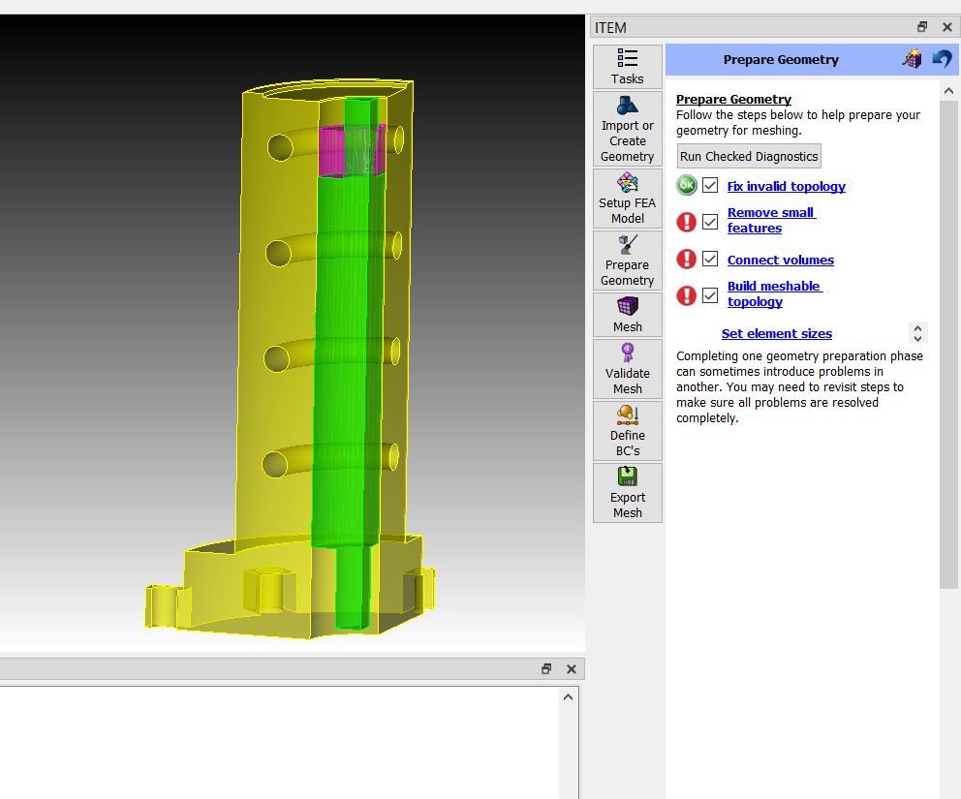
The Prepare Geometry page will help identify problem areas in the geometry.
Icons indicate potential problems yet to be resolved.
Click on link for help in resolving
Important: May need to rerun diagnostics several times during geometry preparation

Slide 10
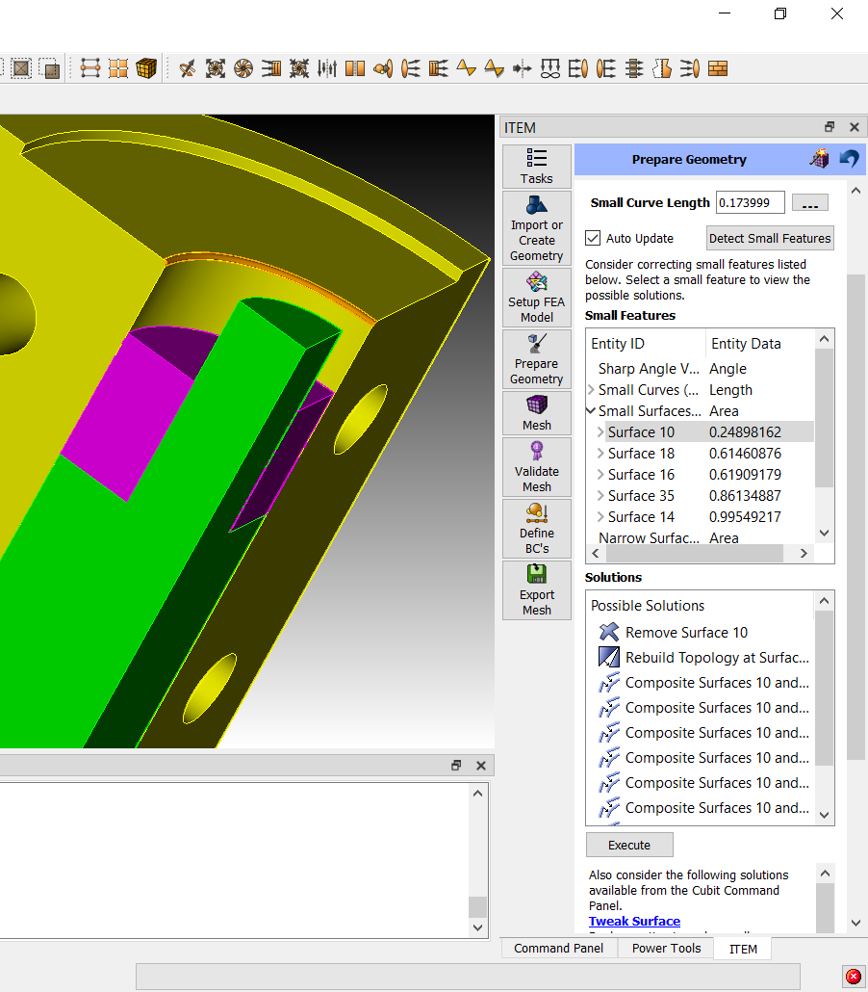
Remove Small Features Page
Press “Detect Small Features” button to run diagnostics
List of geometric entities that fail the diagnostic test. Left click to see solutions for an entity. Right click to zoom, point to, fly-in, etc.
List of specific solutions for selected entity. Left click to see a preview of the solution. Right click to get help or execute the solution (or press Execute button)

Slide 11
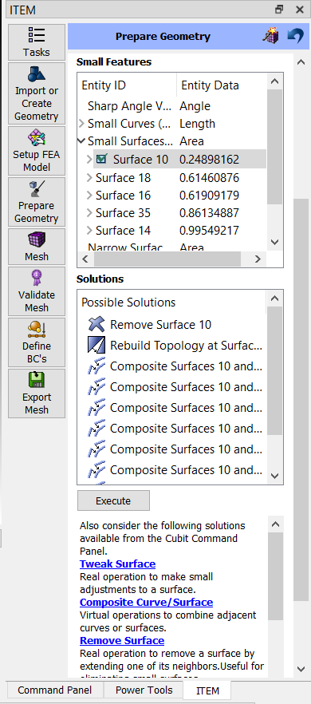
The user may choose to mark a problem entity as ‘okay’.
CUBIT™ won’t report it as a problem thereafter.
ITEM may NOT provide the desired solutions.
Following these links will take you to a CUBIT™ command panel
It may be necessary to use both ITEM solutions and the command panels to get the desired results

Slide 12
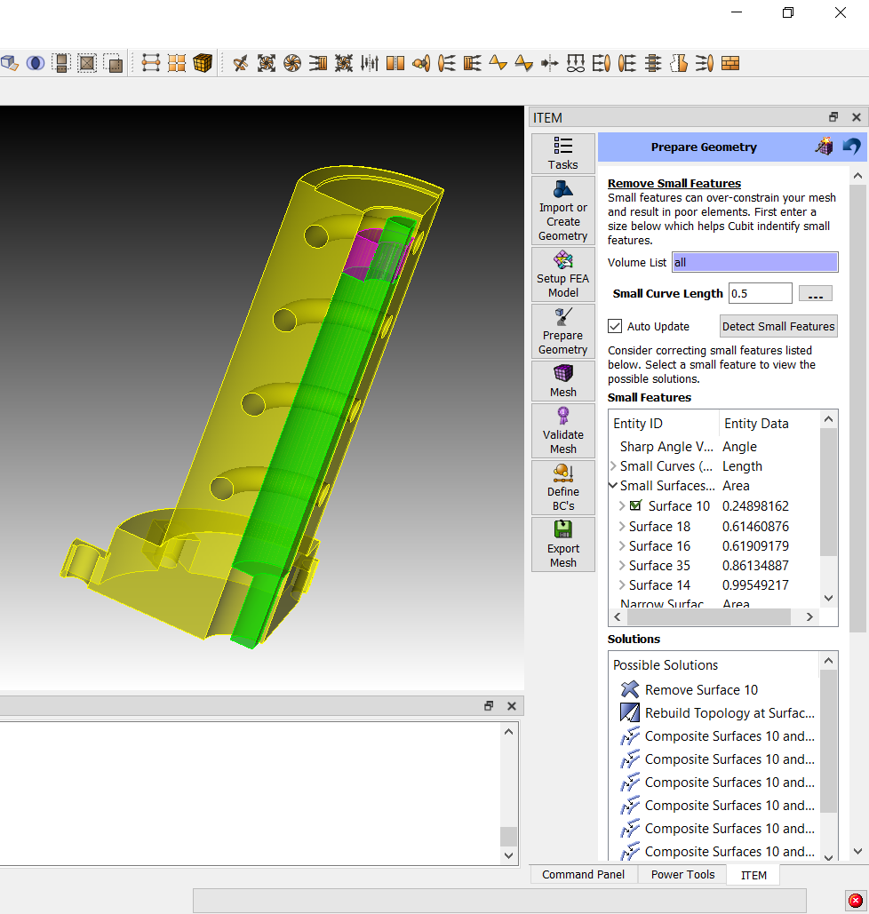
User may choose to change the small curve length threshold.
Changing the small curve size will change the number of entities that are detected

Slide 13
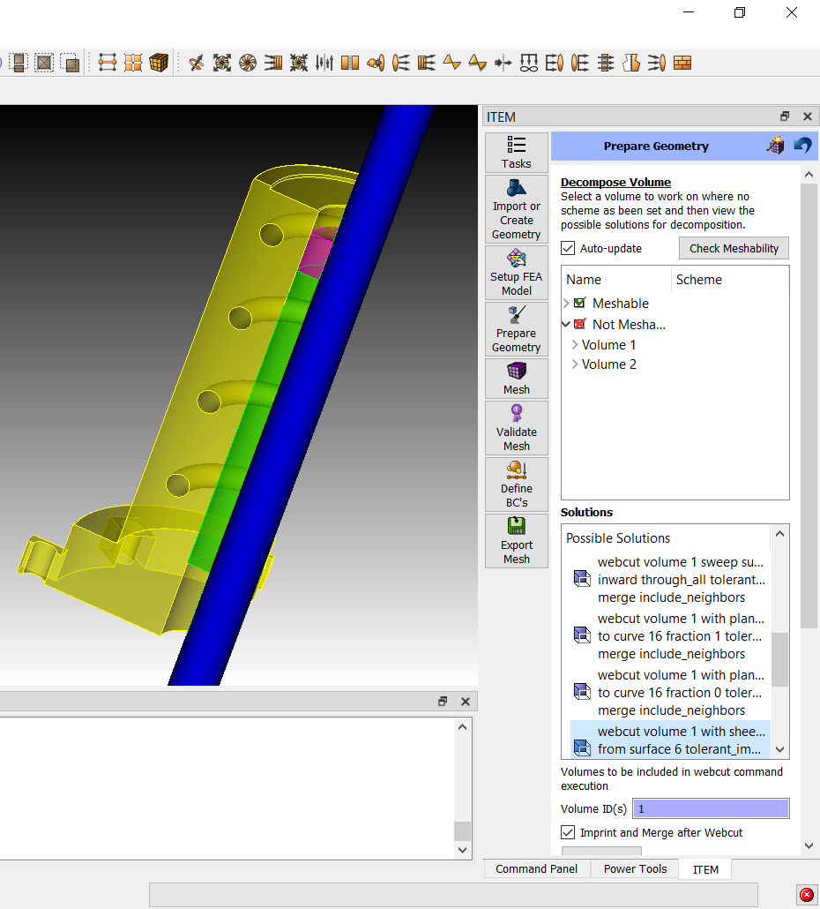
Selecting a solution will preview the webcut.
It may be necessary to include other volumes in the webcut. Indicate those other volume ids here.

Slide 14
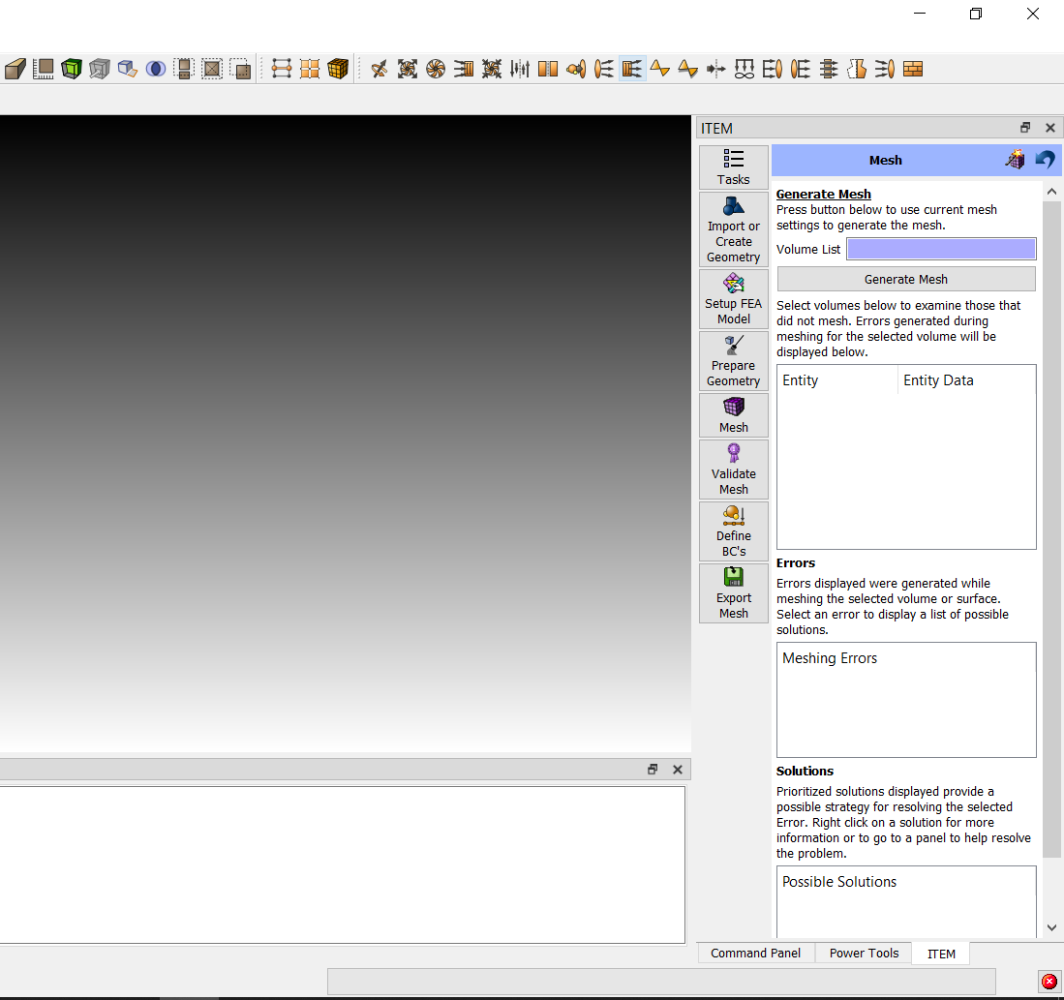
ITEM Exercise
Use ITEM to mesh item-example.sat
Notes:
When diagnosing small features I set the ‘small curve size’ to 1 – This way the narrow surface at the base of the cylinder will be flagged as bad and can be removed.
Need to core out the cylinder first
Remove the blends

