Slide 1
CUBIT™ Fast-Start Tutorial
7. CUBIT™ Power Tools
Notes:
Type: FORMAL - Training
Title: Cubit 100 Training
SAND Number: SAND2020-0679 TR
Contact: Hensley,Trevor Michael

Slide 2
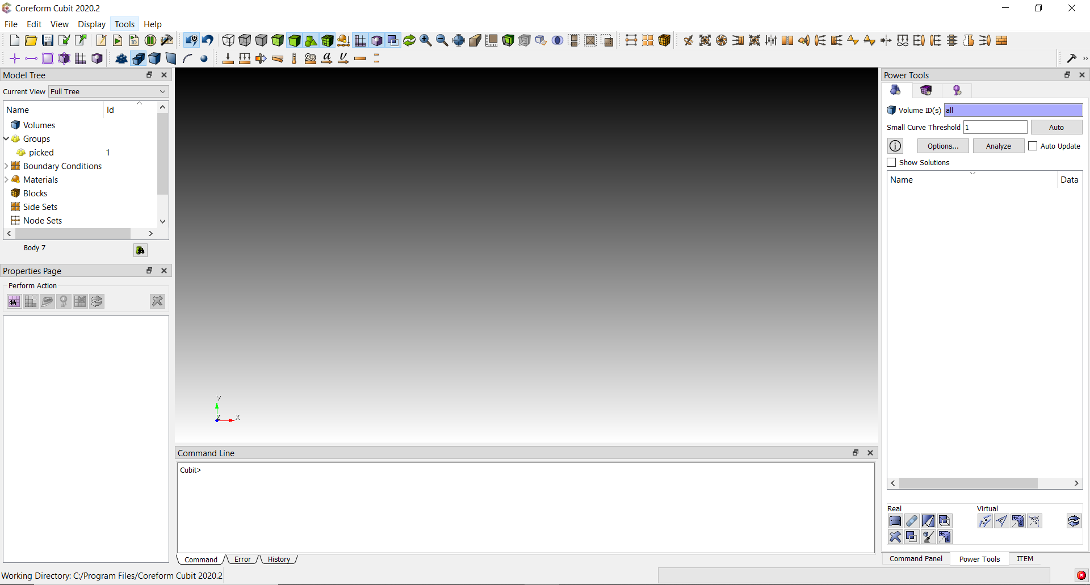
Power Tools
Power Tools Dock Widget tab is located next to the command panels by default.

Slide 3
Geometry Power Tools
Geometry Power Tools are located in the First tab of the PowerTools window.

Slide 4
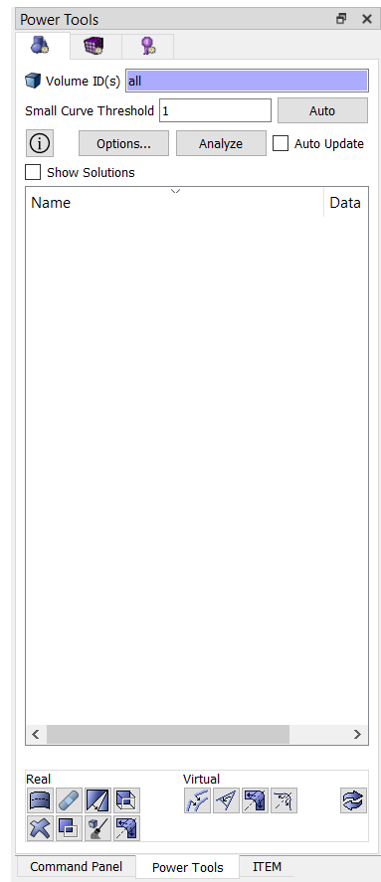
The Geometry Power Tools Panel
Entities to analyze
Characteristic mesh size
Run geometry analysis
Geometry analysis output
Geometry Operations

Slide 5
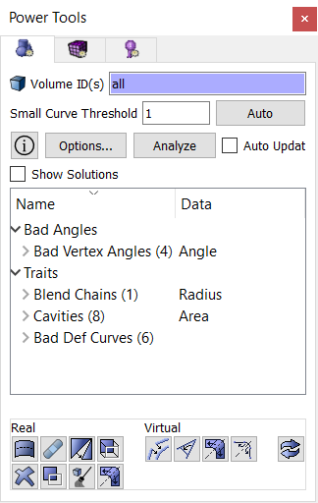
Example: Using the Geometry Power Tools
Import knuckle.sat
Select “all” or “1” for volumes to analyze
Enter 1.5 as the shortest edge length
Hit “Analyze”
You should see results in your output window that look similar to those shown.

Slide 6
Example: Using the Geometry Power Tools
“Bad Def Curves” indicates there is a problem with the geometry definition. These are the most serious problems and should be fixed first.
Fix the geometry problem by running the healer. Hitting this button will bring up the healer dialog in the main command panel.

Slide 7
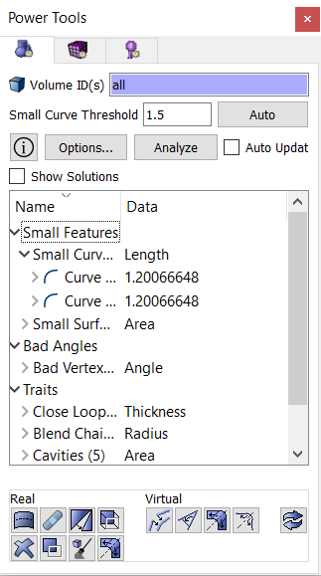
Example: Using the Geometry Power Tools
Hit the “Analyze” button again after running autoheal to remove outdated data from the output.
Expand the “Small Curves” field to see the curves that have been found.

Slide 8
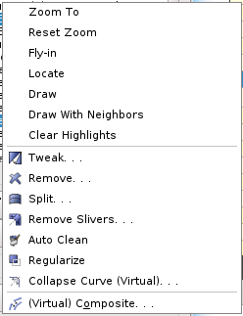
Example: Using the Geometry Power Tools
Examine the “Small Curves”. Notice the length of the curves is less than the shortest edge length entered earlier. From the expanded list right click on a curve.
Use the context menu options to examine each curve. Nothing needs to be fixed with these curves.

Slide 9
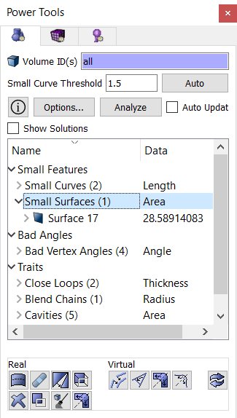
Example: Using the Geometry Power Tools
Expand the “Small Surfaces” field to see the surface that have been found.

Slide 10
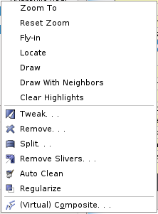
Example: Using the Geometry Power Tools
Examine the surface.
This is a surface we want to remove.
Use the “Remove Entity” button
- or -
the “Remove” option from the context menu.
These will bring up the remove surface dialog in the main command panel

Slide 11
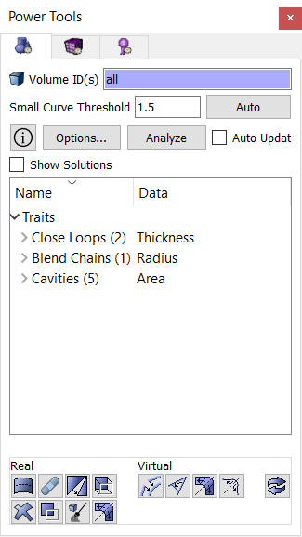
Example: Using the Geometry Power Tools
Hit the “Analyze” button again after removing the surface to remove outdated data from the output.
Check the rest of the output and remove anything else that should be remove.

Slide 12
Mesh Power Tool
Mesh Power Tools are located on the Entity Tree window under the purple tab.

Slide 13
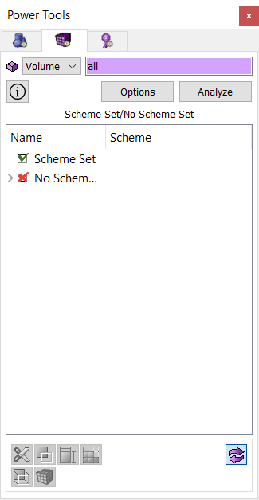
The Mesh Power Tool Panel
Entities to analyze
Run scheme analysis
Scheme analysis output
Tools for working on model

Slide 14
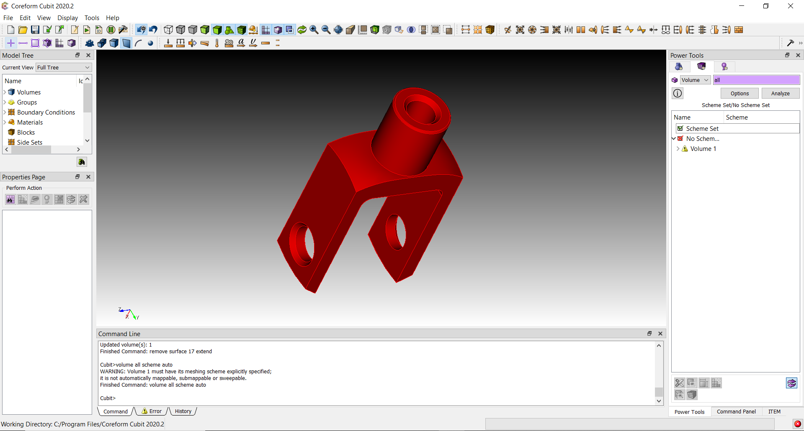
Example: Using the Mesh Power tools
Run the scheme analysis on knuckle.sat after cleaning up geometry but before doing any decomposition.
Volume 1 is painted Red, indicating no scheme set
Results are displayed in two ways
Volume 1 listed under No Scheme Set
Listed in the power tool window
Displayed Graphically

Slide 15
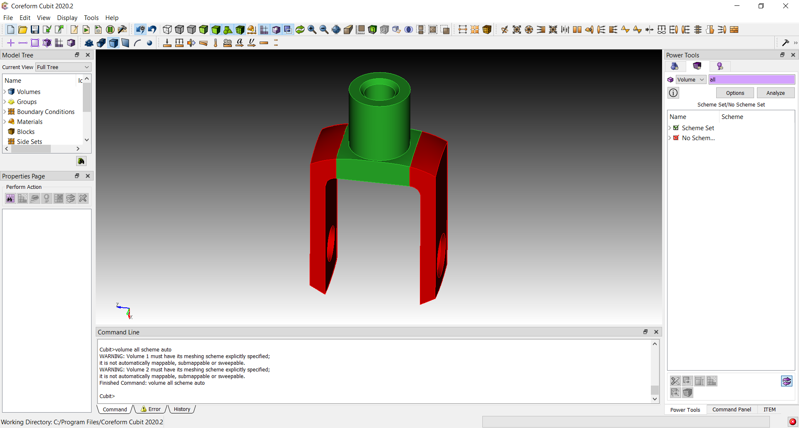
Example: Using the Mesh Power tools
Begin the decomposition process you did in Exercise 13. After each webcut, run the analysis again to check meshability
Note when a volume moves to the Scheme Set category
Volumes where scheme is set are painted green

Slide 16
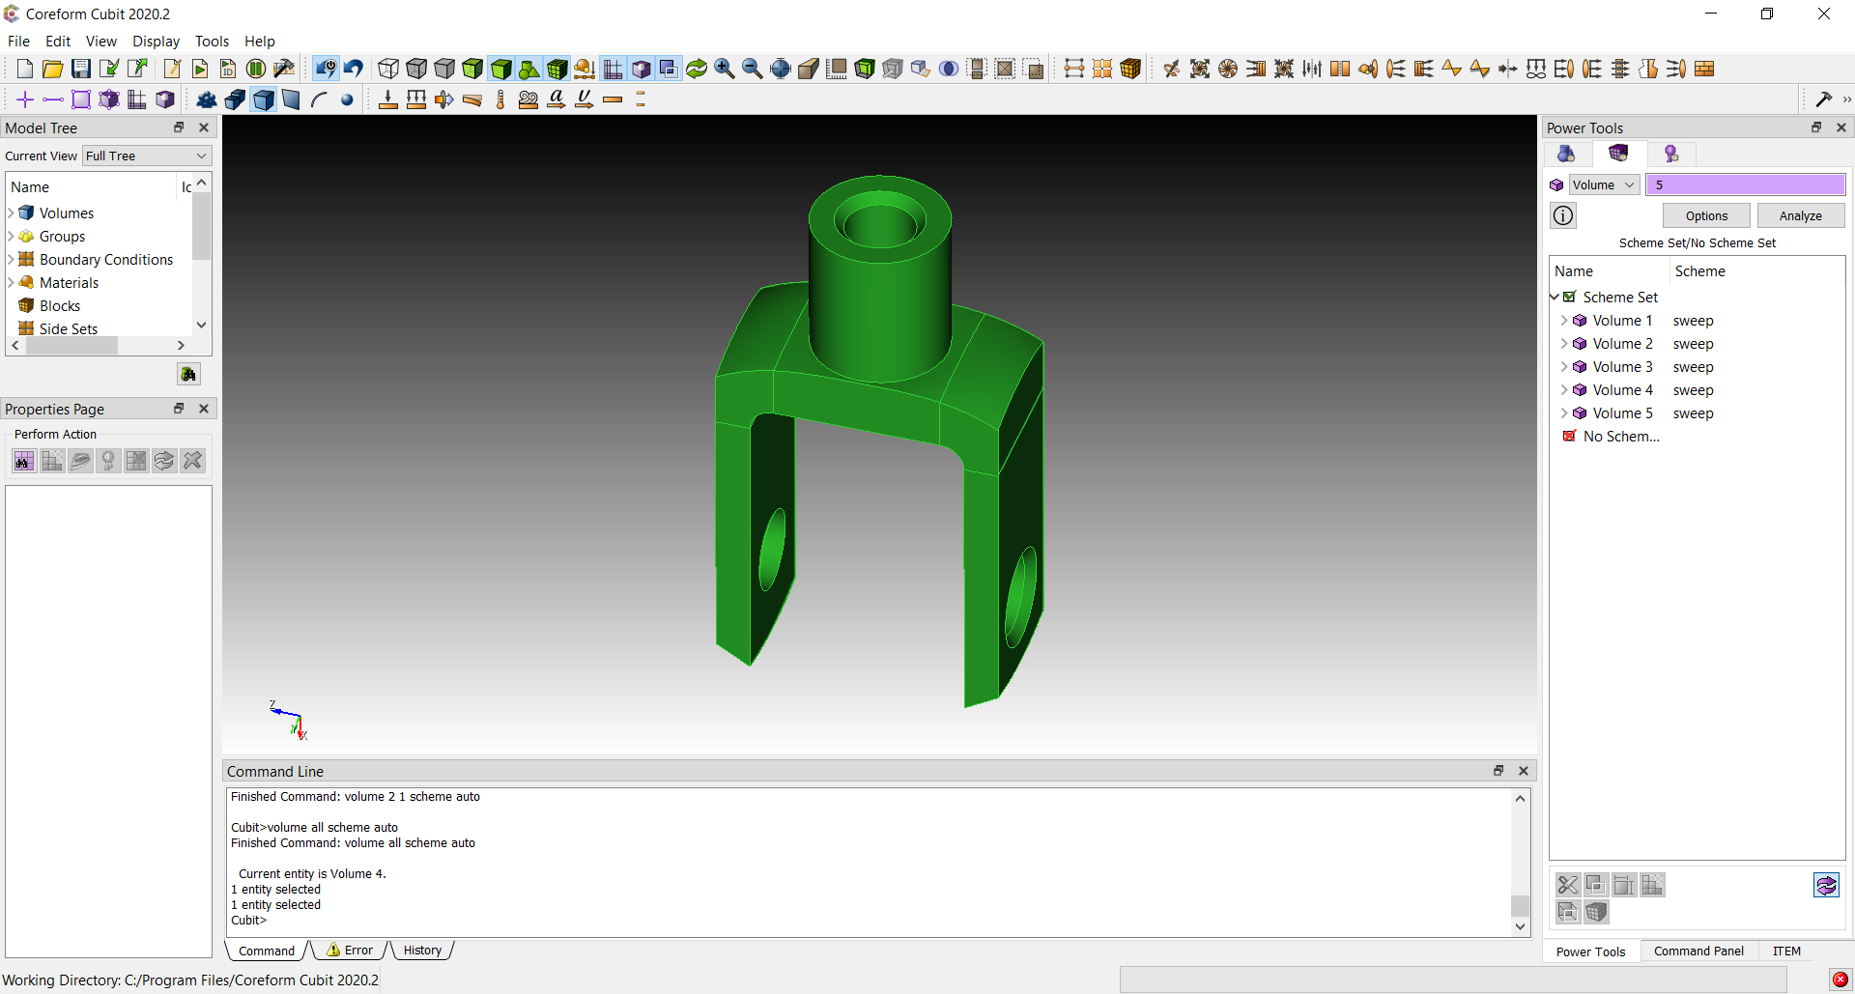
Example: Using the Mesh Power tools
Complete the decomposition
Run imprint and merge
Run the analysis again
Mesh the parts
All volumes should be painted green if schemes successfully set
All volumes should be listed under Scheme Set

Slide 17
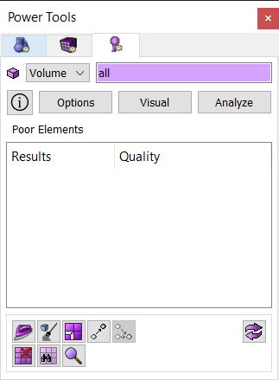
The Mesh Quality Power Tool
Hit the quality Tab to display the Mesh Quality Power Tool
Entities to analyze
Run mesh quality analysis
Select Metrics to use during analysis
Display additional mesh quality visualization options
Mesh Quality analysis output
Tools for improving element quality

Slide 18
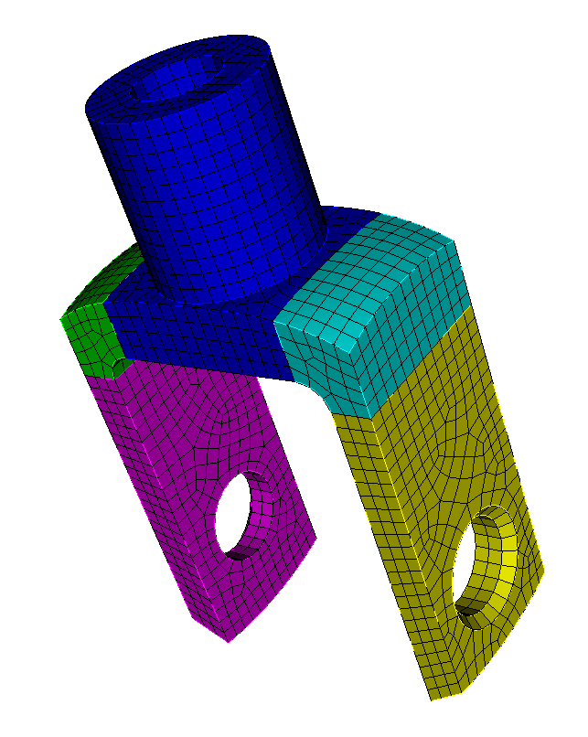
Example: Mesh Quality Power Tool
Reset CUBIT™
Import the cub file: knuckle.cub
Or use the meshed knuckle model from the previous exercise

Slide 19
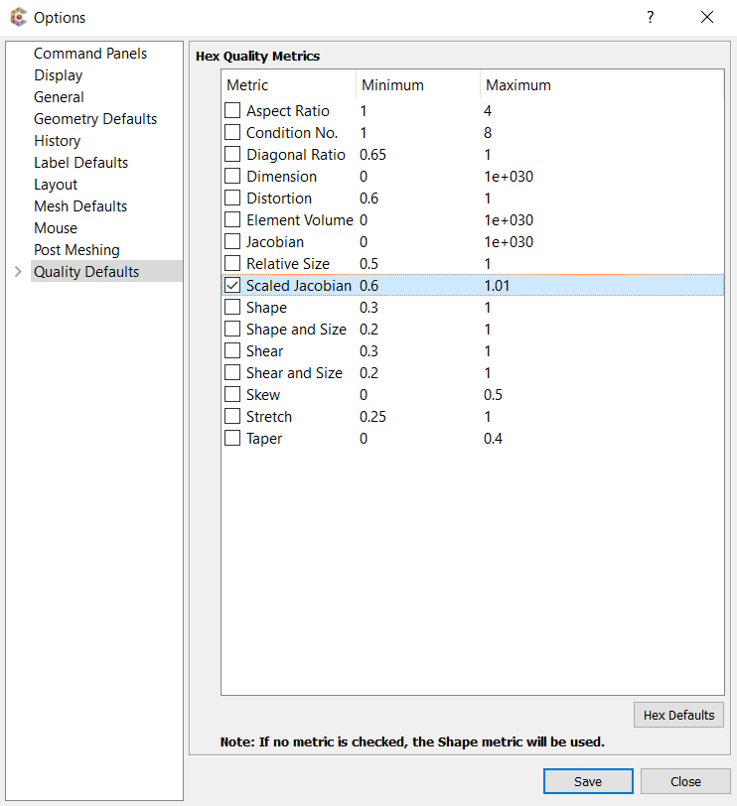
Example: Mesh Quality Power Tool
Select the Options Box
The Options Dialog should appear
Check the Scaled Jacobian Metric
Change the minimum value to 0.6 (Hit Return)
Click Save
The Quality Power Tool will show results for all checked metrics
The Quality Power Tool displays results for all elements falling below the minimum

Slide 20
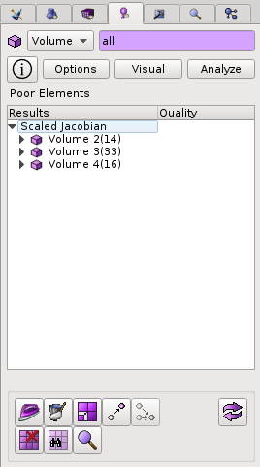
Example: Mesh Quality Power Tool
Enter “all” in the edit field
Hit the Analyze Button
Drop down the list under Scaled Jacobian
List shows all Volumes where at least one element has Scaled Jacobian < 0.6

Slide 21
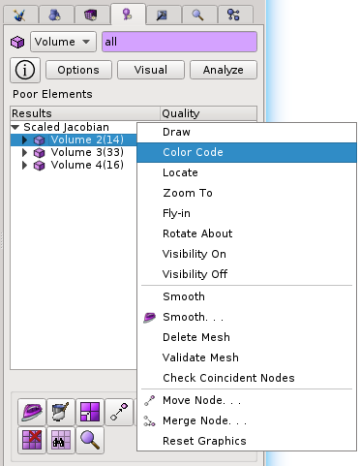
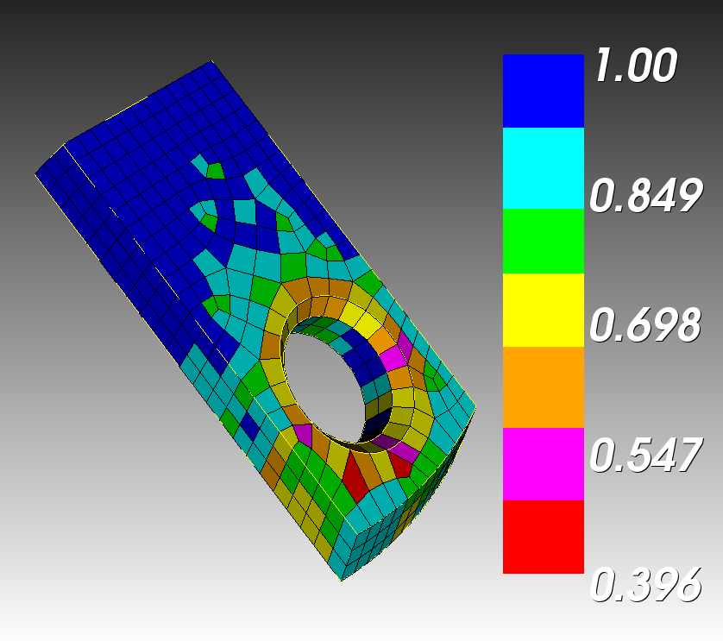
Example: Mesh Quality Power Tool
Right Click on the first volume in the list and select Color Code
Color Code displays the elements in the selected volume, colored according to their Scaled Jacobian Value

Slide 22
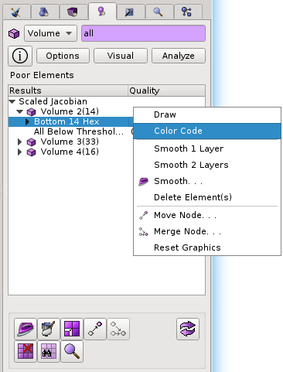
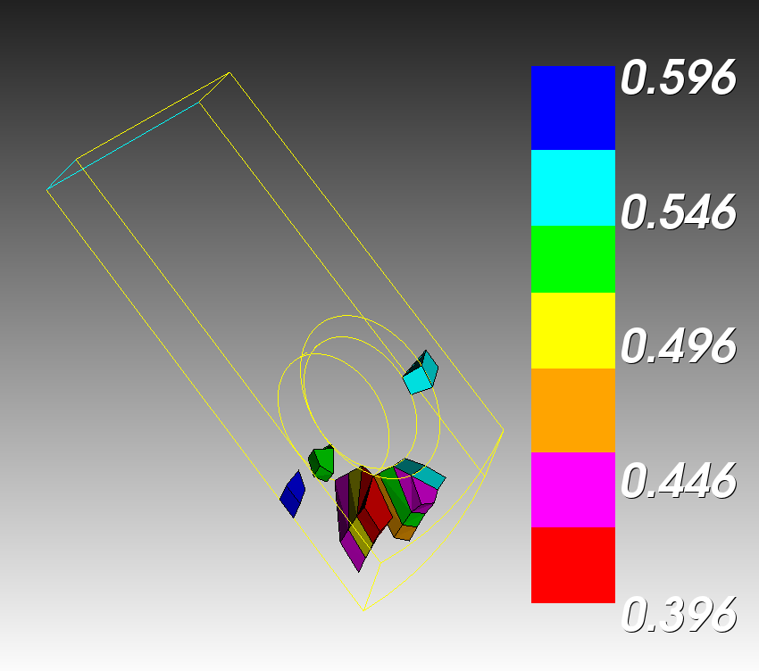
Example: Mesh Quality Power Tool
Drop down the list under Volume 2
Right click on the first line in the list and select Color Code
Color Code in this case displays only the elements in volume 2 falling below the 0.6 minimum Scaled Jacobian Metric

Slide 23
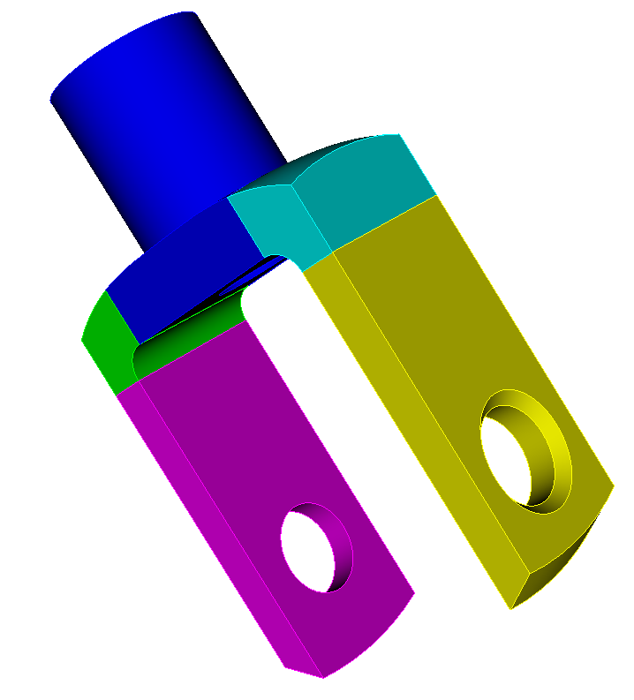
Example: Mesh Quality Power Tool
Try to improve the mesh quality by removing the chamfers on volumes 2 and 3.
First delete the mesh, remove the chamfers and then remesh. How does the element quality improve?
Check your result with the Mesh Quality Power Tool.
Volume 2
Volume 3
Chamfer

