Slide 1
CUBIT™ Fast-Start Tutorial
6. Geometry Tools
Notes:
Type: FORMAL - Training
Title: Cubit 100 Training
SAND Number: SAND2020-0679 TR
Contact: Hensley,Trevor Michael

Slide 2
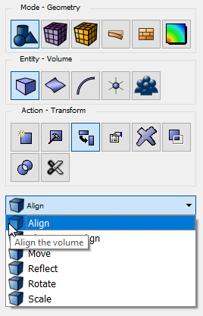
Geometry Transformations
1
Click Mode-Geometry
2
Click Entity-Volume
1
3
Click Action-Transform
2
Align
Move the volume to align with another entity
3
Three-step Align
Align the volume using the 3-step method
Move
Translate the volume a specified distance and direction
Reflect
Reflect the volume about a specified plane
Rotate
Rotate the volume about a specified axis
CUBIT™ is Unit-less
Hint:
Use Scale to change Units
Scale
Scale the volume by a factor in x, y and/or z

Slide 3
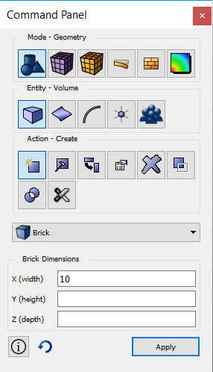
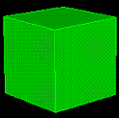
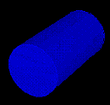
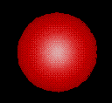
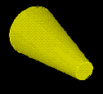
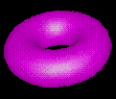
Geometry Creation
1
Click Mode-Geometry
2
Click Entity-Volume
1
3
Click Action-Create
2
Geometry Primitives
3
Created centered at origin
Use transformations to position

Slide 4
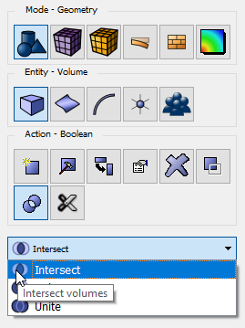
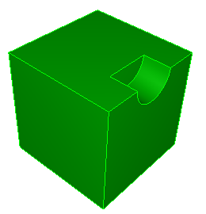
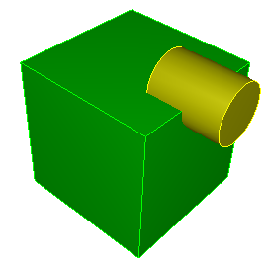
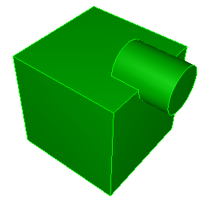
Geometry Booleans
Perform Boolean operations between volumes
1
Click Mode-Geometry
1
2
Click Entity-Volume
2
3
Click Action-Boolean
3
Subtract
Union
Intersect

Slide 5
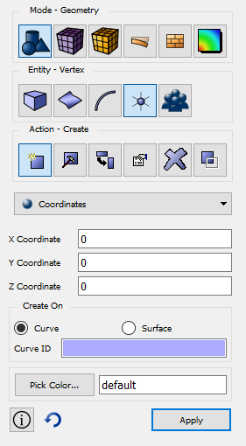
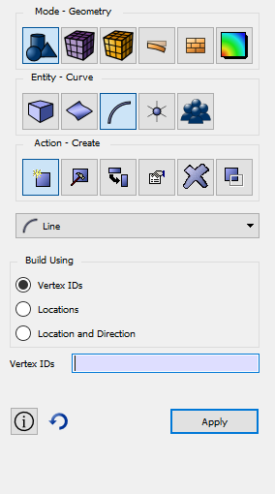
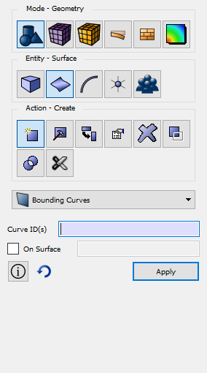
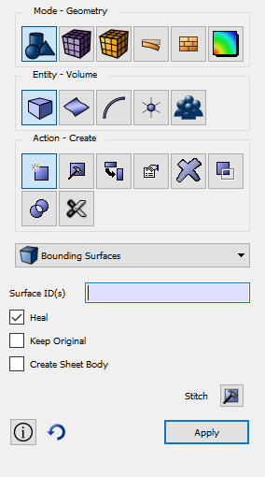
Bottom-Up Geometry Creation
1
Start by defining vertices
2
Connect them with curves
3
Create a surface from a loop of curves
4
Create a volume from a closed set of surfaces

Slide 6
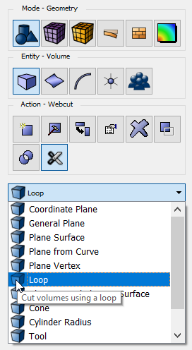
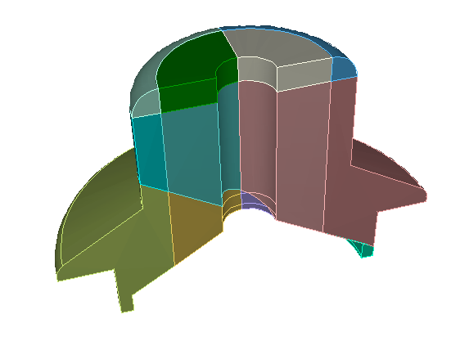
Web Cutting
1
Mode - Geometry
Web-cutting slices through your geometry creating additional volumes
1
2
Entity-Volume
2
3
Action-Webcut
3
Many different options for web-cutting
Each brings up a separate command panel
Web-cutting is most often used to enable sweeping

Slide 7
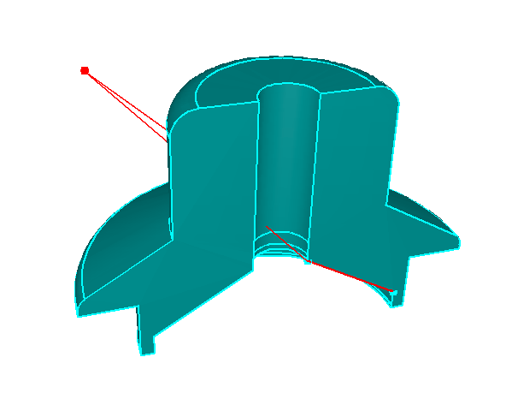
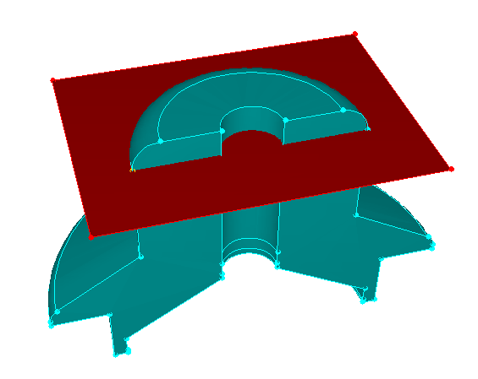
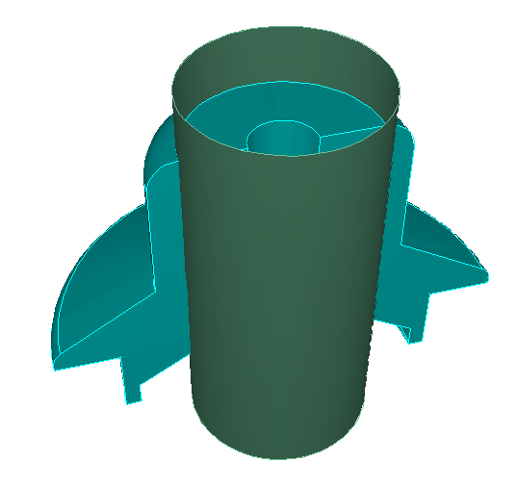
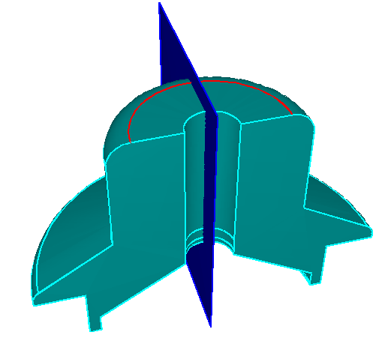
Web Cutting
Plane from vertices:
Coordinate plane:
Example Webcuts
Result:
Cylindrical surface:
Plane normal to curve:

Slide 8
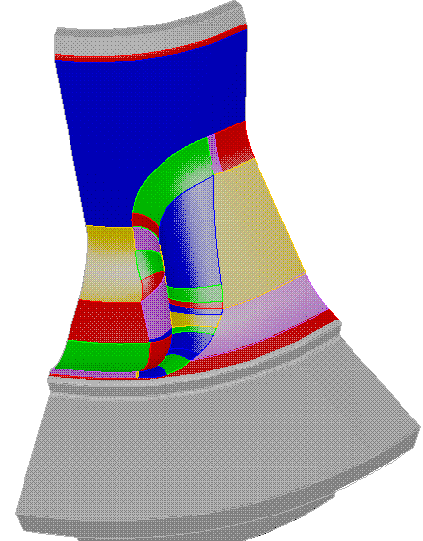
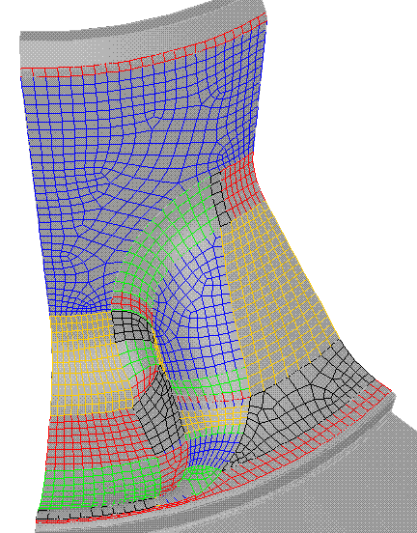
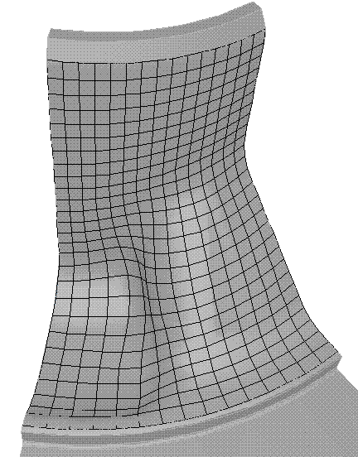
Virtual Geometry
Composite Operation:
Combines surfaces together
Mesh is not constrained to intermediate curves
Used to improve mesh quality
Does not change the CAD model

Slide 9
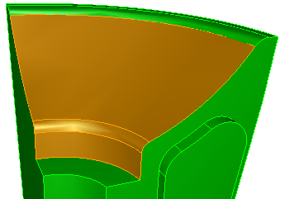
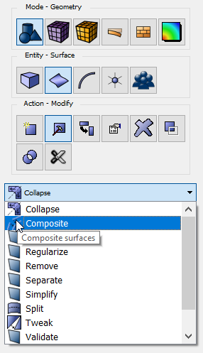
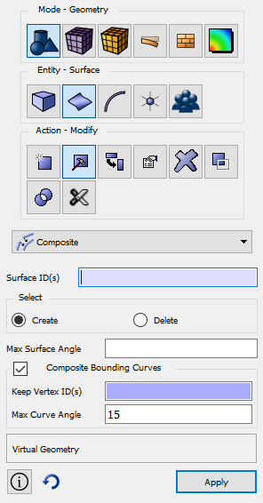
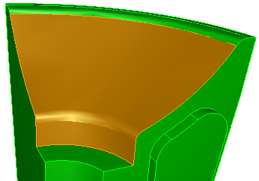
Creating a Composite Surface
1
Goto Geometry:Surface:Modify
2
Select Composite
3
1
2
Select Surfaces
4
Click Apply

Slide 10
Geometry Tweaking
Surfaces can be moved or replaced
Adjacent geometry is modified as needed
Useful for
Fixing problems such as gaps
Feature removal
To make sweepable
“Real” Operation
Changes the CAD Model Definition
Fillet Removed

Slide 11
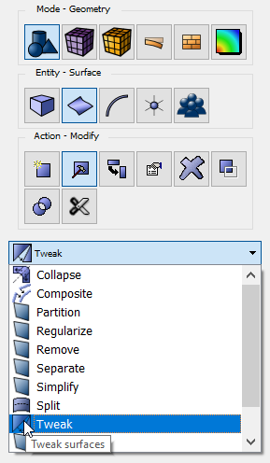
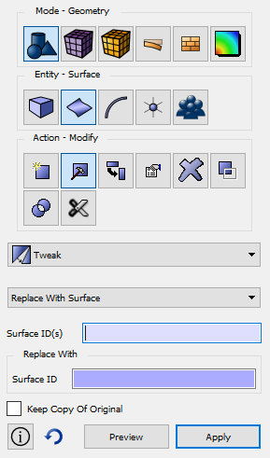
Replace Surface
1
Go to Geometry:Surface:Modify
2
Select Tweak
3
3
Select Replace
With Surface
5
1
4
Pick Surfaces to remove
3
5
Pick an adjacent Surface
2
6
Click Apply

Slide 12
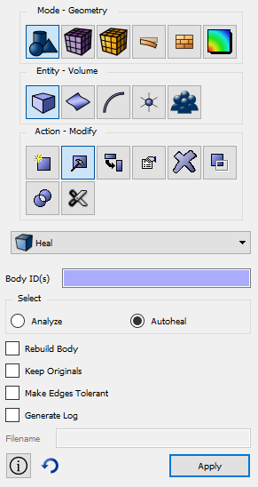
Healing
Translating geometry into the ACIS format can be often problematic
Pro/E is less accurate than ACIS if you use the default tolerances
Gaps, overlaps, and internal inconsistencies are common
The ACIS Healing Husk may fix many problems
1
Click Mode-Geometry
1
2
Click Entity-Volume
3
Click Action-Modify
2
Choose Heal from the dropdown menu
4
3
4
Analyze
Lists problems with the selected volumes
AutoHeal
Attempts to fix the problems

Slide 13
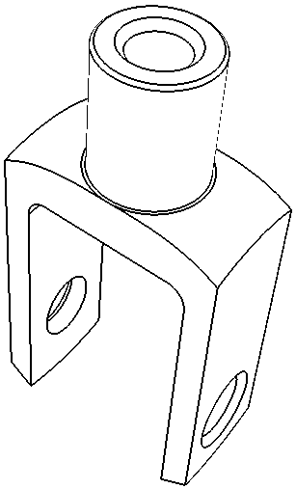
Exercise - Knuckle
Steps:
Import “knuckle.sat”
Heal the Model
Remove details around holes
Webcut, where necessary
Imprint and Merge
Mesh with a size of 1.5

