Slide 1
CUBIT™ Fast-Start Tutorial
4. The Basic CUBIT Process
Notes:
Type: FORMAL - Training
Title: Cubit 100 Training
SAND Number: SAND2020-0679 TR
Contact: Hensley,Trevor Michael

Slide 2
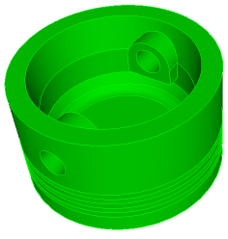
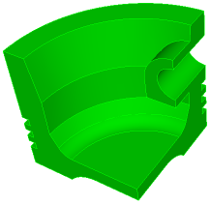
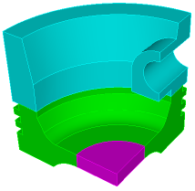
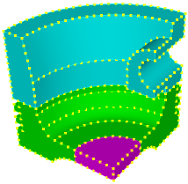
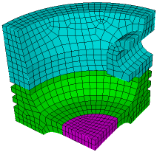
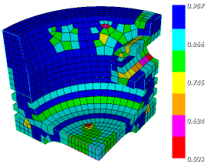
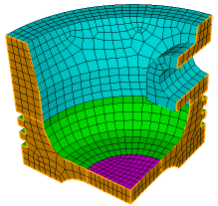
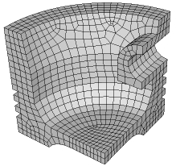
The Basic CUBIT™ Process
1
2
3
Import Solid Model
Simplify Geometry
Decompose Geometry
4
5
6
Imprint & Merge
Set Schemes
& Intervals
Mesh
7
8
9
Check
Quality
Apply B.C.s
Export
Mesh

Slide 3
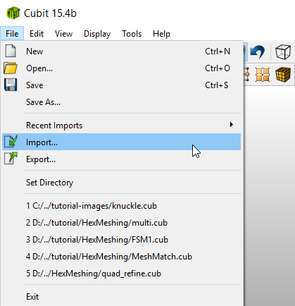
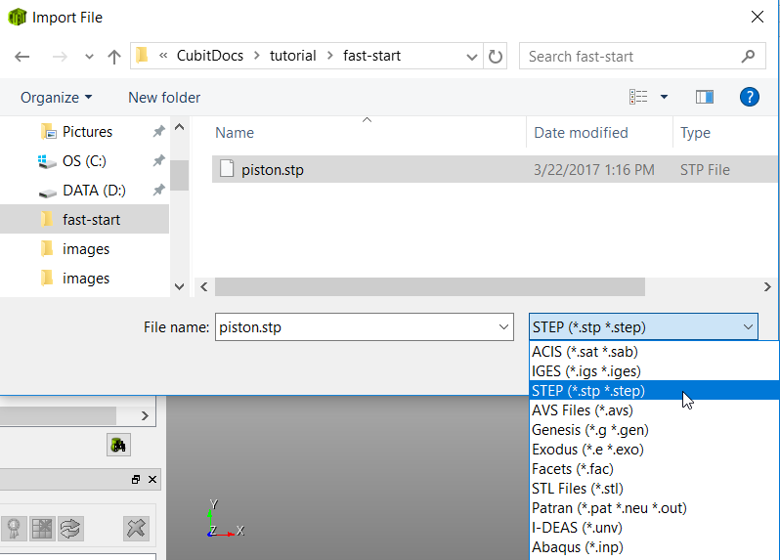
1
Import Solid Model
Import the STEP file
“piston.stp” from the
Geometry_Files-Basic
directory
1
File->Import
3
Select “piston.stp”
2
Set the file filter type
to STEP (*.stp *.step)

Slide 4
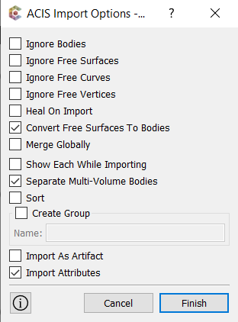
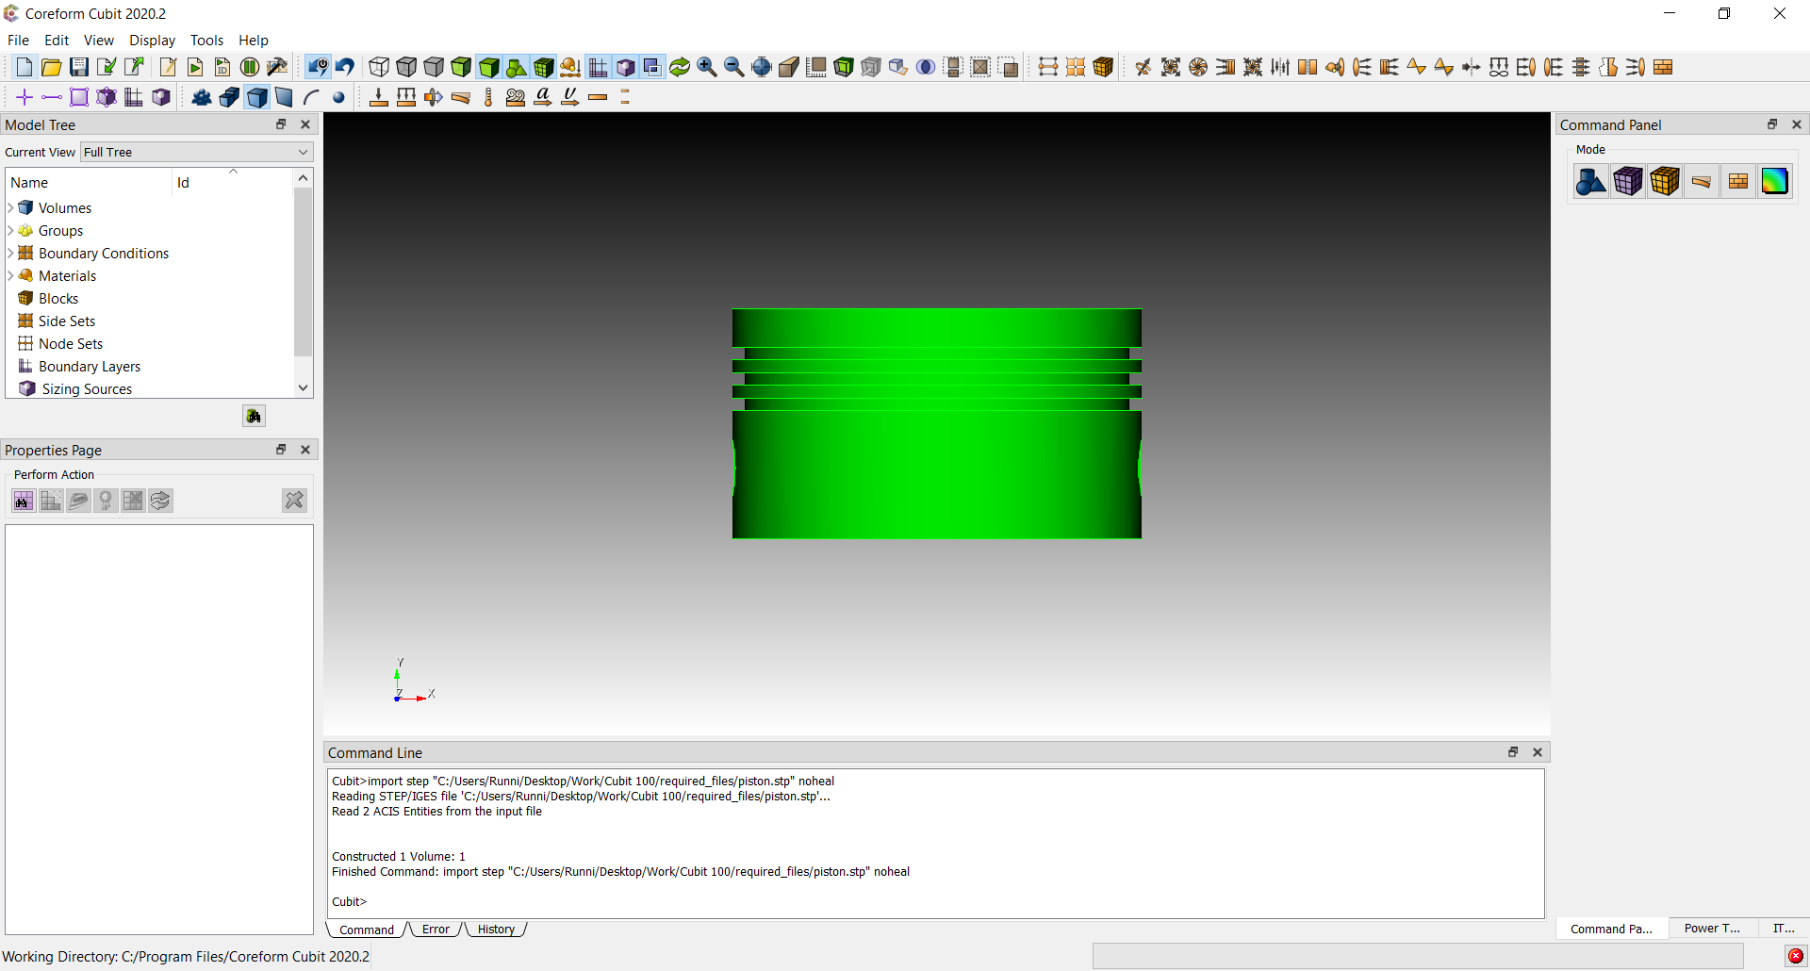
1
Import Solid Model
Import the STEP file
“piston.stp” from the
Fast-start directory
4
Select Finish

Slide 5
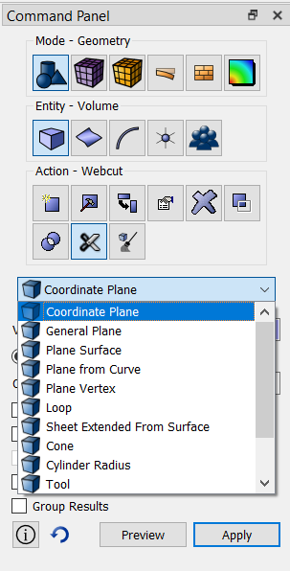
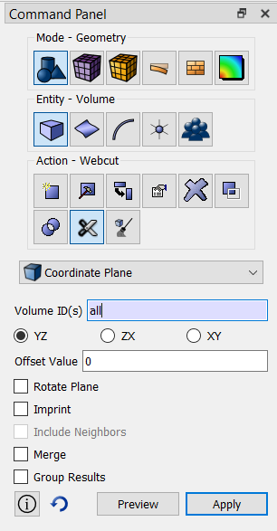
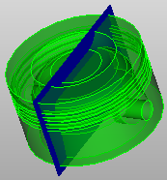
2
Cut the model into
quarters to take
advantage of
symmetry
Simplify Geometry
1
Define and preview a cut through the part
1
Click Mode-Geometry
2
2
Click Entity-Volume
3
Click Action-Webcut
5
3
6
4
4
Select Coordinate Plane from the menu
5
Select volume (or enter all in the field)
7
6
Choose Webcut With YZ Plane
Cutting plane Preview
7
Click Preview to display a preview of the plane

Slide 6
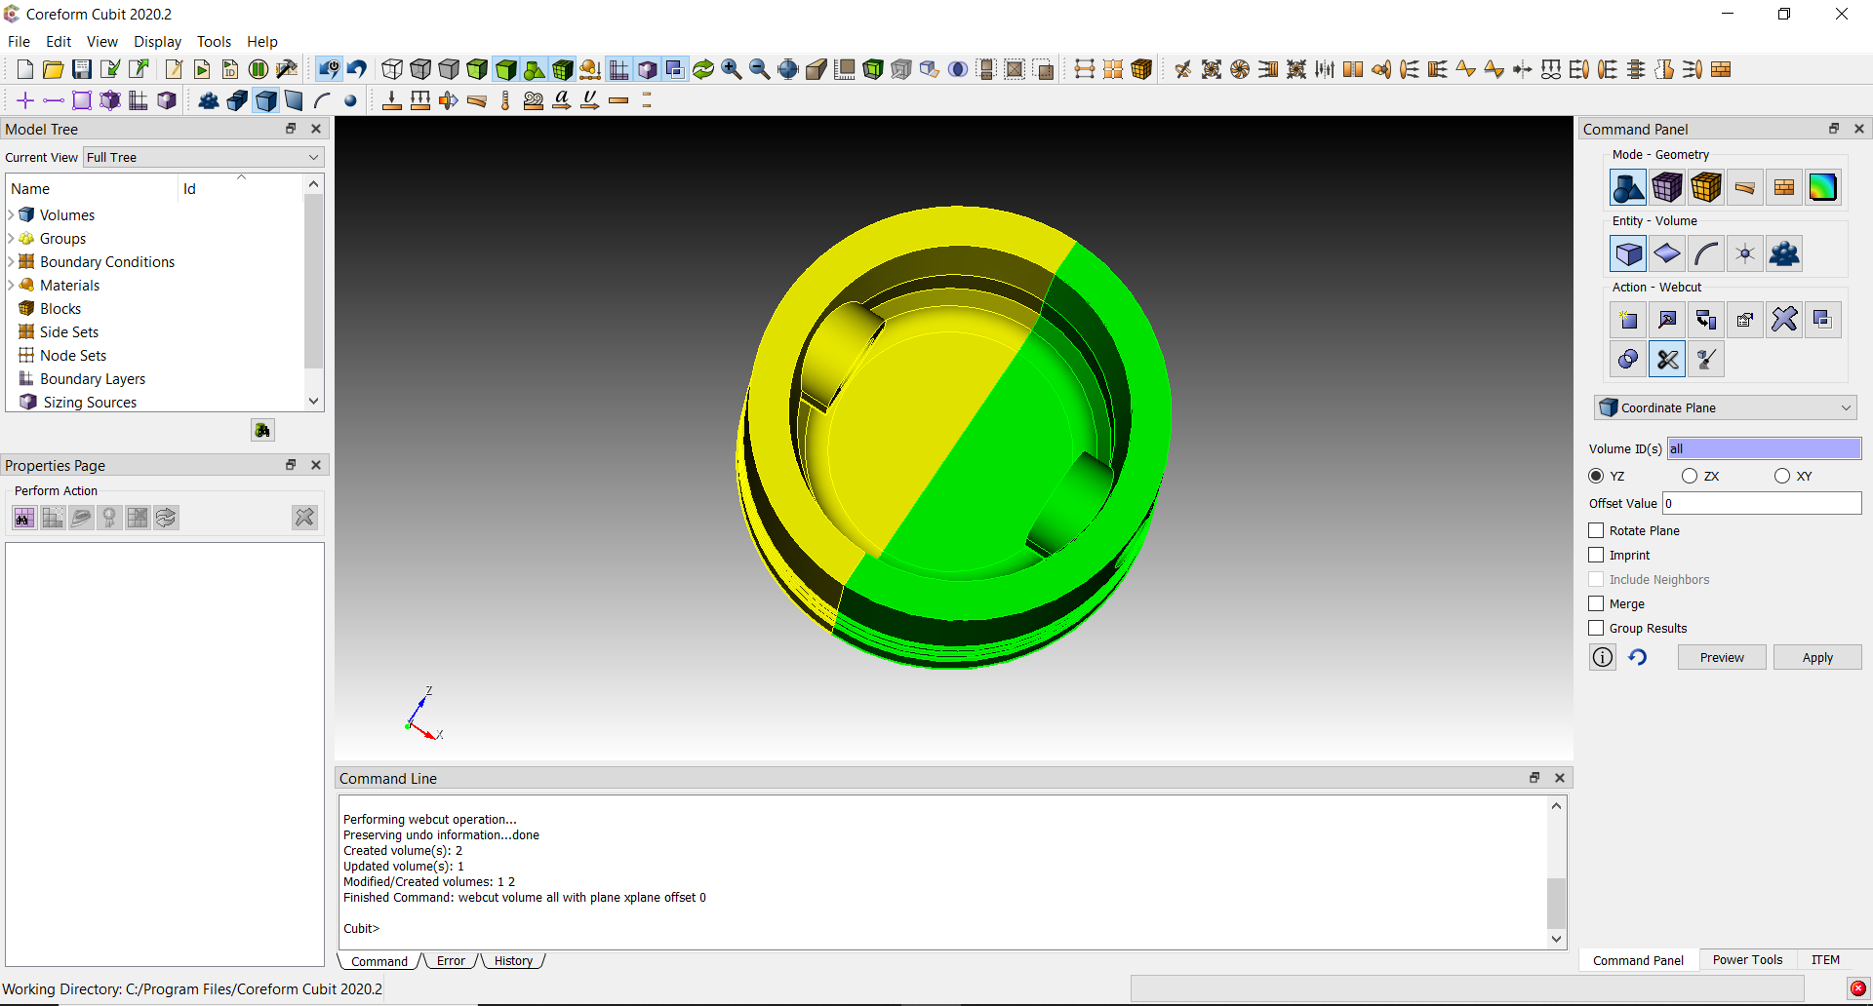
2
Simplify Geometry
Cut the model into
quarters to take
advantage of
symmetry
Two separate and unconnected bodies
Two separate and unconnected bodies
8
Execute the webcut command by pressing Apply

Slide 7
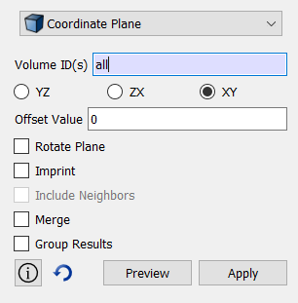
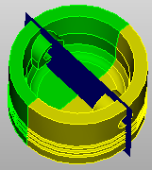
2
Simplify Geometry
Cut the model into
quarters to take
advantage of
symmetry
Define and preview the second cut through the model
9
Change cutting plane to the XY Plane
Cutting plane Preview
10
Preview the cutting plane

Slide 8
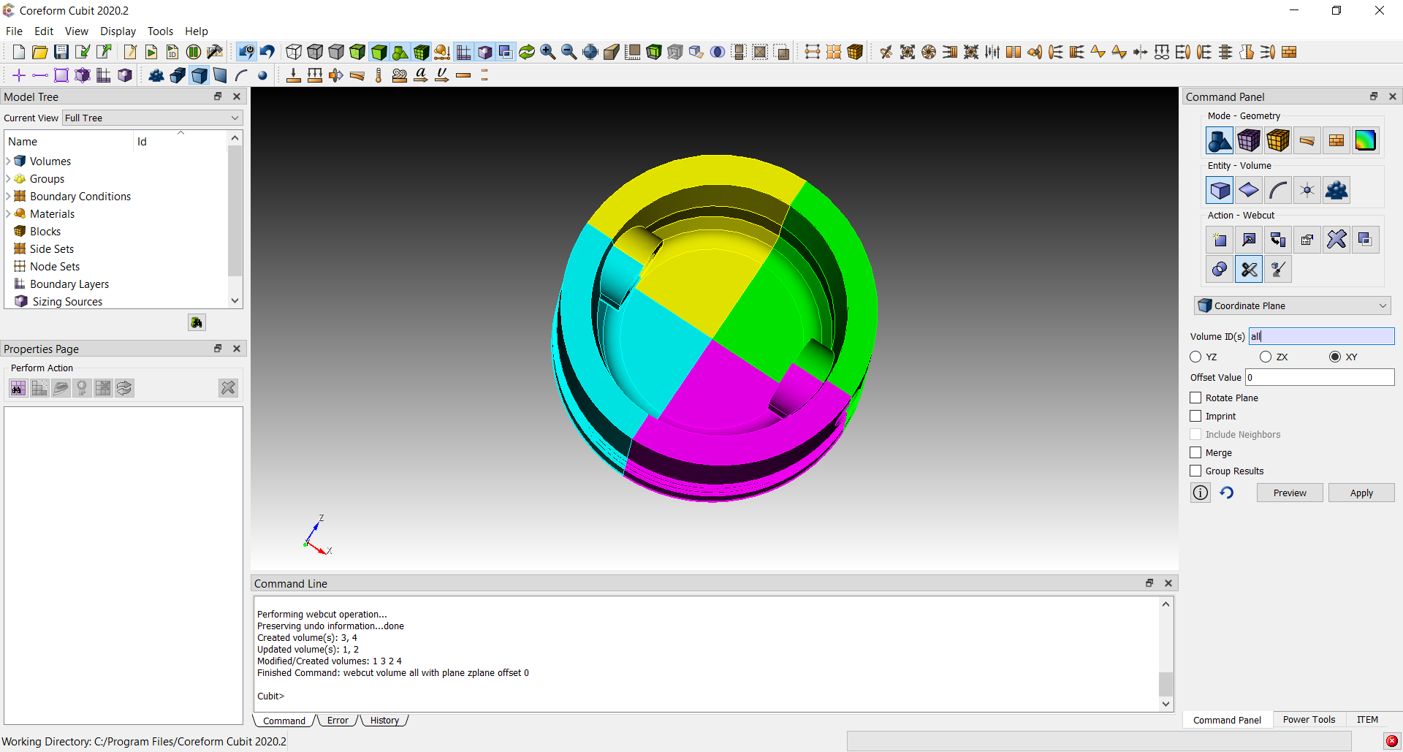
2
Simplify Geometry
Cut the model into
quarters to take
advantage of
symmetry
Four separate and unconnected volumes
Four separate and unconnected bodies
11
Execute the webcut by pressing Apply

Slide 9
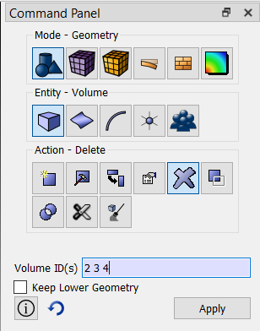
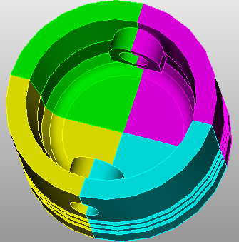
2
Simplify Geometry
Cut the model into
quarters to take
advantage of
symmetry
Delete 3 of the 4 volumes
12
Change from Action-Webcut to Action-Delete
13
Pick three of the four volumes from the graphics window
12
14
Execute the delete command by pressing Apply
13
14

Slide 10
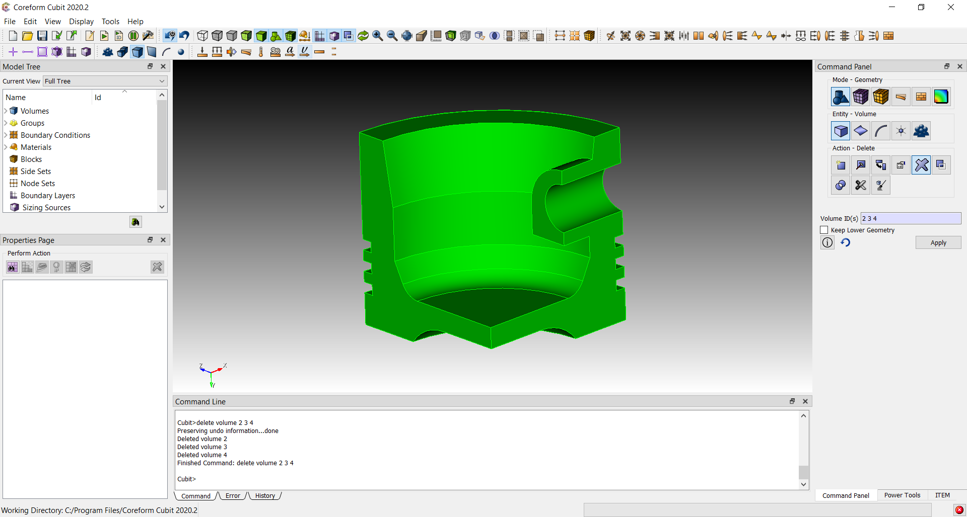
2
Simplify Geometry
Cut the model into
quarters to take
advantage of
symmetry
Simplified model ready for decomposition

Slide 11
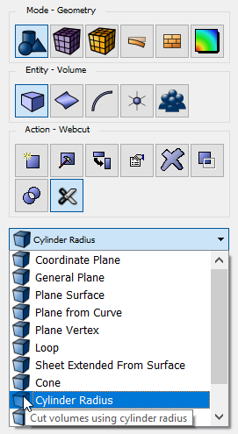
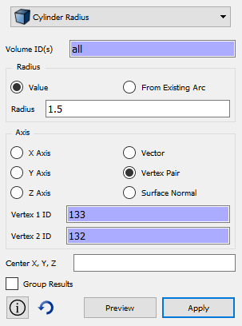
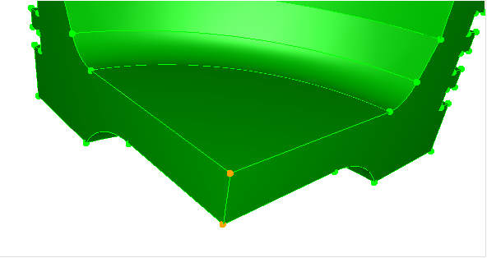
3
Decompose Geometry
Cut the model into
sweepable volumes
1
Define a Cylindrical Webcut
1
Click Entity-Volume
4
2
2
Click Action-Webcut
5
3
Select Cylinder Radius from dropdown menu
4
Select volume (all)
6
3
5
Enter Radius 1.5
7
6
Select Axis as Vertex Pair
7
Select the two vertices as shown to define the cylinder axis
7

Slide 12
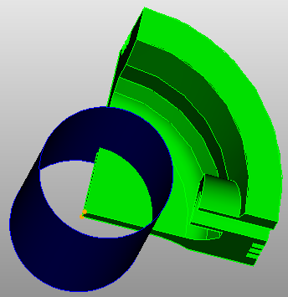
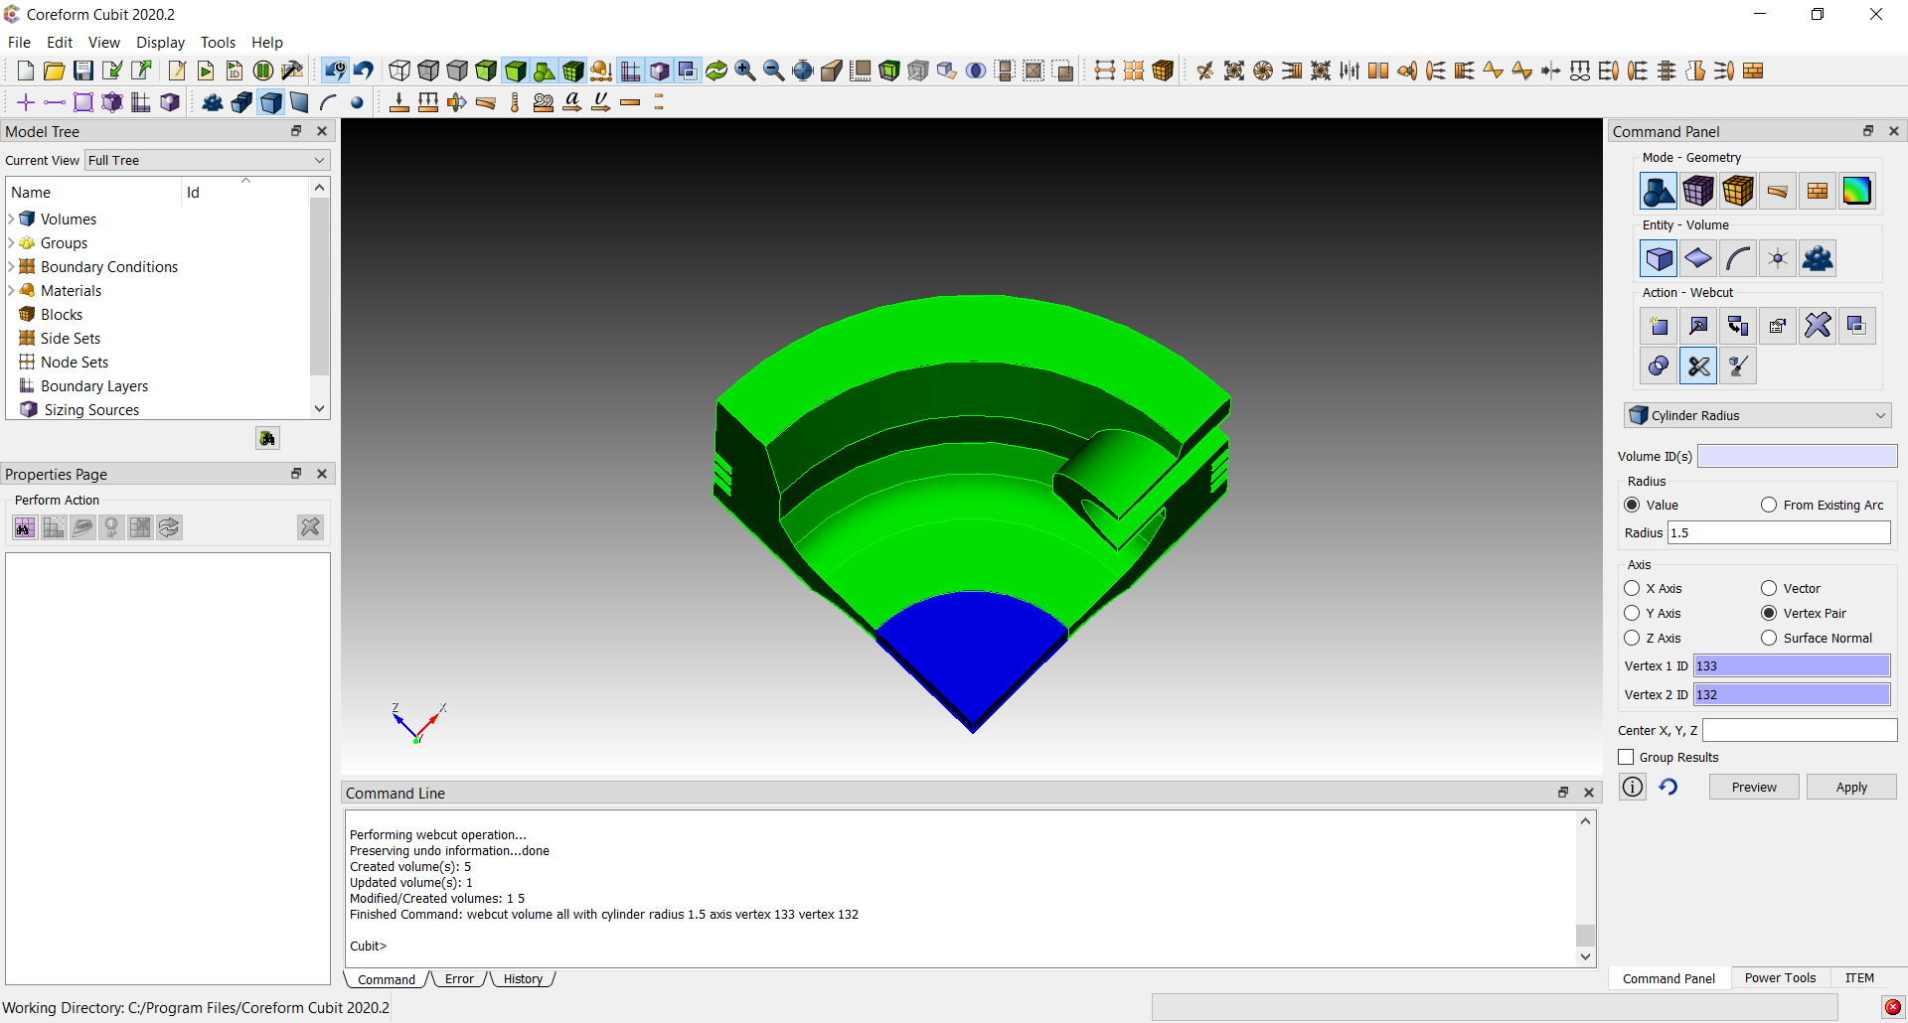
3
Decompose Geometry
Cut the model into
sweepable volumes
Preview and Apply the Cylinder Webcut
Webcut
Preview
8
Click Preview to see a preview of the cutting cylinder
9
Click Apply to cut the volume
8
9

Slide 13
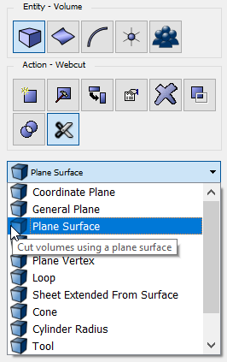
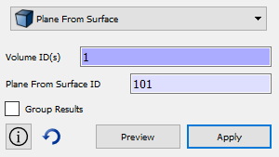
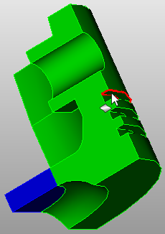
3
Decompose Geometry
Cut the model into
sweepable volumes
10
Define a cutting plane from a planar surface
Click Entity-Volume
13
10
14
11
11
Click Action-Webcut
12
Select Plane from Surface from the drop down menu
12
13
Select the volume to cut (all or 1)
14
14
Select the surface as shown to define the cutting plane

Slide 14
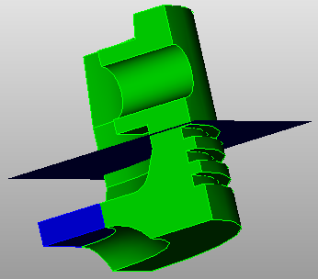
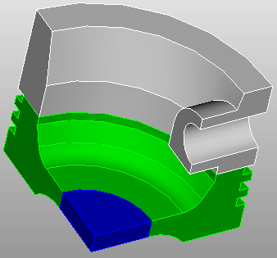
3
Decompose Geometry
Cut the model into
sweepable volumes
Preview and Apply the planar webcut
Webcut
Preview
15
Click Preview to see a preview of the cutting plane
16
Click Apply to cut the volume
15
16

Slide 15
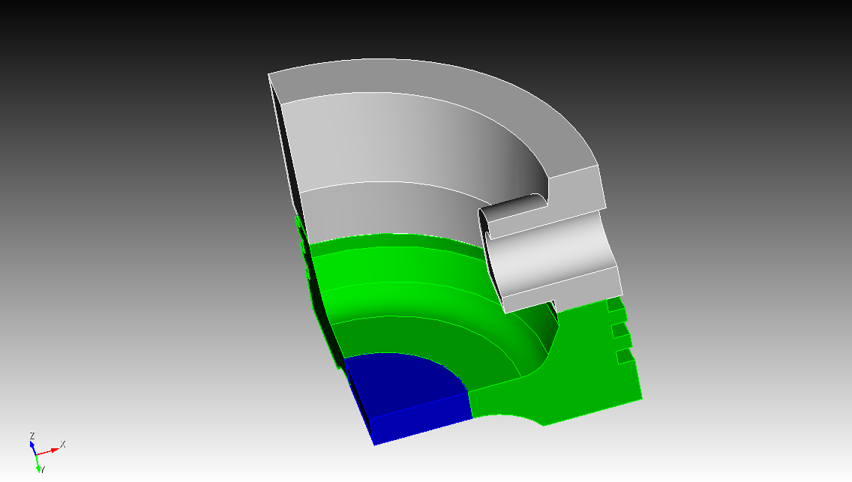
3
Decompose Geometry
Cut the model into
sweepable volumes
sweep
direction 2
sweep direction 1
sweep direction 3
Volumes are now individually sweepable

Slide 16
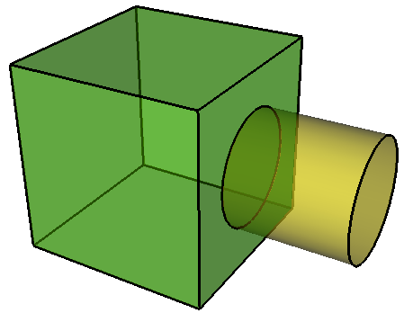
4
Imprint &
Merge
Vol 1
Vol 2

Slide 17
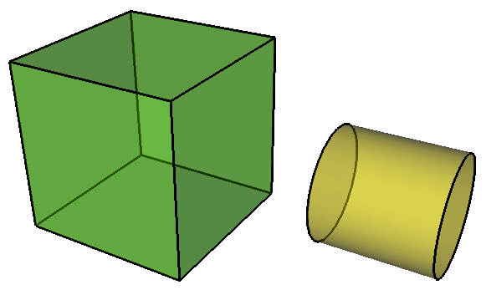
4
Imprint &
Merge
Volumes are independent -- by default, will not share nodes where they meet
Vol 1
Vol 2

Slide 18
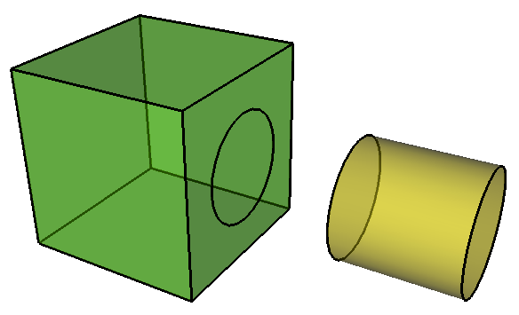
4
Imprint &
Merge
Imprint
Vol 1
Vol 2

Slide 19
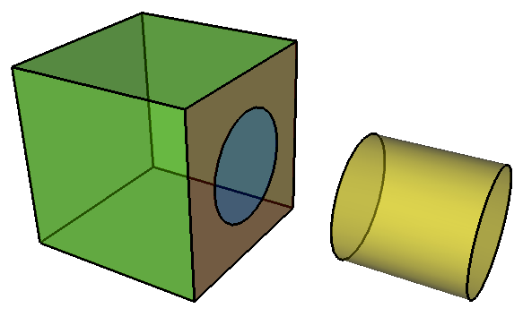
4
Imprint &
Merge
Surface 10
Surface 9
Vol 1
Vol 2

Slide 20
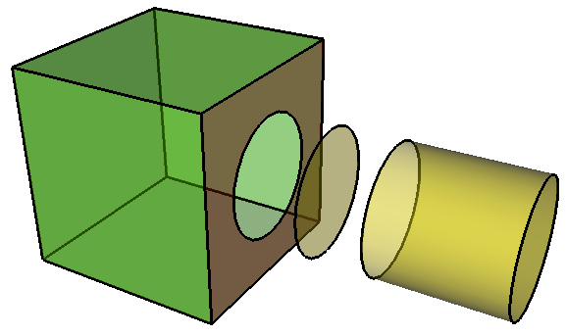
4
Imprint &
Merge
Volume 1 and 2 both share Surface 9
Surface 9
Vol 1
Vol 2
Merge

Slide 21
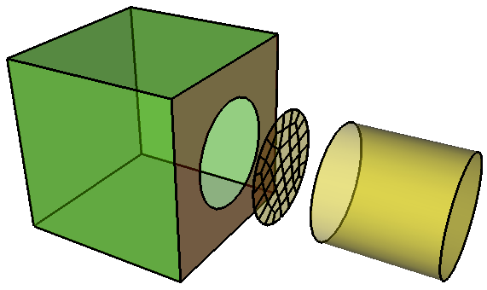
4
Imprint &
Merge
Volume 1 and 2 both share mesh on Surface 9
Surface 9
Vol 1
Vol 2

Slide 22
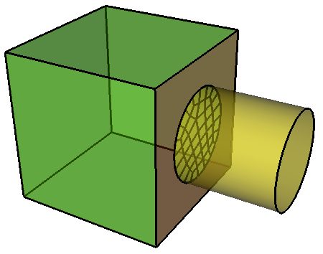
4
Imprint &
Merge
Volume 1 and 2 both share mesh on Surface 9
Surface 9
Vol 1
Vol 2

Slide 23
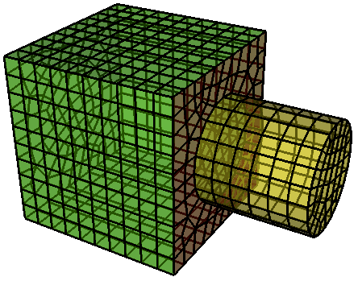
4
Imprint &
Merge
After imprint and merge volumes will share nodes at their interface when meshed.
Vol 1
Vol 2

Slide 24
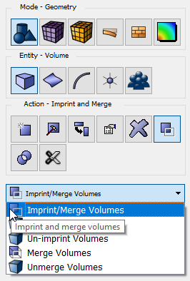
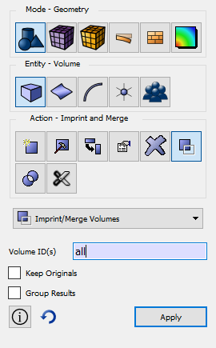
4
Imprint &
Merge
Connect volumes
together to ensure a
continuous FEA mesh
will be generated
Imprint and Merge the volumes
1
1
Click Entity-Volume
2
Click Action-Imprint and Merge
2
3
Select Imprint/Merge from dropdown menu
4
Select volumes
4
3
5
Click Apply
5

Slide 25
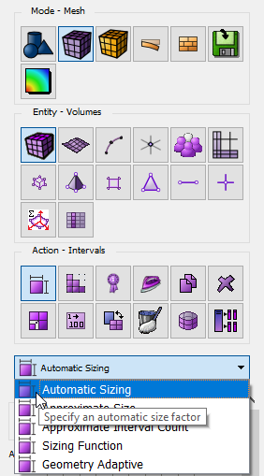
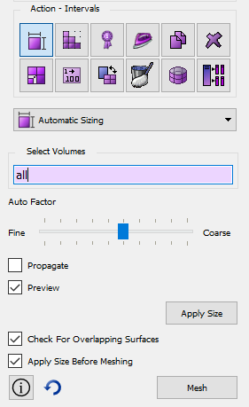
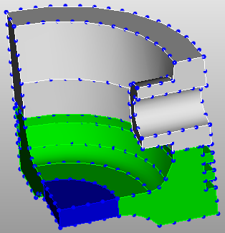
5
Define the meshing
schemes and the mesh
size on the geometry
that will be used
Set Schemes
& Intervals
Preview and set the mesh size
1
1
Click Mode-Mesh
2
2
Click Entity-Volumes
5
3
Click Action-Intervals
4
Click Automatic Sizing from dropdown menu
6
3
5
Select volumes all
6
Drag the slider until the desired resolution is set (see preview in graphics window)
Preview of
nodes on
the curves
4

Slide 26
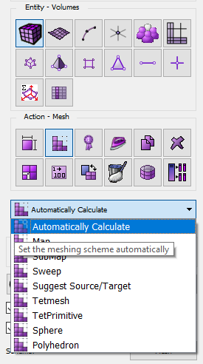
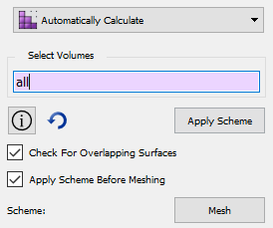
5
Set Schemes
& Intervals
Define the meshing
schemes and the mesh
size on the geometry
that will be used
Set the Meshing scheme to Automatically Calculate
7
Click Action-Mesh
8
Click Automatically Calculate from dropdown menu
9
7
10
9
Select the volumes (all)
8
Click Apply Scheme
10

Slide 27
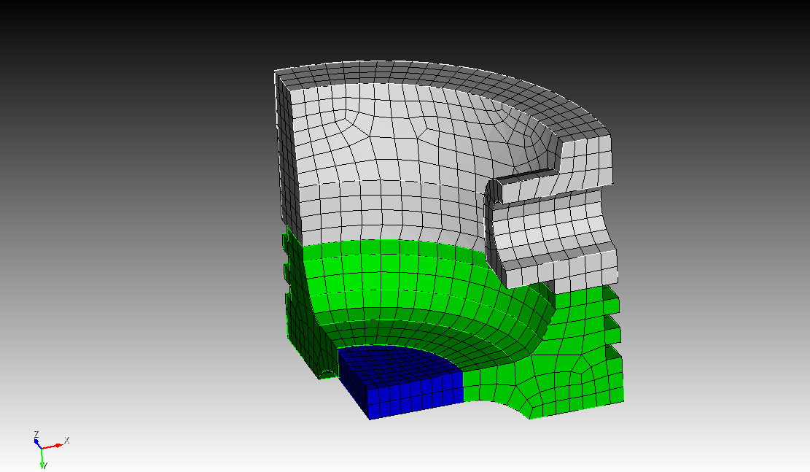
6
Mesh
Create the hex mesh
on the volumes
Mesh the Volumes
1
1
Click the Mesh Button

Slide 28
7
Check Quality
Element Shape Metrics
3
3
3
3
2
2
2
2
Worst Quality
1
Best Quality
0
-0.5
1
0
0.0
1
0
0.5
0
1.0
1
Quads
2
2
-0.5
0
1
2
1
0.0
0
0.5
1
0
1.0
1
Triangles
2

Slide 29
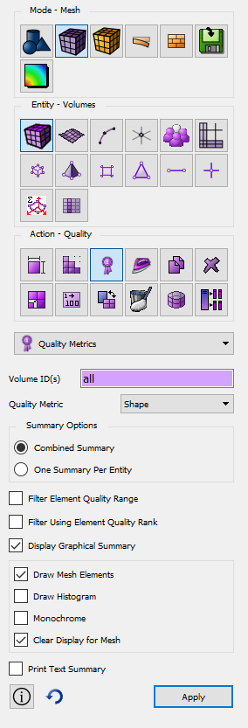
7
Check Quality
Check to see if the
quality of your elements
are reasonable for
analysis
1
Display color-coded elements based on the Shape quality metric
2
1
Click Mode-Mesh
7
Check the Draw Mesh Elements check box
3
2
Click Entity-Volumes
3
Click Action-Quality
8
Click Apply
4
4
Select Volumes (all)
5
5
Select the Shape quality metric from the dropdown menu
6
6
Check the Display Graphical Summary check box
7
8

Slide 30
8
Apply B.C.s
Grouping of Elements with Common Properties
Normally define elements with same Material
Element can be in only one block
Common element type (i.e. hex8, tet10, etc)
Blocks
Grouping of Quads on Hexes (3D),
Edges on Quads (2D)
Normally describe force over an area (ie. Pressure loading)
Side can be in any number of sidesets
Sidesets
Grouping of Nodes
Normally describe force at a point (ie. Point source loading, constraint)
Node can be in any number of nodesets
Nodesets

Slide 31
8
Apply B.C.s
Designate where
materials and boundary
conditions will be
applied on the model
1
2
Define a Material Block with ID=100
3
1
Click Mode – Analysis Groups and Materials
5
Select Volume
6
Select the volumes to add to the block (all)
2
Click Entity-Blocks
4
Click Action - Create
7
Click Apply to create the new block 100
3
5
4
Enter Block ID 100
6
7

Slide 32
8
Apply B.C.s
Designate where
materials and boundary
conditions will be
applied on the model
Define the element type for Block 100 as HEX8
1
1
Click Action – Element Type
2
2
Enter Block ID 100
3
3
Select Volumes
4
4
Select Hex8
5
Click Apply
5

Slide 33
8
Apply B.C.s
Designate where
materials and boundary
conditions will be
applied on the model
Create a Sideset representing a distributed load
1
1
Click Entity-Sidesets
2
2
Choose Action – Create Sideset
3
4
3
Enter a Sideset ID of 1
4
Select Surface
5
5
5
Pick the surfaces as shown where the distributed load should be applied
6
6
Click Apply

Slide 34
9
Export Mesh
Create an FEA Mesh
File to be used in
an analysis
Export a Genesis file containing mesh, blocks and sidesets
1
1
Click Mode - Export
2
Click Operation-Export Mesh
2
3
Choose Genesis from the dropdown menu
3
4
Click Browse. Enter the file name “qtr_piston.g” in a directory of your choosing
4
5
5
Select Export All to export all block ids
6
Click Apply
6

