Slide 1
CUBIT™ Fast-Start Tutorial
3. Getting Started
Notes:
Type: FORMAL - Training
Title: Cubit 100 Training
SAND Number: SAND2020-0679 TR
Contact: Hensley,Trevor Michael

Slide 2
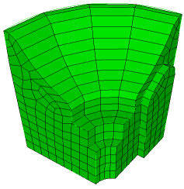
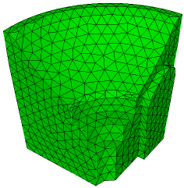
Getting Started Exercise
Solid Model
Hex Mesh
Tet Mesh
Import the geometry from a file
Set the mesh size to 0.5
Set the mesh scheme to sweep
Create a hexahedral mesh
Delete mesh
Set the mesh scheme to tetmesh
Create a tetrahedral mesh

Slide 3
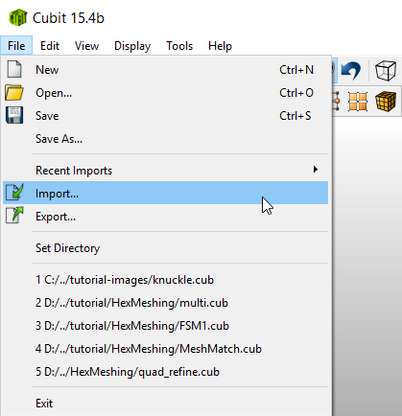
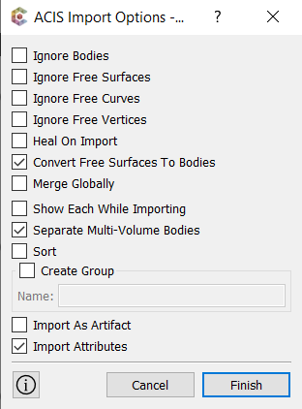
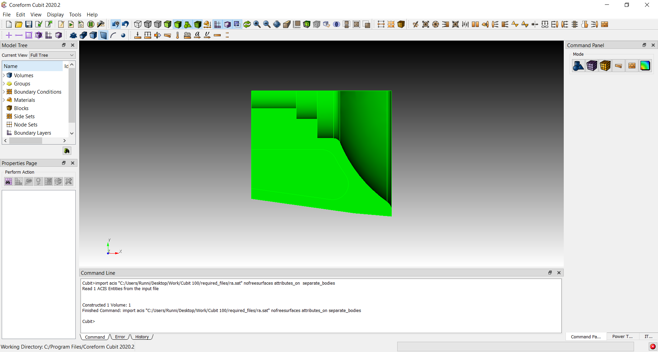
Import the Solid Model
1
2
Click Finish
2
1
Use the File->Import menu to import the file “ra.sat”

Slide 4
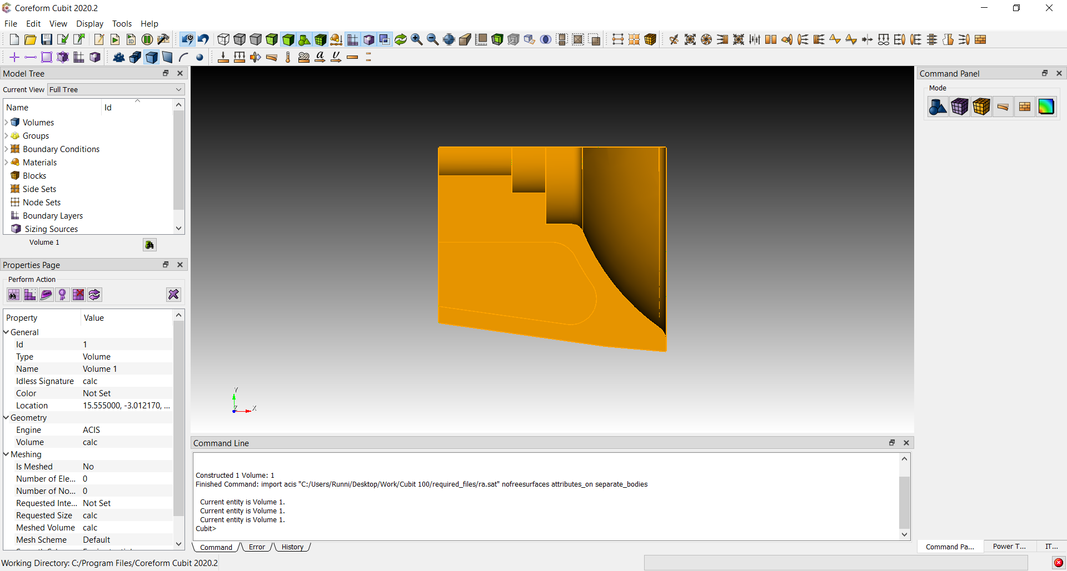
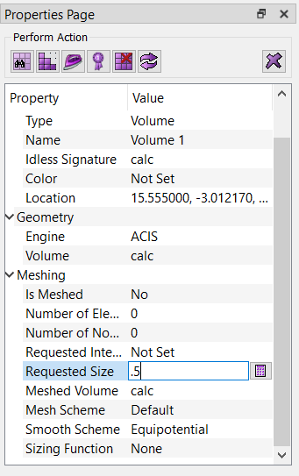
Set the Mesh Size
1
Click Volume Selection Filter Icon
1
2
Double click on the part
2
3
Set the Requested Size on the property panel to 0.5 and hit Return
3

Slide 5
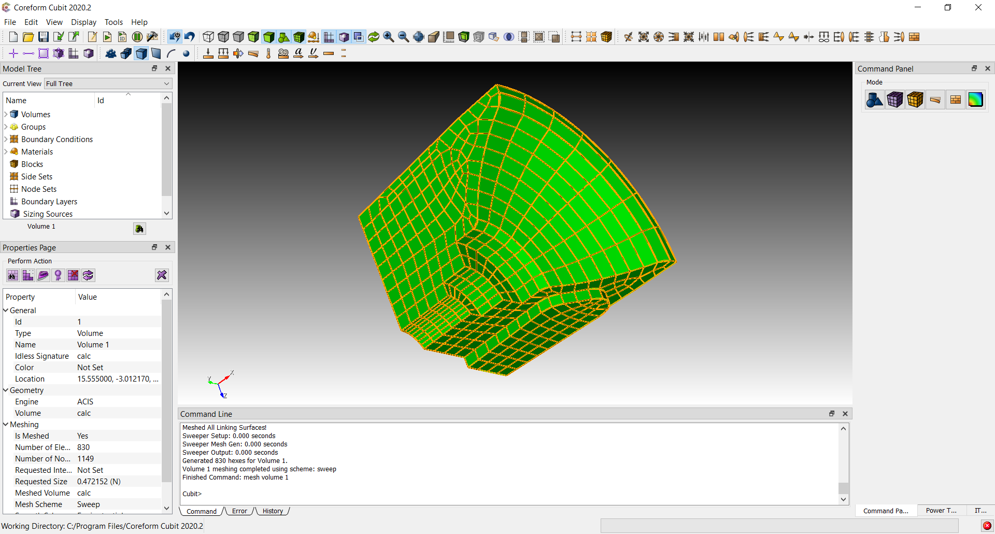
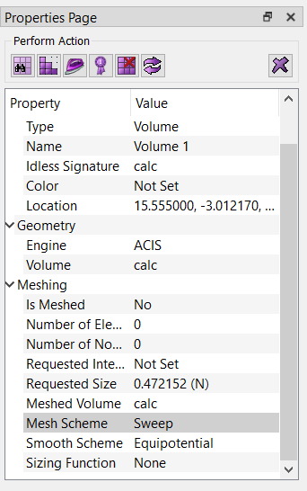
Create a Hexahedral Mesh
2
1
Select the Sweep scheme from the dropdown menu next to Mesh Scheme
1
2
Click the Mesh Button

Slide 6
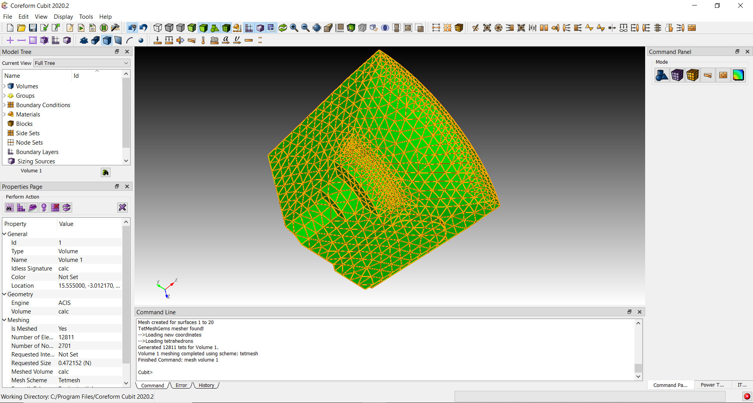
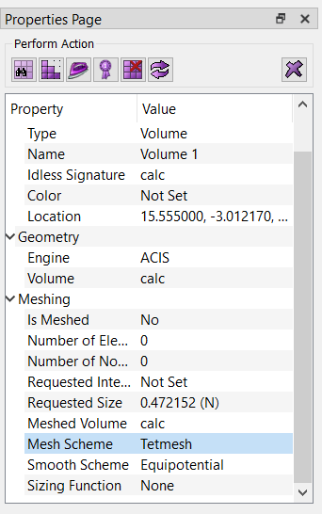
Create a Tetrahedral Mesh
1
3
1
Delete the mesh and reset the volume by clicking on the Reset Button
2
2
Choose the Tetmesh scheme from the dropdown menu next to Mesh Scheme
3
Click the Mesh Button

