Slide 1
CUBIT™ Fast-Start Tutorial
2. User Interface Basics
Notes:
Type: FORMAL - Training
Title: Cubit 100 Training
SAND Number: SAND2020-0679 TR
Contact: Hensley,Trevor Michael

Slide 2
Pulldown Menu Commands
Toolbar Commands
Command Panel
Graphics Window
Model Tree
Power Tools
Properties Page
Command Line

Slide 3
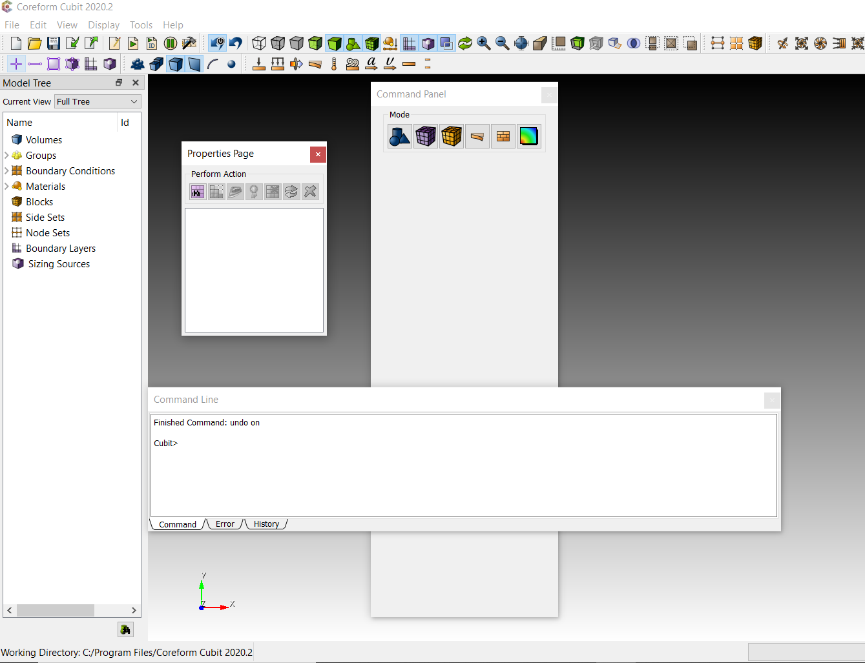
Float or dock dialogs and toolbars by clicking and dragging
Press and hold the Ctrl button while dragging to avoid redocking

Slide 4
The Command Panel

Slide 5
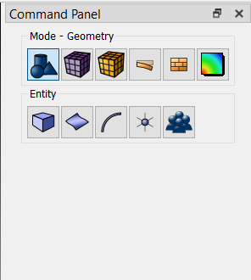
Operation Mode Buttons
Press an icon to enter a new mode
- Geometry: Create, modify, cleanup…
- Mesh: Intervals, schemes, smoothing…
- Boundary Conditions
- Post Processing: Customizable shortcut

Slide 6
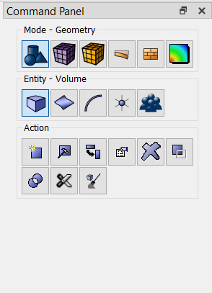
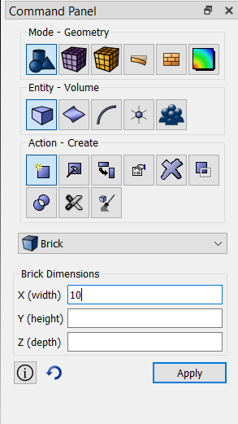
Operation Mode Buttons
Each Button press takes you to a lower level

Slide 7
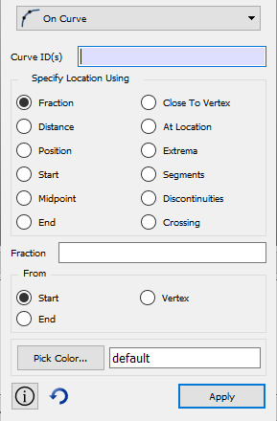
Typical Dialog Layout
Drop Down Menu
Select the type of operation (sub-action).
ID Input Field
You can type IDs here, or fill the box by picking
Command Options Input
Execute Button
Click button or hit alt-a to execute the command.

Slide 8
Input Fields
ID input allowed
Graphical Selections
Typed IDs
Ranges (example: 1 to 3, all, …)
Relations to other entities (example: curve in surface 2)
Aprepro
Input placed in brackets { } will be evaluated when the command is executed, using Aprepro (example: {10*.02})

Slide 9
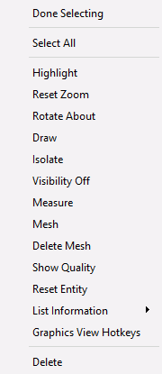
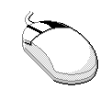
ID Input Fields
Right clicking in the input field will display an additional command menu
Done Selecting – Move to next field in dialog
Select All – Select all input type entities
Select Other – Used when picking from graphics window. Cycles through nearby entities
Right Click
These options only apply when something is selected in the graphics window

Slide 10
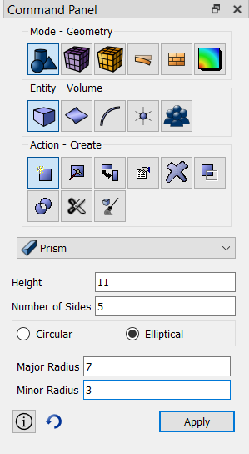
Exercise 1a: Become Familiar with the Interface
Create a pyramid for viewing
4
Height = 11
Sides = 5
Select Elliptical
Maj. Rad = 7
Min. Rad. = 3
1
2
3
1
5
In Geometry click Volume
Hit Apply
2
Click Create
5
3
Select Prism

Slide 11
The Graphics Window

Slide 12
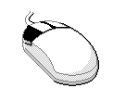
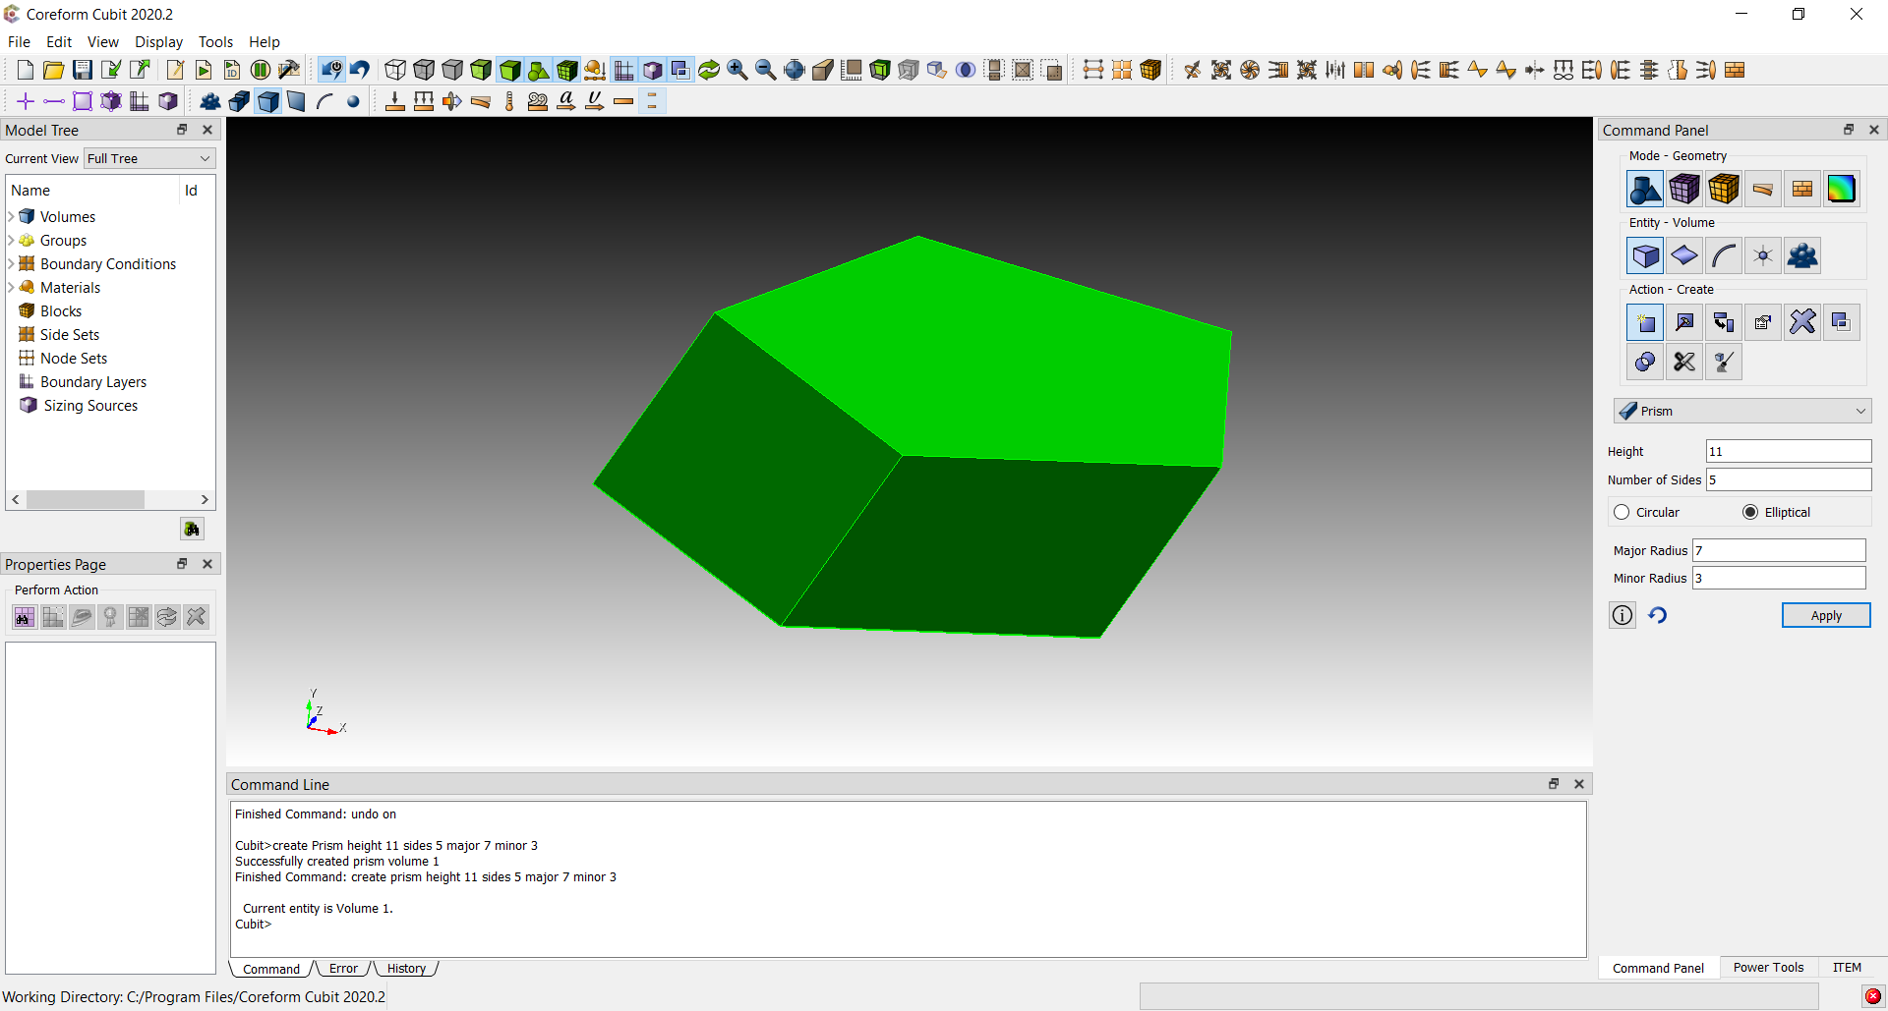
Zooming
To zoom in and out, move the mouse into the graphics window, hold the right mouse button down, and move the mouse pointer vertically.
Mouse settings may be changed in Tools/Options/Mouse.

Slide 13
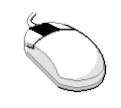
Rotate
To rotate the model about an axis normal to the screen, move the mouse near the edge of the graphics window, hold the middle mouse button down, and move the mouse pointer along the edge of the window

Slide 14
Spin
To rotate the model about the spin center, move the mouse near the center of the graphics window, hold the middle mouse button down, and move the mouse pointer.

Slide 15
Panning
To pan, move the mouse into the graphics window, hold the left mouse button down, and move the mouse pointer horizontally or vertically.

Slide 16
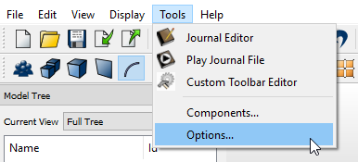
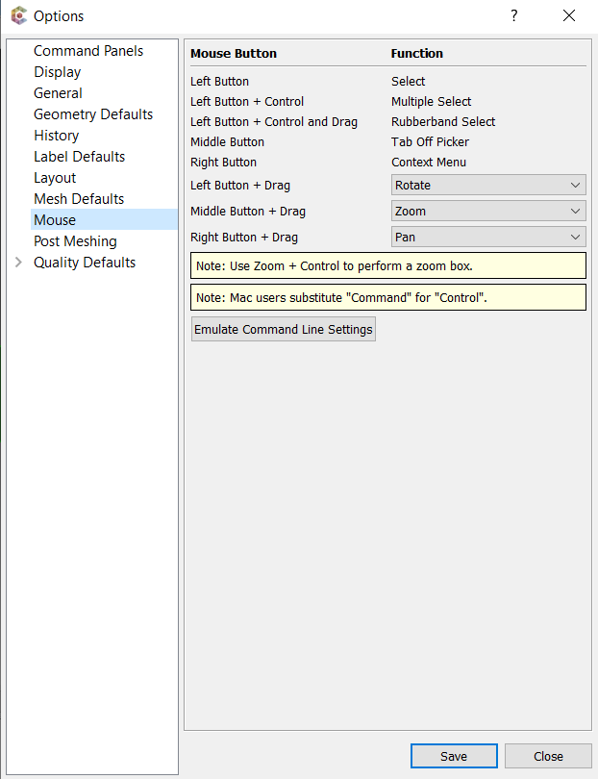
Customizing Mouse behavior
Select Tools:Options
In Options: Select Mouse

Slide 17
Display Tool Bar
Display Composite Surface Curves
Toggle Scale
Zoom in, out, and fit
Curve valence (Display merges)
Display modes
Show Overlaps
redisplay
perspective on/off
Check point save/undo
Custom selection tools
Display BCs
Define cutting plane

Slide 18
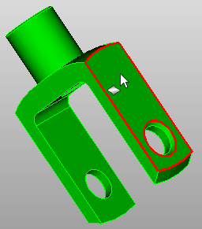
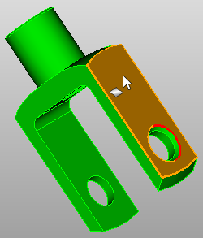
Selecting Entities in the Graphics Window
To select an entity, click and release the left mouse button. Entity is selected when the button is released.
Pre-selection filter highlights the current geometry that would be selected on a mouse click. The cursor style indicates the entity type that will be selected.

Slide 19
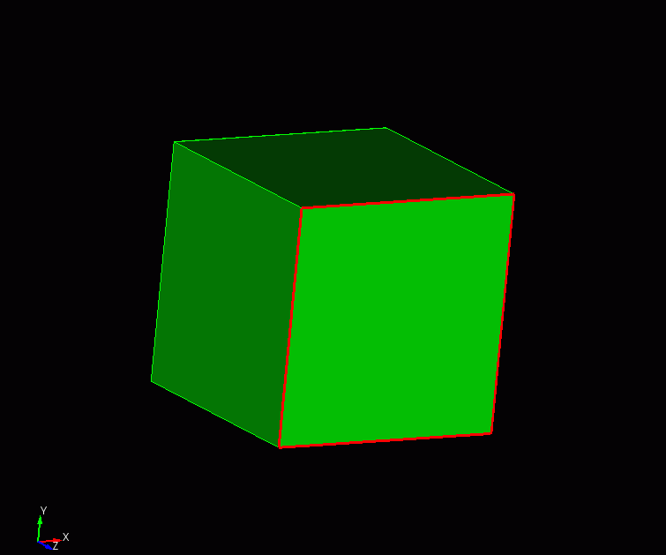
Selecting Surfaces in the Graphics Window
Move cursor to a surface. The bounding curves of the surface are highlighted, and cursor indicates surface type.

Slide 20
Selecting Curves in the Graphics Window
Move the cursor to a curve. The curve is highlighted, and the cursor indicates curve type.

Slide 21
Selecting Vertices in the Graphics Window
Move the cursor to a vertex. The vertex is highlighted, and the cursor indicates vertex type.

Slide 22
Selecting Other Entities in the Graphics Window
- Volumes, can be selected by double clicking on surfaces
- Groups
- Bodies
- Hex Elements
- Tet Elements
- Quad Elements
- Tri Elements
- Element Edges
- Nodes

Slide 23
Entity Selection Filter
Toolbar buttons toggle entity types that will be included in pre-selection
Default
Volume
Surface
Curve
Vertex
Active ID Input field “hijacks” pre-selection so that only the expected entity type is selectable

Slide 24
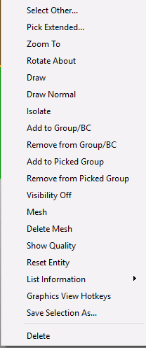
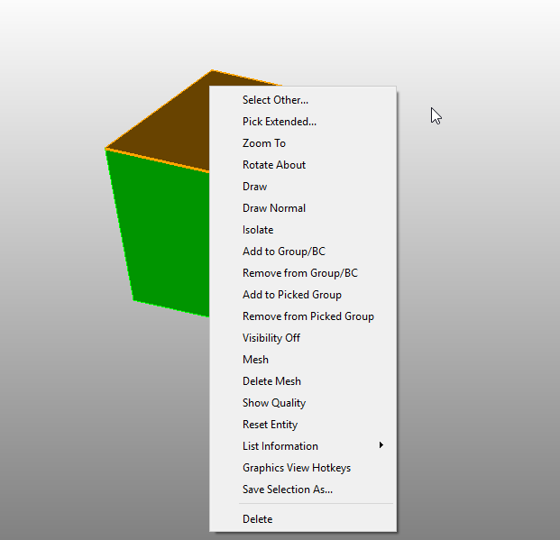
Pop-Up Menu with Selection
Right Click Menu options
Select Other: Cycles through nearby entities
Pick Extended: show the pick extended dialog
Zoom To: zoom to selected entity and set the entity’s centroid as current spin center.
Draw: Draw the selected entity
Visibility Off: Turn the visibility of the current entity off
Measure: Measure between two selected entities (two entities must be selected)
Reset Entity: Resets the scheme and sizing information to the default
List Information: List information for selected entities in the command window
Delete: Delete the current selection
2
1
Right Click
Select an entity in the graphics window (Hold Ctrl key to make multiple selections)
1

Slide 25
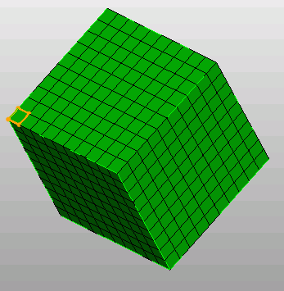
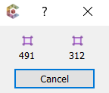
Select Other Menu
From right click menu with active selection click on “Select Other”.
Presents other possible targets within the current pick radius. Entity is highlighted as the mouse passes over its button.

Slide 26
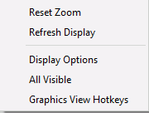
Pop-Up Menu Without Selection
1
2
Pick in an open area of the graphics window
Right Click
Right Click Menu options
Reset Zoom: Set zoom to include all visible entities
Refresh Display: Refresh the display
Display Options: Set other display options (line width, text size…)
All Visible: Turn the visibility of the all entities on
Graphics View Hotkeys: shows map of all hotkeys
1

Slide 27
The Model Tree

Slide 28
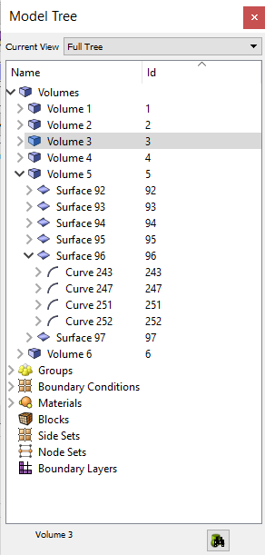
Using the Model Tree
List Type
Current Selection
List View
Expand tree to show selected entity

Slide 29
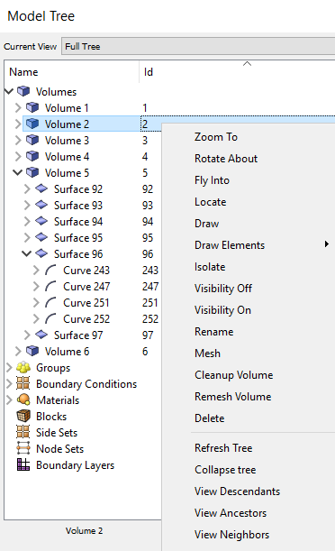
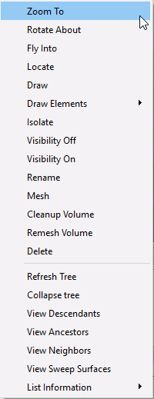
Model Tree Options
1
Select an entity in the tree
1
2
Right Click

Slide 30
Model Tree Options
Right Click Menu options
Zoom To: zoom to selected entity and set the entities centroid as current spin center.
Rotate About: rotate using the selected entity as the center
Fly Into: slowly zoom into selected entity
Locate: point to the selected entity
Draw: draw the selected entity
Draw Elements: draw the mesh elements associated with selection
Isolate: draw and center the selected entity
Visibility On: Turn the visibility of the current entity on
Visibility Off: Turn the visibility of the current entity off
Measure: For curves only: Measure between the two vertices of the curve
Rename: Change the entity’s name
Mesh: Mesh the selected entities

Slide 31
Model Tree Options
Right Click Menu options
Cleanup Volume: execute cleanup hex/tet command on volume
Remesh Volume: execute tet remesh command on selection
Delete: delete the selected entity (volumes, free entities only)
Refresh Tree: reset the list to Full Tree
Collapse Tree: collapse all expanded items in the tree
View Descendents: show a tree with the current entity at the top expandable to show descendents (lower dimension)
View Ancestors: show a tree with the current entity at the top expandable to show ancestors (higher dimension)
View Neighbors: show a tree with the current entity at the top expandable to show all entities that are attached to it
View Sweep Surfaces: show a tree with only sweep surfaces shown
List Information: List properties of the selected entities in the command window.

Slide 32
The Properties Page

Slide 33
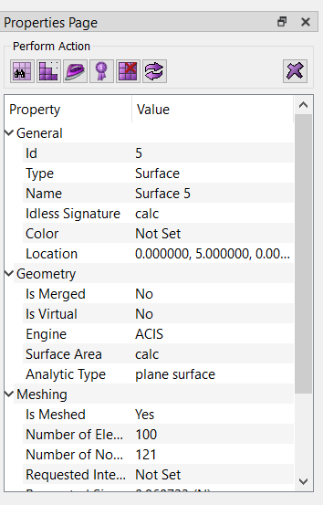
Using the Properties Page
Action Buttons
Preview Mesh
Mesh
Smooth
Quality Check
Delete Mesh
Reset Entity
Delete Entity
Entity properties. Grayed properties cannot be edited. Others can be changed from this page.

Slide 34
The Command Window

Slide 35
Entering Commands
All commands can be entered in the command window
Partial words OK
Can use general ID ranges
draw curve 1 to 5 except 4
draw curve in volume 2

Slide 36
Repeating Commands
Use the keyboard up and down arrows to see the previously executed commands
You can also select a previous command, right-click and choose copy/paste

Slide 37
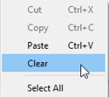
The Command Menu
Right click in the Command window to view the command menu

Slide 38
Command Syntax Help
After entering part of a command, type ‘?’
Lists commands that start with what has been typed, respecting word order
CUBIT> create?
Type help followed by keywords
Lists all commands that use the listed keywords in any order
CUBIT> help create vertex
Command syntax meaning
{ } - At least one of the items in curly braces must be
included in the command
[ ] - Items inside square brackets are optional
<> - A parameter of some type is expected at the location of
the pointed braces
| - Can be read as OR; separates options inside of braces

Slide 39
Echoing IDs to the Command Line
Fill in IDs on the command line by picking
Type the command up to the point where an ID is needed
CUBIT> draw surface
Pick the entity with the mouse
Type ‘e’ to echo the ID to the command window
CUBIT> draw surface 34

Slide 40
The Error Tab
Icon alerts user that an error has occurred
Click on the tab to see the error output

Slide 41
Exercise Become Familiar with the Interface
Practice
Zoom, rotate, spin, pan
Use the tool buttons to change mode and zoom
Select different entity types
Draw surface all except 1 from command line
CUBIT> draw surf all except 1

