Slide 1

CUBIT™ Fast-Start Tutorial
11. Mesh Control
Notes:
Type: FORMAL - Training
Title: Cubit 100 Training
SAND Number: SAND2020-0679 TR
Contact: Hensley,Trevor Michael

Slide 2
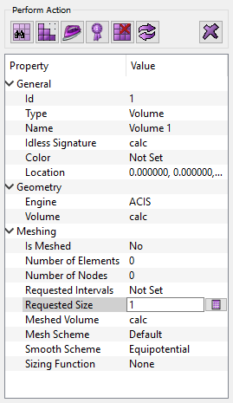
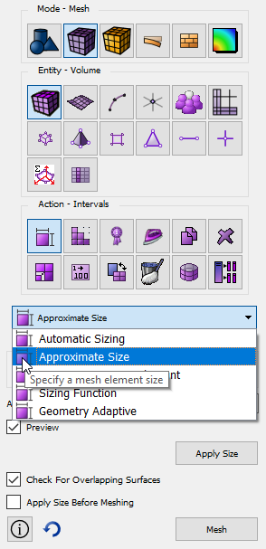
Mesh Sizing
1
Mesh size is an attribute of the geometry. Select entity then set attribute
2
Automatic Sizing: relative value
1 = fine mesh
10 = coarse mesh
Good way to preview element sizes
3
Approximate Size: mesh algorithms will try to maintain constant edge length
Approximate Interval Count: number of intervals on a curve. Will match approximately
Sizing Function: Specify a sizing function.
Geometry Adaptive: Size based on geometry characteristics.
Mesh size can be set on geometry entities from property panel
Mesh Size Command Panels

Slide 3
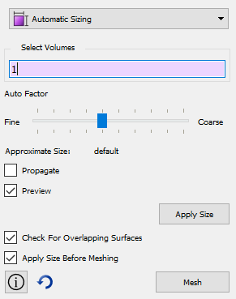
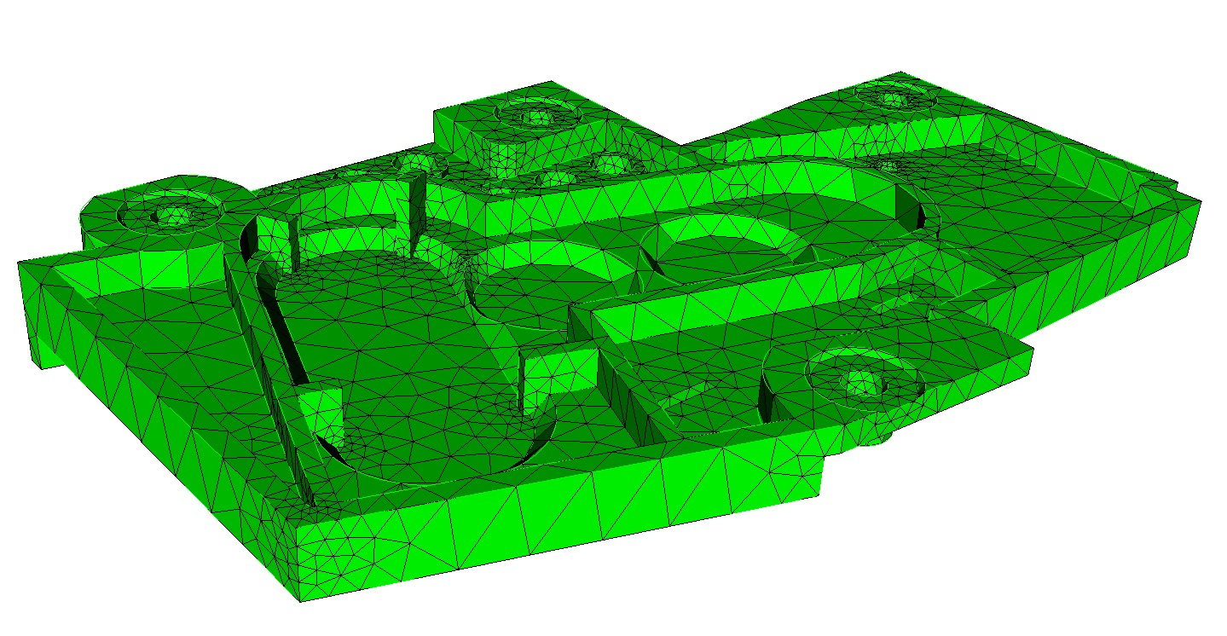
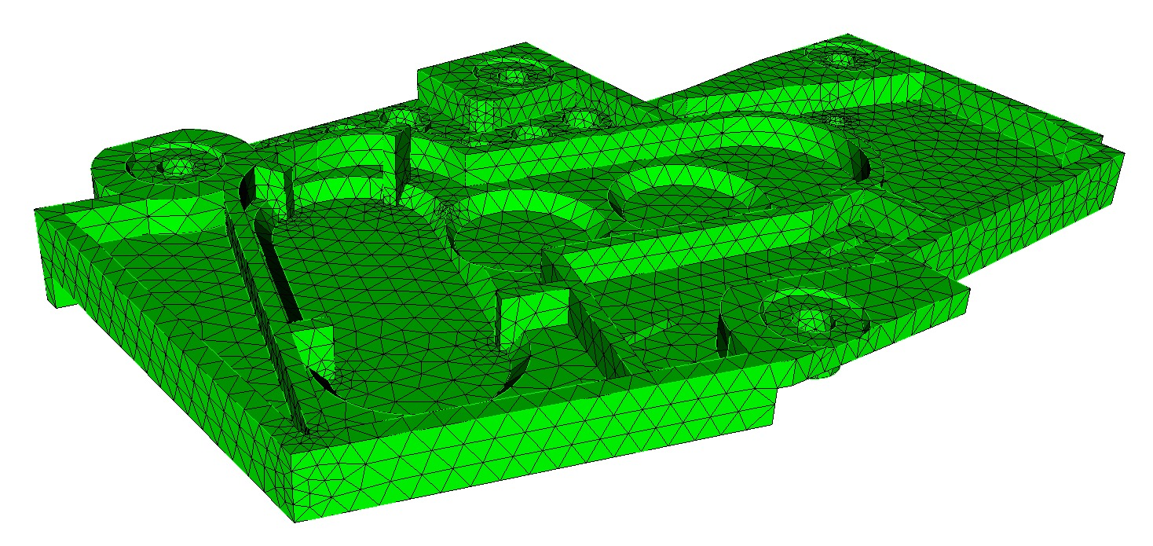
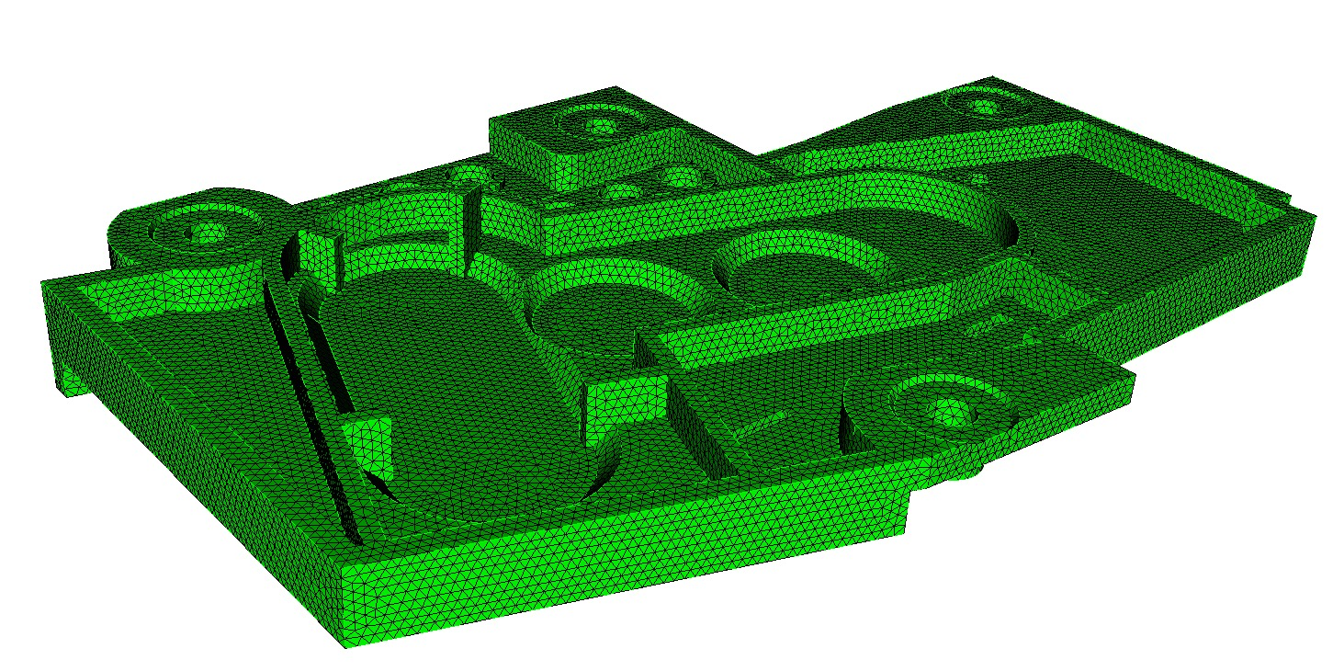
Auto Mesh Sizing
Move slider to see preview of mesh on curves
Auto size = 7
No need to know exact size of elements
Auto size = 5
Uses heuristic to compute size of element
If no size has been set, CUBIT™ will compute an auto mesh size=5
Auto size = 1

Slide 4
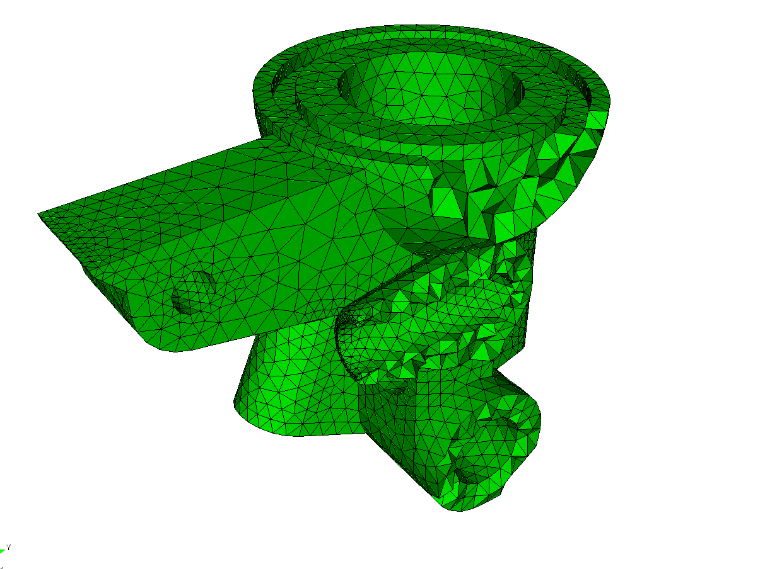
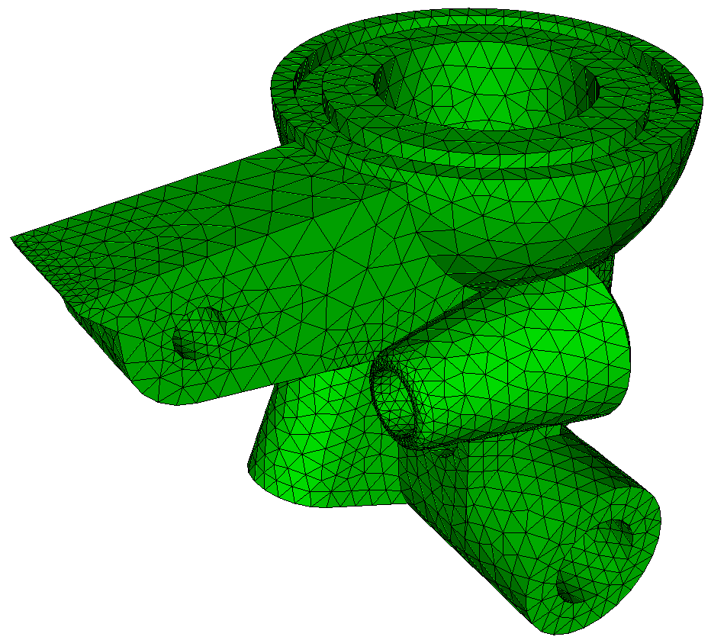
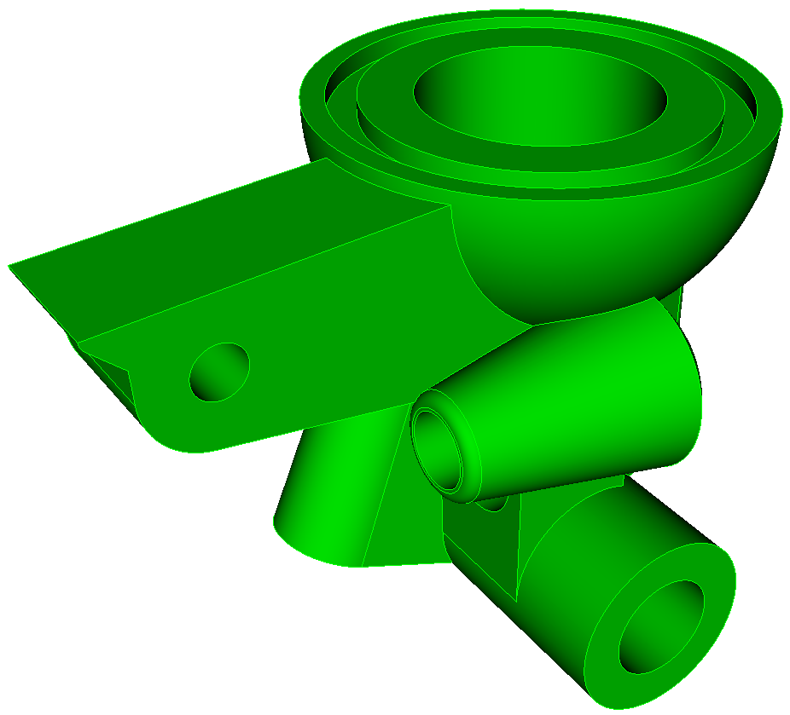
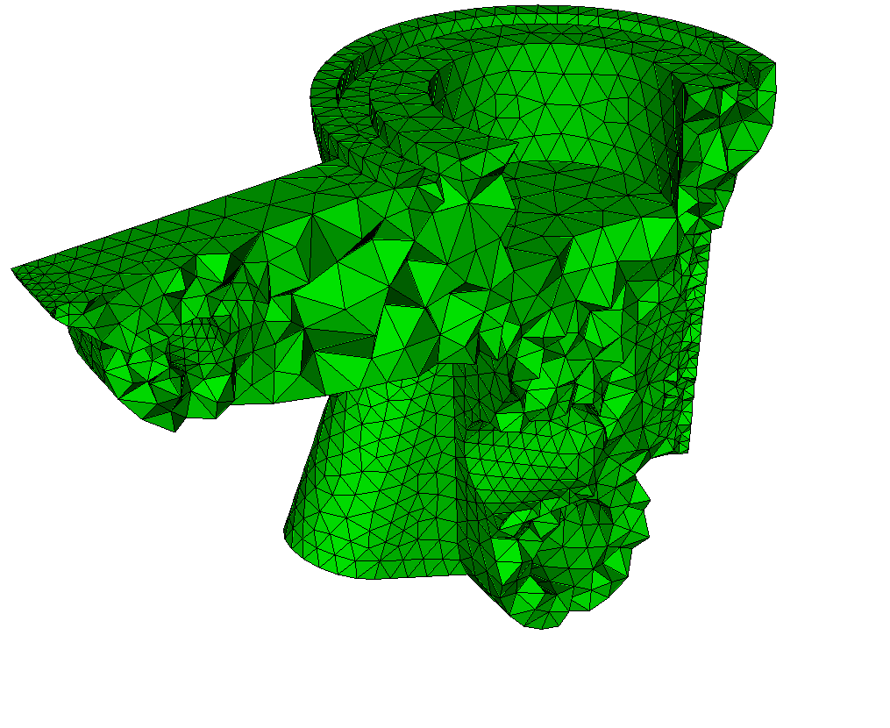
TetMesh Scheme
Arbitrary geometry
Mostly push-button/automatic
May still require geometry clean-up

Slide 5
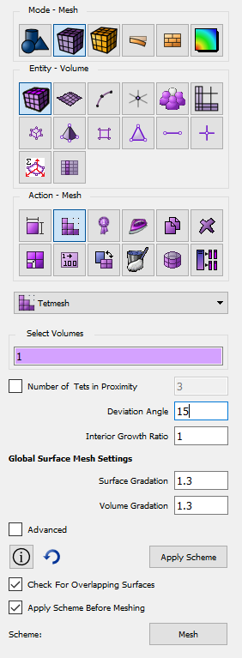
TetMesh Scheme
1
2
3

Slide 6
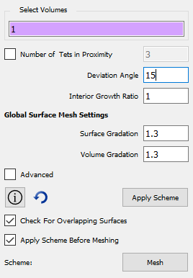
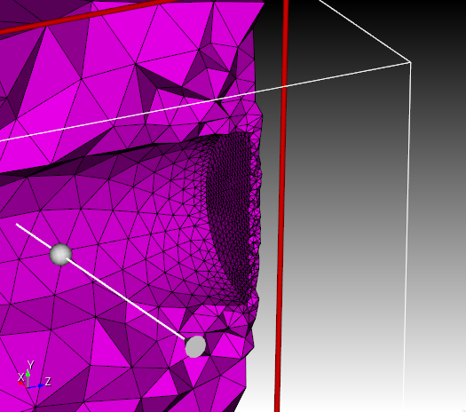
TetMesh Scheme
Number of Tets in Proximity

Slide 7
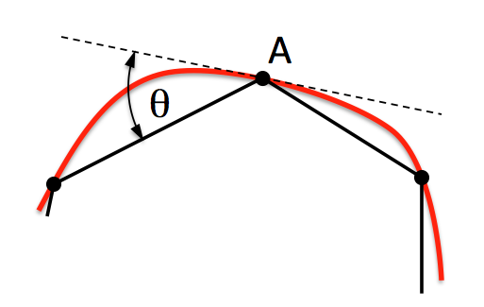
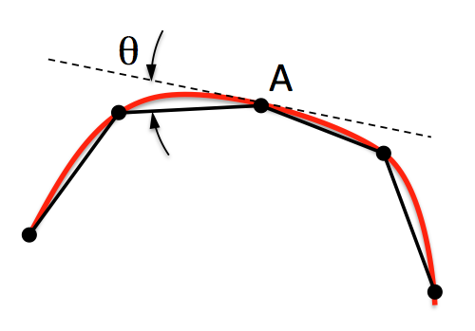
TetMesh Scheme
Deviation Angle
Deviation Angle
Deviation Angle (Geometry Approximation Angle)

Slide 8
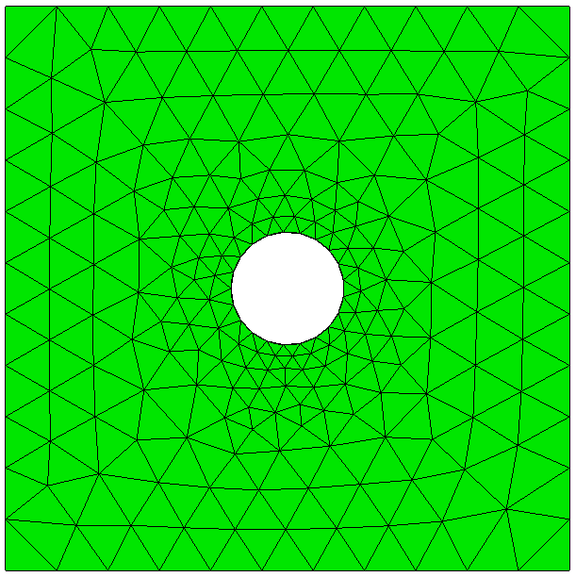
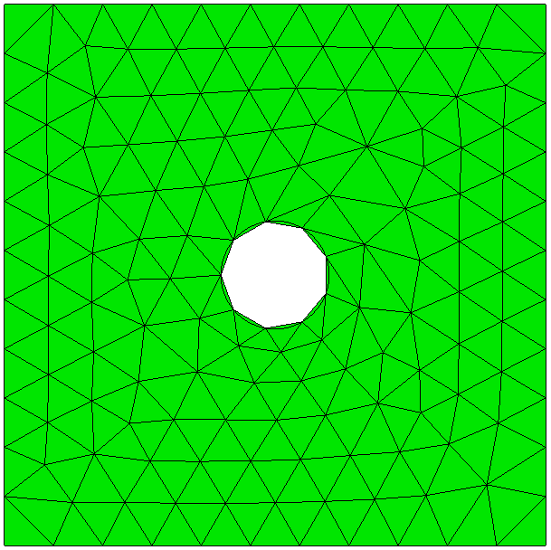
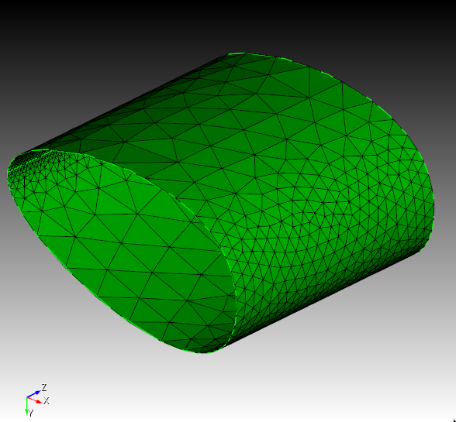
TetMesh Scheme
Deviation Angle (Geometry Approximation Angle)

Slide 9
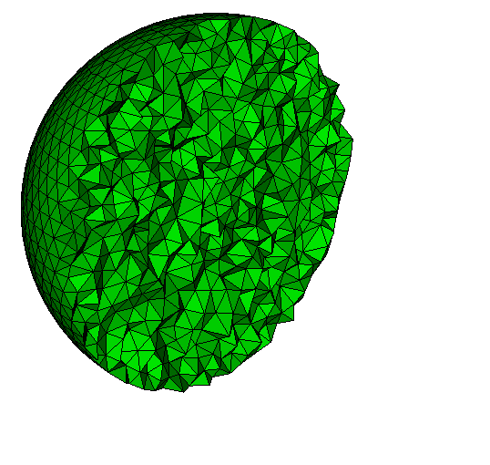
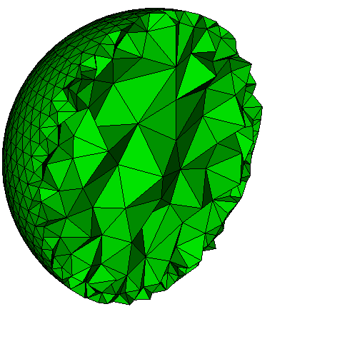
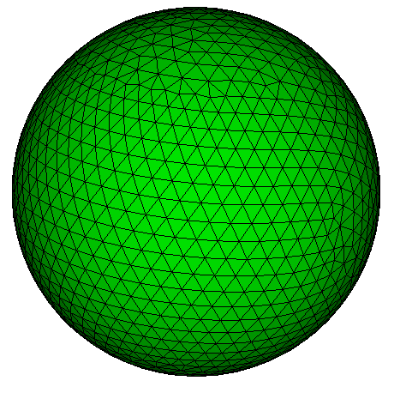
TetMesh Scheme
1.0
1.3
Interior Growth Ratio

Slide 10
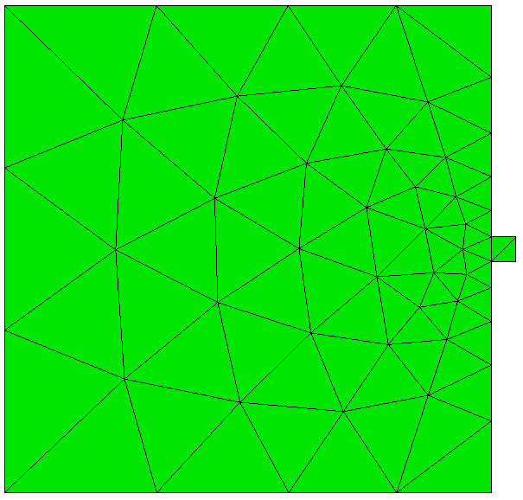
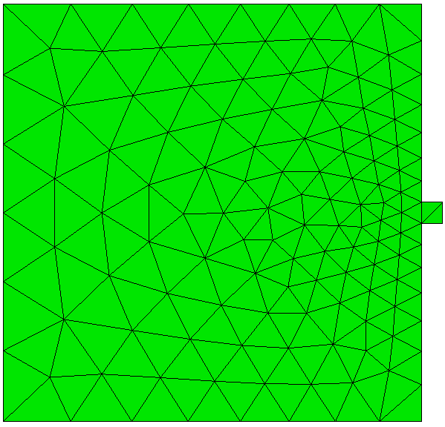
TetMesh Scheme
1.3
1.1
Surface Gradation

Slide 11
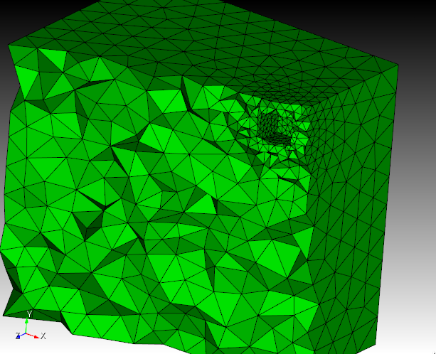
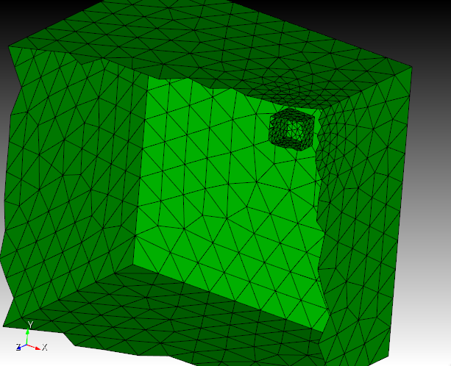
TetMesh Scheme
Surface Volume Gradation

Slide 12
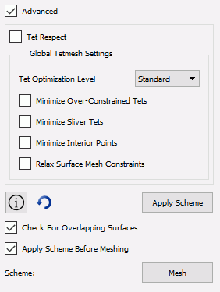
TetMesh Scheme
Tet Respect: Force TetMesh to conform to internal features (specified here)
Tetmesh Global Settings
Mesh Optimization settings not normally changed

Slide 13
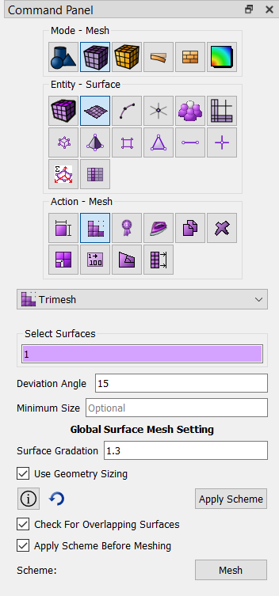
TriMesh Scheme
TriMesh Scheme:
Settings on Volume (TetMesh Scheme) are by default propagated to surfaces
1
2
Deviation Angle
Normally no reason to set Trimesh Scheme separately
3
4
Surface Gradation

Slide 14
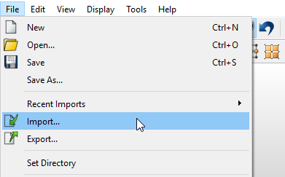
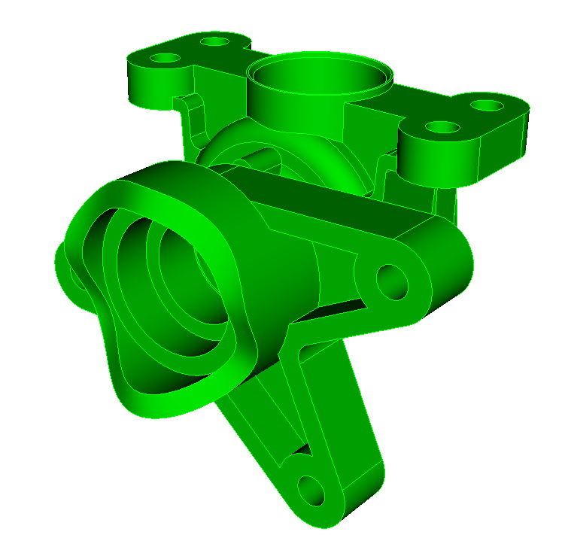
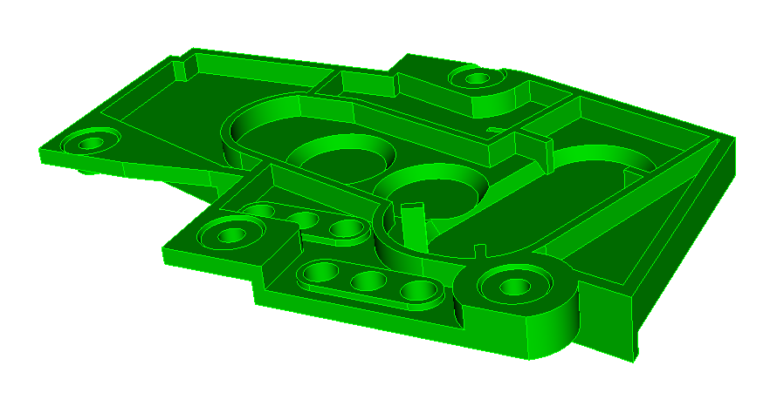
Exercise 1: Tet meshing
Import model
1
Import ACIS file driver.sat OR cad6.sat
1
cad6.sat
driver.sat

Slide 15
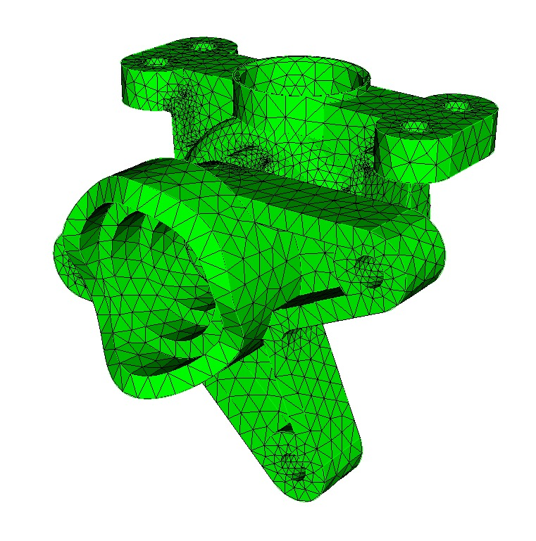
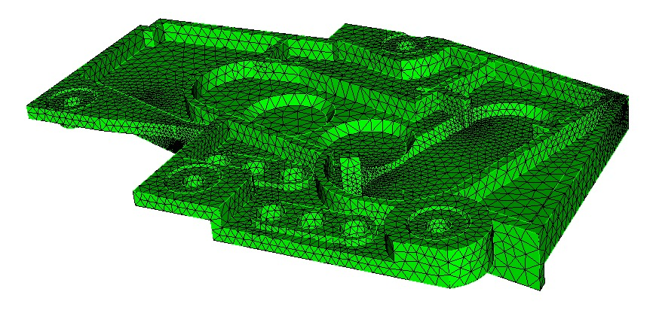
Exercise 1: Tet meshing
1
1
Mode - Mesh
2
2
Entity - Volume
3
Action - Mesh
4
Select Volume to Mesh (1)
3
Choose Tetmesh from Dropdown
5
4
6
Apply the Tetmesh Scheme
7
Click the Mesh Button
5
OR
From Cubit Command Window
6
Volume 1 scheme tetmesh
Mesh Volume 1
7

Slide 16
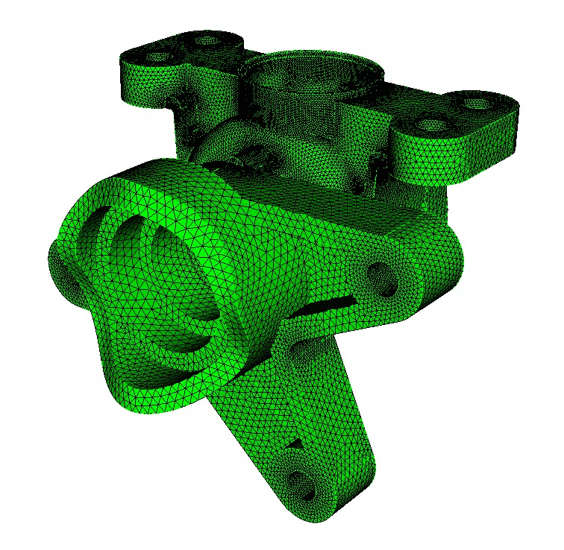

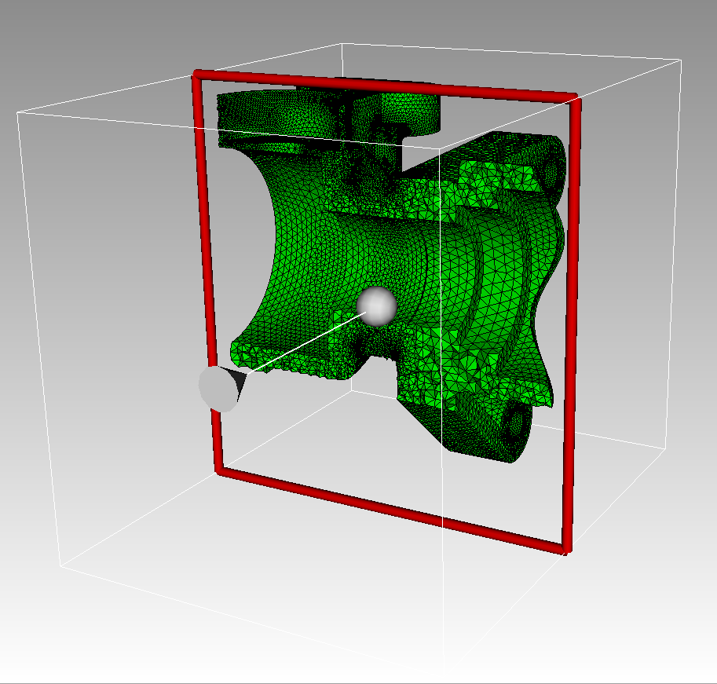
Exercise 1: Tet meshing
Modify the following parameters and observe the changes to the mesh
Number of Tets in Proximity = 3
Deviation angle = 5
Surface Gradation = 1.2
Use the slice tool to see the interior of the mesh
From the command line:
draw tet all

Slide 17
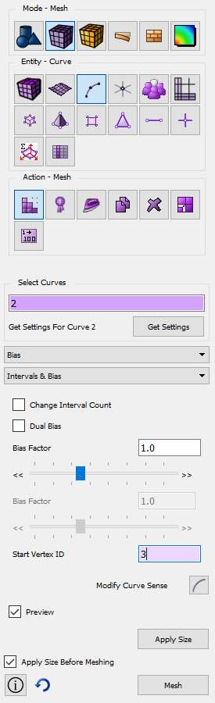
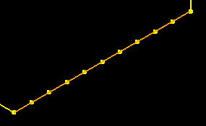

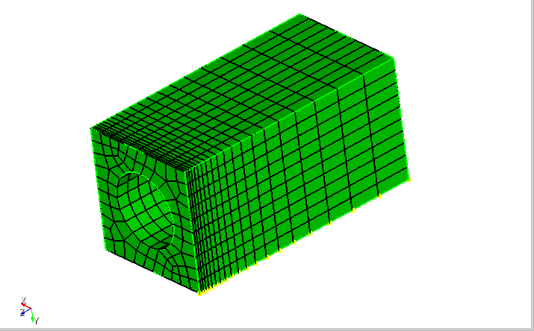
Curve Biasing
1
Navigate to Curve Bias Panel
1
2
Pick a Curve.
3
Select Bias and Intervals & Bias
2
4
Set number of intervals, start vertex, etc..
3
Adjust slide bar to preview biased mesh.
5
4
5
Propagate Curve Bias
Choose from Bias Scheme on GUI panel
3

Slide 18
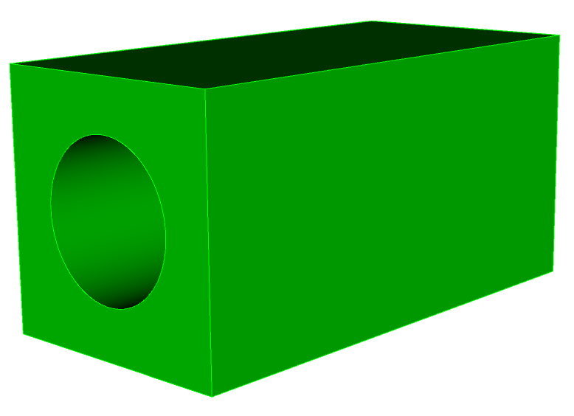
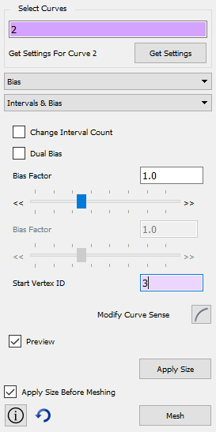
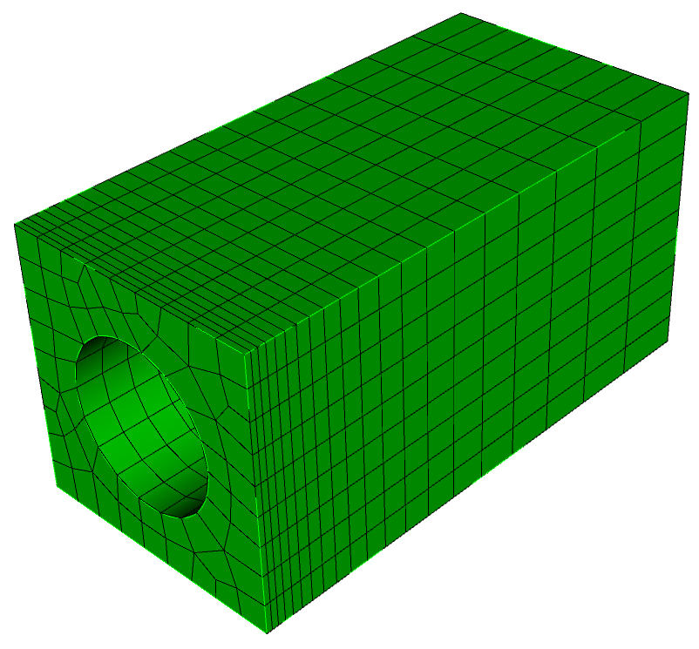
Mesh Control Exercise 2
1
Create the simple model shown using the GUI or command line
Use the procedure shown in the previous slide to generate a biased mesh
Experiment with different options of curve bias
What happens if propagate curve
bias is not applied?
Brick x 10 y 10 z 20
Create cylinder height 25 rad 3
Subtract vol 2 from vol 1
2
3

Slide 19
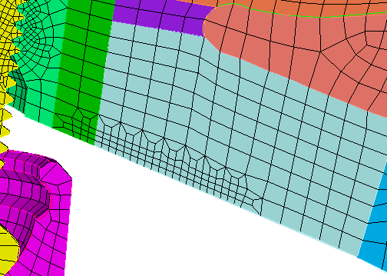
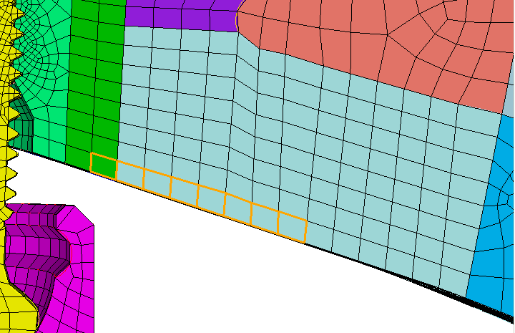
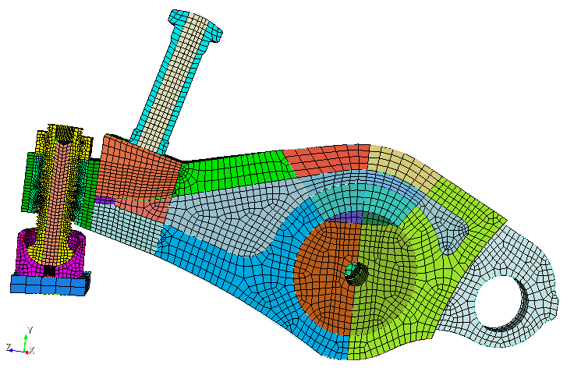
Mesh Refinement
Hex, tet, face, and tri mesh refinement
  Simply specify a mesh or geometry entity and size
  Works across volume boundaries

Slide 20
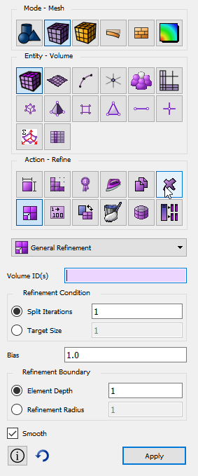
Mesh Refinement
Refine {Node|Edge|Tri|Face|Tet|Hex} <range> [NumSplit <int = 1>|Size <double> [Bias <double>]] [Depth <int>|Radius <double>] [Sizing_Function] [no_smooth]
Refine {Vertex|Curve|Surface|Volume} <range> [NumSplit <int = 1>|Size <double> [Bias <double>]] [Depth <int>|Radius <double>] [Sizing_Function] [no_smooth]

Slide 21
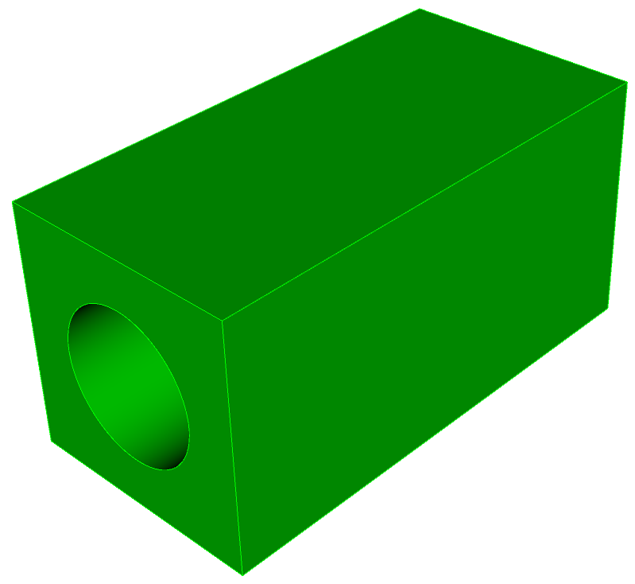
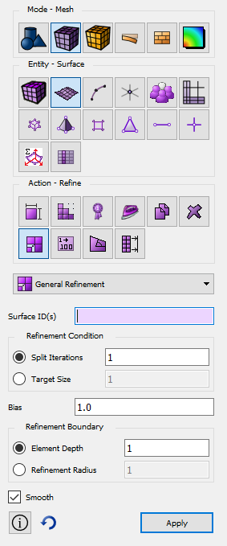
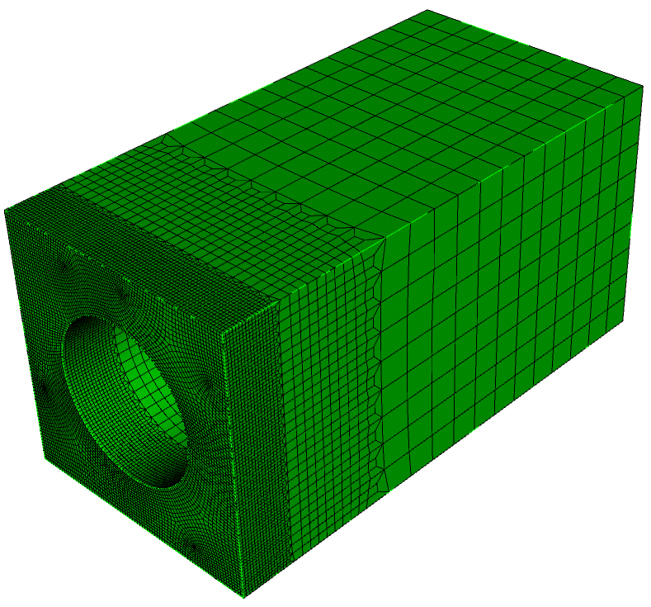
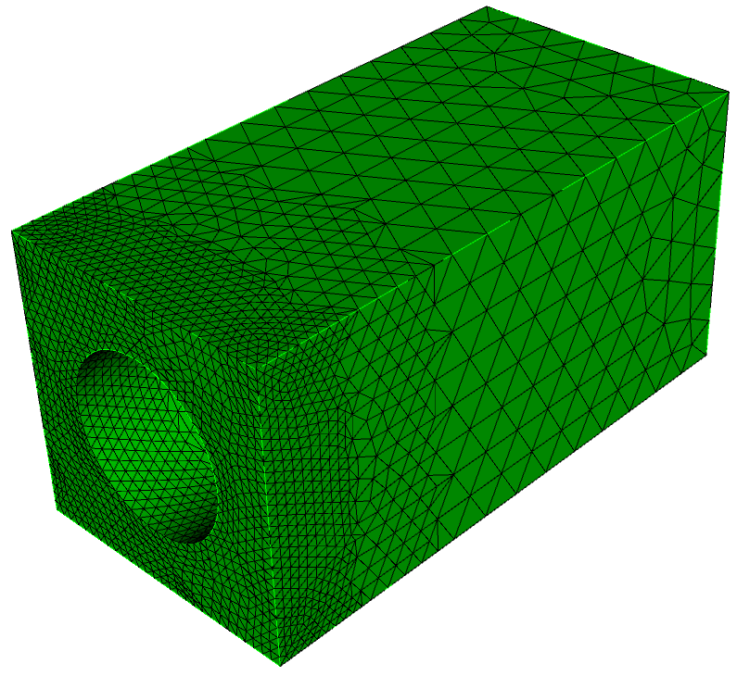
Mesh Control Exercise 3
1
Use the same model you created for exercise 2 and reset the volume
Use the refine surface command panel to generate a graded hex mesh. Try an element depth of 5.
Reset the volume, generate a tet mesh and use the same tool to generate a graded tet mesh
2
3
Graded hex mesh using element depth 5 applied twice
Graded tet mesh using element depth 5 applied twice

Slide 22
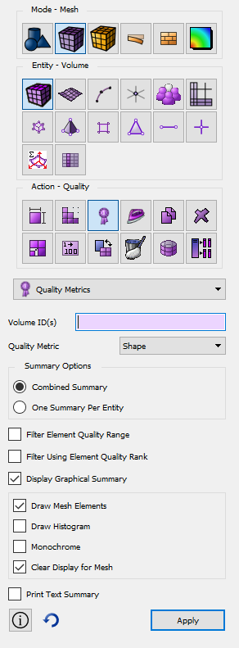

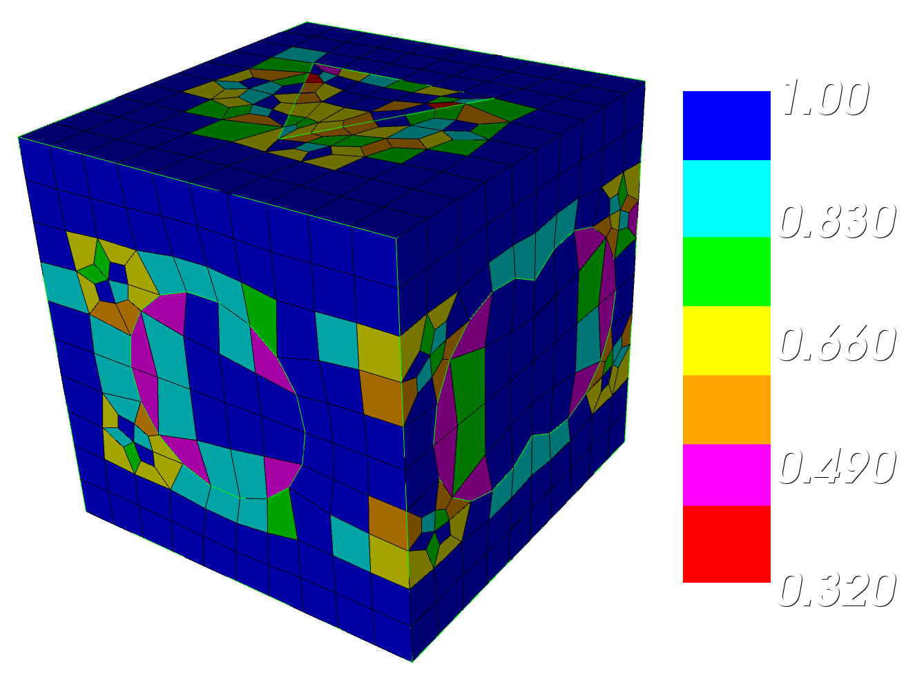
Mesh Quality Command Panel
1
Navigate to Mesh Quality Panel
Note that this panel is available for volumes, surfaces and elements
1
2
Select a meshed volume to examine
3
Select a Quality Metric
4
Select the options for displaying the metrics
2
3
4

Slide 23
Quality Metrics
Definitions of the metrics are in the online documentation
  Go to the quality page and hit the F1 key
Notes:
23

Slide 24
Automatic Mesh Quality Checks
Quality is automatically computed after every meshing or smoothing operation
Always check output window following meshing
CUBIT> Mesh Volume 1
ERROR: >>>> Negative Jacobian Hex Element Generated! <<<<<
Check Mesh Quality.
CUBIT> Mesh Volume 1
WARNING: >>>> Poorly-shaped Hex Element Generated! <<<<<
Check Mesh Quality
Use smoothing, cleanup or modify the geometry to improve quality before using mesh with poor quality in an analysis
Poor quality may be acceptable if located where physics is not as important. Engineering judgment needed.

Slide 25

Mesh Quality
Select Options (or Preferences on Mac) menu to define quality metric(s) to use and the minimum and maximum criteria

Slide 26


Smoothing
Smoothing adjusts node locations without changing element connectivity.
Many different smoothing schemes with different characteristics
Usually iterative algorithms that attempt to improve the local mesh quality
Short cut to smoothing command panel
Smoothing schemes for surfaces and volumes
Smoothing schemes applied as an attribute, (similar to meshing scheme)
Surface and volume schemes are independent (unless free boundary option selected)
Smooth scheme can be set from the property panel
Smooth scheme can also be set from the command panel

Slide 27
Smoothing
Surface Smoothing Schemes
Volume Smoothing Schemes
Equipotential
Centroid Area Pull
Optimize Jacobian
Winslow
  longtime favorite for structured meshes has been extended to unstructured in CUBIT - theoretical guarantee against mesh folding
  fast and high quality, try first
Laplacian, centroid area pull (smart Laplacian)
  fast, poor near concave features
Untangle
  remove stubborn inverted elements
Condition number
  improve stubborn low-quality elements
  must be non-inverted to start
Mean Ratio
Laplacian
  fast, poor quality near concave features
Equipotential
  medium fast and medium quality
Untangle
  remove stubborn inverted elements
  Can take a long time
  Control time limit:
  Volume <range> Smooth Scheme Condition Number [beta <double=2.0>] [cpu <double=10>]
Condition number
  Guarantees the same or better quality
  improve stubborn low-quality elements
  must be non-inverted to start (runs untangle if inverted)
  Can take a long time
  Control time limit:
  Volume <range> Smooth Scheme Condition Number [beta <double=2.0>] [cpu <double=10>]

Slide 28




Mesh Control Exercise 4
1
Open cub file “graft.cub”
Navigate to the volume mesh quality panel
Draw the mesh quality of volume 1 using the shape metric.
Filter the mesh based on an upper limit of .4 and a lower limit of 0 and redraw the mesh.
Draw the shape quality histogram for volume 1.
Smooth volume 1 using mean ratio.
Draw the mesh quality of volume 1 using the shape metric and the same filter as before.
Set the 3D filter in the tool bar.
Select one of the poorly shaped elements and examine the properties panel.
2
3
4
5
4
6
3
7
8
9

Slide 29



Mesh Control Exercise 5
1
Import the acis file “driver.sat”
Draw surface 55
Set the mesh size to 1.0 on surface 55
Mesh surface 55 using the paving scheme
Check the edge length quality. Use the quality command panel located under edge elements
What is the smallest edge length? Average edge length? Zoom to the smallest edge.
Use the edge length surface smoothing scheme to smooth surface 55
Check the edge length quality again for surface 55
Note any changes to the mesh What is the smallest edge length now?
Surface 55
2
3
4
5
The paver can sometimes create small edges in order to resolve the mesh
6
7
8
9

Slide 30



Interactive Node Editing
Select nodes to reshape elements
  Draws element outlines as nodes are moved.
  Can display element quality as nodes move

Slide 31

Mesh Import
Importing an existing mesh into CUBIT™
Note that in addition to Exodus, Patran, Ideas, Abaqus, Fluent and Nastran mesh file formats are also supported.
1
Select the File->import menu
Choose the Genesis/Exodus File Filter
Select a mesh file to import
2
3
4
Choose how you want CUBIT™ to use the mesh
Mesh Geometry: A new “mesh-based” geometry definition is automatically created on import. Vertices, Curves, Surfaces and Volumes are generated from the boundary of the mesh.
Free Mesh: Imports the mesh with no geometry association
Lite: Imports a light-weight version of the mesh suitable for responsive display and a small set of operations.
4

Slide 32



Free Mesh
Geometry
Mesh
Mesh Owned By Geometry
Traditionally this is the only way mesh could exist in CUBIT™.

Slide 33
Free Mesh
Geometry
Mesh
Mesh Not Owned By A Geometric Owner (“Free Mesh”)
Now mesh can exist and be manipulated without a geometric owner.

Slide 34



Mesh Control Exercise 6
1
Import the exodus file “crunch.e” as a mesh-based geometry. Use a feature angle of 0
Examine the mesh quality. What do you notice?
Navigate to the Remesh Tet Command Panel
2
3
3
3
crunch.e
Tet mesh after deformations applied from an analysis
3

Slide 35


Mesh Control Exercise 6 (continued)
4
Select Remesh Poor Quality
5
Select Scaled Jacobian
6
Use a value < 0.1
7
Select Preview Only
8
Click Apply
The elements in the mesh that meet the criteria of scaled Jacobian less than 0.1 will be displayed. These are the elements that will be remeshed. (The rest of the mesh will not be affected)
9
Uncheck the Preview Only Toggle
10
Click Apply
11
Examine the mesh quality. What do you notice?

