Slide 1
CUBIT™ Fast-Start Tutorial
10. Geometry for Sweeping
Notes:
Type: FORMAL - Training
Title: Cubit 100 Training
SAND Number: SAND2020-0679 TR
Contact: Hensley,Trevor Michael

Slide 2
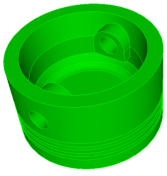
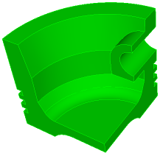
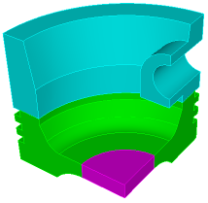
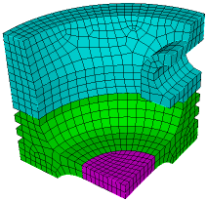
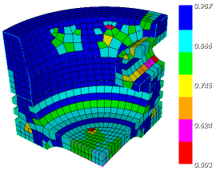
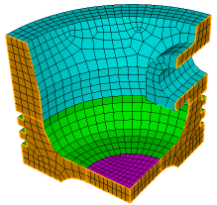
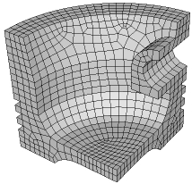
The Basic CUBIT™ Process
1
2
3
Import Solid Model
Simplify Geometry
Decompose Geometry
4
5
6
Imprint & Merge
Set Schemes
& Intervals
Mesh
7
8
9
Check
Quality
Apply B.C.s
Export
Mesh

Slide 3
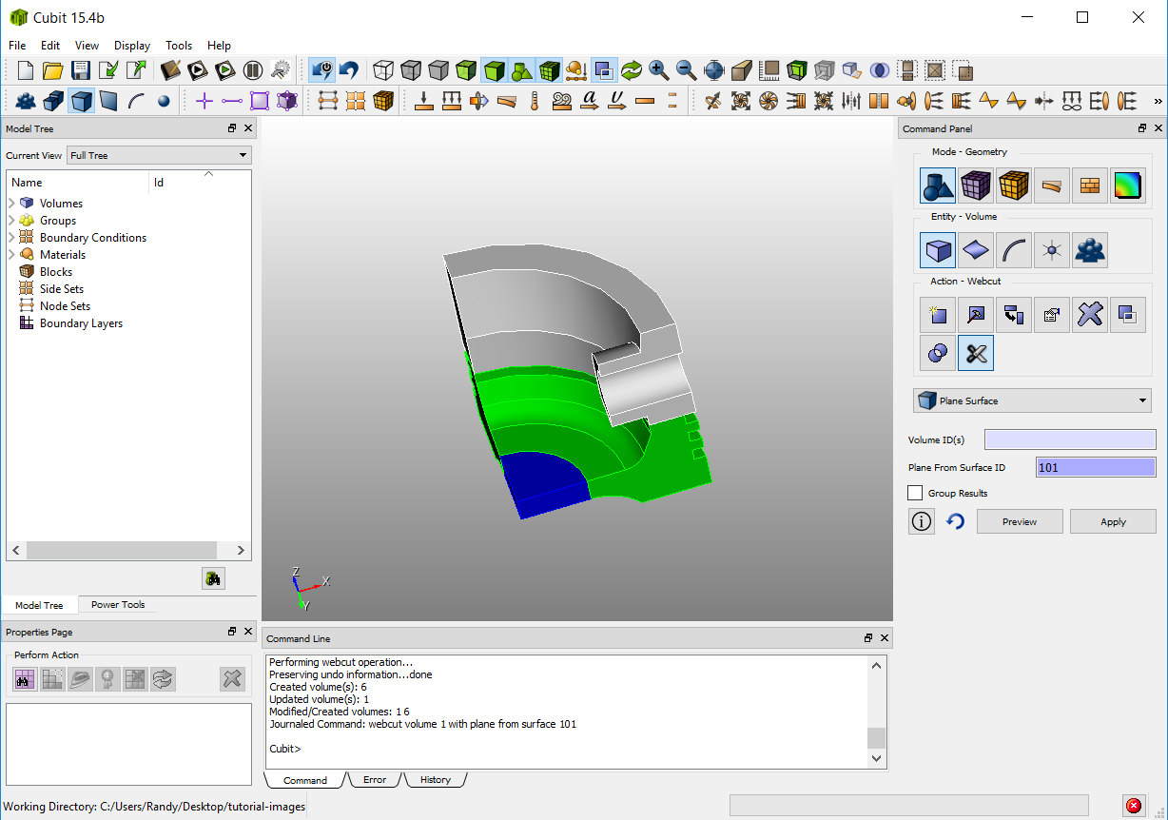
3
Decompose Geometry
Cut the model into
sweepable volumes
sweep direction 1
sweep
direction 2
sweep direction 3
Volumes are now individually sweepable

Slide 4
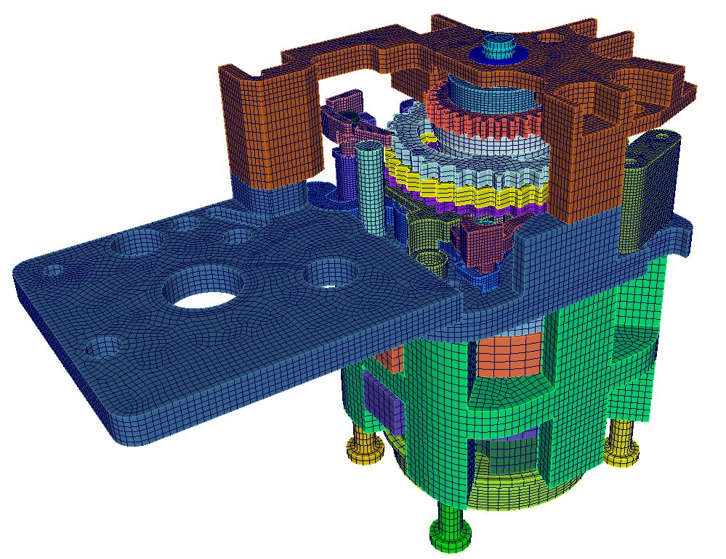
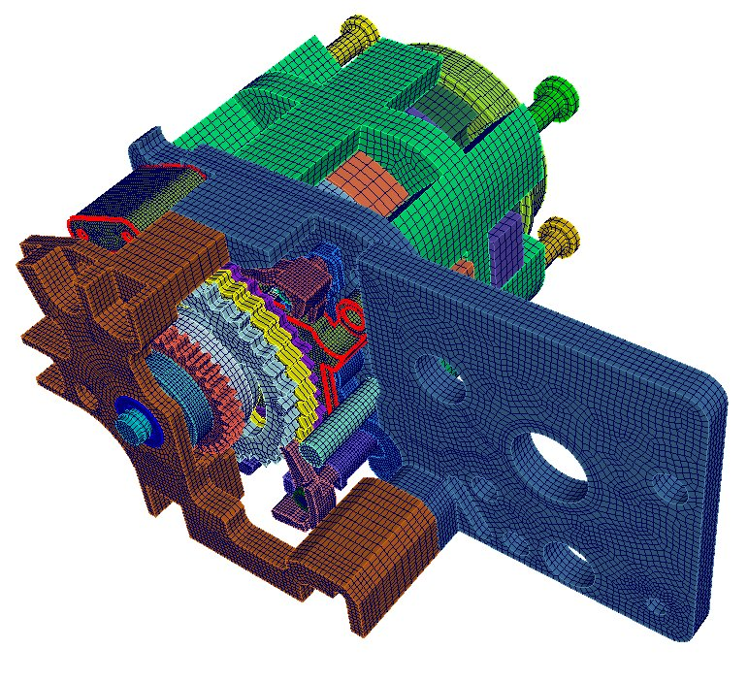
Decomposition for Sweeping
Most geometry will require partitioning into smaller volumes before it is capable of being meshed with a quality hex mesh.
There are at least 2 strategies to decompose your model for sweeping.
Using CUBIT™ Web Cutting and geometry tools (typical)
Using CAD package (i.e. Pro/E, Solidworks) Standard to create cut features.
BPinch Assembly Model
(Tim Jones)
Always look for a similar example on how to define the cut.
The hardest part of hex meshing is figuring out how to decompose the volume.

Slide 5
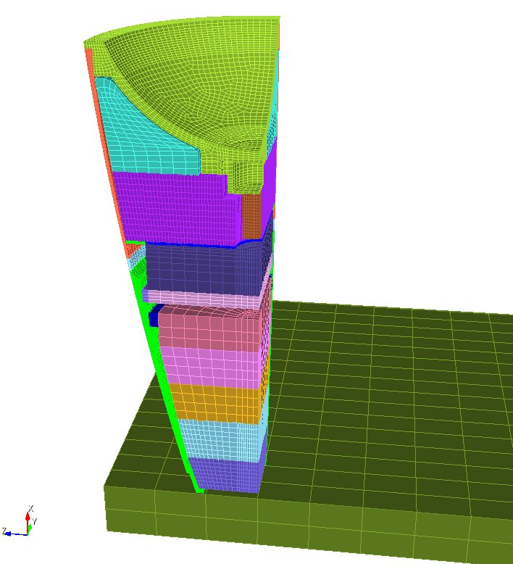
Decomposition for Sweeping
Depending on your geometry you may want to use both CUBIT™ and CAD tool for partitioning (web cutting)
Many web cutting and Boolean operations are available in CUBIT™.
B61 Assembly Model
(Tim Jones)
Most partitioning (web cutting) can be done from within CUBIT™

Slide 6
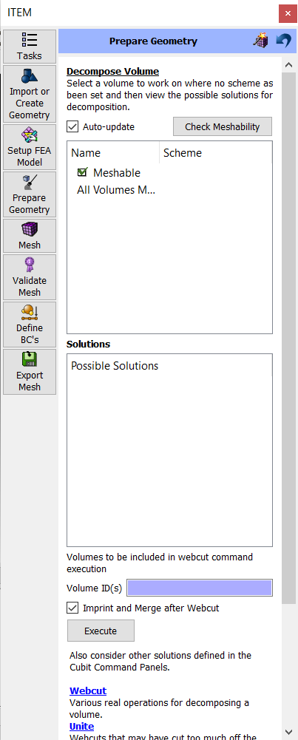
Web Cutting
ITEM Decompose Volume panel
1
Checks meshability of each volume
2
Displays/Previews various webcut alternatives
3
Executes the webcut
4
Imprints and merges new volumes
5
Recomputes meshability
ITEM not guaranteed to suggest the best webcut
May require webcutting using the command panels
When using command panels, remember to imprint and merge!
Shortcut to webcut panels

Slide 7
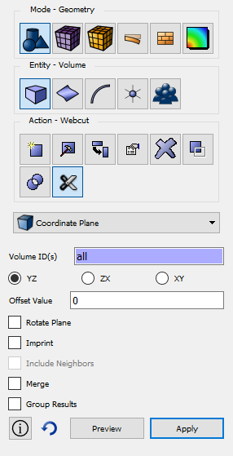
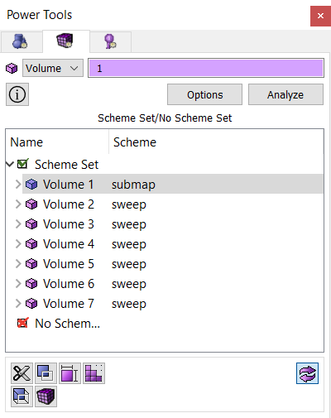
Web Cutting
Webcut panels offer a variety of different tools for decomposing your model for sweeping
Use webcutting in conjunction with ITEM decompose Volume Panel or Meshing Power Tool
Meshing Power Tool
Webcut Command Panel

Slide 8
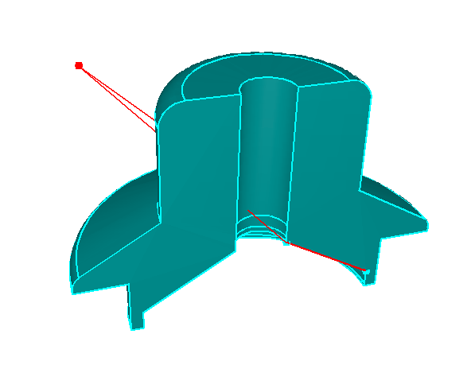
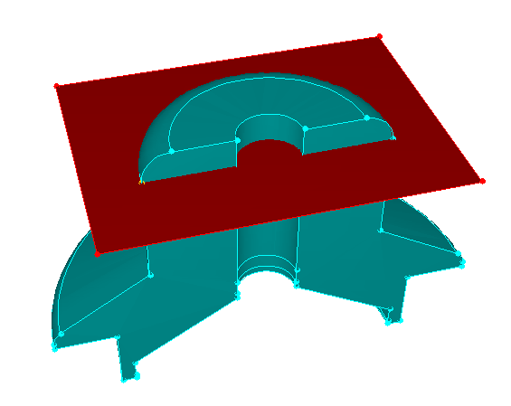
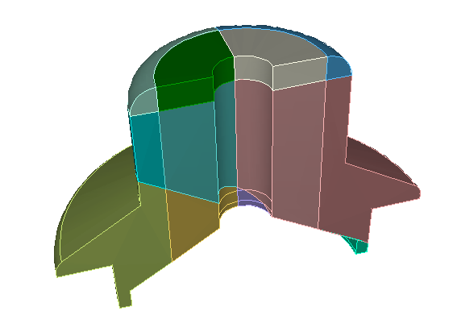
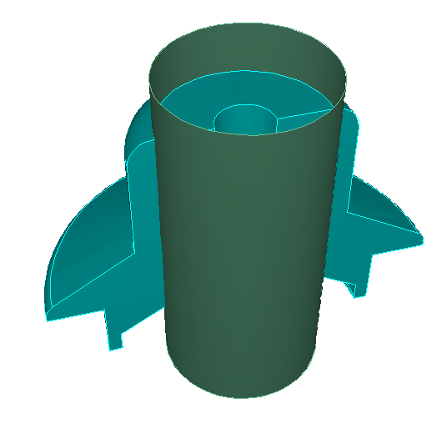
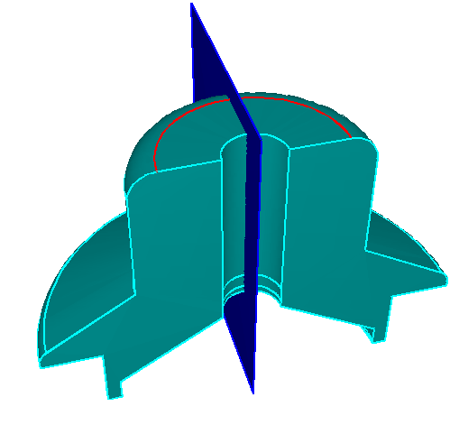
Web Cutting
Plane from vertices:
Coordinate plane:
Example Webcuts
Result:
Cylindrical surface:
Plane normal to curve:

Slide 9
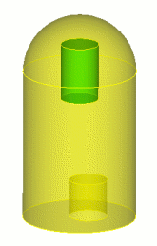
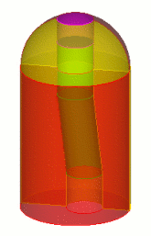
Web Cutting
Decomposition may require creation of a temporary tool volume to aid in cutting the geometry
A Tool volume is first created and used to webcut the volume
A
B
A lofted volume is first created between surface A and B and used as a Tool to cut the volume

Slide 10
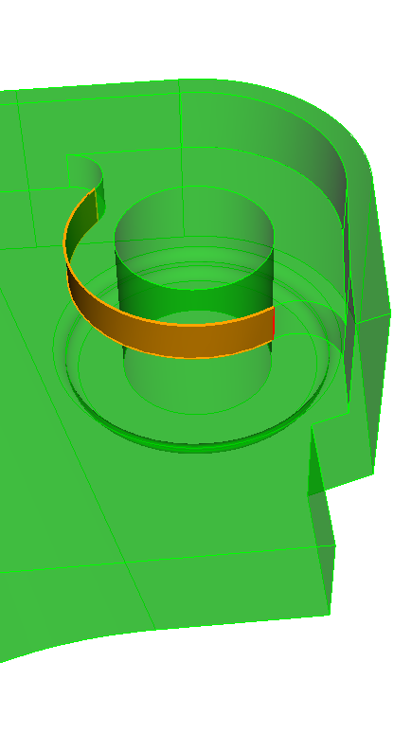
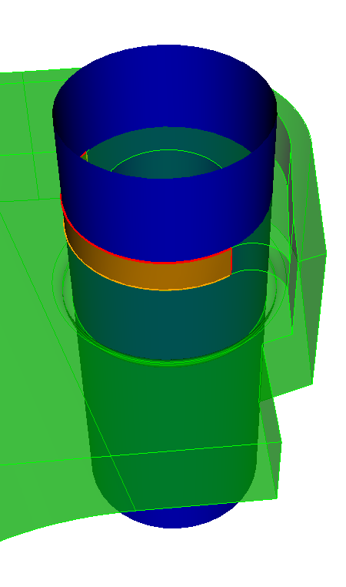
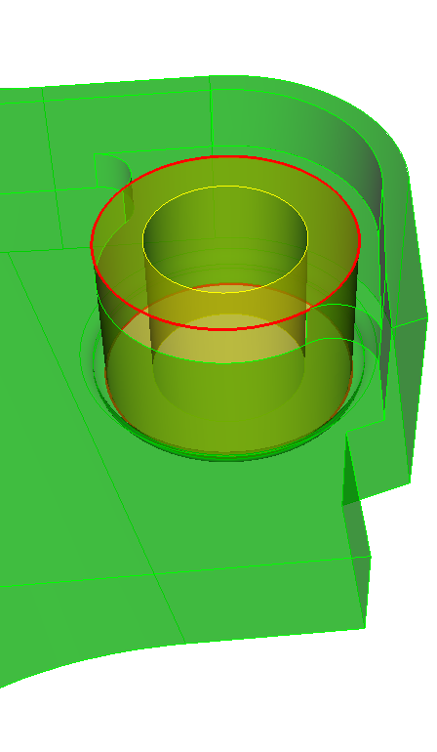
Web Cutting
Webcutting by extending a selected surface. Surface can be non-planar
Extend webcut from this surface
Preview of webcut
Decomposed volumes

Slide 11
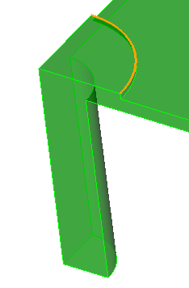
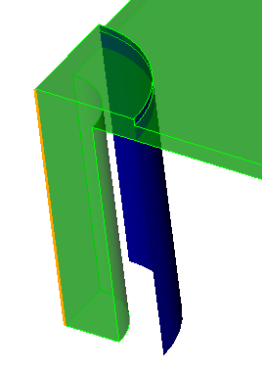
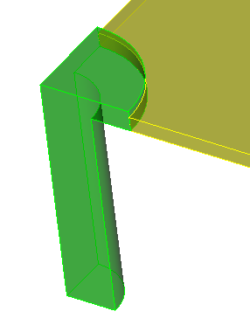
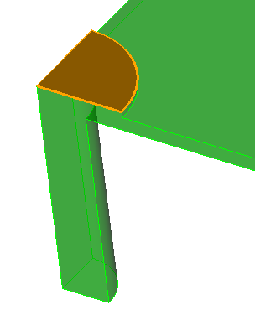
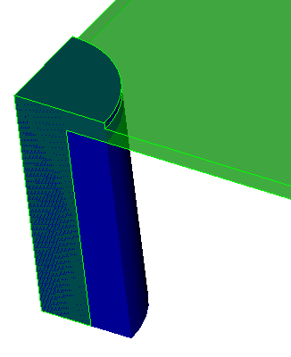
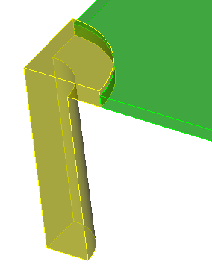
Web Cutting
Webcuts can be made by extruding a surface or curve through the volume along a path
Curve used as sweep webcut tool
Similar results achieved with sweep curve and sweep surface webcut tools
Preview of webcut
Final decomposition
Surface used as sweep webcut tool
Preview of webcut
Final decomposition

Slide 12
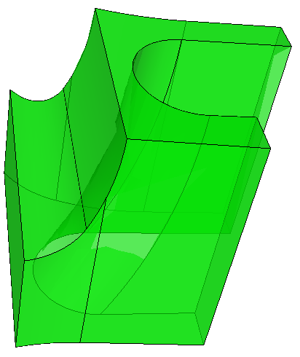
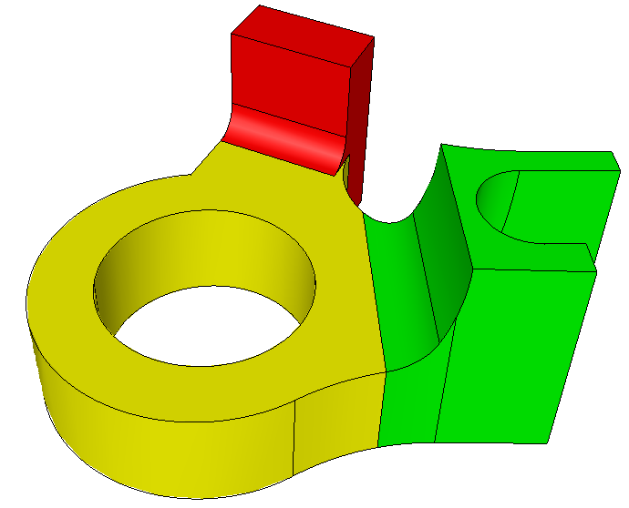
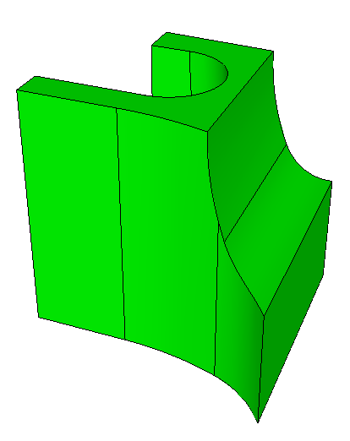
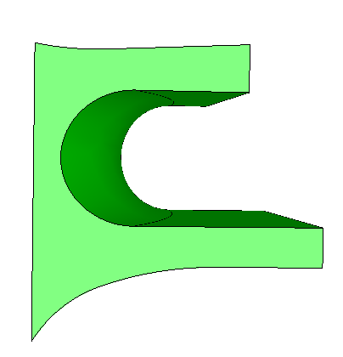
Web Cut Examples
Regardless of where you intend to cut your model if you are having difficultly determining where to cut a model a good place to start is the center of any fillets.
“Sweepable”
in this direction
With poor quality

Slide 13
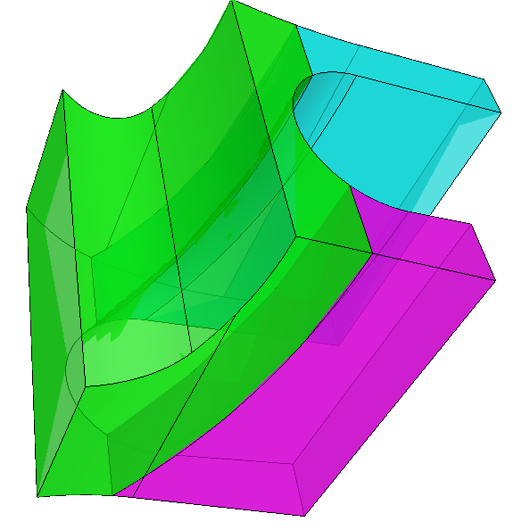
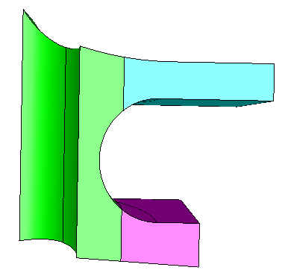
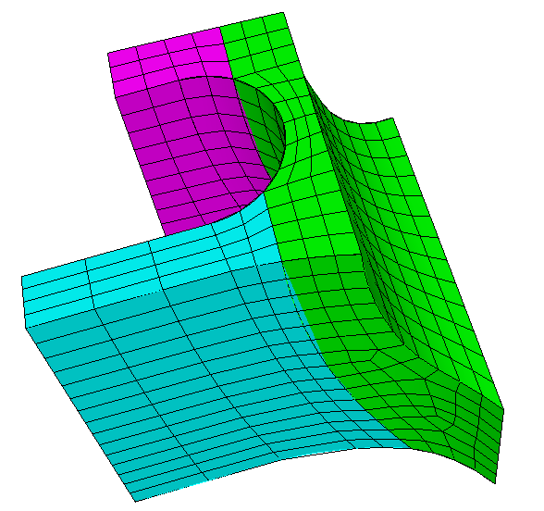
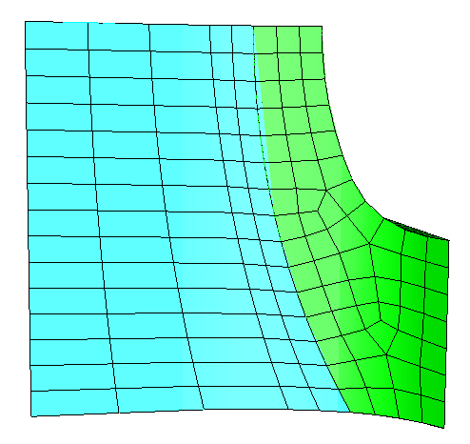
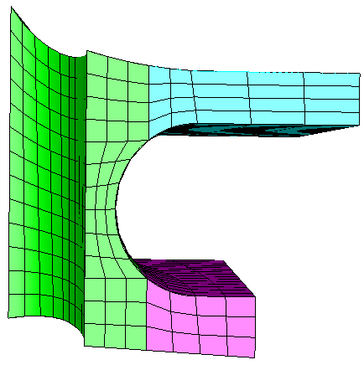
Web Cut Examples
New sweep direction
Cutting through centers of fillets gives added flexibility in sweeping and helps improve quality

Slide 14
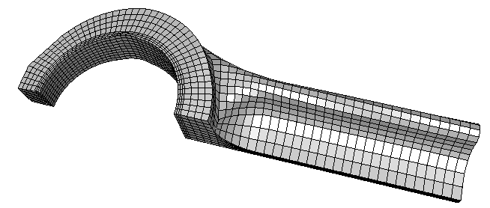
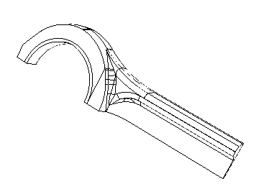
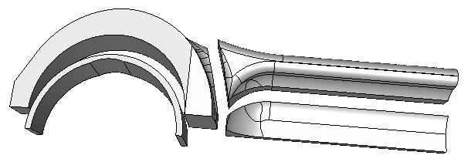
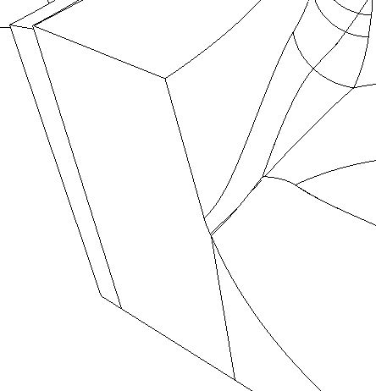
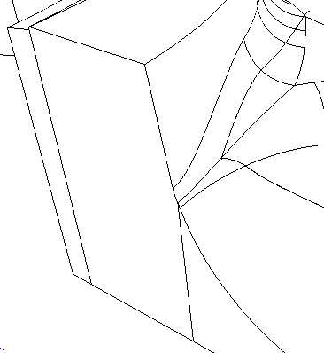
Web Cut Examples
Avoid cuts which leave small sliver surfaces
Moving the cut only slightly will save trouble merging

Slide 15
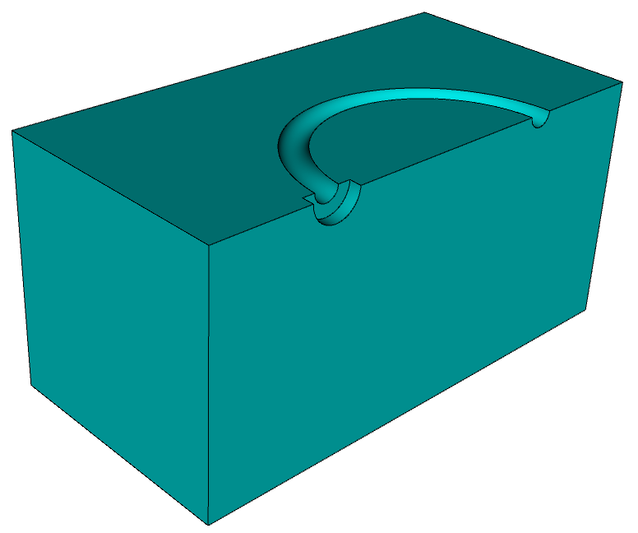
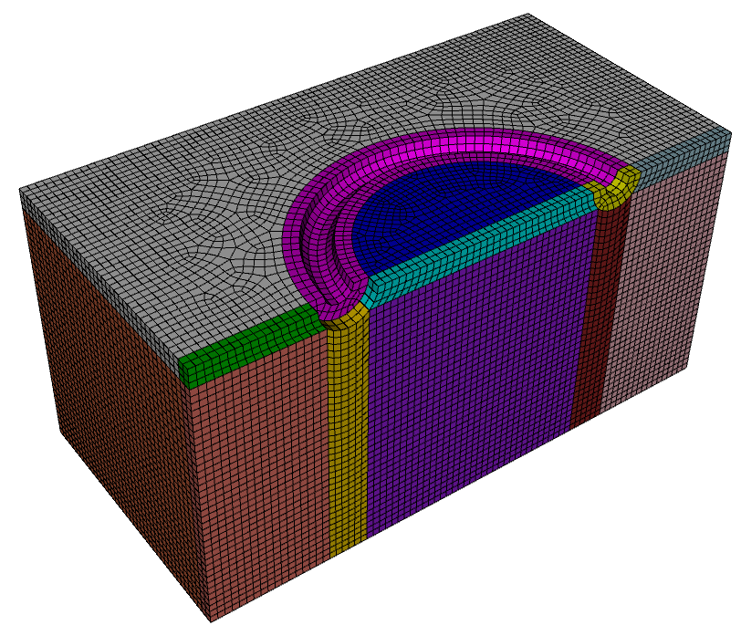
Web Cut Examples
Note: Webcut using an offset surface from the torus – provides good quality elements
Note: Torus surface was split to match sweep direction

Slide 16
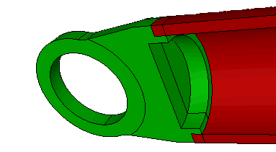
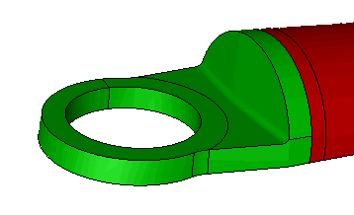
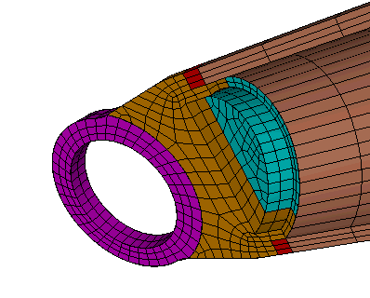
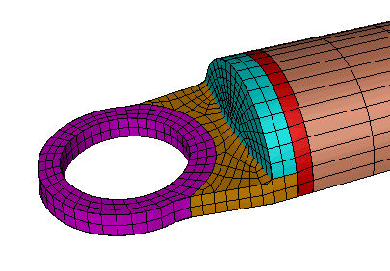
Web Cut Examples

Slide 17
Web Cut Examples

Slide 18
Web Cut Examples
Sweep through thin parts
Note: fillets were split
Rounded parts sweep along axis of curvature

Slide 19
Web Cut Examples

Slide 20
Web Cut Examples
Webcut with extended surface to create this volume

Slide 21
Web Cut Examples
New sweep directions
Polyhedron volume mesh scheme

Slide 22
Exercise 1
Mesh the geometry in the file example01.sat with a contiguous all-hex mesh.
Use a mesh size of 0.15
Hints
Examine sweepability of all volumes. Is there a many-to-many sweep volume?
Don’t forget to imprint and merge
This assembly can be meshed with as little as 1 webcut
CUBIT> webcut volume 5 with sheet extended from surface 70 CUBIT> imprint all CUBIT> merge all CUBIT> volume all size 0.15 CUBIT> volume all scheme auto
webcut volume 5 with sheet extended from surface 70

Slide 23
Exercise 2
Mesh the geometry in the file example04.sat with a contiguous all-hex mesh.
Use a mesh size of 0.15
Hints:
Consider a coring approach: Sweep radially around the outside and top to bottom on the interior core.
Consider creating a tool volume using the loft option for creating volumes to create the core
Remember to delete the tool volume afterward webcutting
Use a sweep surface webcut to extend the core to the top
Split the volumes along a symmetry plane to permit the radial sweep.
Remember to imprint and merge!

